Slide 1
Iteration 1 Team 4
By Dylan Dinh, Amay Kadakia, Shubhayu Shrestha

Slide 2
MoSCoW Requirements
Must Have
Offline Functionality/PWA
Itinerary
Map
Login Requirement (Only for Admin)
Should Have
Key Translations
Emergency Contact Information
Could Have
Image sharing/hosting (Moved from should have after further discussion)
Website Search Feature
Won't Have
Messaging

Slide 3
Project Plan
User-Interface
Itinerary – Begin Work, Iteration 2
Maps – Iteration 2/3
Contact Information – Completed
Offline Functionality – Completed
Translations – Iteration 2
Administrative
Itinerary Management – Iteration 4
Admin Logins – Iteration 3

Slide 4
Risks
Web Development Inexperience
RE = 1.0 * 30 hours = 30 hours
Unrealistic Schedule / Over scoping
RE = 0.5 * 40 hours = 20 hours
Schedule Conflicts
RE = 0.8 * 15 hours = 12 hours
Requirements Volatility
RE = 1.0 * 10 hours = 10 hours
.uta.cloud Server Hosting Issues
RE = 0.5 * 20 hours = 10 hours

Slide 5
Risk Mitigation
Allot time for project work
Learn full-stack development (YouTube, etc.)
Effectively communicate project requirements
Work ahead of schedule

Slide 6
Specification & Design - Changes
Switched from WordPress to Drupal
Easier to work with and create a progressive web app from
Testing on UTA hosted servers (uta.cloud)
Utilizing uta.cloud allows us to have more security on our website.
Drop Firebase, use MySQL
Image hosting no longer needed
Drupal backed by MySQL

Slide 7
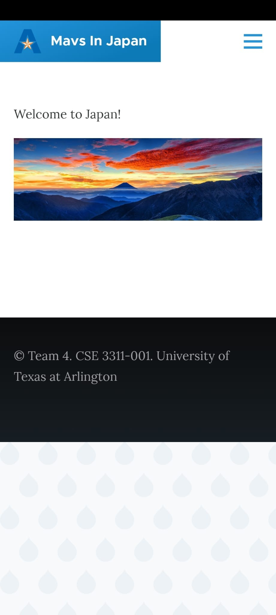
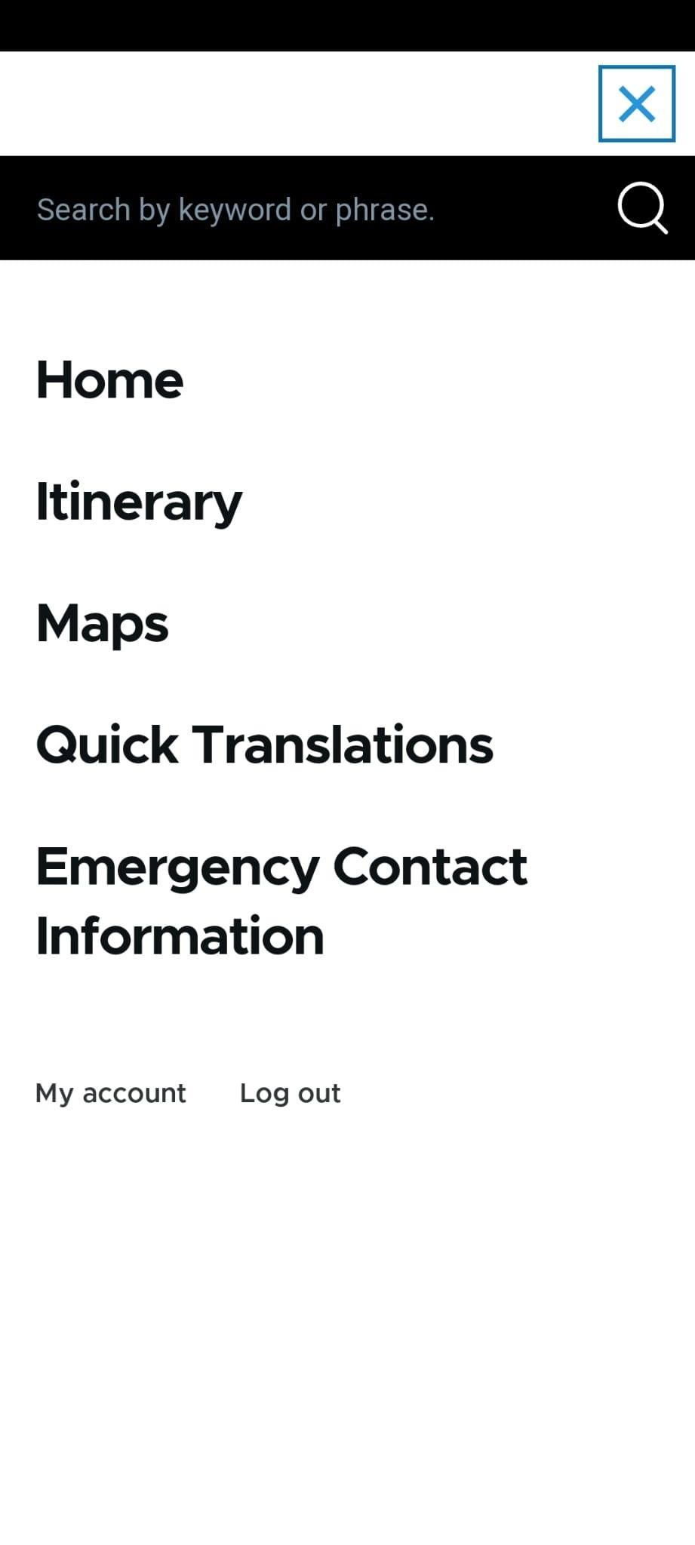
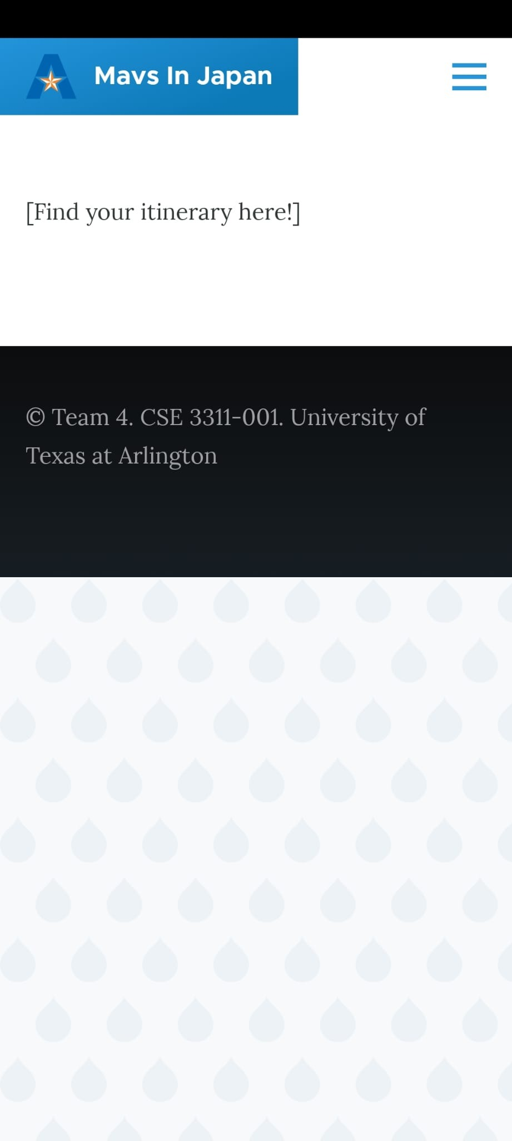
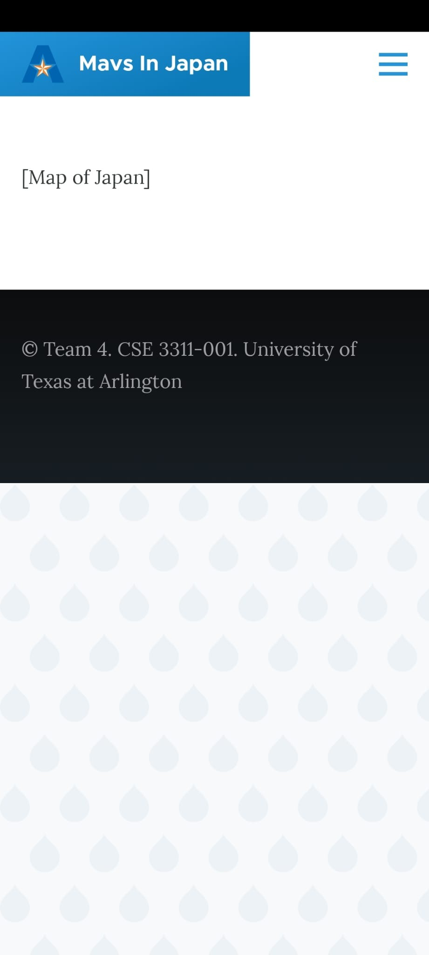
Specification & Design

Slide 8
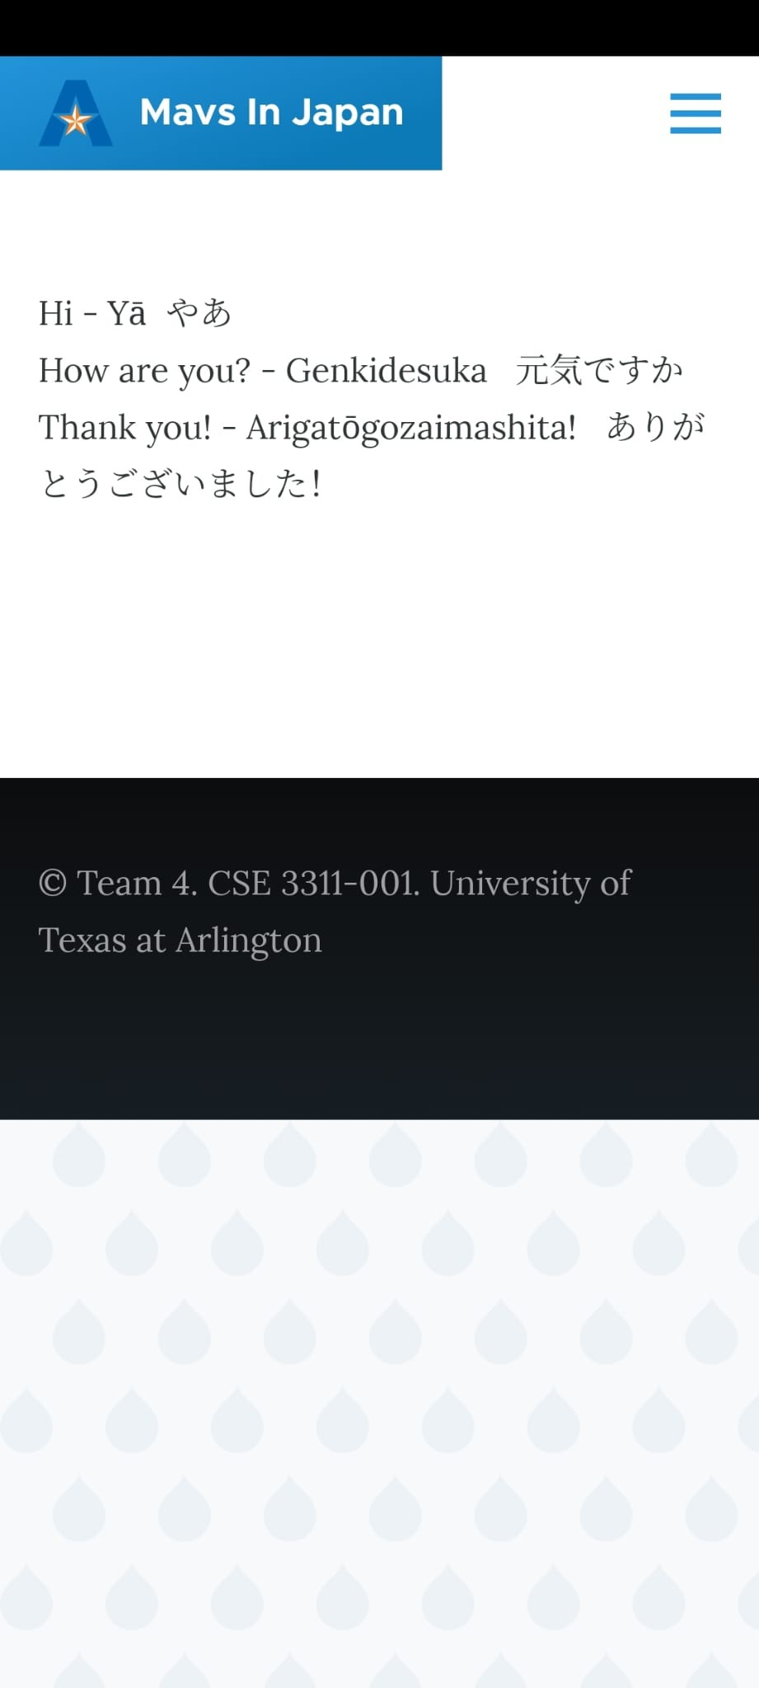
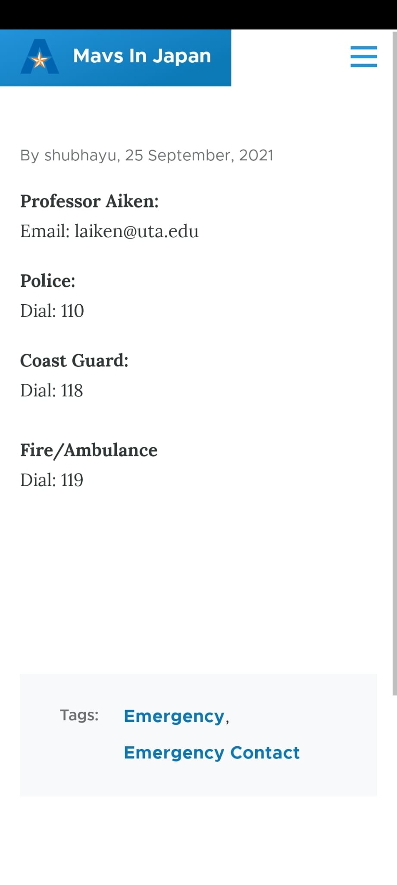

Slide 9
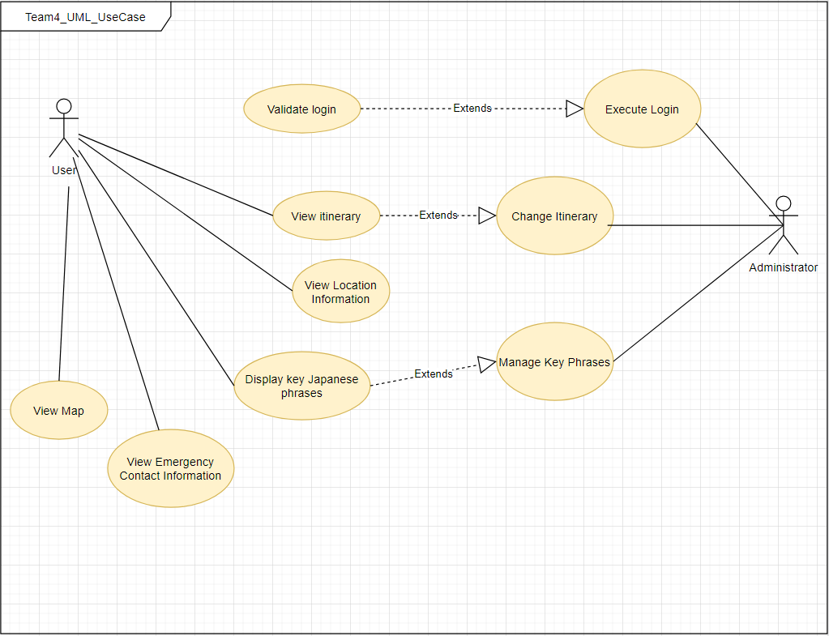
Use Case Diagram

Slide 10
Code - Demo
Link: https://github.com/shubshres/CSE-3311-Team-4
Progressive Web App: https://mavsinjapan.uta.cloud/
Most iteration 1 work was mainly getting the structure of the website to be functional.

Slide 11
Customer & Users
Changes – None
Our primary customer is still Dr. Aiken & her students in the Study Abroad trip.

Slide 12
Feedback
After meeting with Professor Aiken, we made sure we had all of the 'Must Haves' and we got positive feedback regarding our website so far.
Removing the photo's feature for now as Professor Aiken discussed that she will most likely just be using WhatsApp.
We are planning on creating another page that will provide more information about the hotels, which will be done by the next iteration.

