Slide 1
Iteration 2 Team 4
By Dylan Dinh, Amay Kadakia, Shubhayu Shrestha

Slide 2
MoSCoW Requirements
Must Have
Offline Functionality/PWA
Itinerary
Map
Login Requirement (Only for Admin)
Should Have
Key Translations
Emergency Contact Information
Could Have
Image sharing/hosting (Moved from should have after further discussion)
Website Search Feature
Won't Have
Messaging
Notes:
Note: Talk here about why we don't want to require students to have to login in order to use the app.

Slide 3
Project Plan
User-Interface
Itinerary – Mostly Completed
Maps – Partly functional, complete in Iteration 3
Contact Information – Completed
Offline Functionality – Completed
Translations – Completed
Administrative
Itinerary Management – Iteration 4
Admin Logins – Iteration 3
Notes:
Talk here about

Slide 4
Risks
Web Development Inexperience
RE = 1.0 * 30 hours = 30 hours
Unrealistic Schedule / Over scoping
RE = 0.5 * 40 hours = 20 hours
Schedule Conflicts
RE = 0.8 * 15 hours = 12 hours
Requirements Volatility
RE = 1.0 * 10 hours = 10 hours
.uta.cloud Server Hosting Issues
RE = 0.5 * 20 hours = 10 hours
6. Misunderstanding Customer Requirements
RE = 0.3 * 10 = 3 hours
Notes:
Quickly gloss over the risks here since we've already talked about these last time.
Instead talk about the addition of misunderstanding user requirements.
Also talk about how we've been managing these risks, or how most of them haven't been an issue yet.
Can also talk about how we did in fact run into an issue with uta cloud hosting, which stopped our development for a couple of days.

Slide 5
Risk Mitigation
Allot time for project work
Learn full-stack development (YouTube, etc.)
Effectively communicate project requirements
Get periodic feedback from Dr. Aiken about progress
Work ahead of schedule
Notes:
Same as last slide.

Slide 6
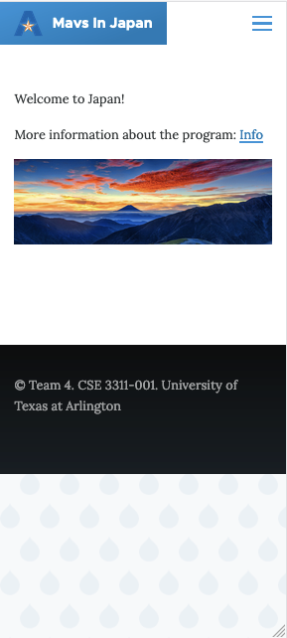
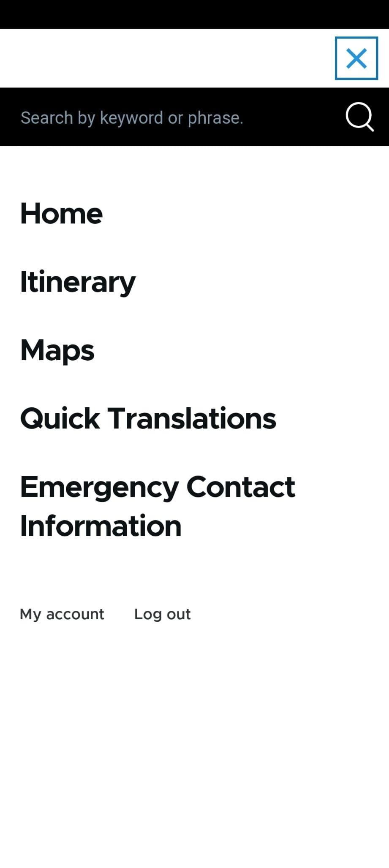
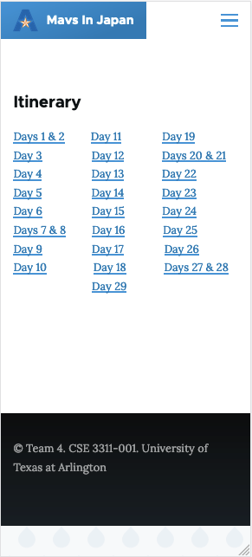
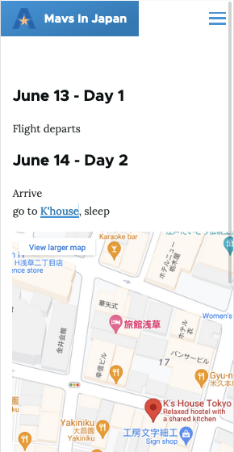
Specification & Design - Updates
Notes:
Thank you Shubhayu,
So there hasn’t been a lot of structural changes with web app however we have added a lot more information using the itinerary that Prof. Aiken sent us. As you see in the image, we have implemented a map into daily itinerary pages we are still working on making sure the map has the correct resolution for different deceives.

Slide 7
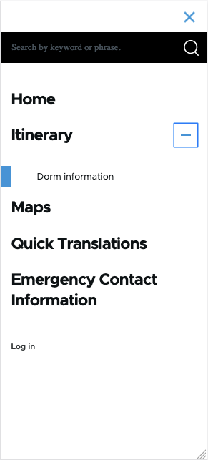
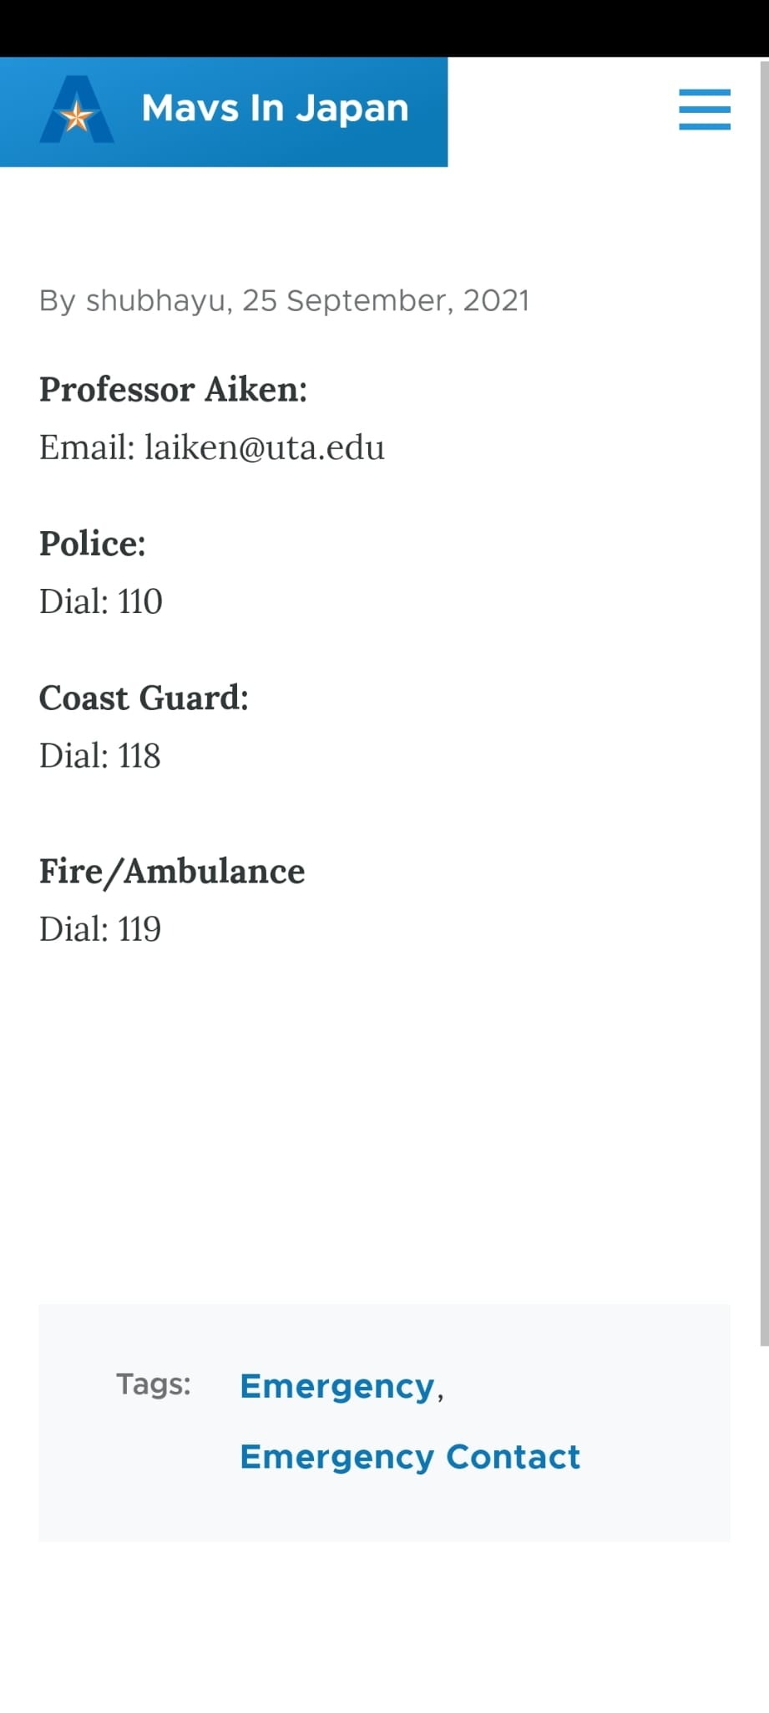
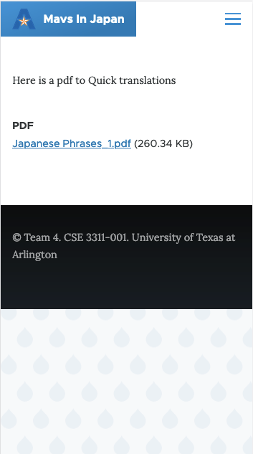
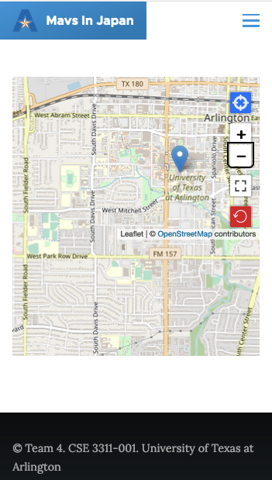
Notes:
Additionally, we have also updated the translations page with the pdf provided by Prof. Aiken and the Maps page has an open-sourced map that we are using. That’s because we are testing the maps we can use with PWA.

Slide 8

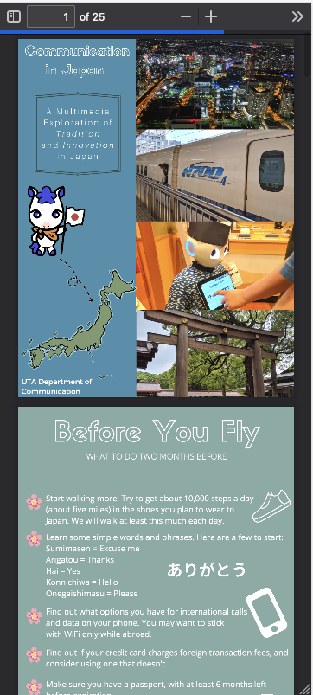
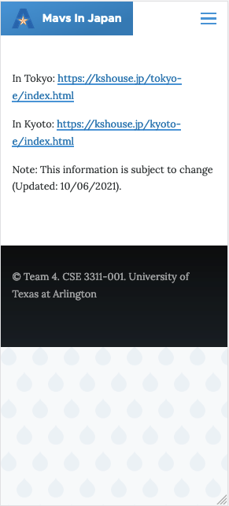
Notes:
On our home page we have added a link the info pdf sent by Prof. Aiken and also included the dorm information.

Slide 9
Code - Demo
Link: https://github.com/shubshres/CSE-3311-Team-4
Progressive Web App: https://mavsinjapan.sxs4805.uta.cloud/
Notes:
Here is the link to our github repository where you can find our code and also a link to our webpage. And here is quick demo of the things we have added.

Slide 10
Customer & Users
Changes – None
Our primary customer is still Dr. Aiken & her students in the Study Abroad trip.

Slide 11
Feedback
Currently working on discussing a better way to implement the maps for the website.
Discussing the layout of the itinerary page.
Continuing to double check to see if we are missing any missing requirements.
Notes:
Todo complete

Slide 12
Q&A

