Slide 1


Government College Of Engineering And Research, Avasari Computer Engineering Department Project On Syntactical Parser For Marathi Text By
Sr. no. | Roll Number | Name
1 | 20221082 | Vaishnavi Nilkamal Swami
2 | 19121017 | Kalyani Mahadev Kadam
3 | 19121056 | Pranav Pradip Ranaware
Guide
Prof. P.V. Kulkarni

Slide 2
Project Details
Project Title: Syntactical Parser for Marathi Text
Project Domain: AI
Project Group members:
Sr. No. | Roll no. | Name
1 | 20221082 | Vaishnavi Nilkamal Swami
2 | 19121017 | Kalyani Mahadev Kadam
3 | 19121056 | Pranav Pradip Ranaware

Slide 3
Contents
Introduction to domain & topic
Project Motivation
Problem statement
Literature Survey
Software Requirement Specifications
Project Design
Sequence diagram , Data flow diagram
Project Planning and Prototyping
Conclusion
References

Slide 4
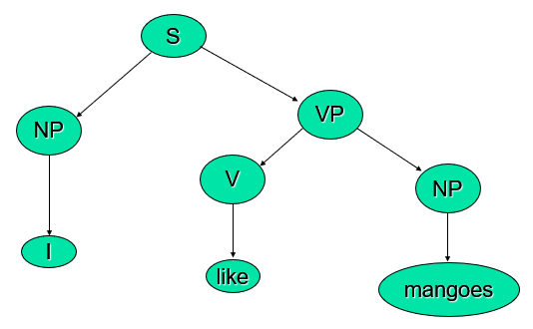
Introduction
Syntax analysis
Context Free Grammer
Parsing
For example
Driven by grammar
S-> NP VP
NP-> N | PRON
VP-> V NP | V PP
N-> Mangoes
PRON-> I
V-> like

Slide 5
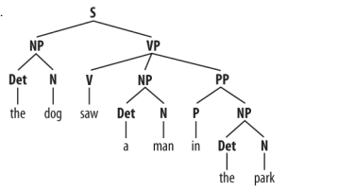
Structure Detection

Slide 6
Motivation
The main or primary motivation of our project is that there are parser in languages like Hindi, Kannada.
Likewise Marathi is also concept which can be introduce through native language so our motivation is toward creating a language to introduce to parser.
Marathi keywords and grammar are chosen to make the native Marathi speaker write programs in the Marathi.

Slide 7
Problem Statement
To design a context free grammer based parser for marathi text using cyk algorithm.

Slide 8
Aim & Objective
Aim
To create a parsing technique based on Marathi language. And to find the accuracy in the sentence, grammatical errors.
Objective
To Select a marathi corpus.
Pre-processing of corpus.
To tokenize a sentences.
To identify parts of speech.
To identify features, for example removing noise, special characters.
To set lexical based grammar rules and occurrence frequency of words

Slide 9
Literature Survey
“Part-of-Speech Annotation Challenges in Marathi” This paper presents Part of Speech (POS) annotation is a significant challenge in natural language processing. The paper discusses issues and challenges faced in the process of POS annotation of the Marathi data from four domains viz., tourism, health, entertainment and agriculture.
“Hindi parser using CYK algorithm” They have used database to fetch Hindi sentences and implemented with the help of user interfaces.
“Syntactic Parsing in Kannada Text/Natural Language Processing” This paper presents a particular syntactical parsing technique on Kannada texts which is one of the South Indian languages.
Continue……..

Slide 10
“A Comprehensive Survey On Indian Regional Language”. This paper presents there are different native languages existing in various parts of the world, each with its own alphabets ,sign, grammar. It is comparatively easy for computers to process the data as represented in the English language through standard ASCII codes than in other in natural languages
“Parsing for Natural Language in Odia: a novel study". In this paper a simple parsing for Odia Language using Context-Free Grammar (CFG) is shown. Parsing is a technique used for building a sentence automatically in the phrases of grammar as well as in lexicon using syntactic analysis. It includes semantic analysis and syntactic analysis that basically attention on parsing for Odia Language based on Context Free Grammar along with top down approach. All the things are being represented as simple tree primarily formalism in context free grammar.

Slide 11
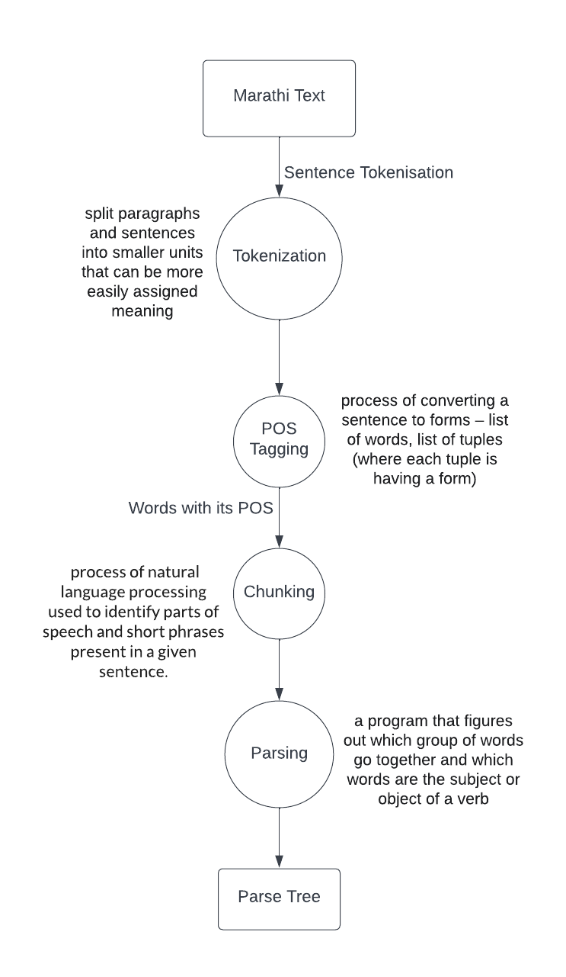
Data Flow Diagram

Slide 12
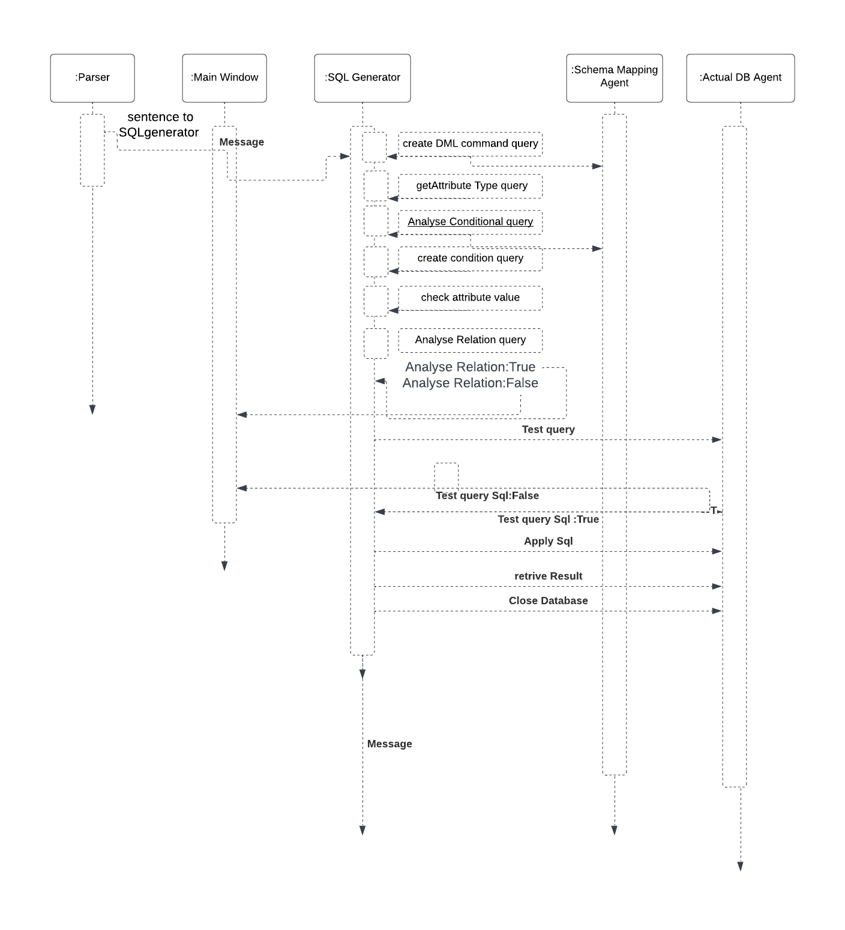
Sequence Diagram

Slide 13
Software Requirement
Python 3.9
NLTK(Natural Language Toolkit)
Hardware Requirement
Windows 7 or higher
I3 processor system or higher
Minimum 4gb RAM or higher
100 gb ROM or higher

Slide 14
Application
Parsing helps in analyzing the input text by associating additional grammatical context to it.
It can also help in identifying the subjects, objects of interest, parts of speech information etc.

Slide 15
Project Planning
Dates | Plans
8 Aug 2022 | Topic Selection
5 Sept 2022 | Synopsis Presentation
30 Sept 2022 | SRS presentation
12 Oct 2022 | Intermediate Review Presentation

Slide 16
Conclusion
The syntactic parser model on Marathi language using CYK algorithm has been in process. It is an efﬁcient dynamic programming technique and suitable for analyzing complex Marathi sentences.
We are trying to develop to parse all possible types of Marathi sentences efﬁciently using the proposed methodology.

Slide 17
References
M. Rajani Shree, “Syntactic Parsing in Kannada Text/Natural Language Processing”, Third International Conference on Intelligent computing information and control systems ICICCS, March 2022.
Gajanan Rane, Nilesh Joshi, Geetanjali Rane, Hanumant Redkar, Malhar Kulkarni and Pushpak Bhattacharyya “Part-of-Speech Annotation Challenges in Marathi”, Indian Institute of Technology Bombay, Mumbai, India.
Harish BS, Rangana RK , “A comprehensive survey on Indian regional language processing” , Proceedings of the international conference [ACCTA-2010] on Special Issue of IJCCT, June 2020.

Slide 18
Das BR, Singh D, Bhoi PC, Priyadarshini P “Parsing for Natural Language in Odia: a novel study” , International Conference on Computer Science, Engineering and Applications (ICCSEA), March 2020.
Nitin Hambir, Ambrish Shrivastav “indi Parser-based on CKY algorithm” Nitin Hambir et al ,Int.J.Computer Technology & Applications,Vol 3 (2), 851-853.

