Slide 1
VACCINATION DATA ANALYSIS
and Visualization
Global Trends in Vaccination Coverage, Disease Incidence & Impact
Python • Oracle SQL • Power BI
Public Health & Epidemiology Analytics Project

Slide 2
OVERVIEW
Project Overview
Global vaccination coverage, disease incidence, and vaccine-effectiveness data were cleaned, structured into a normalized Oracle SQL database, and analyzed to surface insights for public-health strategy, disease prevention, and resource allocation.
PROJECT AT A GLANCE
44
years of data (1980–2023)
Public Health Strategy
Assess vaccination-program effectiveness and prioritize under-covered populations.
69
vaccine antigens tracked
Disease Prevention
Flag diseases with high incidence despite vaccination, and booster-policy gaps.
13
diseases under surveillance
Resource Allocation
Target regions with low coverage for supply and outreach investment.
5
source datasets, normalized into a star-schema SQL database
Global Health Policy
Provide evidence for vaccination policy and progress toward WHO targets.
Vaccination Data Analysis and Visualization
2

Slide 3
METHODOLOGY
Approach & Data Architecture
1
2
3
4
Data Cleaning
SQL Database
Analysis
Visualization
Python (pandas) — missing values imputed, units normalized, years standardized across 5 raw source files.
Cleaned data loaded into a normalized Oracle schema: fact tables (coverage, cases, incidence, schedule, introduction) with dimension tables (geo, disease, antigen, year).
30 project questions answered via SQL joins/aggregations, validated and explored in Jupyter with pandas & correlation analysis.
Power BI dashboards connect to the SQL layer for interactive, filterable exploration of coverage, incidence and disparities.
Vaccination Data Analysis and Visualization
3

Slide 4
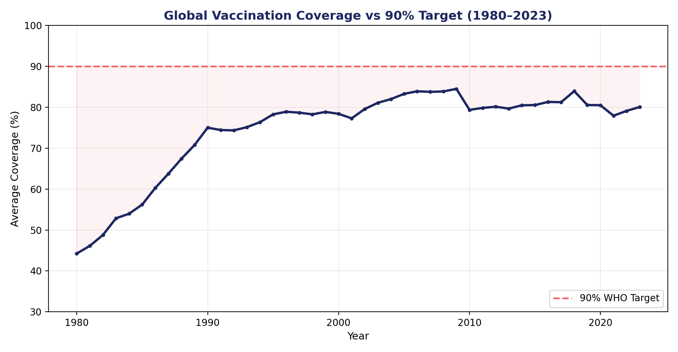
EASY Q1 & Q9
Global Vaccination Coverage vs. 90% Target
KEY INSIGHT
Steady growth, plateauing short of target
Average global coverage across all antigens climbed from 44.3% (1980) to a peak of ~84.5% (2009), then plateaued around 79–84% through 2023 — consistently below the WHO's 90% target.
COVID-era years (2020–2021) show a visible dip, reflecting pandemic disruption to routine immunization.
Vaccination Data Analysis and Visualization
4

Slide 5
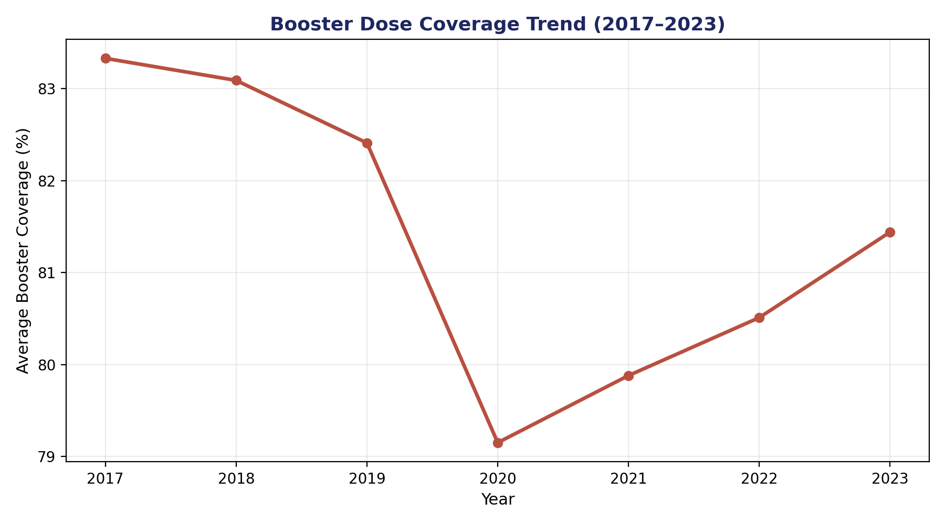
EASY Q6
Booster Dose Coverage Trend (2017–2023)
KEY INSIGHT
Booster uptake dipped, then recovered
Average booster-dose coverage (diphtheria/tetanus/pertussis boosters) fell from 83.3% in 2017 to a low of 79.2% in 2020, coinciding with pandemic disruption, before recovering to 81.4% by 2023.
Booster uptake still trails first-dose coverage, consistent with a general drop-off pattern across multi-dose schedules.
Vaccination Data Analysis and Visualization
5

Slide 6
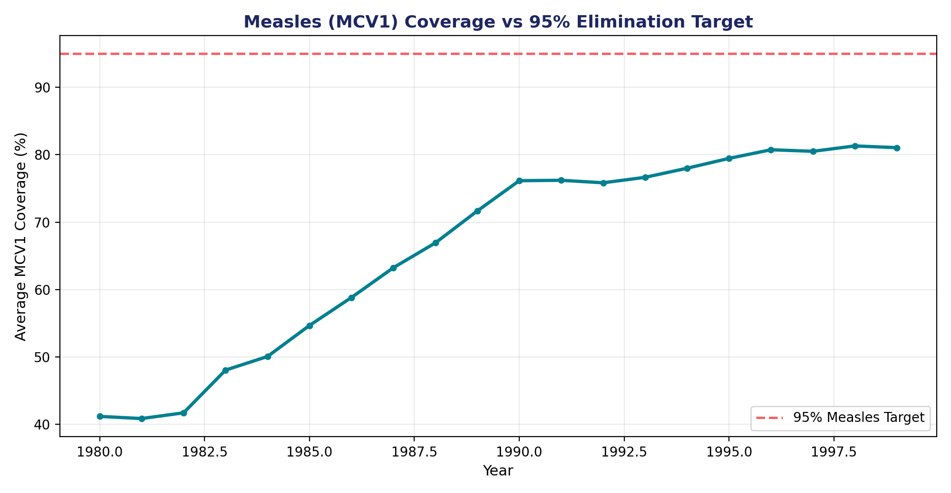
SCENARIO 6
Measles (MCV1) Coverage vs. 95% Elimination Target
KEY INSIGHT
Elimination target not yet met
Global MCV1 coverage rose sharply from 41.2% (1980) to ~81% by 1999, but has never reached the 95% coverage WHO considers necessary for measles elimination.
The persistent gap (13–54 percentage points over the period shown) explains recurring measles outbreaks even in generally well-vaccinated populations.
Vaccination Data Analysis and Visualization
6

Slide 7
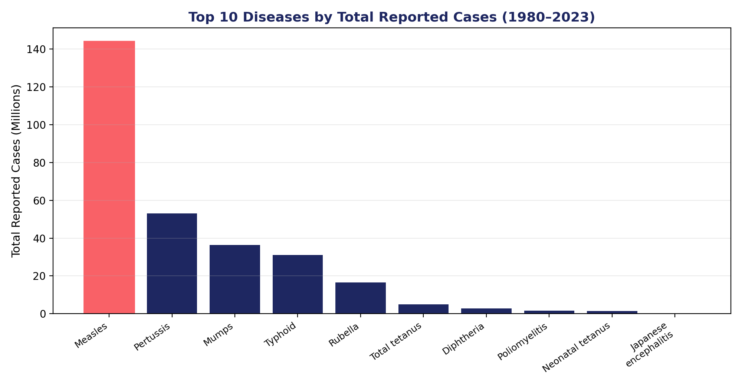
MEDIUM Q2/Q3
Disease Burden: Top 10 Diseases by Reported Cases
KEY INSIGHT
Measles dominates the case burden
Measles accounts for ~144M reported cases (1980–2023) — more than the next two diseases (pertussis, mumps) combined.
High-burden, high-transmissibility diseases with imperfect coverage (measles, pertussis) remain the leading drivers of vaccine-preventable illness globally.
Vaccination Data Analysis and Visualization
7

Slide 8
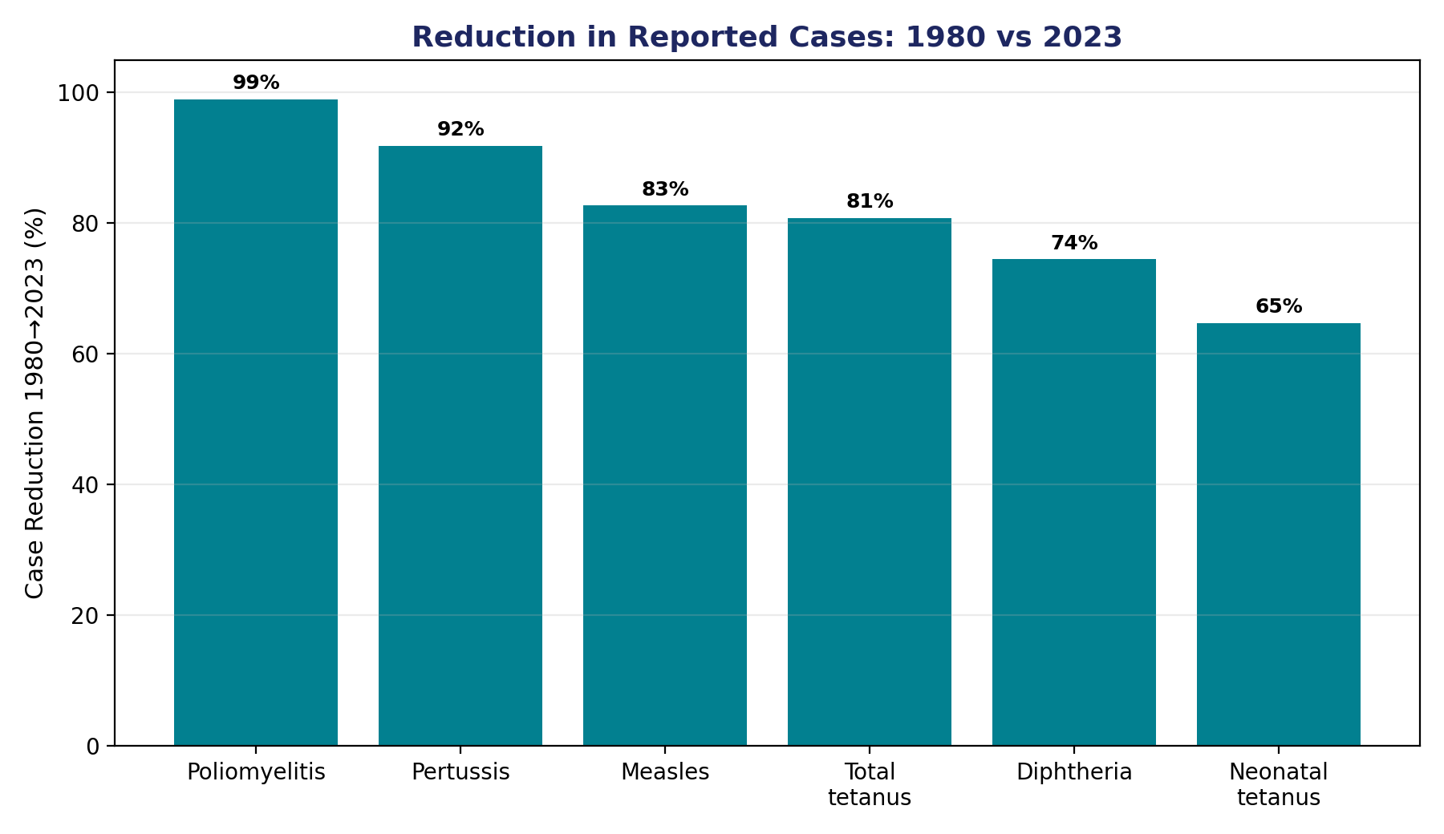
MEDIUM Q3
Vaccination Impact: Case Reduction, 1980 → 2023
KEY INSIGHT
Vaccination is working — dramatically
Poliomyelitis cases fell 99% between 1980 and 2023. Pertussis fell 92%, measles 83%, tetanus and diphtheria 75–81%.
These reductions track closely with rising antigen coverage over the same period, providing strong directional evidence for vaccination effectiveness (see correlation analysis, next).
Vaccination Data Analysis and Visualization
8

Slide 9
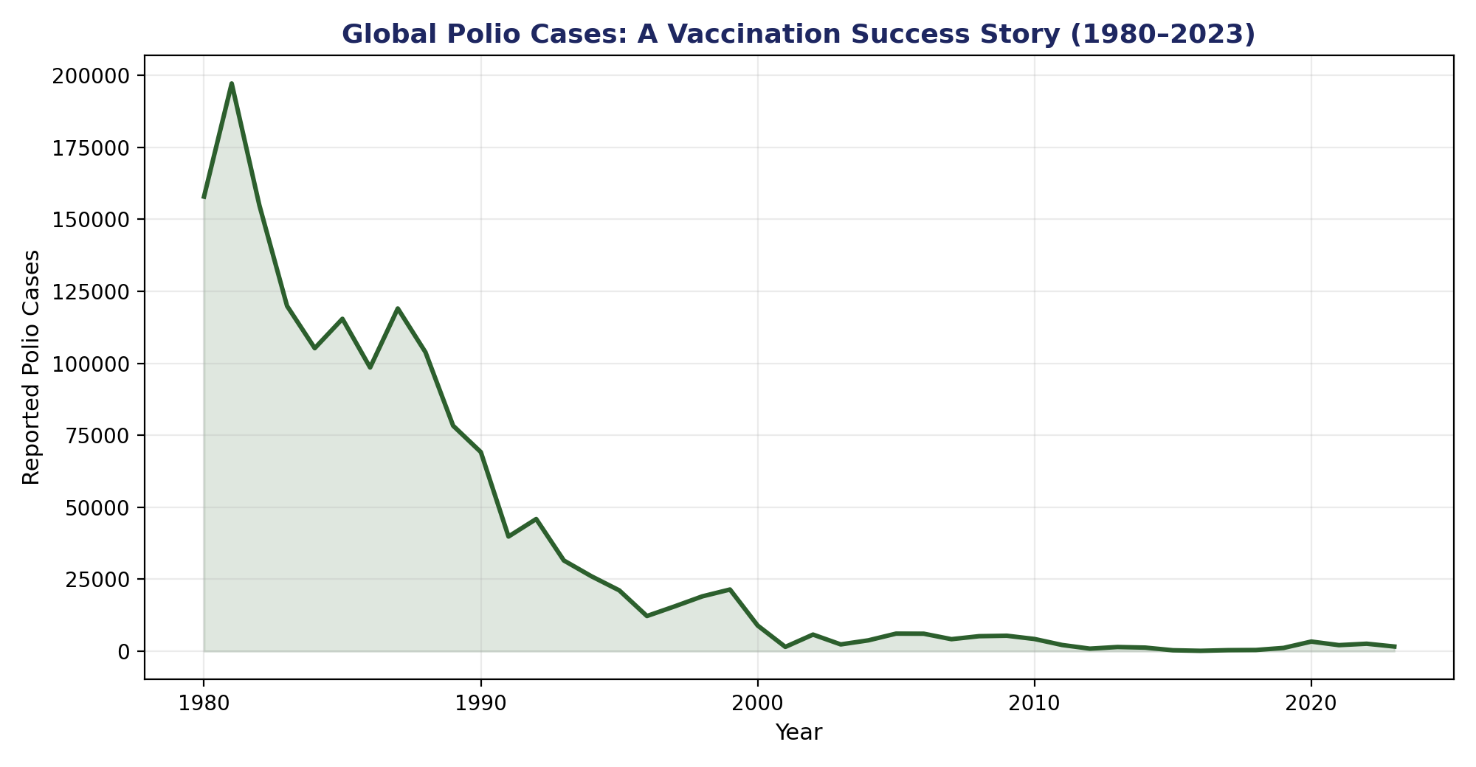
SCENARIO 5
Polio: A Vaccination Success Story
KEY INSIGHT
Near-elimination of a once-major disease
Reported polio cases collapsed from ~158,000 in 1980 to a low of 126 in 2016 — a >99.9% reduction — closely tracking sustained high OPV/IPV coverage.
A small resurgence (2019–2023, up to ~3,300 cases) underscores the need for continued vigilance even after major progress.
Vaccination Data Analysis and Visualization
9

Slide 10
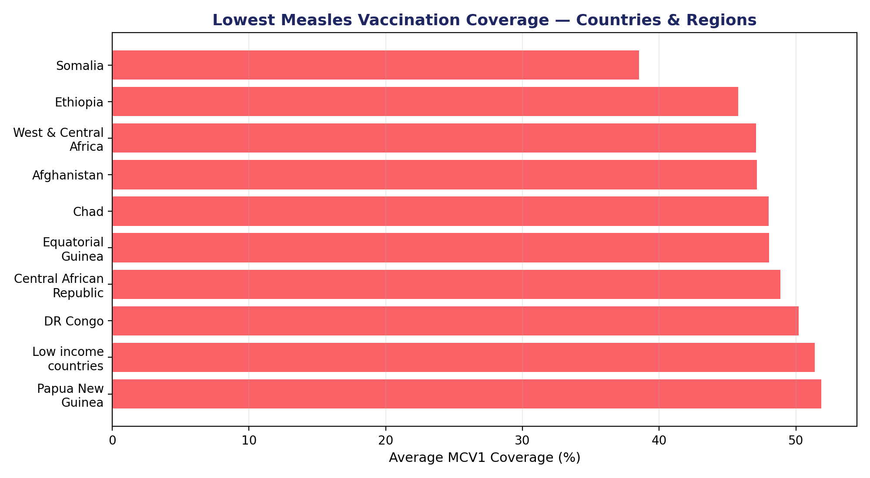
SCENARIO 1
Lowest Measles Coverage — Countries & Regions
KEY INSIGHT
Resource allocation priorities
Somalia (38.5%), Ethiopia (45.8%) and West & Central Africa (47.1%) show the lowest average MCV1 coverage — all well under half the target population reached.
Low-income countries as a group average 51.4% coverage, reinforcing the case for targeted resource allocation and supply-chain investment in these regions.
Vaccination Data Analysis and Visualization
10

Slide 11
EASY Q1 / Q2
Coverage–Incidence Link & Dose Drop-off
MCV1 COVERAGE vs. MEASLES INCIDENCE
DTP1 → DTP3 DROP-OFF
r = −0.205
Up to 100%
A negative correlation across 21,707 country-year records confirms higher measles vaccination coverage is associated with lower measles incidence, as expected. The moderate (not strong) coefficient reflects real-world confounders — outbreak lag, under-reporting, and coverage-quality differences between countries.
Across 48,321 matched country-year records, several countries (e.g. Sierra Leone 2007, DPR Korea 2022) show a complete drop from DTP1 to DTP3 — children starting the schedule but never completing it.
This points to health-system and follow-up gaps — not vaccine hesitancy at first contact — as a key driver of incomplete protection, and a clear lever for intervention (reminder systems, community health worker follow-up).
Vaccination Data Analysis and Visualization
11

Slide 12
SCENARIO-BASED
Answering Real-World Health Scenarios
Resource allocation
199 countries/areas average below 90% MCV1 coverage — Somalia, Ethiopia & Afghanistan rank lowest and are top targets.
Recent outbreak response
Typhoid (13.8M) and measles (2.0M) were the top reported-case diseases in 2023 — the most current outbreak signal.
Vaccine demand estimate
69 vaccine antigens tracked with multi-year dose/target-population data, giving a baseline for demand forecasting by antigen and region.
Polio in unvaccinated populations
Polio cases fell from ~158,000 (1980) to 126 (2016) as coverage rose — a near-eradication trajectory now showing early signs of resurgence.
95% measles target tracking
Global MCV1 coverage has never reached 95%; recent years sit near 80%, a 15-point gap to the WHO elimination threshold.
Vaccination Data Analysis and Visualization
12

Slide 13
HONESTY CHECK
Data Limitations & Not-Answerable Questions
Of the project's 30 brief questions, a handful could not be answered with the provided datasets. Flagging this honestly is part of good analysis — it also defines clear next steps for data collection.
!
Education level vs. vaccination rates
No education/socioeconomic variable exists in any of the 5 source tables.
!
Seasonal patterns in uptake
Coverage data is recorded annually only — no month/quarter field is available.
!
Population density vs. coverage
No population-density variable is included in the datasets.
!
Urban vs. rural, gender-specific rates
No urban/rural flag; sex-disaggregated data exists only for 9 HPV-related antigen codes, not the full antigen set.
!
Socioeconomic disparities within countries
No income, wealth-index, or class variable — WHO_REGION and country are used as the best available proxy.
Vaccination Data Analysis and Visualization
13

Slide 14
PROJECT DELIVERABLES
What Was Built
✓
Cleaned Source Data
5 raw datasets (coverage, incidence, cases, vaccine introduction, vaccine schedule) cleaned and standardized in Python.
✓
Normalized Oracle Database
Star-schema design — fact tables for coverage, cases, incidence, schedule and introduction, linked to geography, disease, antigen and year dimensions.
✓
Analytical Notebook
252 executed cells answering 10 easy, 10 medium and 10 scenario-based project questions via SQL + pandas, with correlation analysis and charts.
✓
Power BI Workbook & Dashboard
vaccinationdataanalysis.pbix — interactive report connecting to the analysis outputs for filterable exploration by year, region, antigen and disease.
Vaccination Data Analysis and Visualization
14

Slide 15
CONCLUSION
Conclusions & Recommendations
Coverage is rising but plateaued
Vaccination clearly reduces disease
Follow-through, not first contact, is the gap
Global average coverage climbed from 44% to ~84% then stalled in the low 80s — sustained investment is needed to close, not just approach, the 90–95% targets.
Polio (−99%), pertussis (−92%) and measles (−83%) all fell sharply as coverage rose, and higher MCV1 coverage tracks with lower measles incidence.
Steep DTP1→DTP3 drop-off in several countries shows the challenge is often completing the schedule, not reaching people initially.
Recommendation: prioritize the lowest-coverage regions (Somalia, Ethiopia, West & Central Africa) for resource allocation, invest in multi-dose follow-up systems to close the DTP1→DTP3 gap, and extend data collection to include population-density and socioeconomic variables for deeper equity analysis.
Vaccination Data Analysis and Visualization
15

Slide 16
Thank You
Vaccination Data Analysis and Visualization | Python · Oracle SQL · Power BI

