Slide 1
Comparison between K-means and Density Based Clustering for Customer Segmentation
Group members:
1614032: Sangeet Pandit
1814001: Mayuresh Kadam
1814002: Dhruv Doshi

Slide 2
Introduction
Customer segmentation is the method of placing customers into marketing clusters based on their shared features and gathering information and analysing trend that may create segment.
Various ways to gather information:
Face to Face Interview
Telephonic Interview
Survey

Slide 3
Criteria for customer segmentation
Criteria for classifying customer:
B2B:industry, number of employers,
products purchased from the firm in the past,
location
B2C: age, gender, marital status, and life stage

Slide 4
Advantages of Customer Segmentation:
Marketing strategy
Promotion strategy
Budget efficiency
Product development

Slide 5
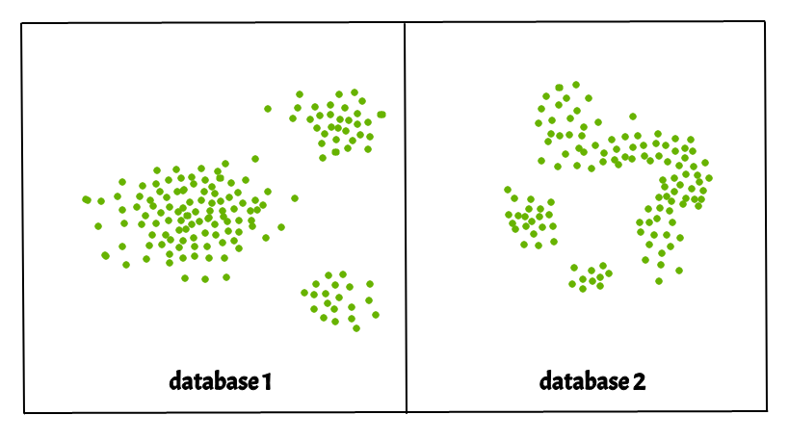
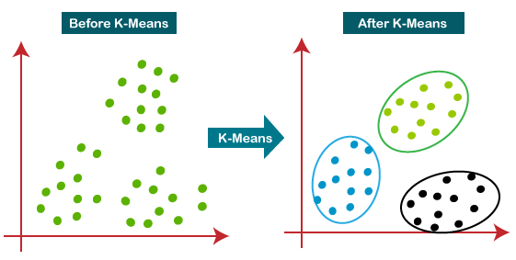
Methods for customer Segmentation
K-Means Clustering
DBSCAN

Slide 6
K-means Clustering
K-Means Clustering is an unsupervised learning method used in machine learning and data science to unravel clustering problems.
K specifies the number of determined clusters that must be produced during the procedure.
It's a centroid-based approach, which means that each cluster has its own centroid.
The main goal of this technique
Iteratively determines the optimal value for K centre points
Each data point is assigned to the k-center that is closest to it

Slide 7
Algorithm for K-Means
Step 1: To determine the number of clusters, choose the number K.
Step 2: Choose K locations or centroids at random. (It could be something different from the incoming dataset.)
Step 3: Assign each data point to the centroid that is closest to it, forming the preset K clusters.
Step 4: Determine the variance and reposition each clusters centroid.
Step 5: Reverse the third steps, reassigning each data point to the cluster's new nearest centroid.
Step 6: If there is a reassignment, go to step-4; otherwise, move to FINISH.
Step 7: The model is now complete.

Slide 8
Implementation of K-Means and DBScan
Tools:
Jupyter Notebook
Google Colab
Spyder
Libraries:
Numpy
Pandas
Seaborn
Matplotlib
DBScan
Sklearn

Slide 9
Implementation of K-Means and DBScan
Dataset:
The dataset is downloaded from Kaggle and we are using Mall_Customers.csv dataset which
consist of 200 entries of customers data.
The data includes the following features:
Customer Id
Customer Gender
Customer Age
Annual Income of the customer (in Thousand Dollars)
Spending score of the customer (based on customer behaviour and spending nature ranging from 1 to 100)

Slide 10
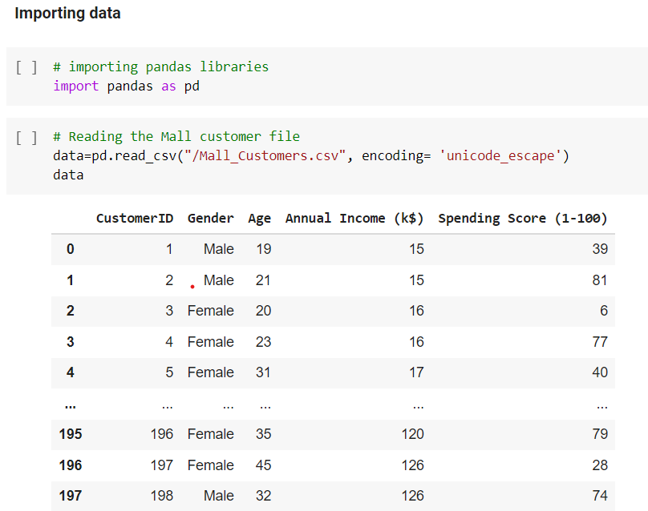
Implementation of K-Means
Step 1: Import the necessary libraries and dataset

Slide 11
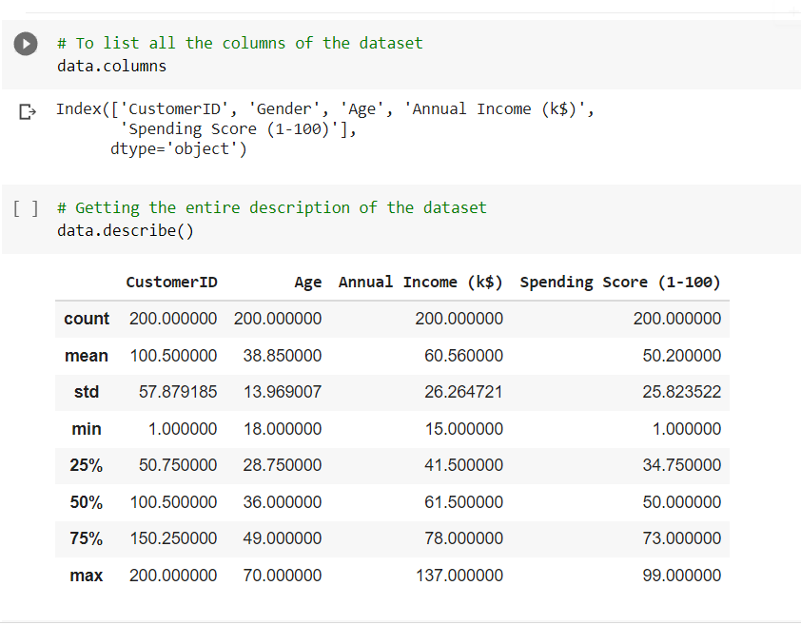
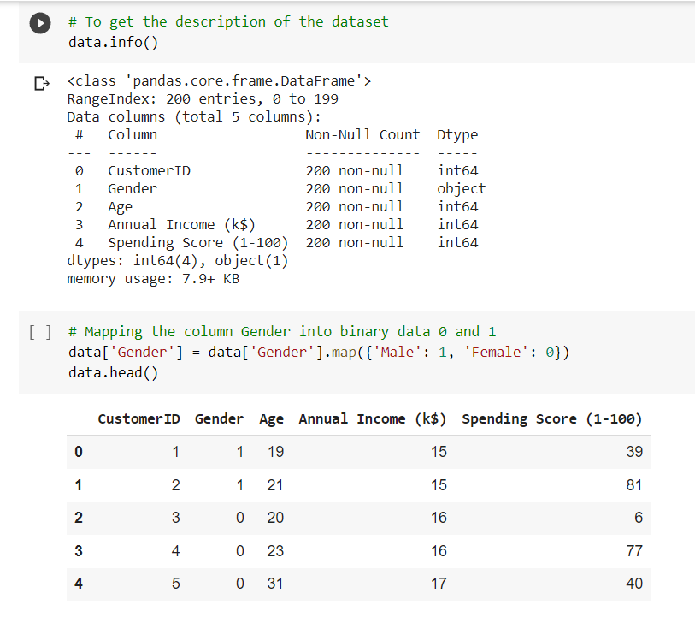
Implementation of K-Means
Step 2 :Processing of data and calculate the null values as well as mapping of gender column to boolean (0 and 1)

Slide 12
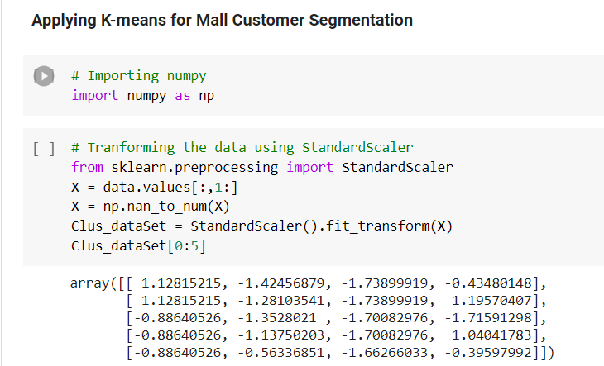
Implementation of K-Means
Step 3 : Applying K Means on this dataset

Slide 13
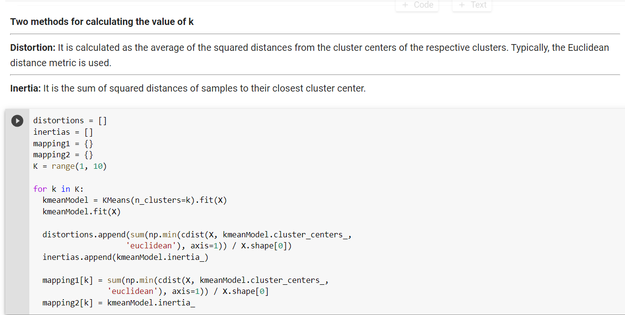
Implementation of K-Means
Step 4:Determine and calculating the value of K by using Elbow method of Distortion and Inertia so as to get best optimal value.

Slide 14
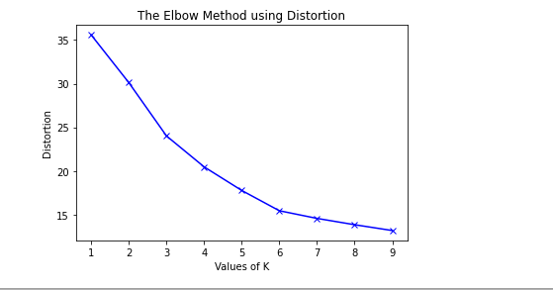
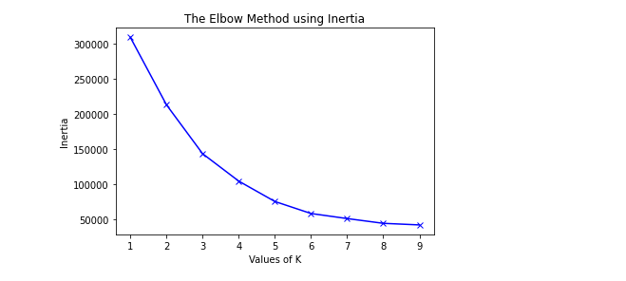
Implementation of K-Means
Result for Elbow method using Distortion and inertia respectively
From this we conclude k values is 5.

Slide 15
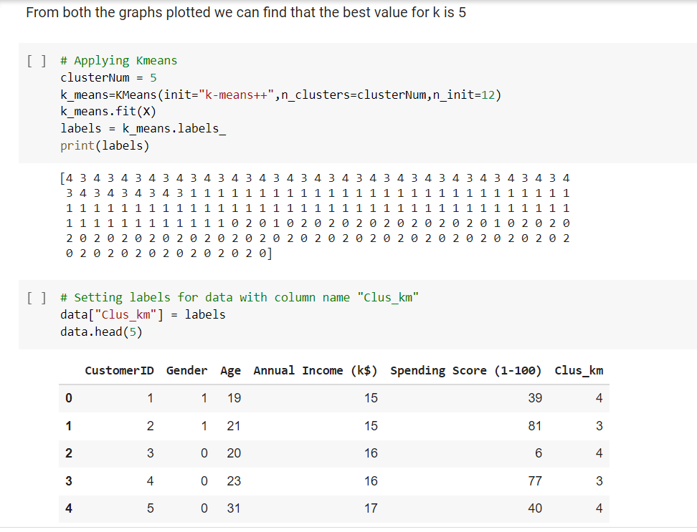
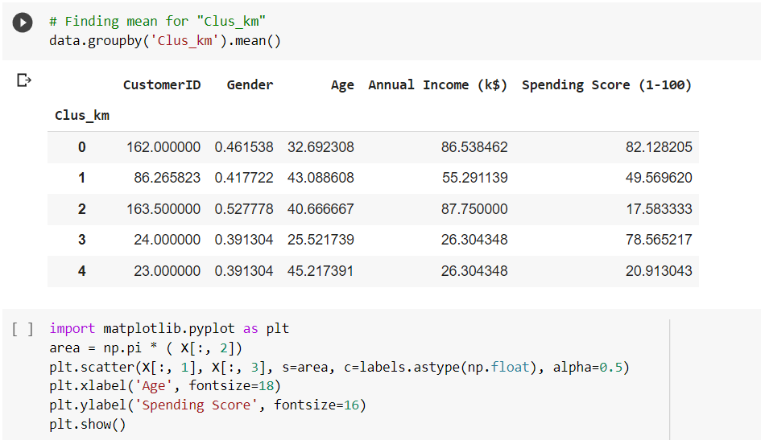
Implementation of K-Means
Step 5: Applying K Means and setting labels for data with column name “Clus _km” as well as finding means of it

Slide 16
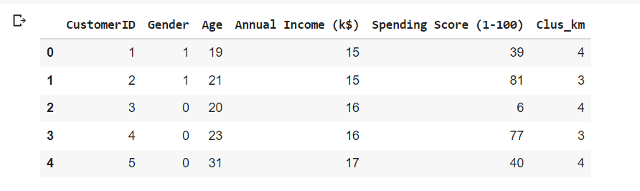
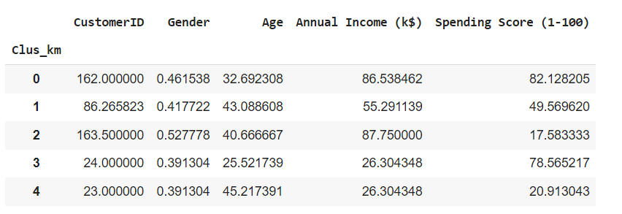
Implementation of K-Means
Result after application of
K-means:

Slide 17
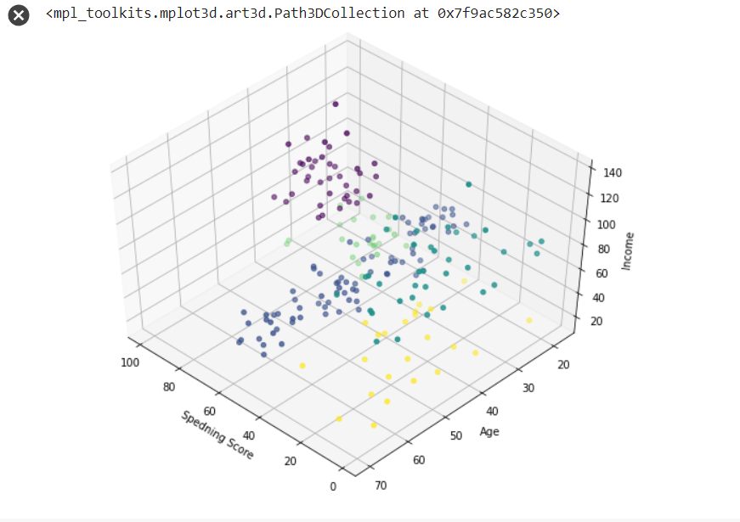
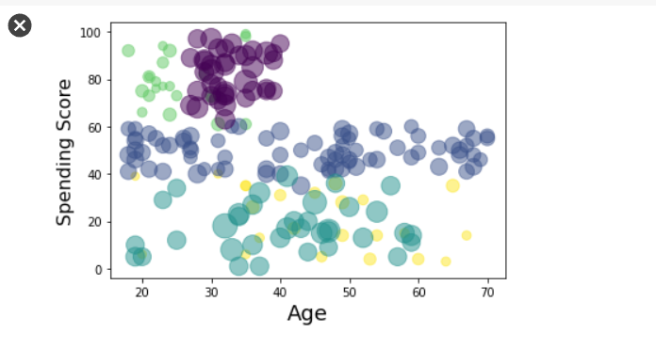
Implementation of K-Means
Step 6 : Display 2D and 3D view of K-Means 5 clusters

Slide 18
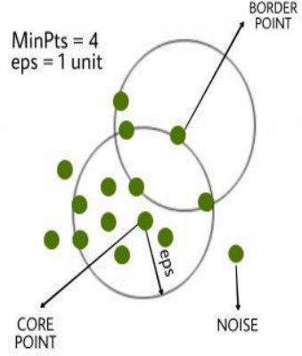
DBScan Clustering
Density-based spatial clustering of applications with noise
Clusters are formed in the dense areas of the data points and are separated by the low-density regions.
2 parameters required:
Eps
Minpts
3 kinds of data points in this algorithm:
Core point
Border point
Noise/outlier

Slide 19
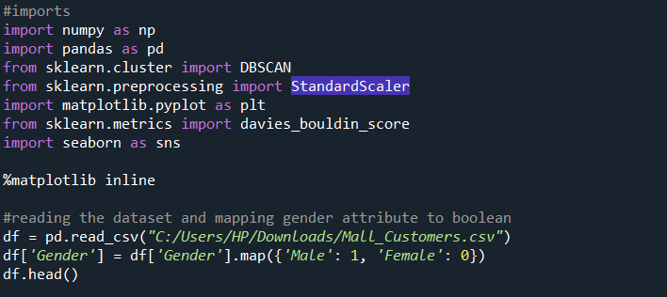
Implementation of DBScan
Step 1: Import the necessary libraries and dataset and mapping of gender attribute to boolean (0 and 1)

Slide 20
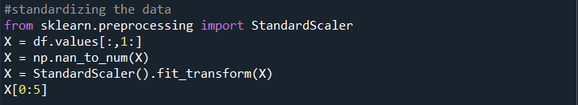
Implementation of DBScan
Step 2 : Standardizing the data and setting the epsilon value.

Slide 21
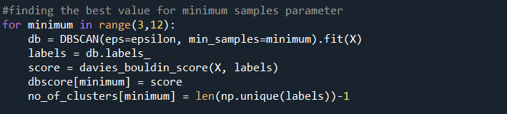
Implementation of DBScan
Step 3 : Finding the best value for minimum samples parameter

Slide 22

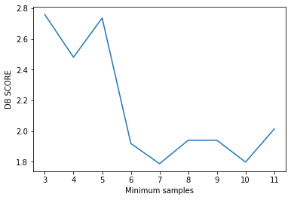
Implementation of DBScan
Step 4:

Slide 23

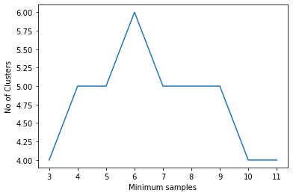
Implementation of DBScan
Step 5:

Slide 24
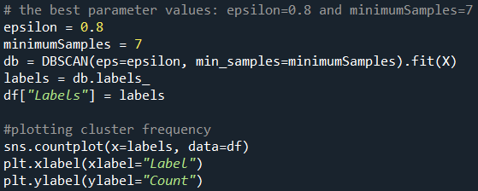
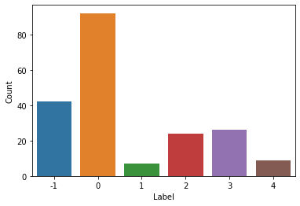
Implementation of DBScan
Step 6 : Selecting the best value for minimum samples as 7 and plotting a cluster frequency plot.

Slide 25
Comparison
K-means clustering | DBScan Clustering
1. Clusters are somewhat spherical in shape. | Clusters are arbitrary in shape.
2.It is sensitive to the number of clusters (k) provided to it. | Number of clusters is not required
3.Good at handling large datasets | Sometimes cannot handle data with high dimensionality
4.K-means cannot handle noisy dataset with many outliers. | DBScan clustering efficiently handles outliers and noisy datasets
5.It requires one parameter : Number of clusters (K) | It requires two parameters : Radius(R) and Minimum Points(M)

Slide 26
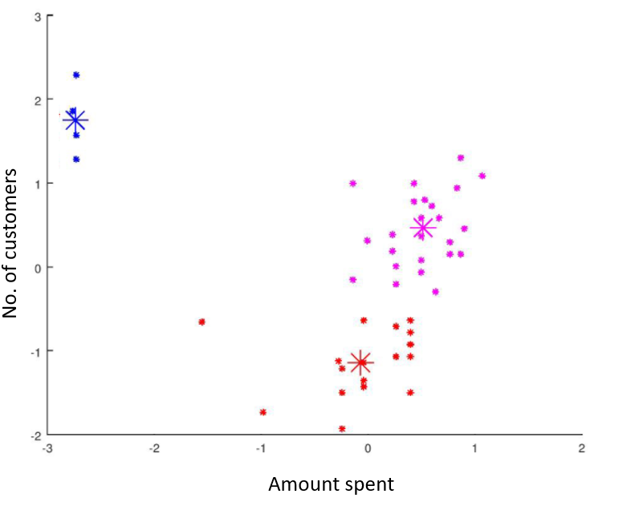
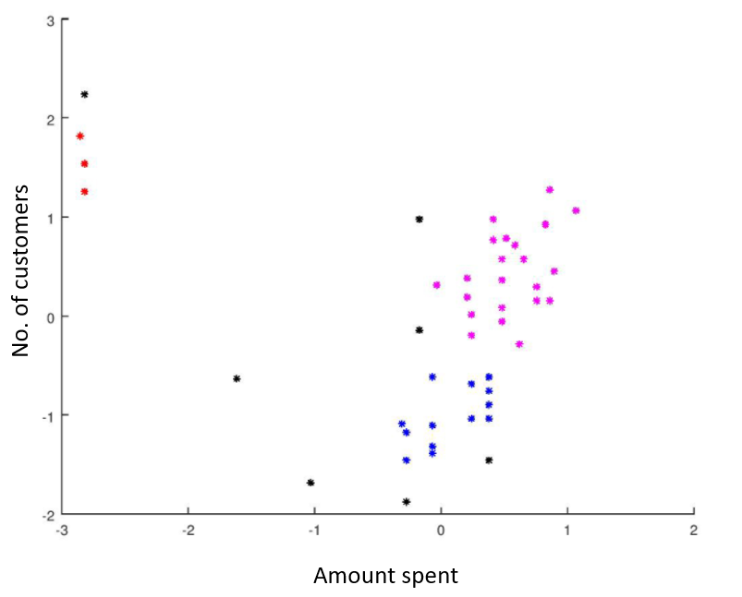
Example
K-means clustering output
DBScan clustering output

Slide 27
Results
When we are dealing with customer related data, it is usually very noisy and presence of outliers cannot be neglected.
For instance, customer A spends Rs. 10 in one month while another customer spends Rs. 10,00,000 in a month, while the mean spending is Rs. 10,000.
Hence, DBScan algorithm would suit better for customer segmentation, when compared to k-means clustering.

Slide 28
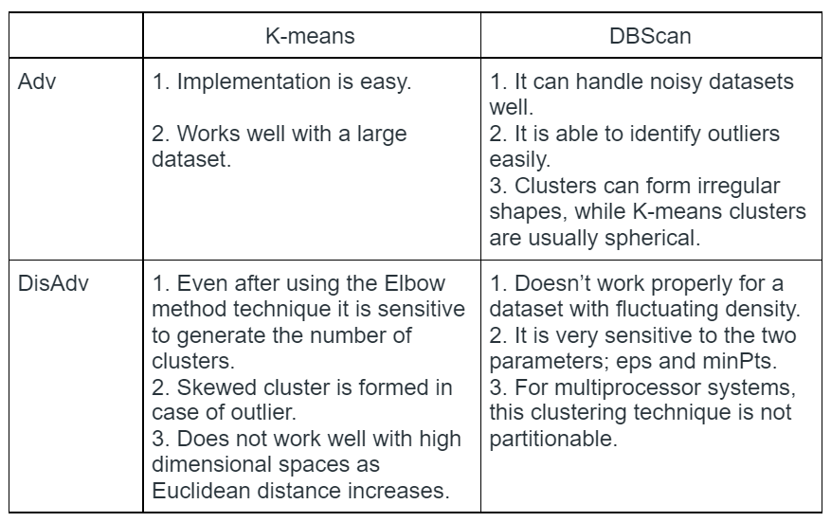
Conclusion

Slide 29
References
[1] Jayant Tikmani, Sudhanshu Tiwari, Sujata Khedkar “Telecom customer segmentation based on cluster analysisAn Approach to Customer Classification using k - means”, IJIRCCE,Year: 2015.
[2] 1Tushar Kansal, 2Suraj Bahuguna , 3Vishal Singh, 4TanupriyaChoudhury1kansaltushar18@gmail.com;2bahugunasooraj@gmail.com;3vishalsinghpari.0816@gmail.com,4tanupriya1986@gmail.com1,2,3,4 University of Petroleum & Energy Studies (UPES),Dept. of Informatics,School of Computer Science,Dehradun
[3] 1st S¸ ¨ukr¨u Ozan, Ph.D. AdresGezgini Inc. R&D Department ˙Izmir, T¨urkiye sukruozan@adresgezgini.com
[4] A. S. M. Shahadat Hossain Department of Computer Science & Engineering Rajshahi University of Engineering & Technology Rajshahi - 6204, Bangladeshshahadat.ruet.cse@gmail.com
[5] Yogita Rani and Dr. Harish Rohil“A Study of Hierarchical Clustering Algorithm”, IJICT,Year: 2013.
[6] Omar Kettani, Faycal Ramdani, BenaissaTadili“An Agglomerative Clustering Method for Large Data Sets”, IJCA,Year: 2014.

Slide 30
Thank you

