Slide 1

Google sheets and Finance
Name : Sahil Shahaji Kadam
Roll no : 150096724124
Cohort : Mark Zukerberg

Slide 2
Google Sheets

Slide 3
What is Google Sheets ?
Google Sheets is a web-based spreadsheet application developed by Google.
It allows users to create, edit, and collaborate on spreadsheets online.
Part of the Google Workspace suite, it integrates seamlessly with other Google tools.

Slide 4
How to acess Google Sheets
Visit sheets.google.com or open Google Drive.
Available on web browsers (Chrome, Firefox, Safari, etc.).
Mobile apps available on iOS and Android devices.
Requires a Google account for access.

Slide 5
Key features
Real-time Collaboration: Multiple users can work on the same spreadsheet simultaneously, seeing each other's changes in real-time.
Formulas and Functions: Offers a wide range of built-in functions and formulas for data analysis.
Integration with Google Workspace: Easily integrates with Google Docs, Slides, and Drive, enabling seamless data import and export.

Slide 6
Benefits
Collaboration: Real-time collaboration enhances teamwork, especially in remote work settings.
Accessibility: Spreadsheets are stored in the cloud, making them accessible from any internet-connected device.
Cost-effective: Free for all Google account users, with additional features available for paid Google Workspace accounts.

Slide 7
Advantages
User-friendly: Intuitive interface suitable for beginners and advanced users alike.
Compatibility: Can open and save spreadsheets in Microsoft Excel format.
Automatic Saving: Changes are saved automatically, reducing the risk of losing work.

Slide 8
Disadvantages
Internet Dependence: Requires an internet connection for full functionality, although offline access is possible with prior setup.
Feature Limitations: Lacks some advanced features available in other spreadsheet software like Excel.
Offline Access: Offline access requires prior setup, which can be inconvenient for some users.

Slide 9
Google Finance

Slide 10
What is Google finance?
Google Finance is an online platform that tracks stock market prices and financial news.
It provides a comprehensive view of financial markets and personal investment portfolios.
Originally launched in 2006, it has undergone several updates to improve user experience.

Slide 11
How to acess Google finance
Visit google.com/finance or simply type "Google Finance" in the Google Search bar.
Accessible via web browsers on both desktop and mobile devices.
No login required for basic access, but signing in with a Google account allows for personalized portfolio management.

Slide 12
Key features
Real-time Stock Tracking: Provides live updates of stock prices, market indices, and related data.
Financial News: Aggregates financial news from various reputable sources, ensuring users stay informed on market trends.
Portfolio Management: Users can create and monitor personalized investment portfolios, tracking performance over time.

Slide 13
Benefits
User-friendly Interface: Intuitive and easy to navigate, even for beginners.
Real-time Data: Offers up-to-date information on stock prices and market movements.
Customizable Alerts: Users can set up alerts for specific stock prices, market changes, and financial news updates.

Slide 14
Advantages
Free Access: Provides extensive financial data and tools at no cost.
Integration with Google Services: Seamlessly integrates with other Google tools like Calendar and Gmail for a unified user experience.
Comprehensive Market Coverage: Covers a wide range of international financial markets, making it useful for global investors.

Slide 15
Disadvantages
Basic Analytical Tools: Lacks advanced tools for in-depth financial analysis.
Data Delays: Occasionally, there may be delays in data updates, which can affect decision-making.
Limited In-depth Analysis: Provides basic financial data and news, but lacks the depth of analysis found in specialized financial software.

Slide 16
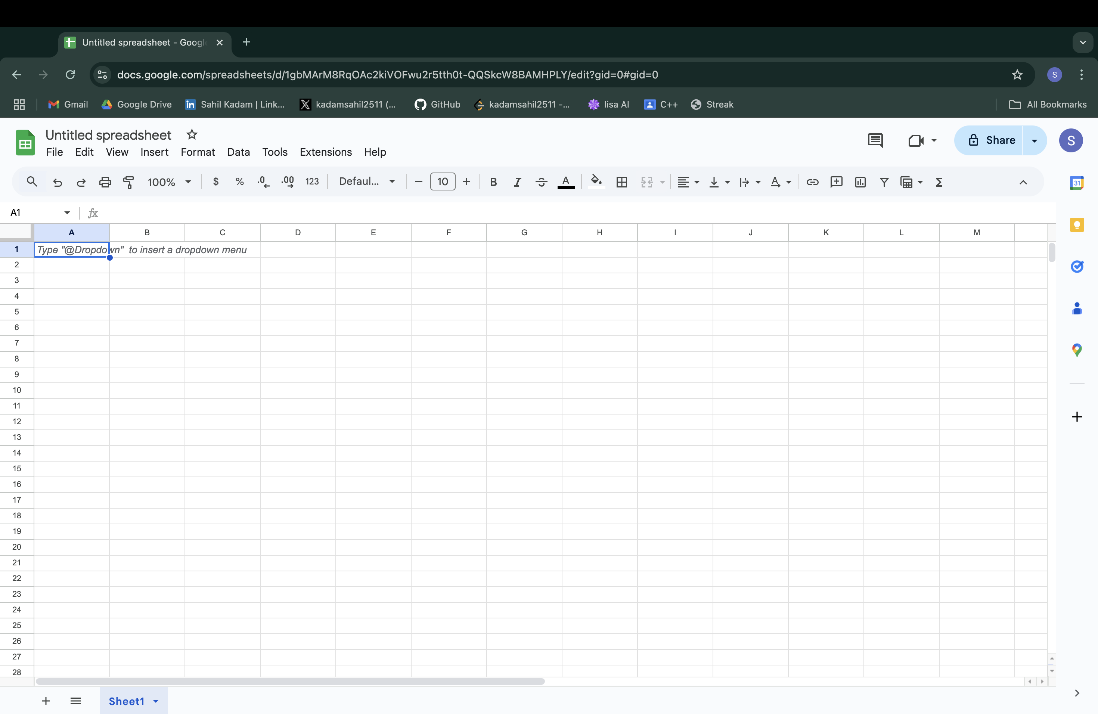
Google Sheets UI

Slide 17
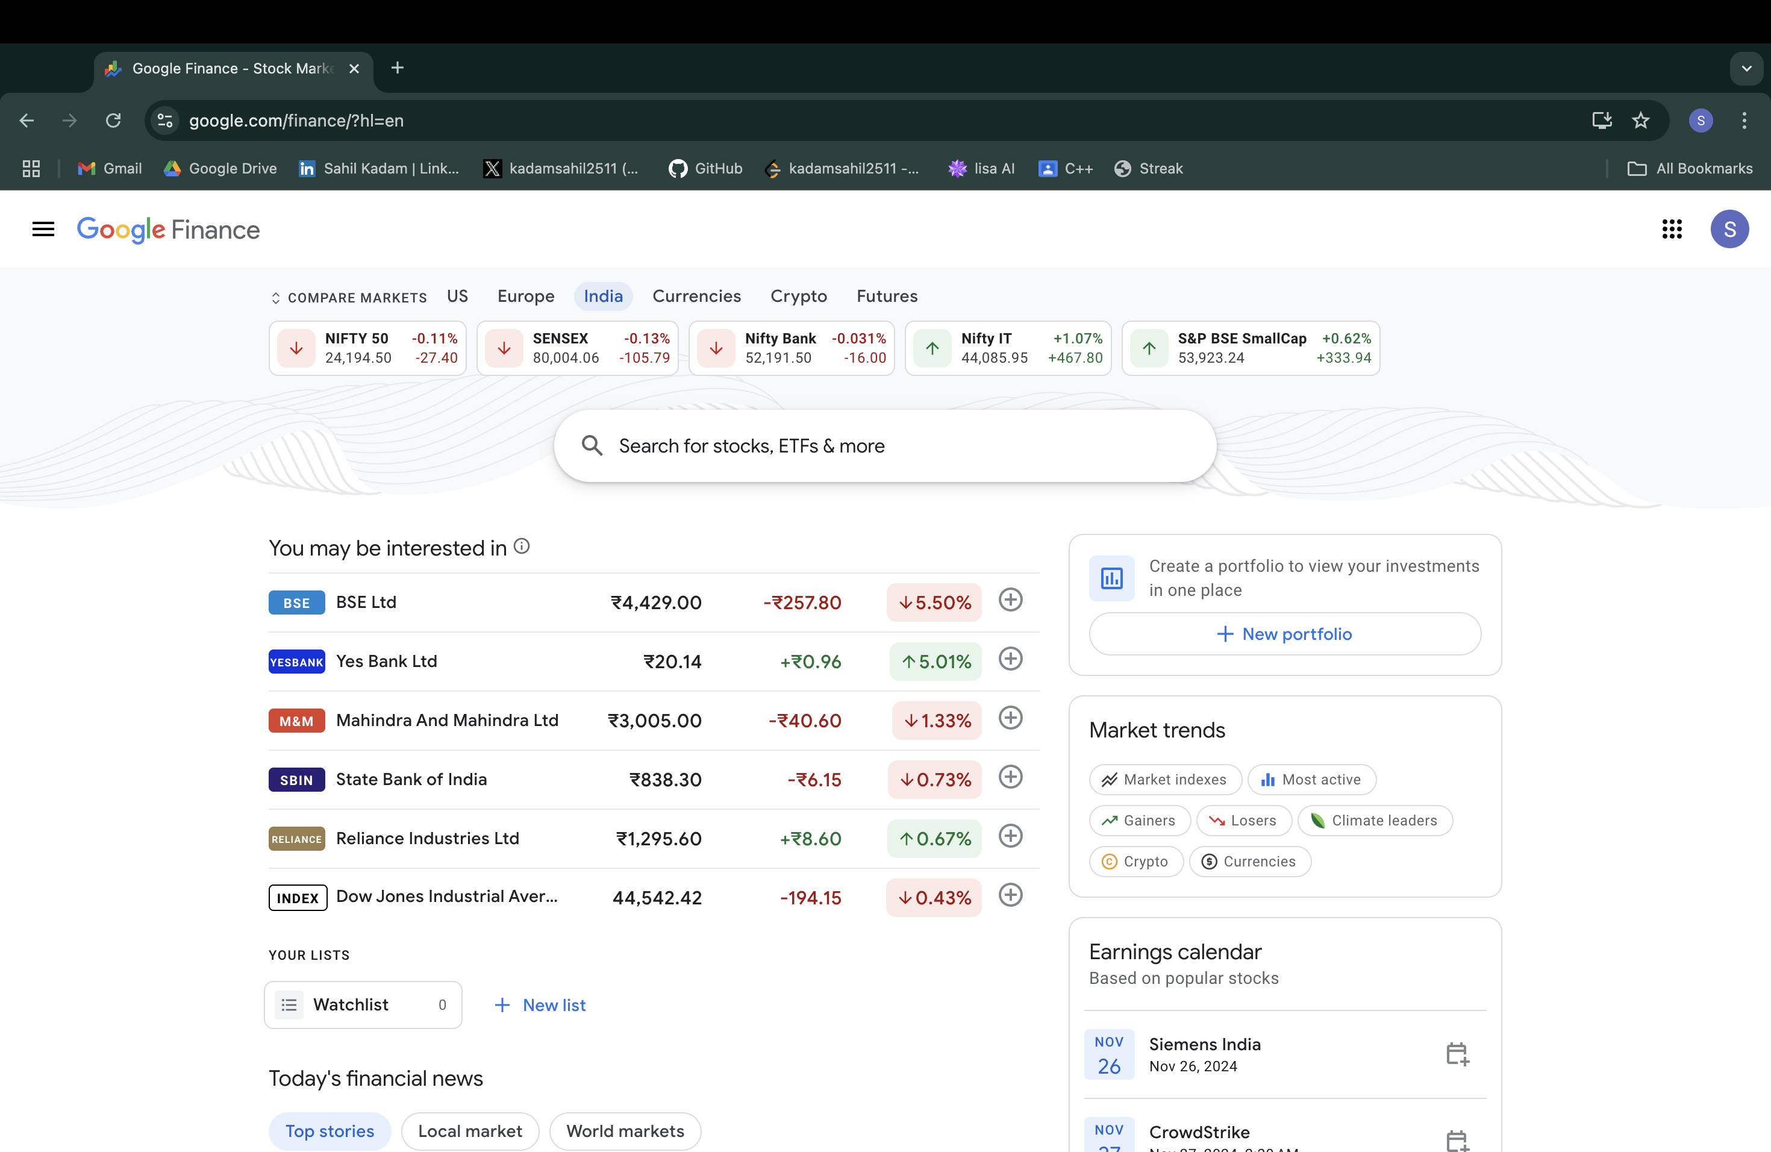
Google Finance UI

Slide 18
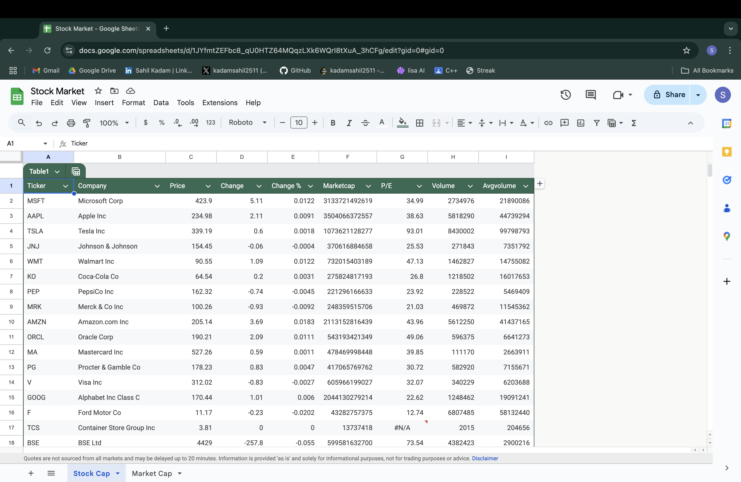
Google Finance integrated into Sheets

Slide 19
Thankyou Any Questions ?

