Slide 1
INDMONEY GROWTH · DISCOVERY ENGINE
Why first-time SIPs lapse by month 12
A public-evidence engine for finding the moments that break the habit — and the interventions that keep it alive.
8,115 public documents · 1,726 strict SIP/MF candidates · 1,726 deep-coded · 334 grounded signals
October 2026

Slide 2
EXECUTIVE SUMMARY
The retention problem is a sequence of moments, not a single reason
• The strongest lapse-associated theme is cash-flow shocks and competing commitments: 14 signals, 100% lapse rate among resolved outcomes.
• System friction is the most fixable: failed mandates/debits and cancellation mazes create lapses the investor did not choose.
• Market noise is high-reach but not uniformly harmful: many investors continue through drawdowns when they have a goal and a habit.
• Three plays: mandate rescue, pause-don't-stop, and a cancellation path that works. All are workflow and clarity, not fund recommendations.
• Measure one thing: at least one successful instalment in the last 30 days, 12 months after the first SIP.
Directional public evidence; associations are not causal.
INDmoney Growth · Public evidence · October 2026
2

Slide 3
THE BRIEF
Nine discovery questions, nine evidence-backed answers
Question | What the evidence says
1. Who starts? | Salaried first-time investors, often 20s–30s, starting small. Segment evidence is sparse; treat as directional.
2. What do they expect? | Steady, FD-like, or market-beating returns. The first flat period is an expectation shock.
3. What happens in the first 30 days? | KYC, mandate, first debit, and NAV/date confusion. Confusion is the most common coded emotion.
4. What triggers a pause or stop? | Cash-flow shocks, job changes, competing goals, drawdowns, and app/cancellation friction.
5. How does volatility affect them? | It raises checking and anxiety for some; others continue through drawdowns with a goal and a habit.
6. What role do cash-flow shocks play? | Cash-flow shock: 14 signals, 100% lapse among resolved outcomes. The SIP was affordable last month, not this month.
7. What role do platforms play? | Failed mandates, debit issues, cancellation mazes, and support gaps create system-forced lapses.
8. Which segments are at risk? | Directionally, early-stage and cash-flow-constrained investors. Segment cues are sparse; app reviews overrepresent friction.
9. What would make them stay? | Pause instead of stop, mandate rescue, goal progress, human support, and expectation-setting.
INDmoney Growth · Public evidence · October 2026
3

Slide 4
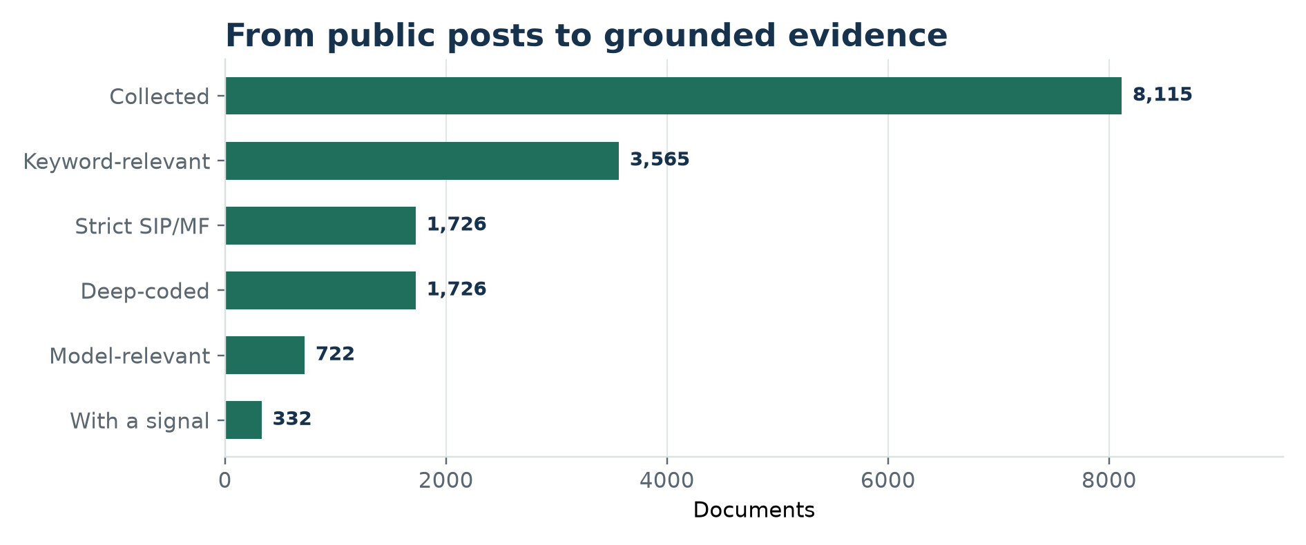
METHOD
From 8,000+ public posts to a grounded evidence base
• 8,115 documents from six sources: Play Store, App Store, Reddit, YouTube, ValuePickr, TradingQ&A.
• 1,726 strict SIP/mutual-fund candidates; 1,726 deep-coded with a free-tier LLM.
• Every behavioural quote is verified against the source; unsupported codes are dropped by deterministic grounding.
• Includes competitor app reviews to learn category-wide friction; INDmoney-specific views are filterable in the dashboard.
• Counts, prevalence, statistics, and opportunity scores are computed in Python/SQL, not by the model.
INDmoney Growth · Public evidence · October 2026
4

Slide 5
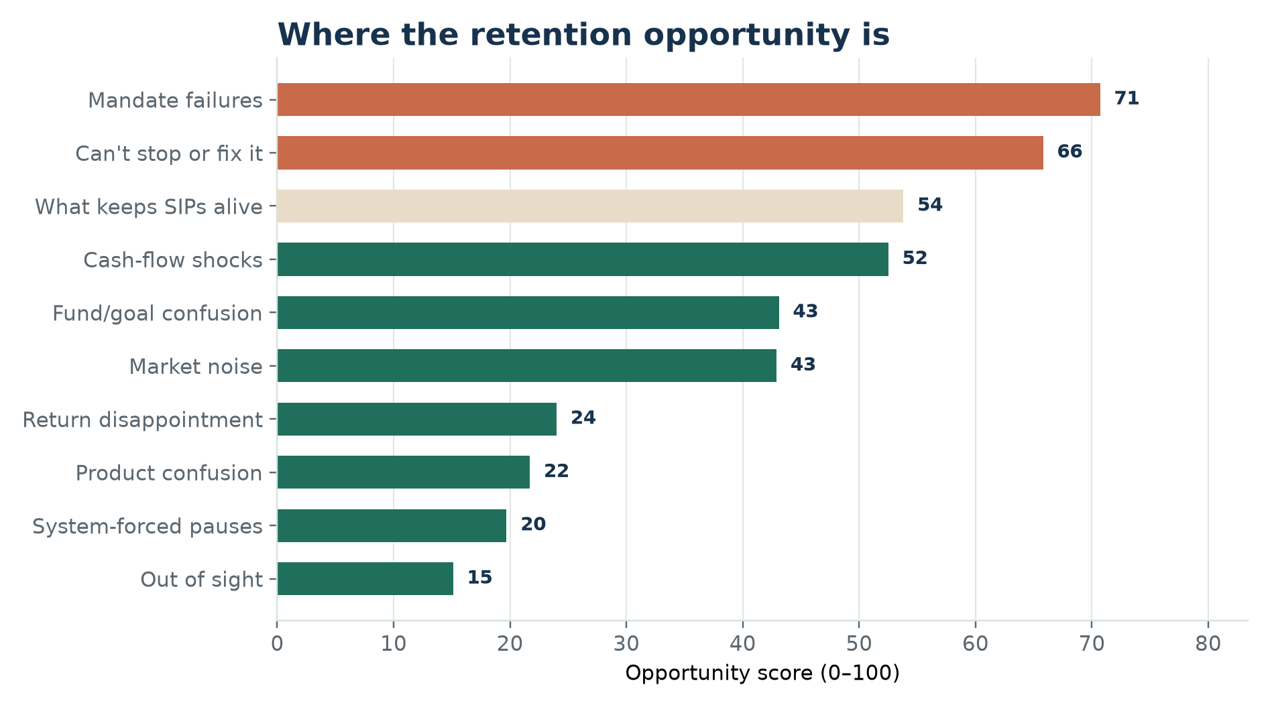
WHAT WE HEARD
Where the retention opportunity is
• Top problem themes: Failed debits and mandate breakage, Can't stop or fix it, Cash-flow shocks and competing commitments.
• The protective theme — what keeps SIPs alive — is shown separately in sand.
• Opportunity score combines reach, lapse lift, evidence strength, solvability, and effort.
• Themes with unresolved outcomes carry a friction prior and are marked n/a in the table.
INDmoney Growth · Public evidence · October 2026
5

Slide 6
THEME 01 · SYSTEM FRICTION
Failed debits and mandate breakage
59
SIGNALS
59
DOCUMENTS
n/a
LAPSE RATE
70.7
OPPORTUNITY
• For many investors, the SIP did not fail because they gave up; the debit did.
• Signals include UPI Autopay confusion, eNach failures, bank blocks, and silent missed instalments.
• The fix is pre-debit visibility and a repair path, not another reminder to invest.
“When I opened my MFU account and tried to use the ePayEezz mandate, following massage is showing- " Consequent to communication received from NPCI asking us to stop the e-NACH through e-sign process at MFU, we are constrained to discontinue ePayEezz...”
reddit · outcome=unknown · stage=m0_setup
“I used to do SIP in college with my internship money. 15k stipend, 4k SIP. 1 month, the stipend got delayed by 2 days. Guess what. I didn't even have money to eat a sandwich for 2 days. The SIP autodeducted the money. Worse yet? It wasn't enough to cover...”
reddit · outcome=unknown · stage=unknown
Fix: A pre-debit health check that flags a weak mandate, low balance, or bank issue. A three-day pre-debit alert with a one-tap repair or top-up path.
INDmoney Growth · Public evidence · October 2026
6

Slide 7
THEME 02 · AFFORDABILITY
Cash-flow shocks and competing commitments
14
SIGNALS
14
DOCUMENTS
100%
LAPSE RATE
52.5
OPPORTUNITY
• The SIP was affordable last month, not this month.
• Job changes, salary delays, medical expenses, house/wedding goals, and income volatility.
• A pause or step-down preserves the habit; a permanent stop loses the investor.
“I have reduced my MF SIP to 10k per month so that I can save on the house fund.”
reddit · outcome=reduced · stage=unknown
“Whenever I saw some expenses coming up, I would stop my investments for a month or two and then resume.”
reddit · outcome=unknown · stage=unknown
Fix: A 1-3 month pause with automatic resume, instead of a permanent stop. A step-down amount that preserves the habit through a temporary squeeze.
INDmoney Growth · Public evidence · October 2026
7

Slide 8
THEME 03 · CONTROL
Can't stop or fix it
38
SIGNALS
38
DOCUMENTS
89%
LAPSE RATE
65.8
OPPORTUNITY
• Investors try to cancel, pause, or repair a SIP and the flow does not work.
• Signals include 'still active', 'money got deducted', missing support, and unclear effective dates.
• A pause option beside cancel and a status tracker turn a dead end into a save.
“I requested to cancel my monthly SIPs around Jan 25, but the Feb 1 SIP was still active and the money got deducted.”
reddit · outcome=unknown · stage=unknown
“I want to temporarily pause this month's SIP deduction. I cannot find any pause option on the website. Can anyone help me how to exactly pause (not permanently cancel/delete) my SIP?”
reddit · outcome=paused · stage=unknown
Fix: A pause option beside cancel, with a clear effective date and one-tap resume. A cancellation status tracker: requested, effective, refunded, closed.
INDmoney Growth · Public evidence · October 2026
8

Slide 9
THEME 04 · EXPECTATIONS
Market noise and loss aversion
31
SIGNALS
31
DOCUMENTS
55%
LAPSE RATE
42.9
OPPORTUNITY
• A red portfolio is not automatically a lapse; the meaning the investor assigns to it matters.
• Some stop; others continue because they have a goal, a habit, or a human to talk to.
• Show goal progress and the trade-off, not fear or urgency.
“Now at the 3 year mark, my overall portfolio is 5% XIRR, and 3 of the above funds have changed rating from 5->3/2. I wanted to know a few things: If I should stop SIP in the existing schemes and start the SIP in different schemes”
reddit · outcome=unknown · stage=m9_late
“Never stopped my SIP even for one month. That's it. That's literally it. I just invested straight through the long flat period of 2018-19 and through COVID.”
reddit · outcome=continues · stage=unknown
Fix: A drawdown explainer that shows goal progress, not only the return number. A 'what happens if you stop' calculator, framed as a trade-off, not a threat.
INDmoney Growth · Public evidence · October 2026
9

Slide 10
THEME 05 · FORCED PAUSES AND CONFUSION
Sometimes the system pauses the SIP — and the investor never finds out why
• Forced pauses: AMC, platform, or regulator restrictions; the investor did not choose to stop.
• Product confusion: direct vs regular, NAV, fund category, and 'which fund is actually debited?'
• Both are clarity problems: explain the reason, the duration, the next step, and the auto-resume.
• No specific fund recommendations; compare categories and mechanics, not returns.
Forced pause signals: 7; product confusion: 1. Small n, high fixability.
INDmoney Growth · Public evidence · October 2026
10

Slide 11
THEME 06 · PROTECTION
What keeps SIPs alive
49
SIGNALS
49
DOCUMENTS
0%
LAPSE RATE
53.8
OPPORTUNITY
• Continuation is not passive. It is a goal, a habit, a support system, and a reason to stay.
• Investors describe continuing through COVID, flat periods, and job changes.
• Protect these moments: goal progress, streaks, community stories, and human encouragement.
“Never stopped my SIP even for one month. That's it. That's literally it. I just invested straight through the long flat period of 2018-19 and through COVID.”
reddit · outcome=continues · stage=unknown
“I will keep my SIPs running. My monthly investment is around 1% of my total portfolio value, so I reckon that stopping a SIP and waiting for a correction is actually not worth the effort”
reddit · outcome=continues · stage=unknown
Fix: Celebrate goal progress and streak milestones without FOMO or urgency. A 'you stayed invested through...' recap that reinforces the identity, not the return.
INDmoney Growth · Public evidence · October 2026
11

Slide 12
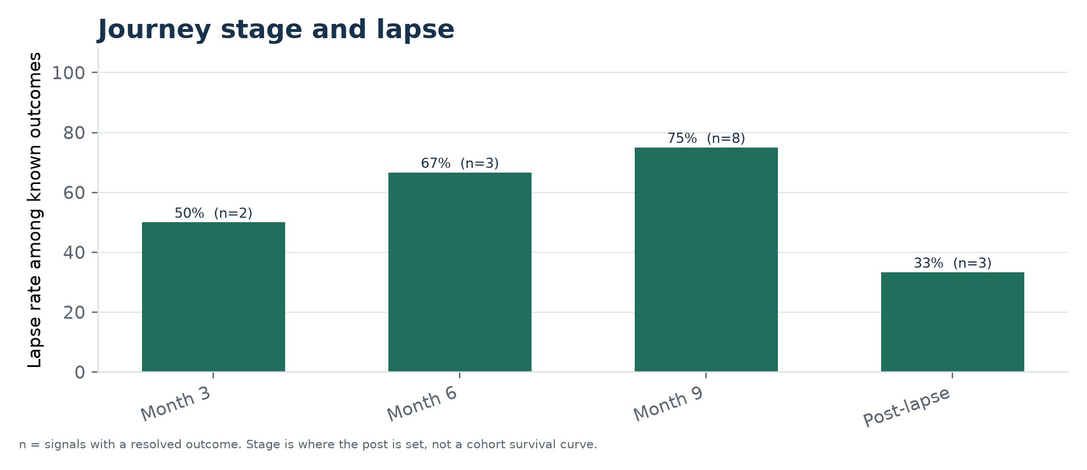
SEGMENTS AND STAGES
Stage tells us where the conversation is, not who survives
• Setup posts cluster around KYC, mandate, first debit, and first statement; most are questions, not resolved stops.
• Later-stage posts include more resolved decisions about returns, goals, and 'is this still worth it?'
• Stage is the point referenced in the post, not a cohort survival curve; do not read 0% at setup as safety.
• Segment cues are sparse and self-reported; use them for hypotheses, not sizing. Triangulate sources.
INDmoney Growth · Public evidence · October 2026
12

Slide 13
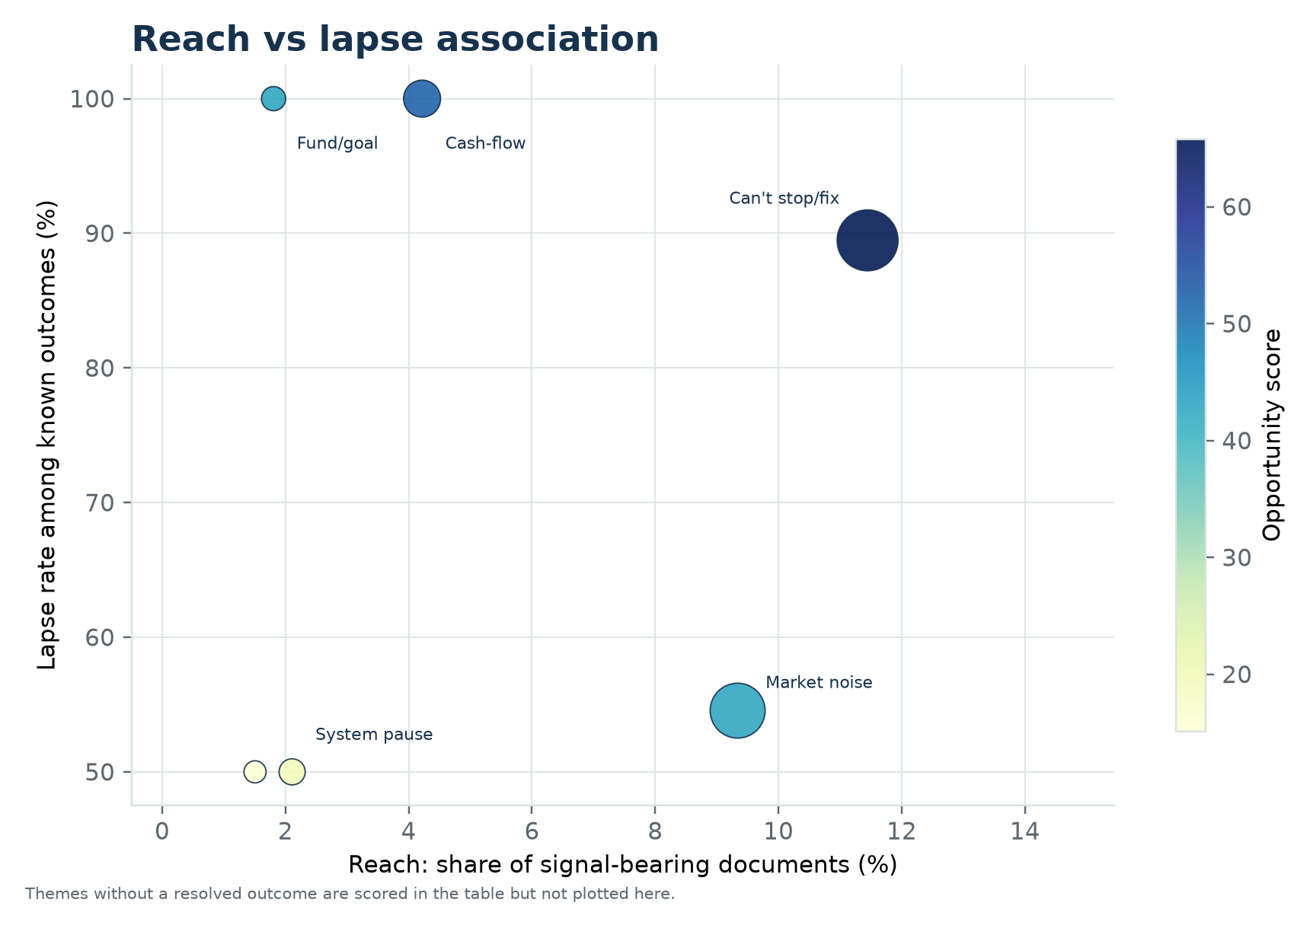
PRIORITISATION
Reach and lapse association point to different plays
• Failed debits and mandate breakage: 18% reach, n/a lapse, score 71.
• Can't stop or fix it: 11% reach, 89% lapse, score 66.
• Cash-flow shocks and competing commitments: 4% reach, 100% lapse, score 52.
• Which fund, which goal?: 2% reach, 100% lapse, score 43.
• Unresolved themes carry a friction prior; the score is a prioritisation heuristic, not a causal effect.
INDmoney Growth · Public evidence · October 2026
13

Slide 14
RETENTION PORTFOLIO
Three horizons, nine interventions, zero fear-based nudges
0–30 days
30–90 days
90–365 days
• Mandate health check before the first debit.
• 3-day pre-debit alert with one-tap repair.
• First-statement explainer: XIRR, absolute return, and market noise.
• Pause 1–3 months with auto-resume, beside cancel.
• Step-down amount and salary-cycle alignment.
• Goal tagging and a plain-language 'what am I invested in' view.
• Drawdown explainer framed as goal progress.
• Two-missed-debit re-engagement with a human fallback.
• Annual goal review and community stories, not FOMO.
INDmoney Growth · Public evidence · October 2026
14

Slide 15
MEASUREMENT
Measure the 12-month habit, not the download
Metric | Definition | Cadence
Primary: 12-month retention | At least one successful instalment in the last 30 days, 12 months after the first SIP. | Monthly cohort
Mandate recovery | Share of failed/at-risk mandates repaired before the next debit date. | Weekly
Pause-to-resume | Share of paused SIPs that resume within 90 days. | Monthly
Cancellation save | Share of cancellation intents that choose pause, step-down, or repair. | Weekly
Support resolution | Median time to resolve a SIP/mandate issue; share resolved in one touch. | Weekly
Guardrails | Complaints, opt-outs, support load, mis-selling risk; no fear/FOMO/urgency copy. | Continuous
INDmoney Growth · Public evidence · October 2026
15

Slide 16
VALIDATION
What we trust, and what we are still testing
Quote verification
Grounding
Every behavioural quote must be an exact substring. Fabricated or over-long quotes are rejected.
Deterministic rules check first-person actions, negations, attempts, payment stops, temporary pauses, and segment evidence.
Gold set + kappa
Red team
200-item evaluation set; second model on 100 items (all 80 resolved outcomes + relevance controls). relevance κ=0.81, outcome κ=0.94, theme κ=0.60. Kappa is agreement, not truth.
15/15 red-team tests pass, including an end-to-end prompt-injection call. Known limitations remain.
INDmoney Growth · Public evidence · October 2026
16

Slide 17
LIMITATIONS
What this evidence can and cannot tell us
• Public posts are self-selected; people with problems are more likely to post.
• Self-reported outcomes are not the 12-month product metric.
• Theme-lapse associations are correlational, not causal.
• App reviews are short and often lack context; narrative sources carry more explanatory weight.
• Hinglish and Indic-language coverage is limited; segment cues are sparse.
• The corpus spans 2014–2026; platform and market conditions change over time.
INDmoney Growth · Public evidence · October 2026
17

Slide 18
RECOMMENDATION
Start with the two plays that remove a lapse the investor did not choose
• Pilot 1: mandate rescue. Pre-debit health check, 3-day repair window, auto-retry, and a clear reason.
• Pilot 2: pause-don't-stop. A 1–3 month pause with auto-resume, step-down, and salary-cycle alignment.
• Instrument the 12-month metric and the pause-to-resume bridge before scaling.
• Human-adjudicate the 30-item review queue, then expand to the full 200 before sizing; keep red team in CI.
• Expand the narrative corpus (Reddit, forums, YouTube) before sizing segments.
No specific funds or stocks. No fear, FOMO, or urgency-based nudges.
INDmoney Growth · Public evidence · October 2026
18

Slide 19
APPENDIX
Sources, codebook, and reproduction
• Sources: Play Store, App Store, Reddit, YouTube, ValuePickr, TradingQ&A.
• Codebook v0.2: triggers, behaviours, emotions, expectations, help-seeking, outcomes, segments.
• Pipeline: collect → normalize → strict filter → LLM extract → quote verify → ground → quantify → validate.
• Reproduce: collect_sample.py, extract_signals.py, analyze.py, export_evidence_log.py.
• No internal analytics, CRM records, or primary interviews. Public data only.
Source | Signals | Lapse rate
reddit | 122 | 81%
play_store:Coin by Zerodha | 48 | n/a
app_store:Coin by Zerodha | 35 | 0%
play_store:Kuvera | 30 | 38%
play_store:ET Money | 24 | 100%
app_store:ET Money | 19 | 100%
app_store:Paytm Money | 15 | n/a
play_store:Paytm Money | 12 | n/a
INDmoney Growth · Public evidence · October 2026
19

