Slide 1

TEAM NAME : SAFE TECH
TEAM LEAD : KADARKARAI V
MEMBER : ANAKA M C
PROJECT : ROAD WATCH AI CHATBOT
EMAIL : kadarkarai474@gmail.com
LINK : ROADWATCH

Slide 2
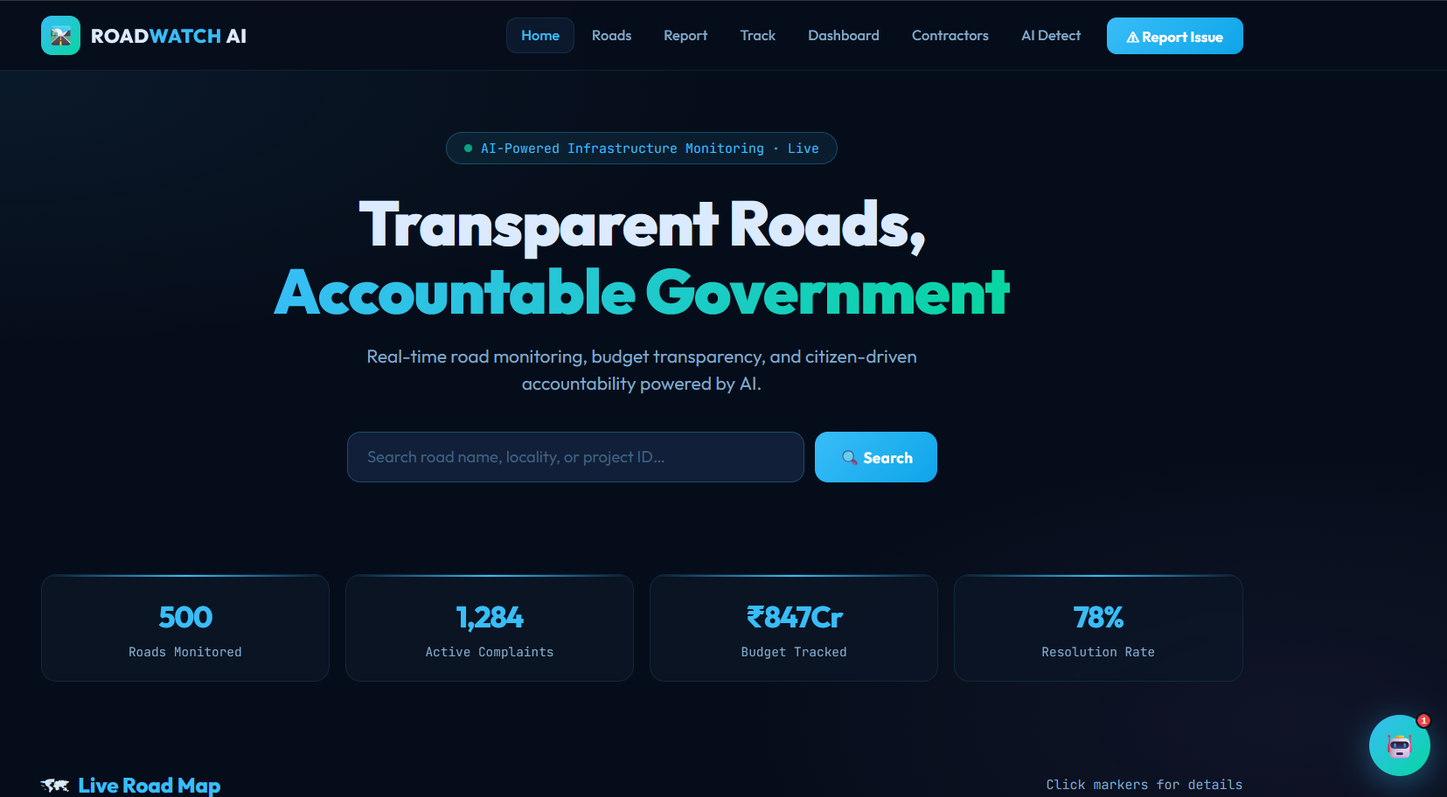
FEATURES OF ROADWATCH AI
Full Chatbot System
Futuristic UI
Live Complaint tracking
Location Based Reporting
AI Damage Detection
Smart Reporting System

Slide 3
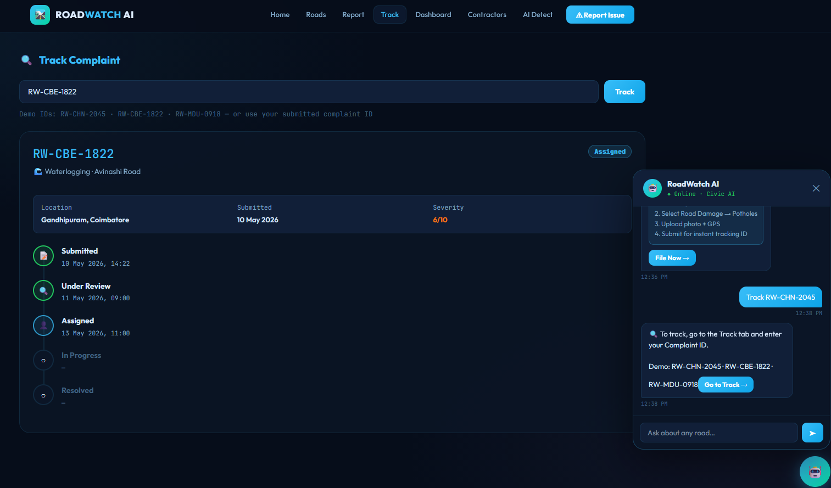
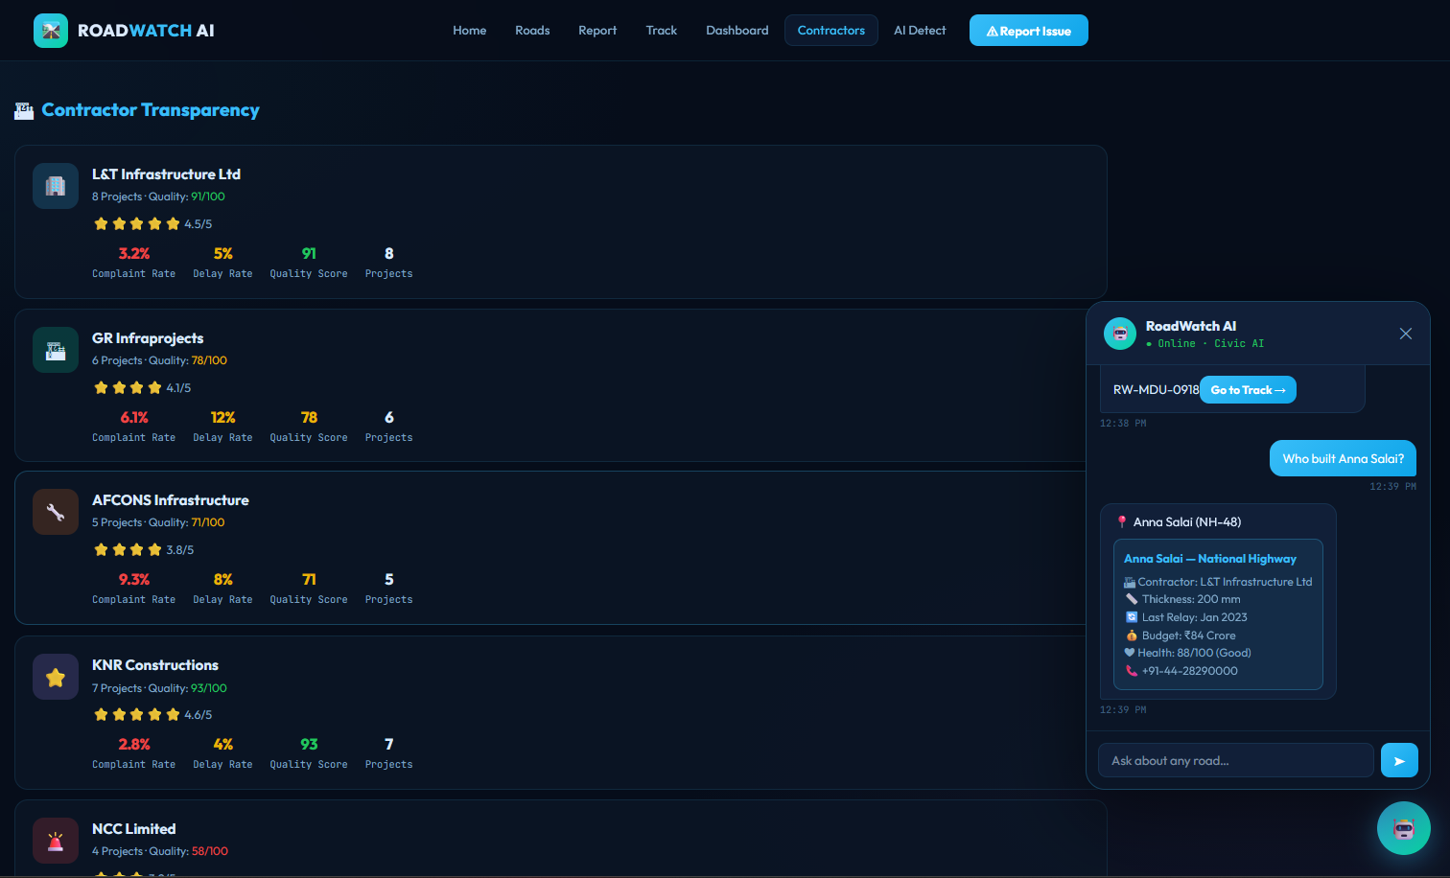
ROAD CONTRACTOR DETAILS
Contractor Details
Contractor transparency
Road information
Complaint Tracking

Slide 4
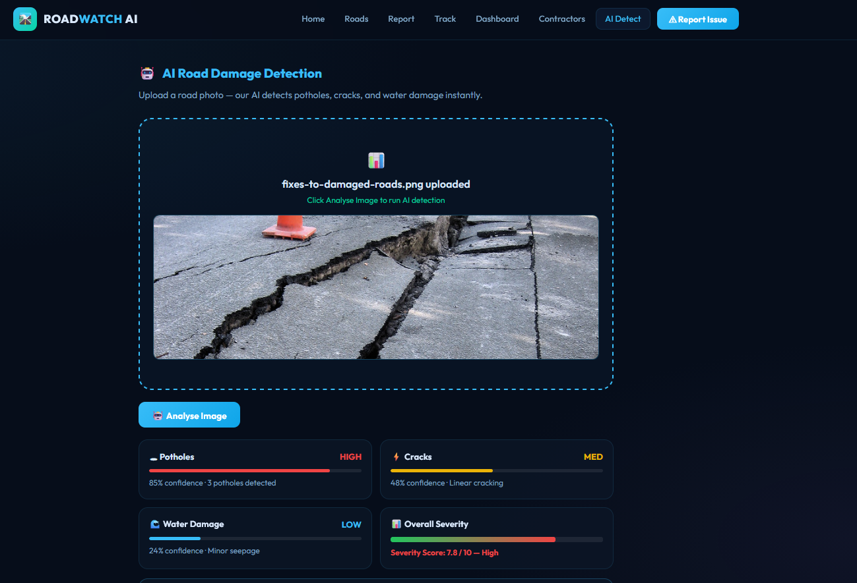
AI DAMAGE DETECTION
Analyze image using AI
High, med , based analysis
Overall Security points
Auto complaint options also available
Location based access also available on reporting issues

Slide 5
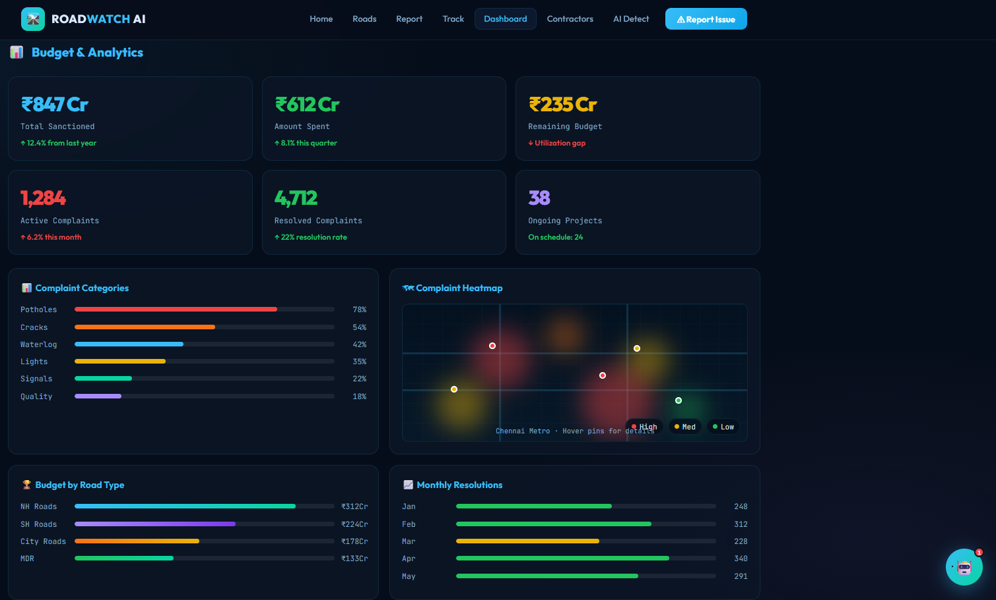
BUDGET & ANALYTICS

Slide 6


