Slide 1
Content-Adaptive Video Encoding with FFmpeg / x264
CS5185 group project · 5-minute presentation · group members: ______

Slide 2
Task and constraints
12 clips, 1280x720 @ 30 fps, no audio; compress to 5% and 2% of original size.
Only FFmpeg libx264 may encode; parameter tuning only, no x264 source changes.
Outputs must remain complete and decodable; no frame dropping or shortening.
Grading weights completeness and evidence more than raw numbers.

Slide 3
System workflow
probe: metadata -> target_bytes, target bitrate (0.98 overhead margin).
features: frame difference + edge fraction -> timeline.
decision: content-dependent candidate set (medium / veryslow / AQ-motion or long-GOP).
encode: two-pass x264 with VBV cap; feedback re-encode, candidates kept.
evaluate: aggregate PSNR-Y, MS-SSIM, aligned frame pairs.

Slide 4
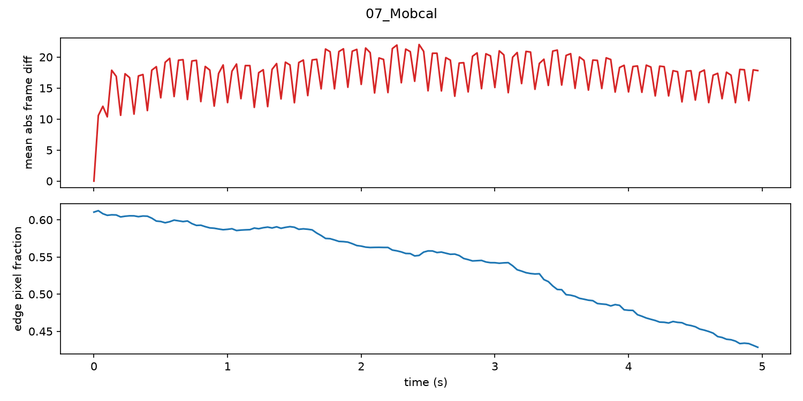
Content features separate the clips
Static (01, 04): low frame difference, high edge density.
Fast/shaky (07, 08): frame difference 17-20, edge density 0.5+.
Feature timeline explains where the encoder should spend bits.

Slide 5
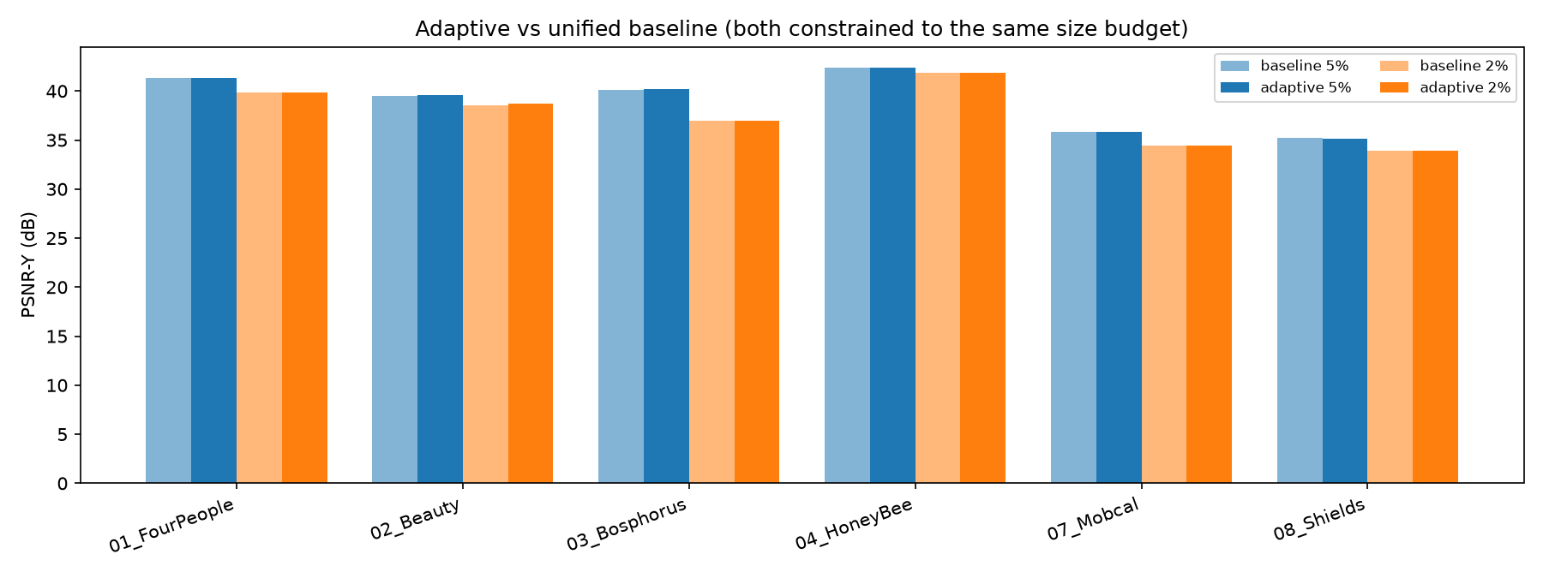
Results: adaptive vs baseline
All 12 baseline and 12 adaptive runs met the +-3% budget.
Adaptive wins 8/12 at matched size, mean gain +0.03 dB, ~5x encode time.
Main finding: budget dominates quality; parameters are second order.

Slide 6
Findings and limitations
Two-pass ABR overshoots 40-50% on 5 s clips; VBV fixes it.
03_Bosphorus loses 3.15 dB from 5% to 2%; 04_HoneyBee only 0.55 dB.
Search-based controller is reproducible but costly; features are clip-global.
Next: per-shot feature windows, CRF search, subjective scoring.

