Slide 1
Brainstorming
Team: Wasted

Slide 2
Worst Ideas
Johnny: Burning trash, Force taxation on cleanliness, App on trashy location, No trash bag, Drug to block smell, Public trash department Bury trash in the ground, Hold the trash in a single location, Bad odor detection devices, Fan the odor out.
Shaila: Everyone has to eat their trash, Everyone has to drive to Nebraska to dump their trash, Wrap the entire trash can in plastic wrap, Compost all of your trash, Melt down the plastic waste to reuse it yourself, Reuse your plastic bottles, Perfume for trash bags, Make everything else just smell worse, Have trash eating bacteria in your trash, Sell all your trash, Burn the trash, Nose plugs
Jaeyong: putting coffee to mask the smell, trash shredder, trash compactor, trash smoker, no trash bags, fragrant trash bags, ziplock style trash bag, don’t recycle, put all the trash in one place
Charles: Grenades, Fart spray, Shoot into space, flush down toilet, burn it, bury it, tie it up in a million bags, nose plugs, device that damages sense of smell, one place to dispose of trash, no trash bags
Brett: Smelly spray to block different smelly smell. Metal trash bag with lock and key. Trash can that ties the bag each time you close lid, then you have to untie it to use again. No trash bags. Febreze trash bags. Object that you throw in each bag which sprays nice smells. Nose plugs with fragrance. Keep trash next to flowers.
Annalina: spray, scented bags, dividers for trash, never throw anything out, composting, throw everything outside, light it on fire, don't have a trash bin

Slide 3
Reverse the Problem
Harder | Solution
Never clean trash can | Self cleaning trash can
No Trash bags | Container for trash
Use a fan to push bad smell around | Use a container that avoids airflow from entering/ exiting
Put all trash in one area | Have dividers for trash, multiple disposal sites
No trash dump sites | Thermal generator/ Incinerator
No law/citation against littering | Enforce community regulations
Only eating the stinkiest food | Throw it into your sink disposal instead of the trash
Vacuum sealer for trash bag that spews smelly air out | Sanitize/purify the air spewing out. Use another item such as spray to mask the smell
Ban against nose plugs | Permanently remove sense of smell at birth
Garbage collectors come less often (once a month) | Uber but for trash, can order someone to pick up on a daily basis
Less recycling/ composing | Promote more recycling/ composing

Slide 4
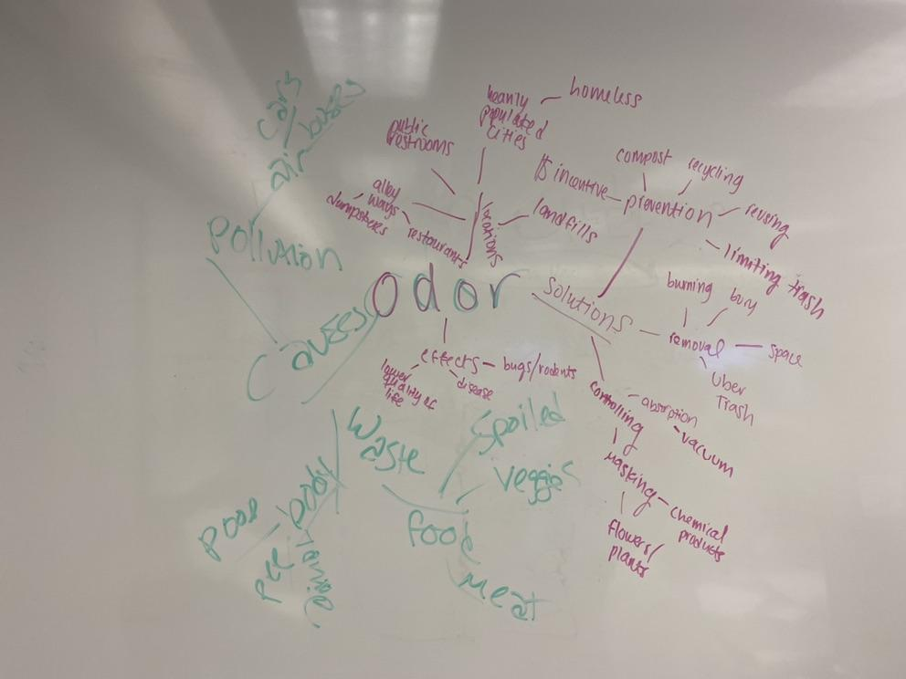
Mind Mapping

Slide 5
Brain Walking
Charles: Vacuum seal lid for trash cans, uber for your trash, inhaling a molecule through your nose to trick your brain into smelling something other than a foul odor, Nose plugs, A method of shooting into space, giant plastic wrap, neighborhood compactors, neighborhood burial sites
Brett: Uber for trash, a Febreze-like spraying trash can, Trash can which incinerates contents, Trash bag which ties itself off and vacuum seals the bag. “Odor Bomb” which is put into trash can to absorb odor or destroy chemicals which produce odors
Jaeyong: Compact the trash, making it into a manageable size, then spray with odor absorbing liquid which is washed away after. Burn the trash, use it as some sort of fuel. Bury the trash, or use it as a building material. Give usable food waste to farms to feed animals. Inhaler for your nose that keeps a pleasant smell when around foul odor.
Annalina: Burning in a thermal generator, spray like Febreeze such as routine air spray by planes, decreasing/limiting products that go in trash, compact trash and extract odor and purify that odor, at home smusher, install fees for controlling odor, space trash management facility utilizing trash for fuel
Johnny: Raw waste is to compost. Cooked waste is to be animal feed. Food waste turning compost into fertilizer for plants, masking smell or using trash for their food. Vacuum sealed container for food waste to stay in until it makes it to the animeals. Use tightly sealed composting container to prevent odor leakage.
Shaila: Bacteria that eats trash and emits compost, Air purifying plants, Fee for not composting, Incentive for composting, At home method to transform plastic, Driving very far away to throw away trash, Recycle, Mandatory, Bulk items to be crushed or repaired, Promote waste reduction through social activities, App to monitor odor/waste, stores/trash management facilities rewarding people who bring and recycle trash, Flowers grown from trash and then sold to keep up with the cost, Better funding for recycling facilities, tax incentives for recycling, Composting containers are tightly sealed

