Slide 1
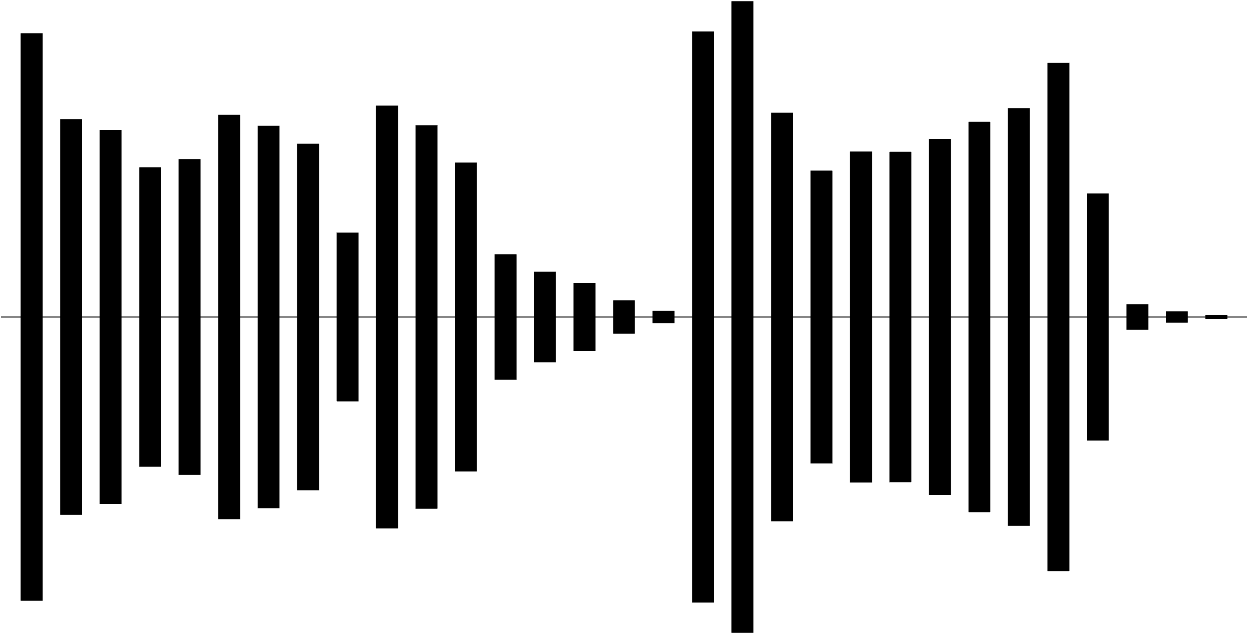


Clean Sound
RIR
Reverberant Obs.

