Slide 1
114
SMENTOK
SISTEM MANEJEMEN STOK
ADILIAKA

Slide 2
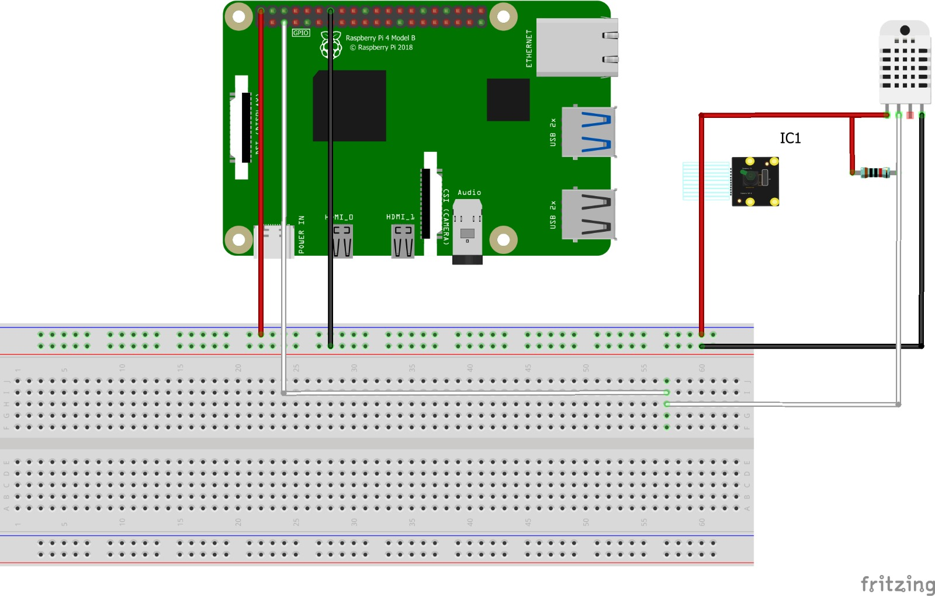
SKEMA ELEKTRONIK

Slide 3
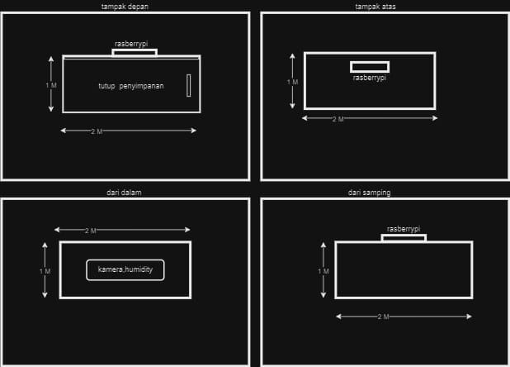
DESAIN PERANGKAT KERAS

Slide 4
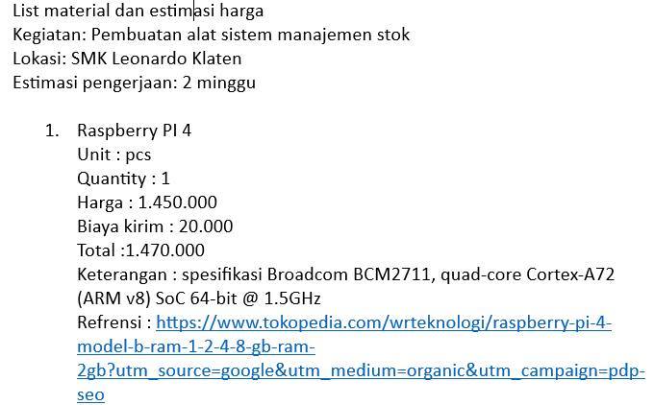
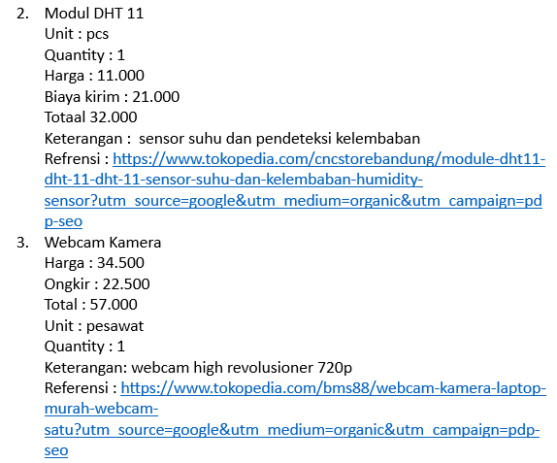
BOM
Drafting & CAD Technology
Major for college

Slide 5
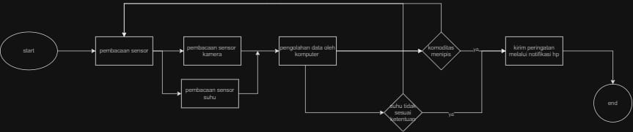
ALIRAN PROSES
Drafting & CAD Technology
Major for college

