Slide 1
SLOPD: POLICE LOG ANALYSIS
Jacob Schoenburg, Parker Petersen, Ollie Sheehan, Brogan Pietrocini, Kaden Buckley

Slide 2
What is a police log?
• Report created by an officer or responder to document an incident
• Contains:
- Incident ID
- Date
- Time of Events
- Type of Incident
- Address
- Officer
- Comments

Slide 3
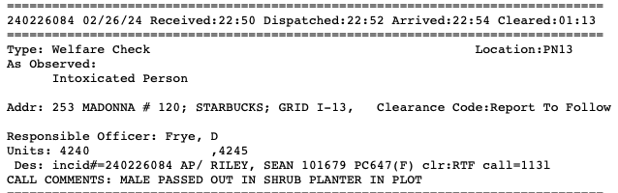
Example Police Log
Incident ID
Date
Times
Type
Address
SLO Grid ID
Comments

Slide 4
Analysis
Scrape SLO PD Police Logs from slocity.org
Generated at 3 pm daily M-F
Merge with existing data
Records from Jan 22, 2024
Clean and extract useful info
Analyze data
Map incidents
Hypotheses:
High percentage of incidents related to partying/alcohol near campus
More incidents during weekends than weekdays

Slide 5
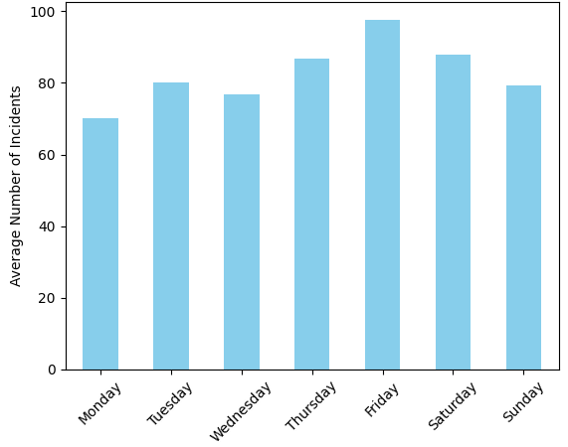
Average Incidents per Day of Week

Slide 6
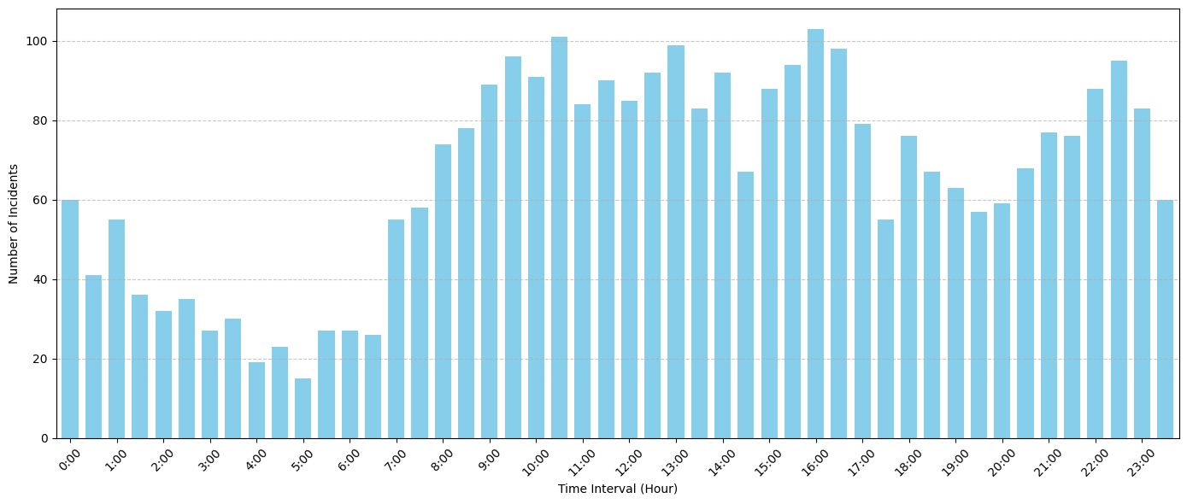
Aggregate Incident Counts by Hour
6x Increase in Incidents

Slide 7
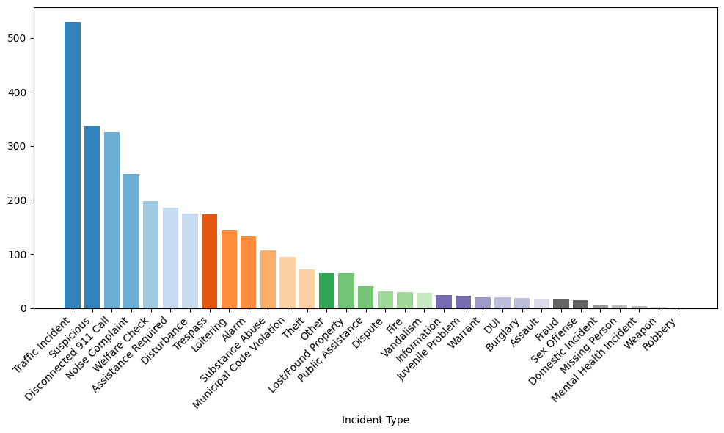
Incidents by Type

Slide 8
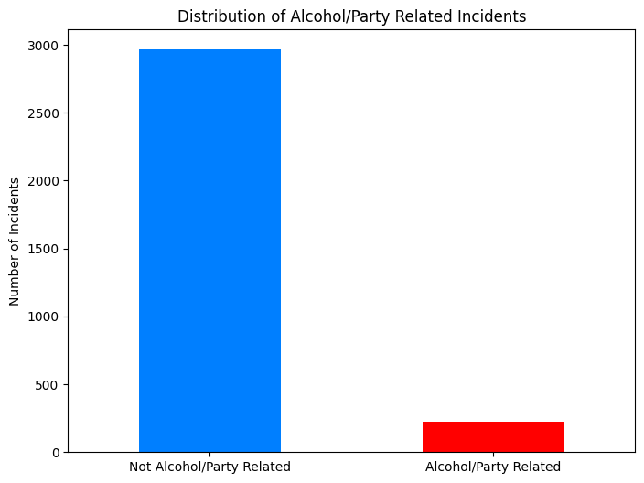
Distribution of Alcohol/Party Related Incidences

Slide 9

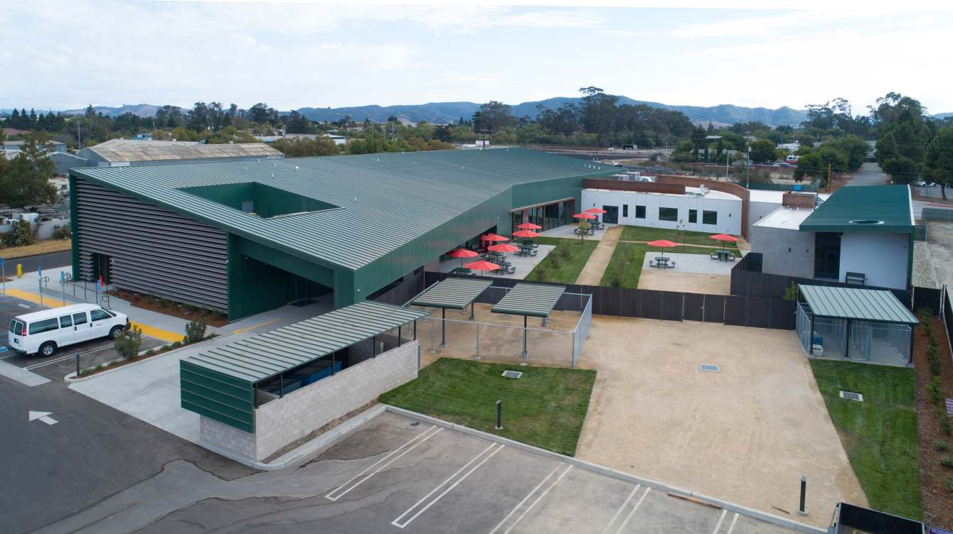

Homelessness
8.5% of incidents involved homeless
62 incidents took place at 40 Prado Homeless Services Center

Slide 10




Future Pipeline Framework Using AWS
1
3
2
4
Glue
Athena
Streamline automated ETL Process
S3
Efficiently Query to drive exploration
Sagemaker
Utilize S3 for file storage
Final Models and Visualizations

Slide 11
NEXT STEPS
Automate Pipeline through AWS
Incorporate SLOPD's Grid for Incident Mapping
Explore relationships in popular locations
Segment various groups (students, homeless, etc.)

Slide 12

THANKS!
Have you seen this man?

