Slide 1
Kadence Chan
DAAA/2A03
P2317889

Slide 2

Objective of analysis
To gain insights on whether Malls in the vicinity and the parameter of MRTs near the HDB resale prices affects its prices and give and explanation
This Photo by Unknown Author is licensed under CC BY-SA

Slide 3

My Dataset
The dataset I used is from: 1: Amendment to MP2014 Rail Station — Data.gov.sg and 2: Shopping Mall coordinates (kaggle.com)
Website: Dataset is about :
1: The location of all the mrts in Singapore and its location
Consists of: Name, latitude, longitude
2: The location of all the shopping malls in Singapore and its location
Consists of : Mall Name, LATITUDE, LONGITUDE
This Photo by Unknown Author is licensed under CC BY-NC

Slide 4
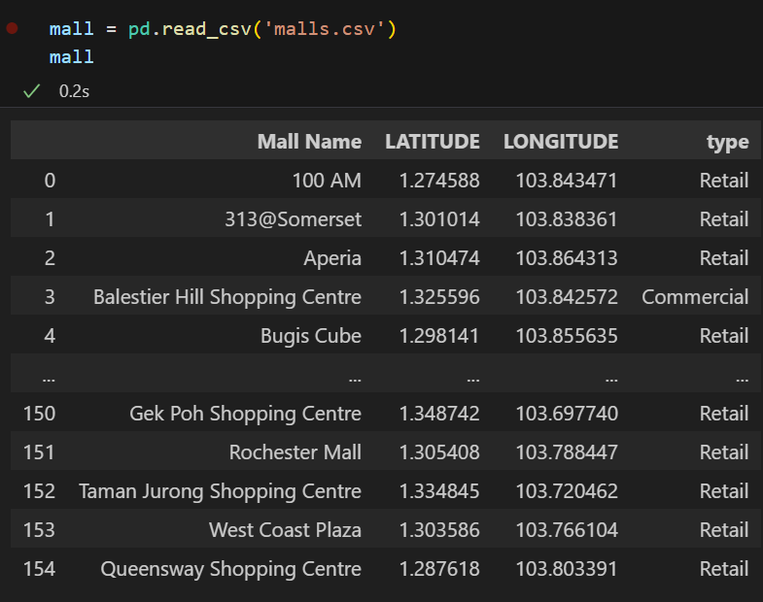
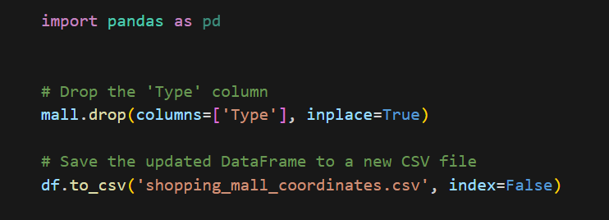
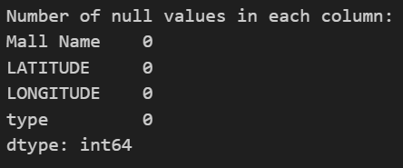
Data Wrangling
3. I realised that there was a column called type which was redundant, so I removed and saved to new dataset called: shopping_mall_coordinates.csv
Load the dataset
2. Checking for null values,

Slide 5
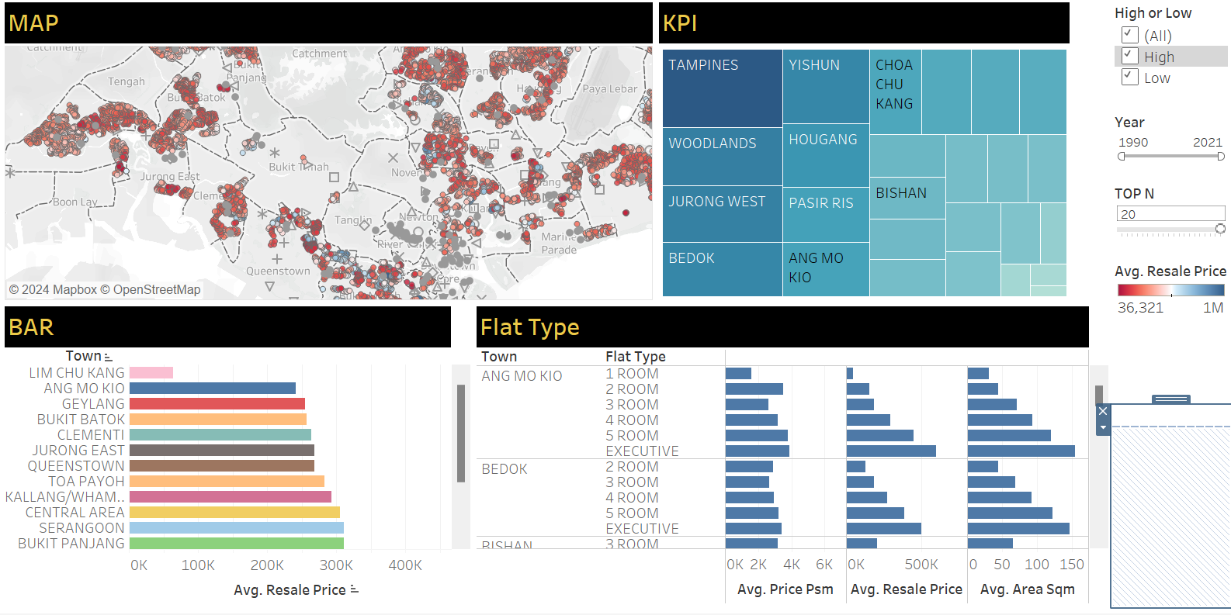
Charts

Slide 6
Insights
If we focus just on lim chu kang we can see that the average resale price is around 60k and base on the map there is no amenities or mrt in its vicinity. This could be why it sells for so low.
On the other hand, Punggol has about 11 mrt stations and 4 malls in its vicinity and has an average resale price of 443k
But that does not mean more MRT and malls equal higher resale price for example: Chua Chu Kang has 8 malls and 6 MRT yet it only has resale prices of average 325k
This means that having more MRT or malls in the vicinity is not definitive of higher resale prices for HDB, but there is correlation

Slide 7
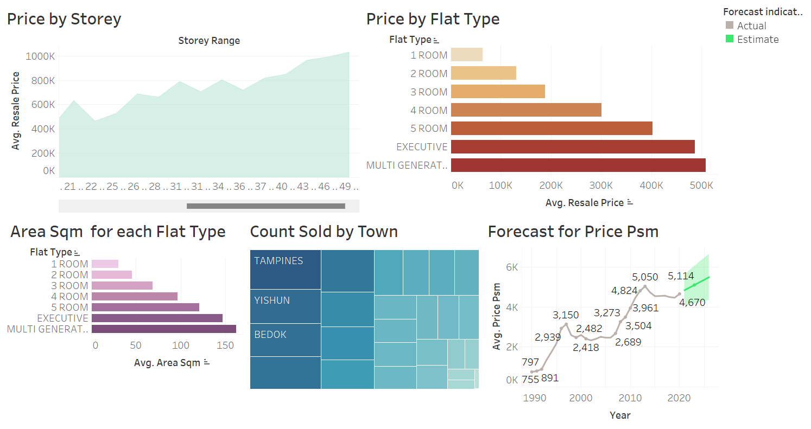
Charts

Slide 8
Insights
Using the charts we can see that different factors also affects the prices, such as Year, Storey, Area and Flat Type
Example the higher the Level(Storey) the higher the average resale price on average. But on closer look u will see that for older generation of houses particularly those like Jurong east or Chua Chu Kang they usually do not have HDB’s having very high levels thus the price between the levels are pretty much the same.
Tampines sells the most number of resales clocking in at 74161 and Lim Chu kang at 63. This could be due to its location as linking back to the map we see that lim Chu Kang has little to no amenities however Tampines is quite the opposites and Tampines having lots of housing estates

Slide 9
Suggestions
Given the observations made, it seems like the presence of amenities such as malls and MRT stations is correlated with higher HDB resale prices, but it's not the only determining factor.
Other factors like the age of the housing estate, the level of the unit, and the specific location also play significant roles.
One suggestion could be to focus on improving the infrastructure and amenities in areas with lower resale prices, like Lim Chu Kang, to potentially increase their attractiveness to buyers. This could involve initiatives to develop more amenities, improve transportation access, or revitalize the area to enhance its appeal.
Additionally, understanding the preferences of potential buyers in different areas can help in tailoring development plans and marketing strategies to better meet their needs and attract more buyers. For instance, in areas where there are a lot of older generation houses with lower levels, there might be a demand for amenities and facilities catering to senior citizens.Overall, a holistic approach that considers not only the presence of amenities but also other factors influencing buyer preferences and resale prices can help in developing effective strategies for improving HDB resale prices across different areas.

