Slide 1
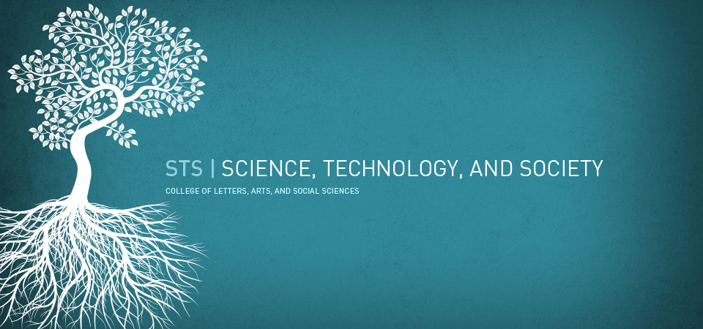
Science, Technology and Society
INTRODUCTION

Slide 2


SCIENCE, TECHNOLOGY AND SOCIETY
STS is an interdisciplinary field that examines how science and technology shape societies, cultures, and the environment and how social, cultural, and environmental factors shape the development of science and technology.

Slide 3
DEFINITIONS OF SCIENCE
1. SCIENCE AS A PROCESS
  Concerned with discovering relationships between observable phenomena in terms of theories.
  Systematized theoretical inquiries
  It seeks for truth about nature.
  It is determined by observation, hypothesis, measurement, analysis and experimentation

Slide 4
DEFINITIONS OF SCIENCE
2. SCIENCE IS A PRODUCT
  Systematized, organized body of knowledge based on facts or truths observations.
  A set of logical and empirical methods which provide for the systematic observation of empirical phenomena.
  Source of cognitive authority.
  Concerned with verifiable concepts
  A product of the mind
  It is the variety of knowledge, people, skills, organizations, facilities, techniques, physical resources, methods and technologies that taken together and in relation with one another.

Slide 5
DEFINITIONS OF TECHNOLOGY
1. TECHNOLOGY AS A PROCESS
  It is the application of science.
  The practice, description, and terminology of applied sciences.
  The intelligent organization and manipulation of materials for useful purposes.
  The means employed to provide for human needs and wants.
  Focused on inventing new or better tools and materials or new and better ways of doing things.

Slide 6
DEFINITIONS OF TECHNOLOGY
1. TECHNOLOGY AS A PROCESS
  A way of using findings of science to produce new things for a better way of living.
  Search for concrete solutions that work and give wanted results.
  It is characteristically calculative and imitative, tends to be dangerously manipulative.
  Form of human cultural activity.

Slide 7
DEFINITIONS OF TECHNOLOGY
2. TECHNOLOGY AS A PRODUCT
  A system of know-how, skills, techniques and processes.
  It is like a language, rituals, values, commerce and arts, it is an intrinsic part of a cultural system and it both shapes and reflects the system values.
  It is the product of the scientific concept.
  The complex combination of knowledge, materials and methods.
  Material products of human making or fabrication.
  Total societal enterprise.

Slide 8
DEFINITIONS OF SCIENCE AND TECHNOLOGY
  A field of endeavor upon which a two-way interaction operates between science and technology.
  Interdependent and overlapping methods which employ both existing knowledge and existing know-how.

Slide 9
DEFINITIONS OF SCIENCE AND TECHNOLOGY
  A system of know-how, skills, techniques and processes which enable society to produce, distribute, install, maintain or improve goods and services needed to satisfy human needs.
  Is an interdisciplinary field of study that seeks to explore and understand the many ways that modern science and technology shape modern culture, values and institutions, and how modern values shape science and technology

Slide 10
PURPOSE OF SCIENCE AND TECHNOLOGY
  To improve quality of human condition.
  To provide solution to our practical problems.
  To establish relevant institutional linkages and essential mechanisms
  To develop individual knowledge.
  To find order in the chaos of nature and deliver personal and social liberation

Slide 11
PURPOSE OF SCIENCE AND TECHNOLOGY
  To give an information and explanation of the natural world
  To develop new areas of knowledge
  To combat irrationality.
  To maintain the availability of natural resources

Slide 12
LIMITATIONS OF SCIENCE AND TECHNOLOGY
  Epistemological concerns. It cannot help us with questions about the God, the ultimate Good, and Truth. It cannot deny nor confirm the existence of God, soul, heaven and other uncertainties.
  Metaphysical concerns. Immaterial and transcendental nature is beyond the grasp of scientific inquiry. It cannot speak to issues of ultimate origin, meaning, or morality.

Slide 13
LIMITATIONS OF SCIENCE AND TECHNOLOGY
  Axiological concerns. It cannot answer questions about value.
  Dependent on the values and personal beliefs of those who use it.
  Use of natural resources that are being used in science and technology are limited
  Data is limited to the physically observable.
  Ultimately rest on past observations

Slide 14
LIMITATIONS OF SCIENCE AND TECHNOLOGY
  Not all of its principles are applicable to different world phenomena.
  Needs human intervention to carry out its functions properly
  It can predict forces of nature but it cannot prevent the prevent the prevalence/occurrence
  Can not guarantee an ultimate solution to any specific problem.
  Can not fully explain what is in the mind of a person.

Slide 15
TECHNOLOGY
  Technological leadership is vital to the national interest of any developing and developed nation.
  As we enter the twenty-first century, humans ability to harness the power and promise of leading-edge advances in technology will determine, in large measure, national prosperity, security, and global influence, and with them the standard of living and quality of life.

Slide 16
TECHNOLOGY
Requirements for technological innovations
research and development
cadre of scientists and engineers
diverse manufacturing base
productive workforce
broad and sophisticated service sector
climate and culture that encourage competition, risk taking and entrepreneurship

Slide 17
TECHNOLOGY
Technology and Economy
  Technology is the single most important determining factor in sustained economic growth, estimated to account for as much as half a nation’s growth over the past 50 years.

Slide 18
TECHNOLOGY
Technology and Economy
Technology is transforming the very basis of competition-enabling small businesses to perform high-quality design and manufacturing work that previously required the resources of big business, while allowing big businesses to achieve the speed, flexibility, and proximity to customers that were once the sole domain of smaller firms.

Slide 19
TECHNOLOGY
Technology and Economy
Technology provides the tools for creating a spectacular array of new products and new services.

Slide 20
TECHNOLOGY and the Quality of LIFE
New technologies are improving the quality of life. These are seen in:
Medical research in pharmaceuticals, biotechnology, and medical devices helps us lead healthier lives and offers new hope for the sick.
Environmental research brings better monitoring, prevention, and remediation technologies.
Advanced monitoring and forecasting technologies – from satellites to simulation – are helping to save lives and minimize property damage by severe weather.

Slide 21
TECHNOLOGY and the Quality of LIFE
New technologies are improving the quality of life. These are seen in:
Sophisticated traffic management systems for land, sea, and air transportation enable the smooth and timely movement of more people and goods.
Agricultural research is producing safer, healthier, and tastier food products.
Automobile research is providing safer, cleaner, energy efficient, and more intelligent vehicles.
Aeronautical technology is making air travel safer, less costly, and more environmentally compatible.

Slide 22
TECHNOLOGY and the Quality of LIFE
New technologies are improving the quality of life. These are seen in:
Energy research is helping to deliver cleaner, renewable, and less expensive fuels.
Information and telecommunications technologies have enabled instantaneous communications around the globe.

