Slide 1
TECHNOLOGY AND SOCIETY : IMPACTS OF TECHNOLOGY ON SOCIETY

Slide 2
CONTENTS
What is Technology?
Technological Revolution
Technology and Modification
Impacts on Society
Positive Impacts
Negative Impacts
Effects on Mankind
Conclusion

Slide 3
WHAT IS TECHNOLOGY?
The application of scientific knowledge for practical purposes, especially in industry.
It can also be stated as the branch of knowledge dealing with engineering or applied sciences.
Machinery and devices developed from scientific knowledge.

Slide 4
Technological Revolution
The Technology Revolution Restructured the Global Economy.
THE WORLD IS IN THE THROES OF A TECHNOLOGICAL REVOLUTION that differs from the periodic waves of technical change that have marked the progress of industrial society since its origins 200 years ago.

Slide 5
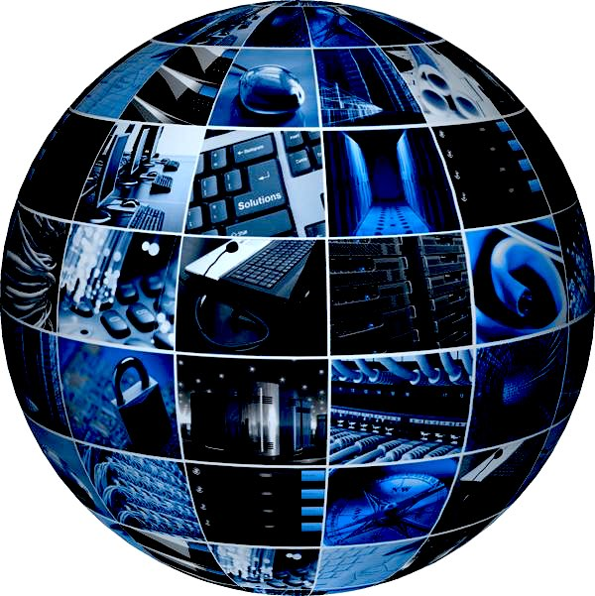
With the time, Technology started to emerge.
The Technology evolved in many sectors :
Communication
Industries
Household

Slide 6
TECHNOLOGY AND MODIFICATION
That’s when the modern technology was born & started to grow up & started to get fed by human being .
Tragedy is that it has become a huge impact to the lifestyles of the people. Addiction to machinery items has become a threat to the lifestyles of children.

Slide 7
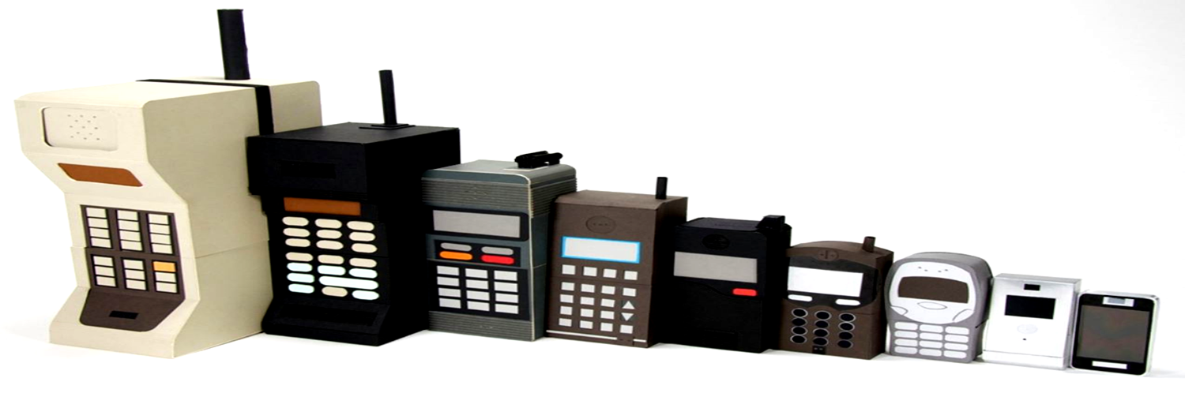
Increasing technology gives a vast passage to communication
or
With the usage of machinery items to communication , mind force us to think that the technology has given the priority to make the communication easier. The same reason itself make the people to go for the latest communication sources available , mostly for MOBILE PHONES.

Slide 8
Impacts On Society
Technology and human life cannot be separated; society has a cyclical co-dependence on technology.
We use technology; depend on technology in our daily life and our needs and demands for technology keep on rising.
Humans use technology to travel, to communicate, to learn, to do business and to live in comfort. However technology has also caused us concerns. Its poor application has resulted into the pollution of the environment and it has also cause serious threat to our lives and society.

Slide 9
Positive Impacts

Slide 10
Communication
Changes in communication technology over the last four decades have been revolutionary.
It has made communication easier around the globe.
Newer advancements like texting and messaging apps have spurred even more efficiency within workplace communication.
Everyday, newer communication devices are being release

Slide 11
Agriculture
Modern agricultural technologies such as ploughing, sowing have allowed farmers to grow vast quantities of food in a shorter lapse of time.
Manufacture of genetically modified crops which are more resistant to several pests and diseases.
For e.g. hybrid seeds can improve crop yields by a factor of two or three in certain situations.

Slide 12
Education System
Nowadays, education is much more easier thanks to the Internet.
It gives students the chance to interact with their classmates more by encouraging collaboration.
Student can have access to digital textbooks online that are constantly updated.
Integrating technology in education everyday helps students stay engaged.

Slide 13
Transport System
Technology has helped in advancing the four types of transportation which include air, road, water, and space
Production of hybrid cars which use less fuel and emit less CO2
CCTV camera to monitor the traffic
GPS: used for navigation

Slide 14
Negative Impacts

Slide 15
Isolation
Social isolation is characterized by a lack of contact with other people in normal daily living, such as, the workplace, with friends and in social activities.
We isolate ourselves by walking around in our own little world, listening to our iPods or staring at the screen of the latest mobile device even when we are around other people.
Studies have shown that people who are socially isolated will live shorter lives.

Slide 16
Developmental Issues in Children
All of the negative effects that social media and television is having on adults are far greater when it comes to the developing minds of children.
There is no way to know what long term effect technology will have on our children because this is the first generation to have unlimited access.

Slide 17
Neurosis
Technology causes people to suffer from mental and emotional disturbances, such as anxiety, phobias and delusions, which are all symptoms of neurosis.
Being convinced you’re very ill after looking up strange diseases on WebMD or thinking you are famous because you have had a viral video are a couple of ways technology neurosis manifests itself.

Slide 18
Effects On Mankind

Slide 19
Technology: A Boon for Mankind
What if there is no TECHNOLOGY?
Technology easies work of human. Improves the quality of lives of human beings and helps ease the burden of human at work or at home
Today, without technology life would be very hard
Advanced technology also extends the lifespan by better medical care. It shortens the distance between people around the world the better communication devices

Slide 20
Technology: A Curse for Mankind
Pollution
The problem of obesity
Disasters
Many claim that advanced technology shortens the distance between people

Slide 21
CONCLUSION

Slide 22
“Society makes choices between many alternatives. Each person makes a decision that influence the choice a society makes . So the way we choose to use technology will determine if it will benefit us positively or harm us in the long run”

Slide 23
The use of technology is unmeasurable, technology has played a big role in many other fields like health care , Job Creation and Data management , etc.
Technology will keep on changing based on the demands of people and the market. So its our role to keep ourselves up-to-date with trending technology
How we use technology determines if it’s good or bad, helpful or harmful. Technology , itself, is neutral. But it is us who make it good or bad basing on how we use it .

Slide 24
TECHNOLOGY
Is a Useful
SERVANT But
A Dangerous
MASTER.
-Christian Lous Lange

Slide 25
THANK YOU

