Slide 1

A Text-Based Analysis of Measles Outbreak
Narratives iN CDC (Centers for Disease
Control and Prevention) Reports and Their Associations With State Demographic Patterns
Jamila Sani and Kehinde Adeniyi

Slide 2
QUESTIONS
Which states were most frequently mentioned in CDC outbreak reporting?
What themes appear in CDC measles outbreak narratives?
Is there an association between demographics and outbreak mention patterns?

Slide 3
METHODOLOGY AND ANALYSIS
Data sources: CDC web pages and ACS (American Community Survey) API
Data: CDC measles outbreak text from web scraping and the ACS demographics (education and state population)
Methods: Text analysis techniques - keyword frequency and topic modeling
Visualization: Bar graphs and scatter plots using ggplot2

Slide 4
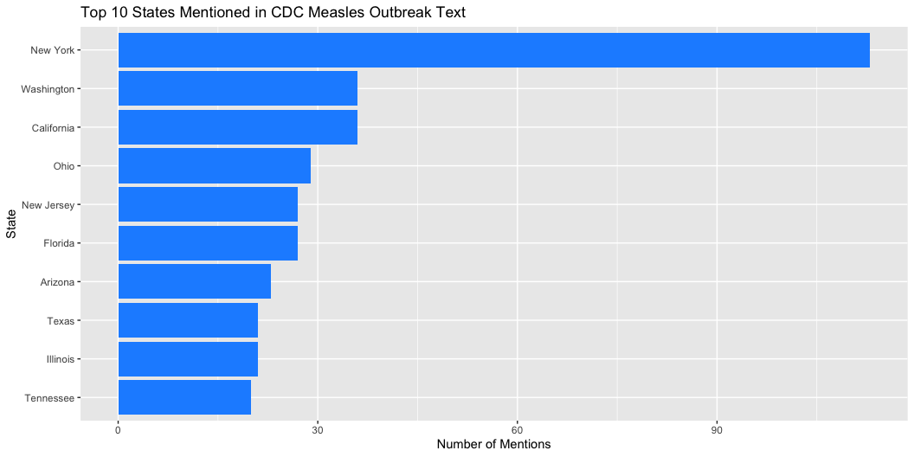

Slide 5
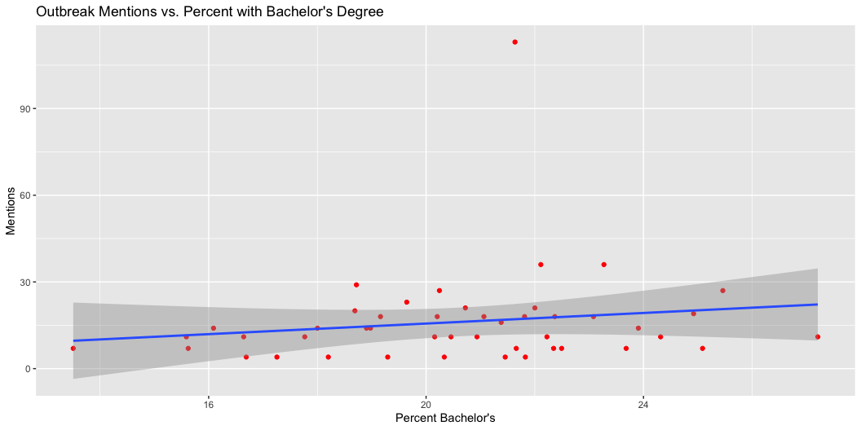
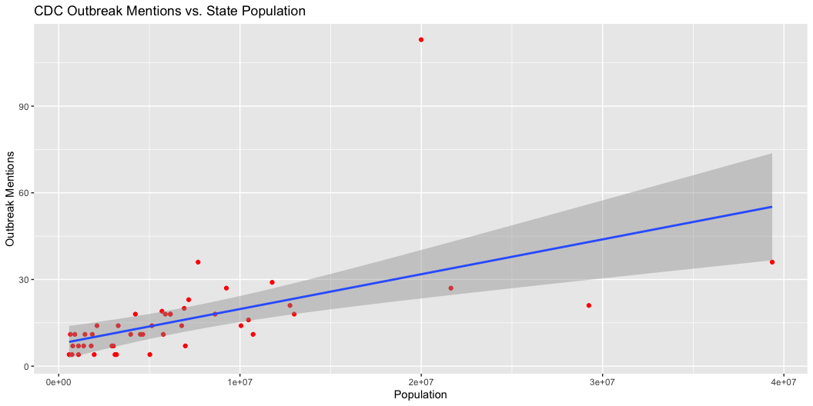
OUTBREAK MENTIONS vs DEMOGRAPHICS

Slide 6
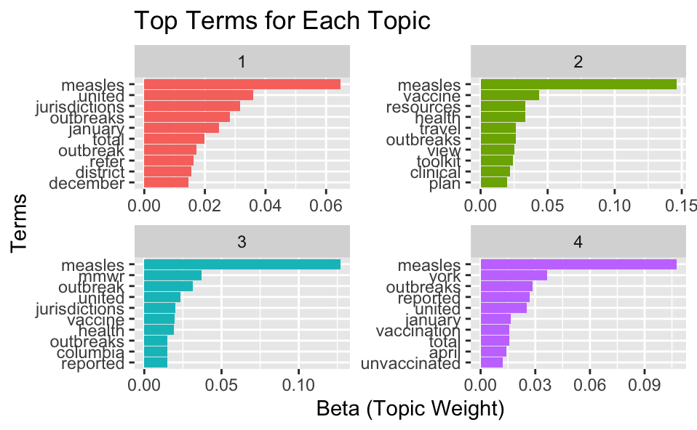
Topic Modeling (output)
topic label and top terms
1 National Outbreak Summaries
  measles, unite… Nation…
2 Vaccination Guidance and Public Health Resources
  measles, vaccine Public
3 CDC Surveillance and MMWR Reporting
  measles, mmwr,… Survei…
4 State Level Outbreaks and Vaccination Status
  measles, york,… State …

Slide 7
Results
Top ten states mentioned in the CDC measles outbreak text as shown graph above were NY, WA, CA, OH, NJ, FL, AZ, TX, IL and TN. With New York being significantly higher than other states.
Topic modeling identified four themes: national outbreak summaries, vaccination and public health guidance, surveillance reporting, and state specific outbreak details.
Population showed a strong relationship with CDC mention frequency, while education level showed a weak or negligible relationship.

