Slide 1

Developing Machine Learning Methods for Business Intelligence
Machine Learning analysis of
Type 2 Diabetes
IN PARTIAL FULFILLMENT OF THE REQUIREMENTS
FOR THE DEGREE OF
MASTER
Prepared By
Kader KABORE

Slide 2

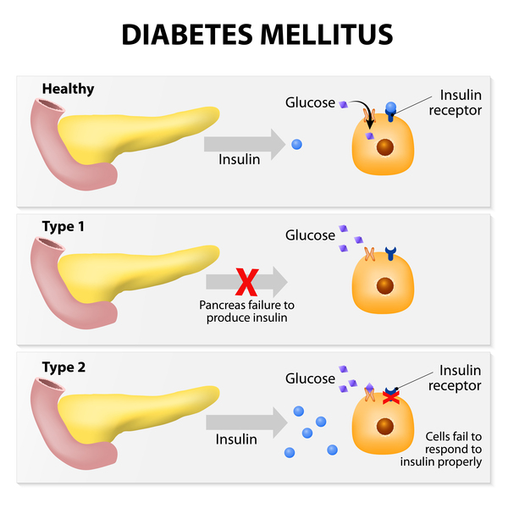

INTRODUCTION
1

Slide 3
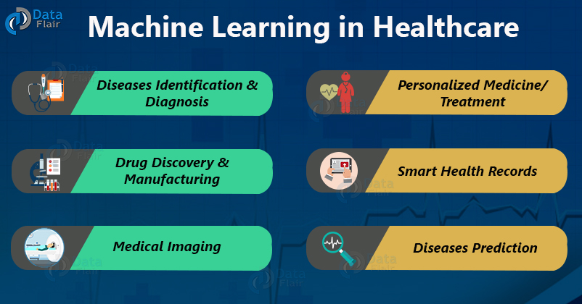
MOTIVATION
https://www.diva-portal.org/smash/get/diva2:8720/FULLTEXT01.pdf
2

Slide 4
DATASET
TYPE | ROWS | FEATURES
HEALTHY | 135 | 1456
T2 DIABET | 135 | 1456
PREPROCESSING
MERGING (0 Healthy /1 T2D)
SUFFLE
3

Slide 5
MODELS
METHOD | Accuracy(std) | F1 Score(std) | Recall(std) | Precision(std) | ROC_AUC(std)
Logistic Regression | 0.61 (+/- 0.06) | 0.56 (+/- 0.08) | 0.56 (+/- 0.11) | 0.58 (+/- 0.07) | 0.64 (+/- 0.11)
RF(T=2000 ,D=200) | 0.67 (+/- 0.08) | 0.61 (+/- 0.13) | 0.57 (+/- 0.18) | 0.68 (+/- 0.11) | 0.74 (+/- 0.08)
Naive Bayes | 0.63 (+/- 0.08) | 0.58 (+/- 0.10) | 0.56 (+/- 0.11) | 0.62 (+/- 0.10) | 0.64 (+/- 0.09)
MLP | 0.59 (+/- 0.08) | 0.55 (+/- 0.08) | 0.53 (+/- 0.09) | 0.57 (+/- 0.09) | 0.65 (+/- 0.05)
KNN(n=4) | 0.57 (+/- 0.06) | 0.36 (+/- 0.13) | 0.27 (+/- 0.12) | 0.57 (+/- 0.15) | 0.60 (+/- 0.08)
SVM | 0.66 (+/- 0.06) | 0.59 (+/- 0.11) | 0.55 (+/- 0.16) | 0.67 (+/- 0.07) | 0.73 (+/- 0.05)
LogiBoost | 0.63 (+/- 0.09) | 0.59 (+/- 0.14) | 0.60 (+/- 0.18) | 0.59 (+/- 0.10) | 0.67 (+/- 0.10)
Ebefors, Thorbjörn, et al. "A walking silicon micro-robot." Proc. Transducers’ 99. 1999.
4

Slide 6
LASSO- RIDGE- NET
METHOD | Accuracy(std) | F1 Score(std) | Recall(std) | Precision(std) | ROC_AUC(std)
Logistic R Lasso Ridge Net | 0.61 (+/- 0.06) L=0.66 (+/- 0.07) 0.62 (+/- 0.05) 0.66 (+/- 0.07) | 0.56 (+/- 0.08) 0.61 (+/- 0.11) 0.57 (+/- 0.08) 0.61 (+/- 0.11) | 0.56 (+/- 0.11) 0.59 (+/- 0.14) 0.56 (+/- 0.10) 0.59 (+/- 0.14) | 0.58 (+/- 0.07) 0.64 (+/- 0.08) 0.60 (+/- 0.06) 0.64 (+/- 0.08) | 0.64 (+/- 0.11) 0.72 (+/- 0.08) 0.64 (+/- 0.10) 0.72 (+/- 0.08)
RF Lasso Ridge Net | 0.67 (+/- 0.08) 0.66 (+/- 0.08) 0.66 (+/- 0.08) 0.66 (+/- 0.08) | 0.61 (+/- 0.13) 0.60 (+/- 0.12) 0.62 (+/- 0.12) 0.60 (+/- 0.12) | 0.57 (+/- 0.18) 0.55 (+/- 0.14) 0.62 (+/- 0.18) 0.55 (+/- 0.14) | 0.68 (+/- 0.11) 0.67 (+/- 0.11) 0.64 (+/- 0.09) 0.67 (+/- 0.11) | 0.74 (+/- 0.08) 0.68 (+/- 0.08) 0.74 (+/- 0.07) 0.68 (+/- 0.08)
SVM Lasso Ridge Net | 0.66 (+/- 0.06) 0.59 (+/- 0.08) 0.62 (+/- 0.07) 0.59 (+/- 0.07) | 0.59 (+/- 0.11) 0.25 (+/- 0.22) 0.53 (+/- 0.10) 0.26 (+/- 0.21) | 0.55 (+/- 0.16) 0.18 (+/- 0.17) 0.46 (+/- 0.11) 0.18 (+/- 0.17) | 0.67 (+/- 0.07) 0.51 (+/- 0.37) 0.64 (+/- 0.12) 0.56 (+/- 0.39) | 0.73 (+/- 0.05) 0.61 (+/- 0.10) 0.68 (+/- 0.08) 0.61 (+/- 0.10)
5

Slide 7
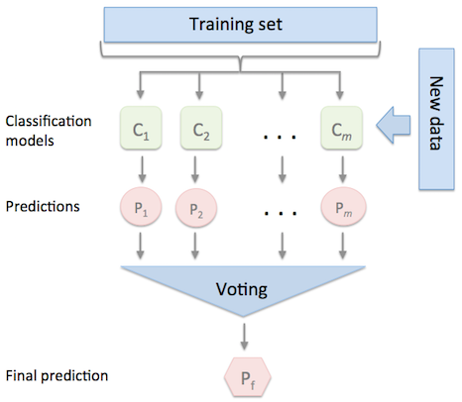
ENSEMBLE METHODS
classifier 1 -> ﻿LogisticRegression -> Weight =1
classifier 2 -> ﻿RandomForestClassifier -> Weight =1
classifier 3 -> Naive Bayes -> Weight =1
METHOD | Accuracy(std) | F1 Score(std) | Recall(std) | Precision(std) | ROC_AUC(std)
Ensemble | 0.69 (+/- 0.06) | 0.65 (+/- 0.08) | 0.62 (+/- 0.12) | 0.69 (+/- 0.08) | 0.71 (+/- 0.08)
6

Slide 8
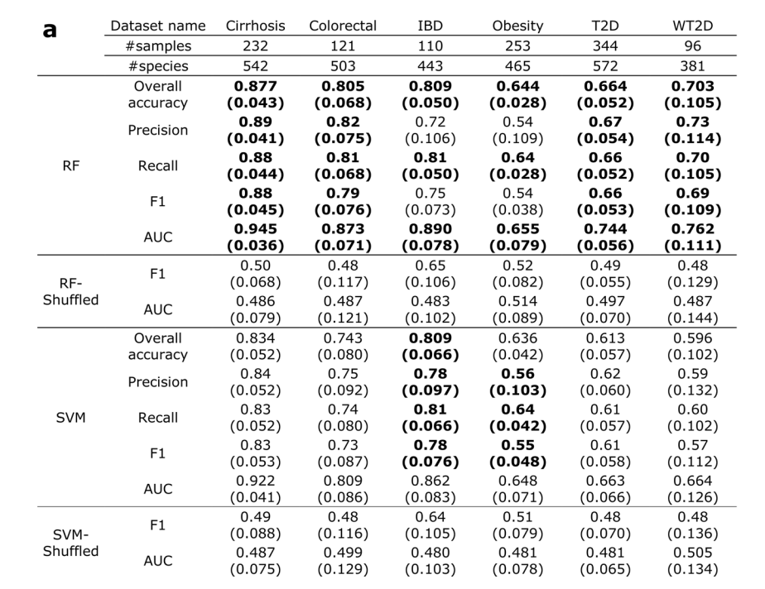
COMPARISON
METHOD | Accuracy(std) | F1 Score(std) | Recall(std) | Precision(std) | ROC_AUC(std)
Ensemble | 0.69 (+/- 0.06) | 0.65 (+/- 0.08) | 0.62 (+/- 0.12) | 0.69 (+/- 0.08) | 0.71 (+/- 0.08)
RF(T=2000 ,D=200) | 0.67 (+/- 0.08) | 0.61 (+/- 0.13) | 0.57 (+/- 0.18) | 0.68 (+/- 0.11) | 0.74 (+/- 0.08)
Pasolli E, Truong DT, Malik F, Waldron L, Segata N (2016) Machine Learning Meta-analysis of Large Metagenomic Datasets: Tools and Biological Insights. PLoS Comput Biol 12(7): e1004977. doi:10.1371/journal.pcbi.1004977.
7

Slide 9
DISCUSSION
Feature Enginering
Feature selection
Deep Learning Methods
7

Slide 10
TO FINISH
THANKS
FOR YOU ATTENTION

