Slide 1

Unity For Academia
C#, Unity Development, and VR Design
Spring 2025 – Week 1
Iman Noferesti

Slide 2
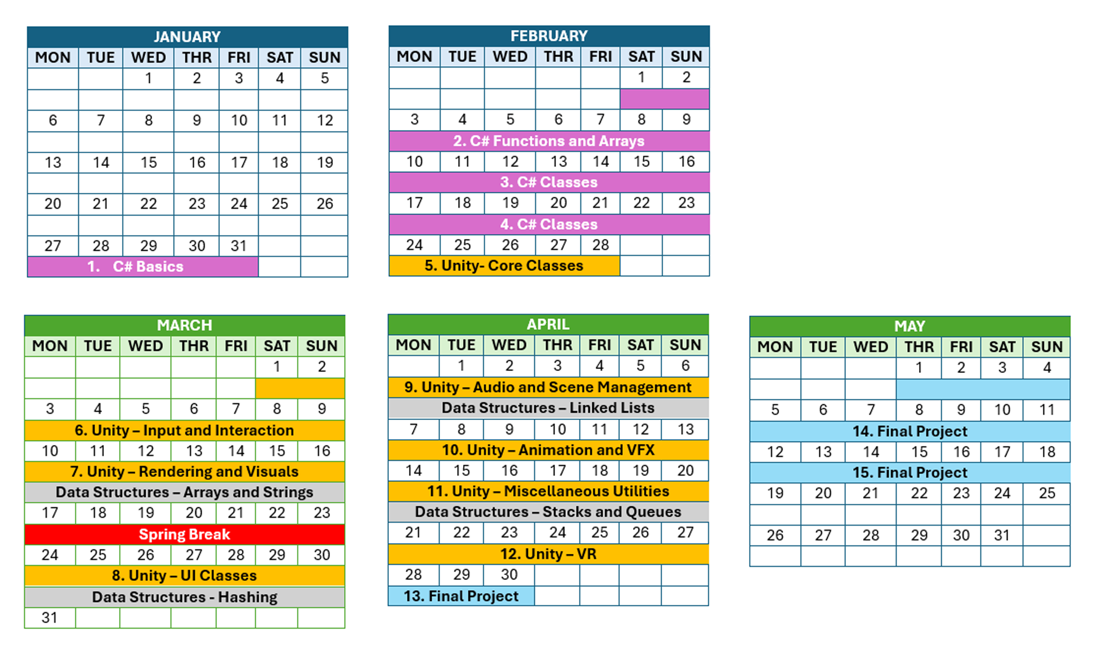
Course Plan

Slide 3
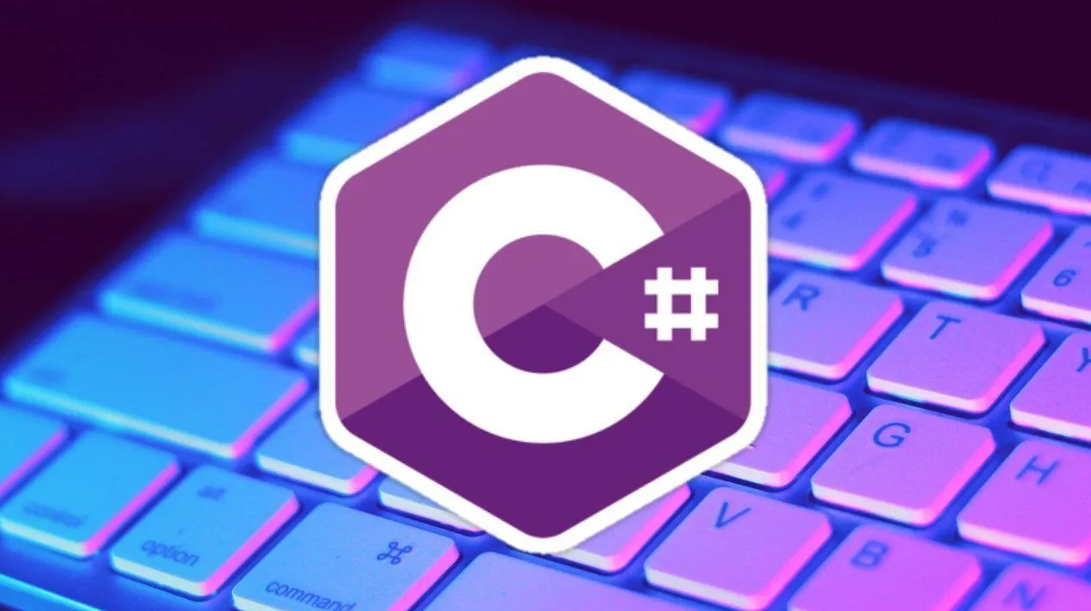
Introduction to C#
C# is a modern, object-oriented programming language developed by Microsoft in 2000 as part of the .NET framework. It is:
Versatile: Used for building desktop, web, mobile, and game applications.
User-Friendly: Designed with simplicity and developer productivity in mind.
Object-Oriented: Encourages modular and reusable code through classes and objects.
Cross-Platform: Supports development on Windows, macOS, and Linux with .NET Core.
Widely Used: Popular in industries like game development (with Unity), enterprise software, and web development.

Slide 4


Get Ready!
GitHub
GitHub is a platform for version control and collaboration. It helps you:
Track changes in your codebase.
Keep your code safe and organized.
Collaborate with others on projects.
JetBrains Rider
JetBrains Rider is a powerful, cross-platform integrated development environment (IDE) for .NET and C# development. It offers:
Advanced code completion, refactoring, and inspections.
Debugging, testing, version control, and database support.

Slide 5
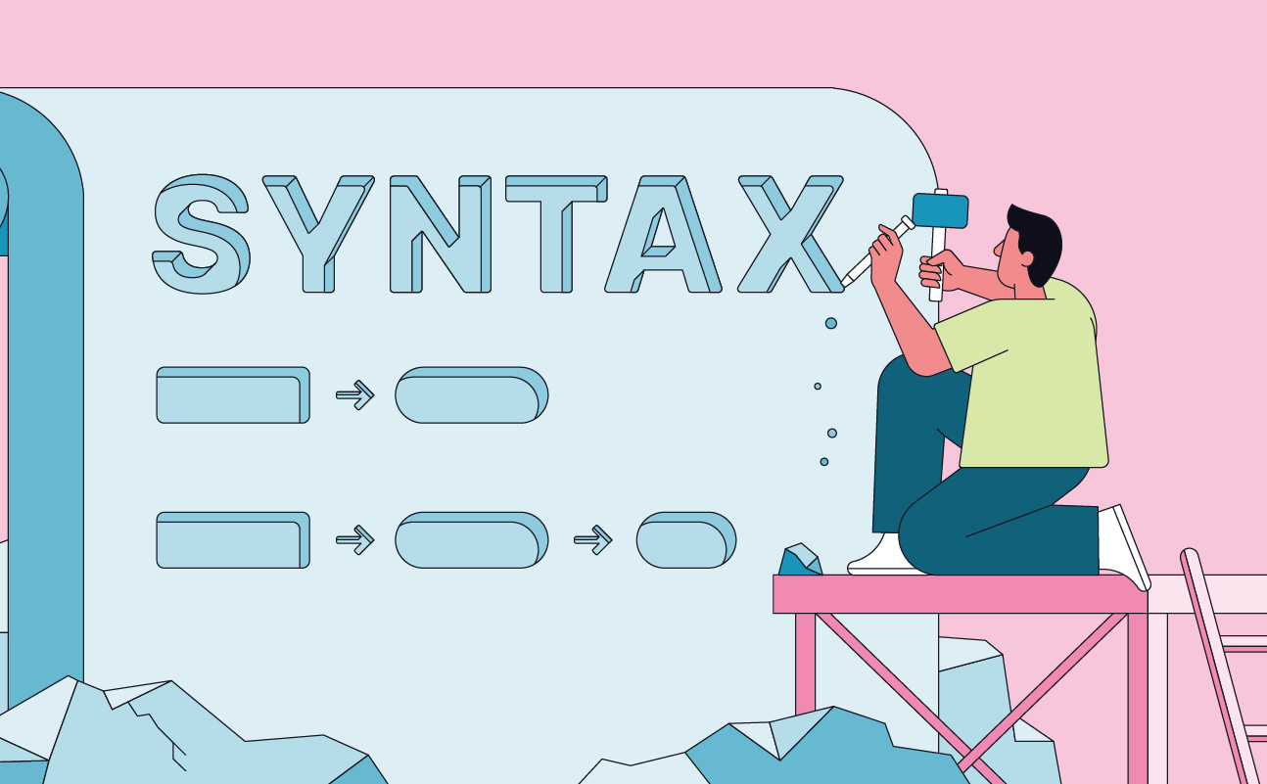

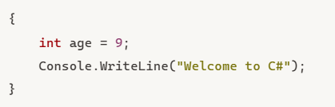
Syntax
Statements
A statement is a source code instruction that declares a type or instructs the program to do something.
Blocks
A block is a sequence of zero or more statements.
A block starts with an opening curly brace { and ends with a closing curly brace }.

Slide 6

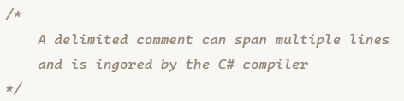
Identifiers
Identifiers are names that you choose for variables, functions, classes, methods, and so on.
The identifier names follow these rules:
The alphabetic (a-z, A-Z) and underscore (_) characters can appear at any position.
Digits cannot appear in the first position but everywhere else.
C# identifiers are case-sensitive.
Ex: counter and Counter identifiers are different.
Comments
You use comments to explain the code or document it.
Types of comments:
Single-line comments
Begins with a double forward-slash (//) and continues to the end of the line.
Delimited comments
A delimited comment starts with /* and ends with */.
A delimited comment can span any number of lines.

Slide 7


Variables
To store data during the execution of the program, you use variables.
By definition, variables are identifiers whose values can change during the program’s execution.
Declare variables
Before using a variable, you need to declare it using the following syntax:
The following example declares a variable age with type int.
By convention, variable names are in the camel case and start with a letter.
Ex: color, textColor
Type | Meaning | Examples
int | Integers (whole numbers) | 1,2,3
float | ~6–9 decimal digits | 1.1f
double | ~15–17 decimal digits | 2.5
string | Text strings | “Hi”
char | Characters | ‘a’, ‘b’, ‘c’
bool | Boolean values | true, false

Slide 8





After declaring a variable, you can assign a value to it using the assignment operator (=), like this:
Or you can do both steps using one statement:
The following increases the value of the age variable by one:
Display variables
To output the age variable to the console, you use the Console.WriteLine() method as follows:
Output=> 18
To embed the age variable in a string and display it, you use the following statement:
Output => The age is 18
Type | Meaning | Examples
int | Integers (whole numbers) | 1,2,3
float | ~6–9 decimal digits | 1.1f
double | ~15–17 decimal digits | 2.5
string | Text strings | “Hi”
char | Characters | ‘a’, ‘b’, ‘c’
bool | Boolean values | true, false
When the compiler sees a string with the $ prefix, it’ll replace all the variables in the curly braces with their corresponding values.

Slide 9




Declare multiple variables
To declare multiple variables, you use multiple statements:
If variables have the same type, you can declare them in one statement and use a comma (,) to separate two variables like this:
Min and max values
Each integer, float, or double type has the MinValue and MaxValue constants that provide the minimum and maximum of the type. To access these values, you use the dot operator (.)
If a number is big, you can use the digit separator (_) to make it more readable.
Type | Meaning | Examples
int | Integers (whole numbers) | 1,2,3
float | ~6–9 decimal digits | 1.1f
double | ~15–17 decimal digits | 2.5
string | Text strings | “Hi”
char | Characters | ‘a’, ‘b’, ‘c’
bool | Boolean values | true, false

Slide 10
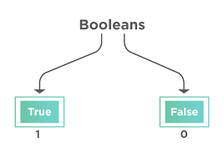



Booleans
C# use the bool keyword to represent the boolean type with two values: true and false.
When comparing two values using the comparison or equality operators, you’ll get a value of the bool type.
Output=> false
Output=> true

Slide 11
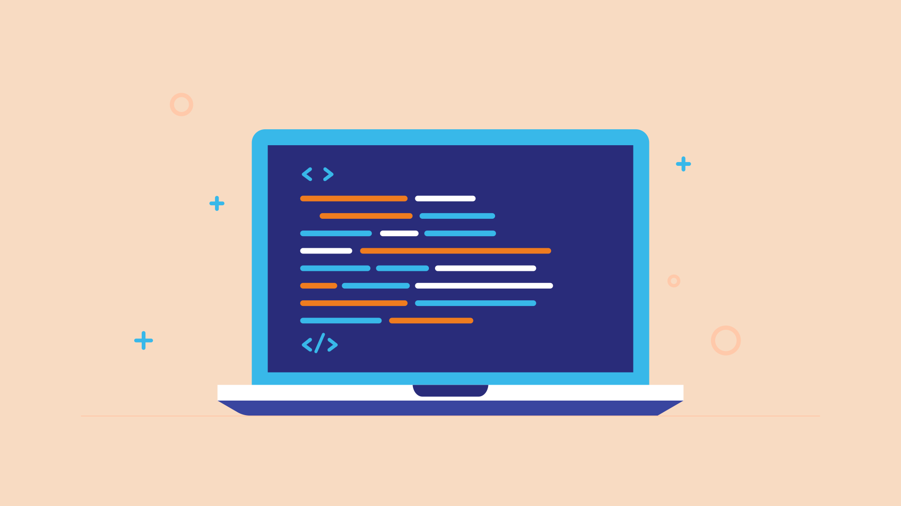





String
Declare a string
The following example declares a string variable and assign it a string literal.
The following example declares and initializes the string using one statement:
To create a zero-length string, you use the String.Empty like this:
It’s equivalent to the following:

Slide 12


Get the length of a string
A string has the Length property that returns the length of a string.
To access the Length property, you use the dot operator (.) like this:
Output=> 5
Concatenate two strings
To concatenate two strings into one, you use the
+ operator. For example:
Output=> Good Morning
Besides the + operator, you can use the string.Concat() method to concatenate two or more strings into a string.

Slide 13


Accessing individual characters
Internally, C# stores a string as a collection of read-only characters. To access an individual character in a string, you use the square bracket notation [] with an index:
The first character has an index of 0. The second character has an index of 1, and so on. For example:
Escape sequences
Special characters preceded by a backslash (\) that represent characters not typically printable or used for special purposes.
Verbatim string
If a string contains backslashes, you can escape them using backslashes. But double backslashes make the string difficult to read
To fix this, you can turn a literal string into a verbatim string by prefixing the @ symbol. The verbatim string disables escape characters so that a backslash is a backslash.
Escape Sequence | Description
\’ | Single quote (')
\” | Double quote (")
\\ | Backslash
\0 | Null character
\b | Backspace
\n | Newline
\t | Horizontal tab
\v | Vertical tab

Slide 14

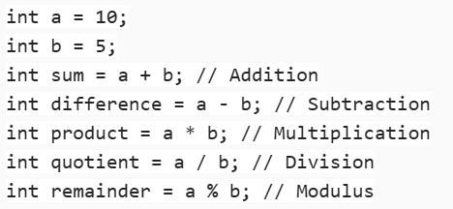
Operators
C# operators are symbols that specify the type of operation to be performed on operands.
Arithmetic Operators: Used for basic mathematical operations.
+ (Addition)
- (Subtraction)
* (Multiplication)
/ (Division)
% (Modulus)

Slide 15
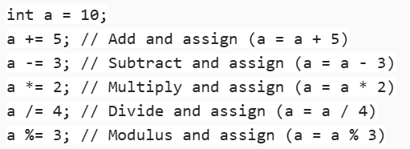
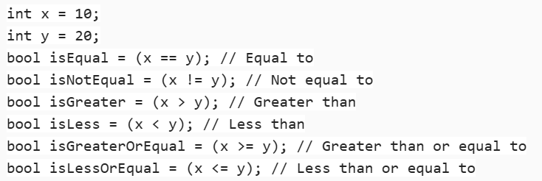
Assignment Operators: Used to assign values to variables.
= (Assignment)
+= (Add and assign)
-= (Subtract and assign)
*= (Multiply and assign)
/= (Divide and assign)
%= (Modulus and assign)
Comparison Operators: Used to compare two values.
== (Equal to)
!= (Not equal to)
> (Greater than)
< (Less than)
>= (Greater than or equal to)
<= (Less than or equal to)

Slide 16

Logical Operators
Logical operations are used to perform Boolean logic on operands, resulting in a Boolean value (true or false).
These operations are commonly used in conditional statements, loops, and decision-making processes.
Logical AND (&&)
Returns true if both operands are true; otherwise, it returns false.
Logical OR (||)
Returns true if at least one of the operands is true. Otherwise, it returns false.

Slide 17
Logical NOT (!)
Returns true if the operand is false, and false if the operand is true.
Logical XOR (^)
Returns true if exactly one of the operands is true. Otherwise, it returns false.

Slide 18
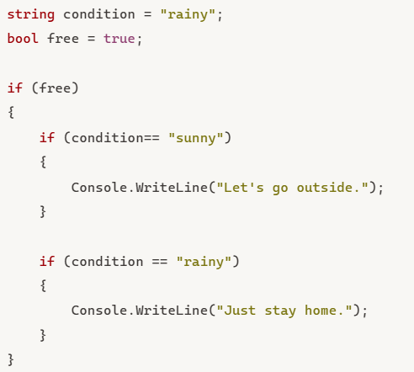
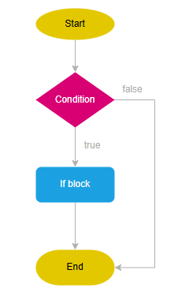
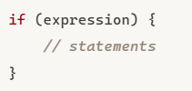
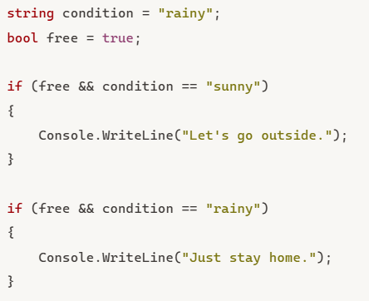
Control Flow
If Statement
The if statement evaluates a condition and executes one or more statements if the result is true.
Otherwise, the if statement passes the control to the statement after it.
Nested If Statement
You can nest if statements inside an if statement.
In practice, you should avoid the nesting of the if statements as much as possible. Otherwise, the code will become difficult to read.

Slide 19
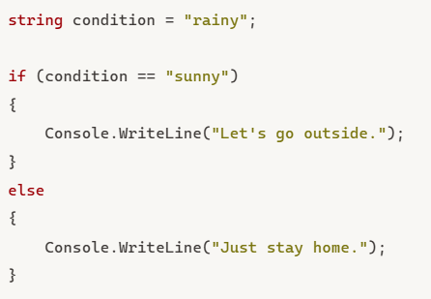
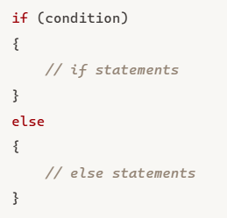
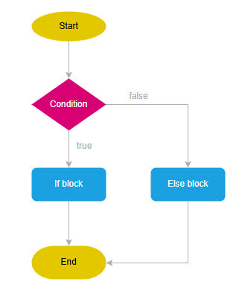
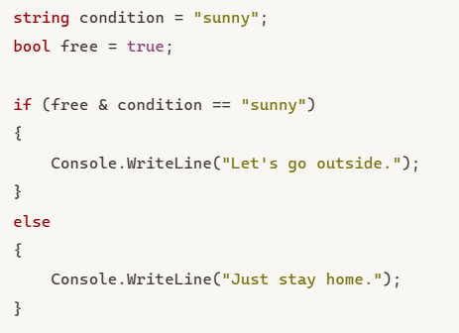
If-Else Statement
In practice, you often want to execute a block when a condition is true and execute another block otherwise.

Slide 20
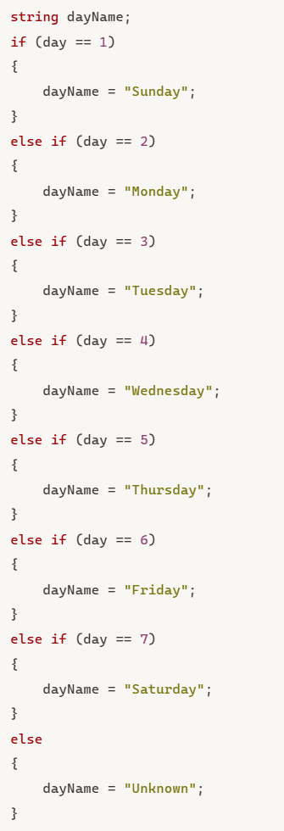
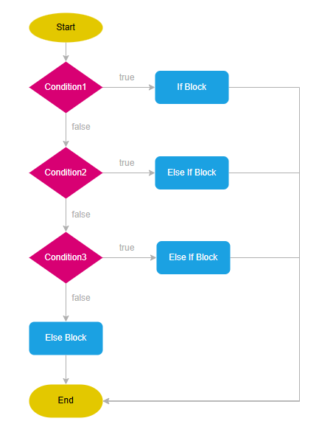
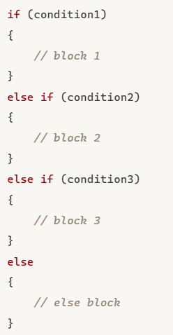
If-Else If Statement
The if statement checks one condition and executes a block if the condition is true.
The if else statement checks one condition and executes a block if the condition is true or another block otherwise.
Sometimes, you may want to check multiple conditions and execute a block if a condition is true. To do that, you can use the if else if statement.

Slide 21
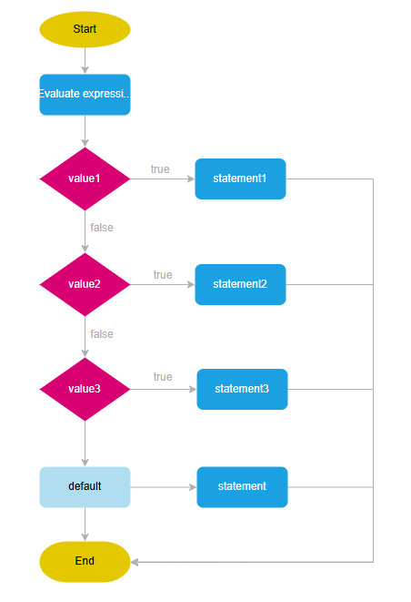
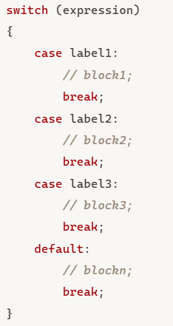
Switch Statement
The switch statement evaluates an expression and selects a block for execution if the expression satisfies a condition.
The default clause is optional. If you don’t specify it and the expression doesn’t match any label, the switch statement doesn’t execute any blocks and passes the control to the statement after it.

Slide 22
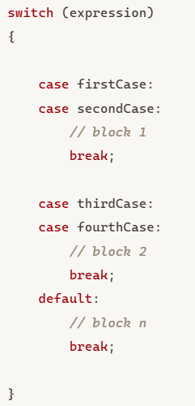
Switch Statement
If you have the same block that corresponds to multiple cases, you can group cases in the switch statement.
You can use the relational operator >, <, >=, <= along with logical operators and, or to match the result of the expression with constants in the switch statement.

Slide 23
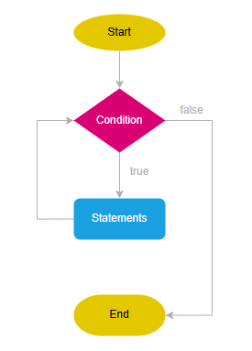
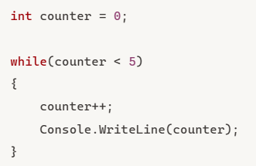
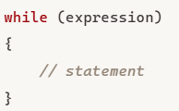
Loops
While Statement
The while statement evaluates a boolean expression and executes a block repeatedly as long as the expression is true.
If the expression is false, the while statement exits and passes the control to the statement after it.
Therefore, you need to change some variable inside the block to make the expression false at some point. Otherwise, you’ll have an infinite loop.
Since the expression is checked at the beginning of each iteration, the while statement is often called a pretest loop.

Slide 24
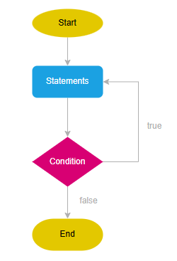
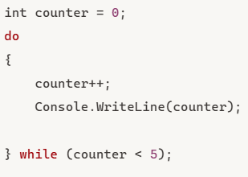
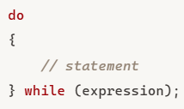
Do While Statement
The do while statement executes one or more iterations as long as a condition is true.
Unlike the while statement, do while statement checks the expression at the end of each iteration. Therefore, it’s called a posttest loop.
The do while statement will always run the first iteration regardless of the expression’s result. And it’ll execute the block repeatedly as long as the expression is true.
Inside the loop, you need to change some variables to make the expression false so that the loop will terminate after some iterations. Otherwise, you’ll have an indefinite loop.

Slide 25
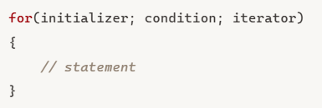
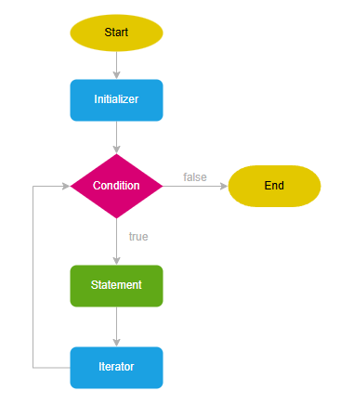
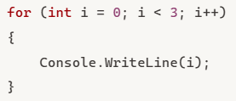
For loop Statement
for statement executes a block while a condition is true.
Initializer
The for statement executes the initializer only once before entering the loop.
Typically, you declare and initialize a local loop variable in the initializer.
Condition
The condition is a boolean expression that determines whether the for statement should execute the next iteration.
The for statement evaluates the condition before each iteration. If the condition is true (or is not present) the for statement executes the next iteration. Otherwise, it’ll exit the loop.
Iterator
The for statement executes the iterator after each iteration.

