Slide 1
Tips to be Covered
Outlines
Slide Structure
Fonts
Colour
Background
Graphs
Spelling and Grammar
Conclusions
Questions

Slide 2
Colour - Bad
Using a font colour that does not contrast with the background colour is hard to read
Using colour for decoration is distracting and annoying.
Using a different colour for each point is unnecessary
  Using a different colour for secondary points is also unnecessary
Trying to be creative can also be bad

Slide 3

Background – Bad
Avoid backgrounds that are distracting or difficult to read from
Always be consistent with the background that you use

Slide 4
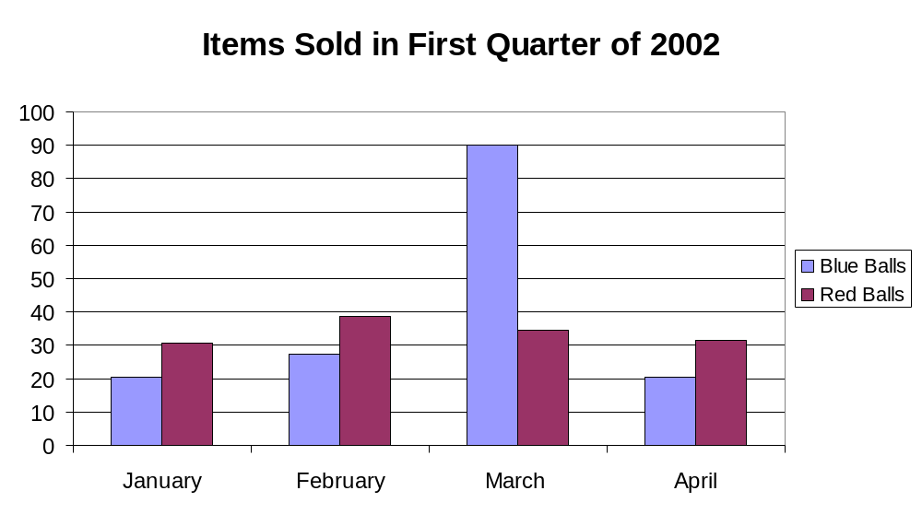
Graphs - Good

