Slide 1
MYSQL Project
V kadhir anand

Slide 2
SQL
SQL is a standard language for storing, manipulating and retrieving data in databases.
Our SQL tutorial will teach you how to use SQL in: MySQL, SQL Server, MS Access, Oracle, Sybase, Informix, Postgres, and other database systems.

Slide 3
MYSQL
SQL is a standard language for storing, manipulating and retrieving data in databases.
Our SQL tutorial will teach you how to use SQL in: MySQL, SQL Server, MS Access, Oracle, Sybase, Informix, Postgres, and other database systems.

Slide 4

MySql Workbench
MYSQL Workbench is the Official Graphical User Interface(GUI) Tool for MySQL.
It allows you to design, create and browse your database schemas, work with database objects and insert data as well as design and run SQL queries to work with stored data.
You can also migrate schemas and data from other database vendors to your MySQLdatabase

Slide 5

MYSQL servers
MySQLServer Workbench
. Oracle.
Microsoft Server.
MangoDB.
Navigation.
No SQL.

Slide 6
Datatypes of MYSQL
DBMS keys
Numeric Datatype.
String Datatype.
DateTime Datatype.
Large Object-(For file and Picture Saving)
Super Key
Candidate Key
Primary Key
Alternate Key or Secondary Key
Foreign Key

Slide 7
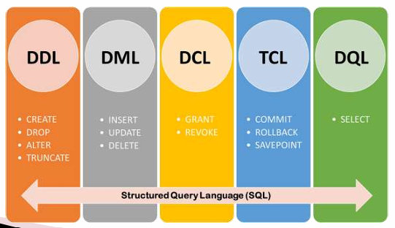
MYSQL General Commands
DDL-DATA DEFINITION LANGUAGE
DML-DATA MANIPULATION LANGUAGE
DQL-DATA QUERY LANGUAGE
TCL-TRANSACTION CONTROL LANGUAGE
DCL-DATA CONTROL LANGUAGE

Slide 8
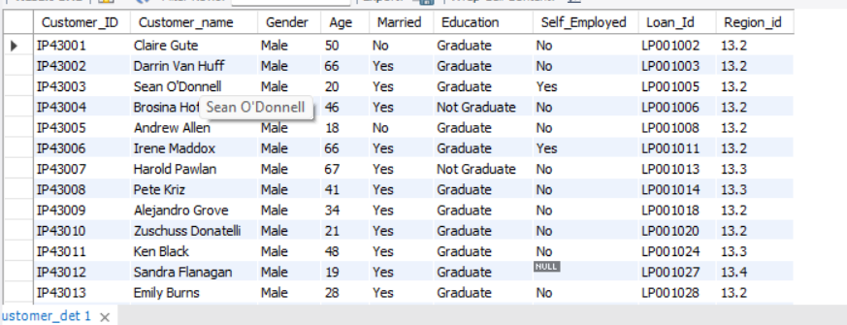
Table creation 1
Create table for to store customer data.
CREATE TABLE customer_det ( Loan_ID VARCHAR(155), Customer_id VARCHAR(155), Loan_Amount VARCHAR(200), PRIMARY KEY (loan_id), Loan_Amount_Term INT, Cibil_Score INT);
Example:

Slide 9
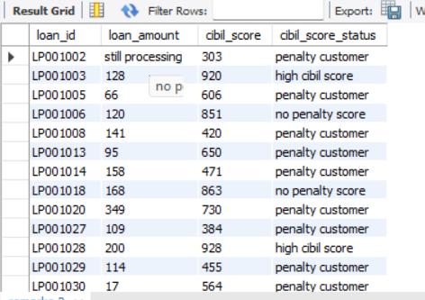
Table creation 2
Create another table to store the customer cibil score data
CREATE TABLE remarks ( loan_id VARCHAR(200), loan_amount VARCHAR(200), cibil_score INT, cibil_score_status VARCHAR(200));
Example:

Slide 10
Trigger creation 1
Create a trigger to update the table 2 whenever the values are inserted into the table.
delimiter //create trigger trigger1 after insert on customer_detfor each rowbegin if new.cibil_score is not null thenif new.cibil_Score > 900then insert into remarks(loan_id,loan_amount,cibil_score,cibil_score_status) values(new.loan_id,new.loan_amount,new.cibil_score,'high cibil score');elseif new.cibil_Score > 750……………
Trigger creation 2
Create a another trigger to update the table 1 whenever the values are inserted into the table.
delimiter // create trigger trigger2 before insert on customer_det for each rowbegin if isnull(new.loan_Amount) then set new.loan_Amount= 'still processing';end if;end //delimiter ;

Slide 11
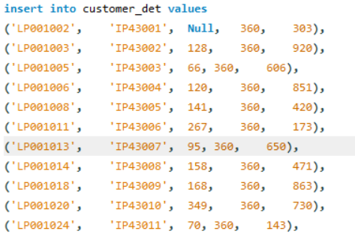
Trigger creation 1
Inserting the values into table 1
Using the insert into query…
Example

Slide 12
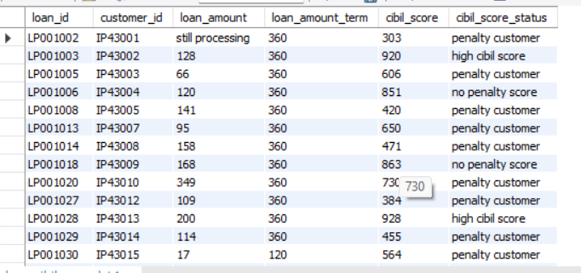
Joining the two tables
Join the table 1 and table 2 using the join query.
SELECT customer_det.loan_id, customer_det.customer_id, customer_det.loan_amount, customer_det.loan_amount_term, customer_det.cibil_score, remarks.cibil_score_statusFROM customer_det INNER JOIN remarks ON customer_det.loan_id = remarks.loan_id;
Example
And then create the joined table as a sql table.
…Using create table table_name as..

Slide 13
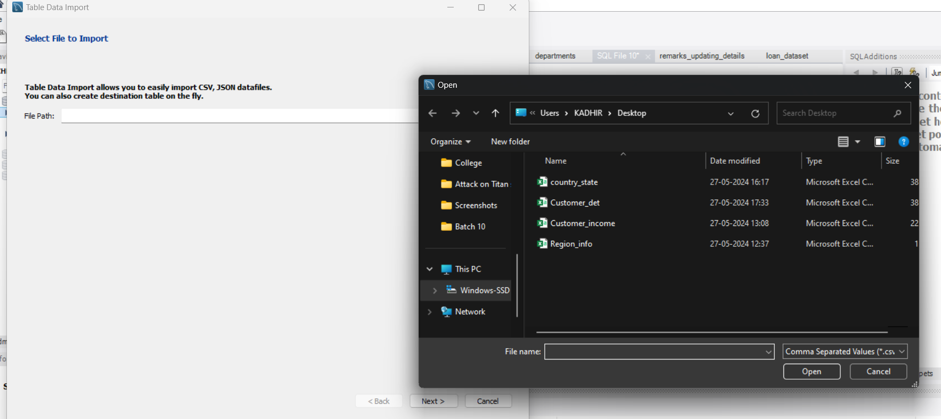
Importing the tables
Import four tables from a excel file.
Example

Slide 14
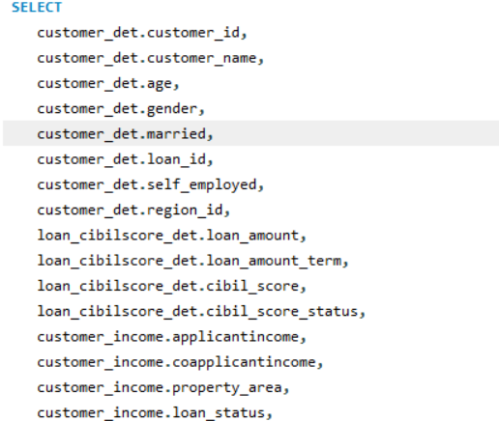
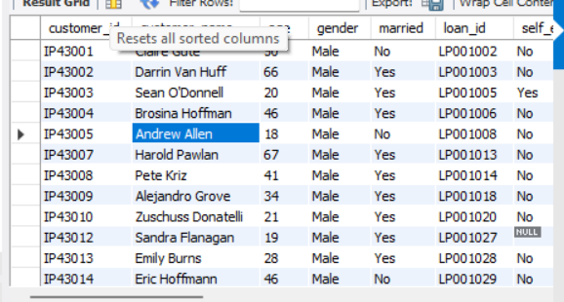
Joining all the tables
Join all five tables into a single table.
Example

Slide 15
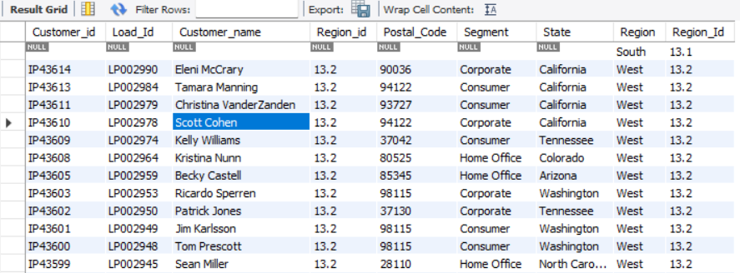
Selecting the null values from two table using joins
Using right join to get the missing region from region_info and country_state table.
Example

Slide 16
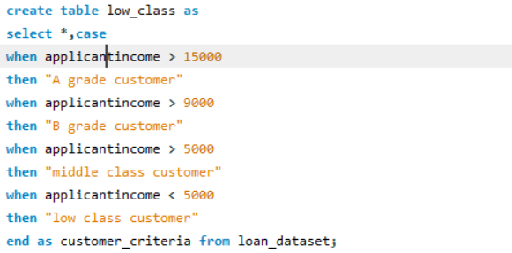
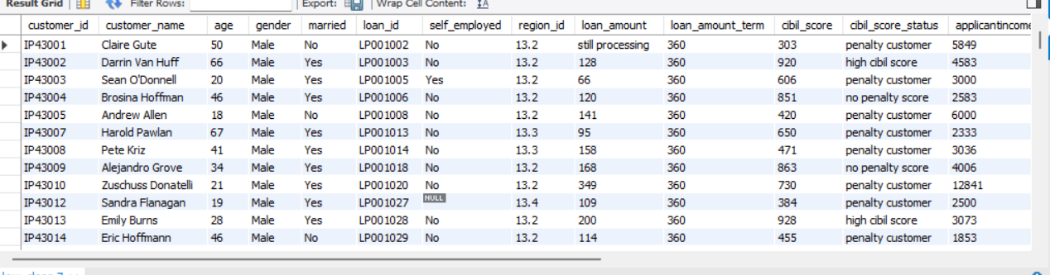
Select statement to apply grades
Applying grades based on customer’s income and then create the select statement as an table
Example

Slide 17
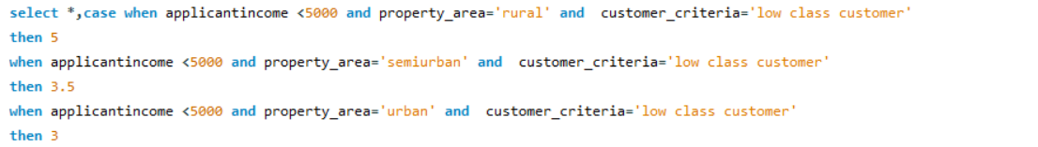
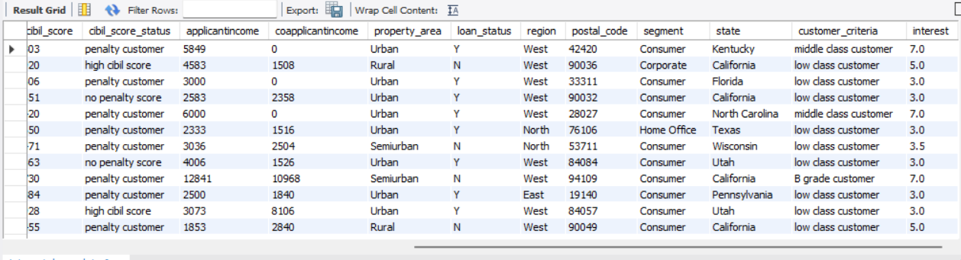
Interest rate to customer using case
Example

Slide 18
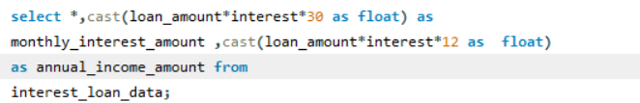
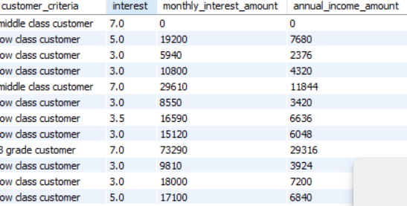
Retrieving the monthly interest and annual interest and creating that input into an table
Annual interest amount and monthly interest amount
Example

Slide 19
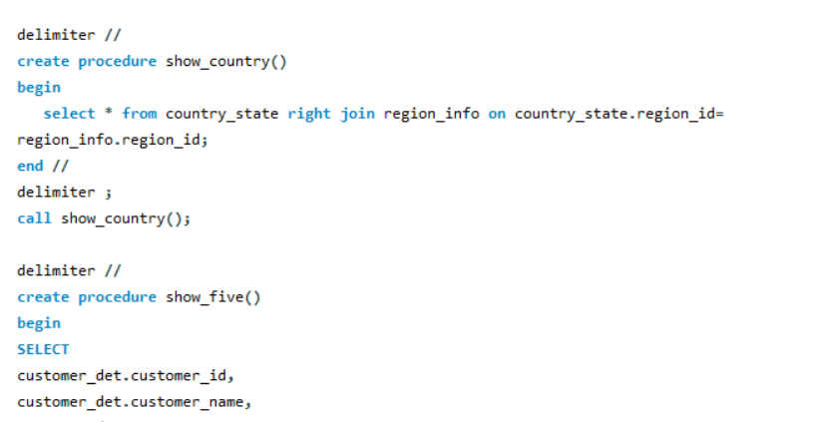
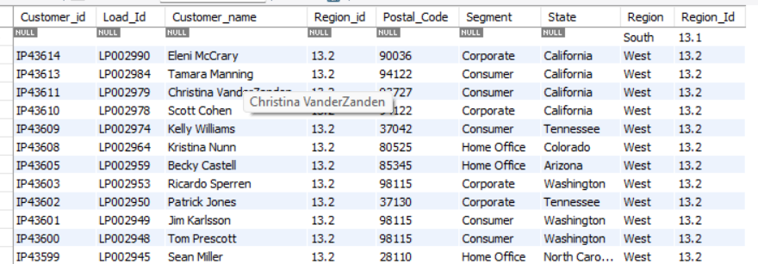
Create procedure for the joins
Example

Slide 20
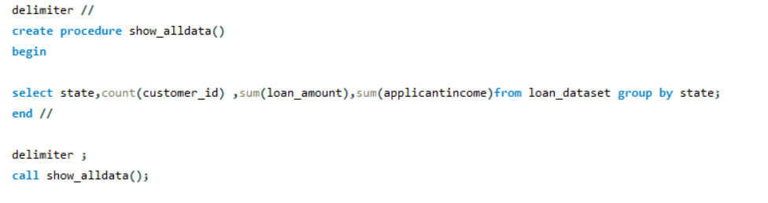
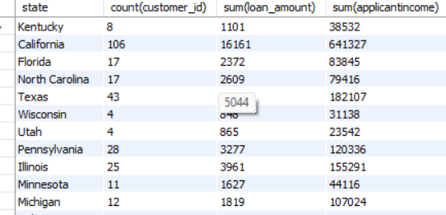
Another procedure creation
Procedures are used to store your sql query and we can call it using the procedure name
Example

Slide 21
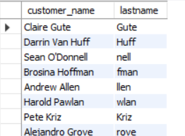
Like and right statement
Retrieving the customer name’s last name
Example

Slide 22

Delete statement
Deleting the customer’s who have the cibil score less than 200

Slide 23
THANK YOU

