Slide 1
Claude Architect Foundations
A 4-hour O'Reilly Live Training
Tim Warner | techtrainertim.com
Notes:
Cold open. This is a skills-first production-architecture course. Mention CCA-F (Anthropic's certification) but do NOT teach to exam items. Set expectations: heavy on live demos, light on slides. The notebooks ARE the course; slides are the scaffolding.

Slide 2
Tim Warner
Microsoft MVP (Azure AI)
Pluralsight Principal Author - 200+ courses, 1M+ learners
O'Reilly Live Training instructor
Microsoft Press / Pearson senior content developer
28+ years on the Microsoft stack
techtrainertim.com | github.com/timothywarner-org
Notes:
30-second bio. I teach from first principles. No glazing, no fluff. If they want production patterns and live demos, they're in the right room. Skip the resume part if pacing is tight; the website is the call-to-action.

Slide 3
Course flow - 4 segments x 50 min
Segment 1 - Building AI Agents That Use Tools
Segment 2 - Tool Design, Integration, and Claude Code Workflows
Segment 3 - Structured Output, Context, and Production Reliability
Segment 4 - CCA-F Certification Capstone
Plus self-study: Segment 2.5 - Control Surfaces and the Console Asset Surface
10-minute breaks between segments. Total 4 hours.
Notes:
Tell them where the slides and code live: github.com/timothywarner-org/claude-architect. Call out Segment 2.5 as the self-study deep dive - not on the 4-hour clock, but the highest exam-objective density in the repo. Cert briefing is the capstone (Segment 4), not the lead. We earn the cert talk after the skills.

Slide 4
"The model is non-deterministic. Your architecture cannot be."
Notes:
Frame the whole course in one sentence. Hooks are deterministic. Schemas are deterministic. Application-layer intercepts are deterministic. The model isn't, and that's fine - it's the right tool for ambiguous decisions. Production patterns build a deterministic shell around a non-deterministic kernel. Every demo in this course is an instance of that pattern.

Slide 5
Segment 1: Building AI Agents That Use Tools
Notes:
Domain 1 - Agentic Architecture and Orchestration. 50 minutes. 27% of the CCA-F blueprint, the single heaviest domain. Live build: customer support agent + PreToolUse hook + coordinator-subagent demo.

Slide 6
What you'll build
A customer support agent with 4 tools (lookup + refund + escalate)
Hook-enforced policy - the $500 refund cap can't be talked around
Structured escalation to human review with a typed summary
Coordinator + subagent isolation demo
By the end of the segment: you can sketch any agent topology
Notes:
This is the live build. Set expectations: we WILL hit edge cases - that's the point. The model is going to TRY to refund more than the cap. The hook is going to say no. The aha moment is watching the model re-plan and escalate correctly.

Slide 7
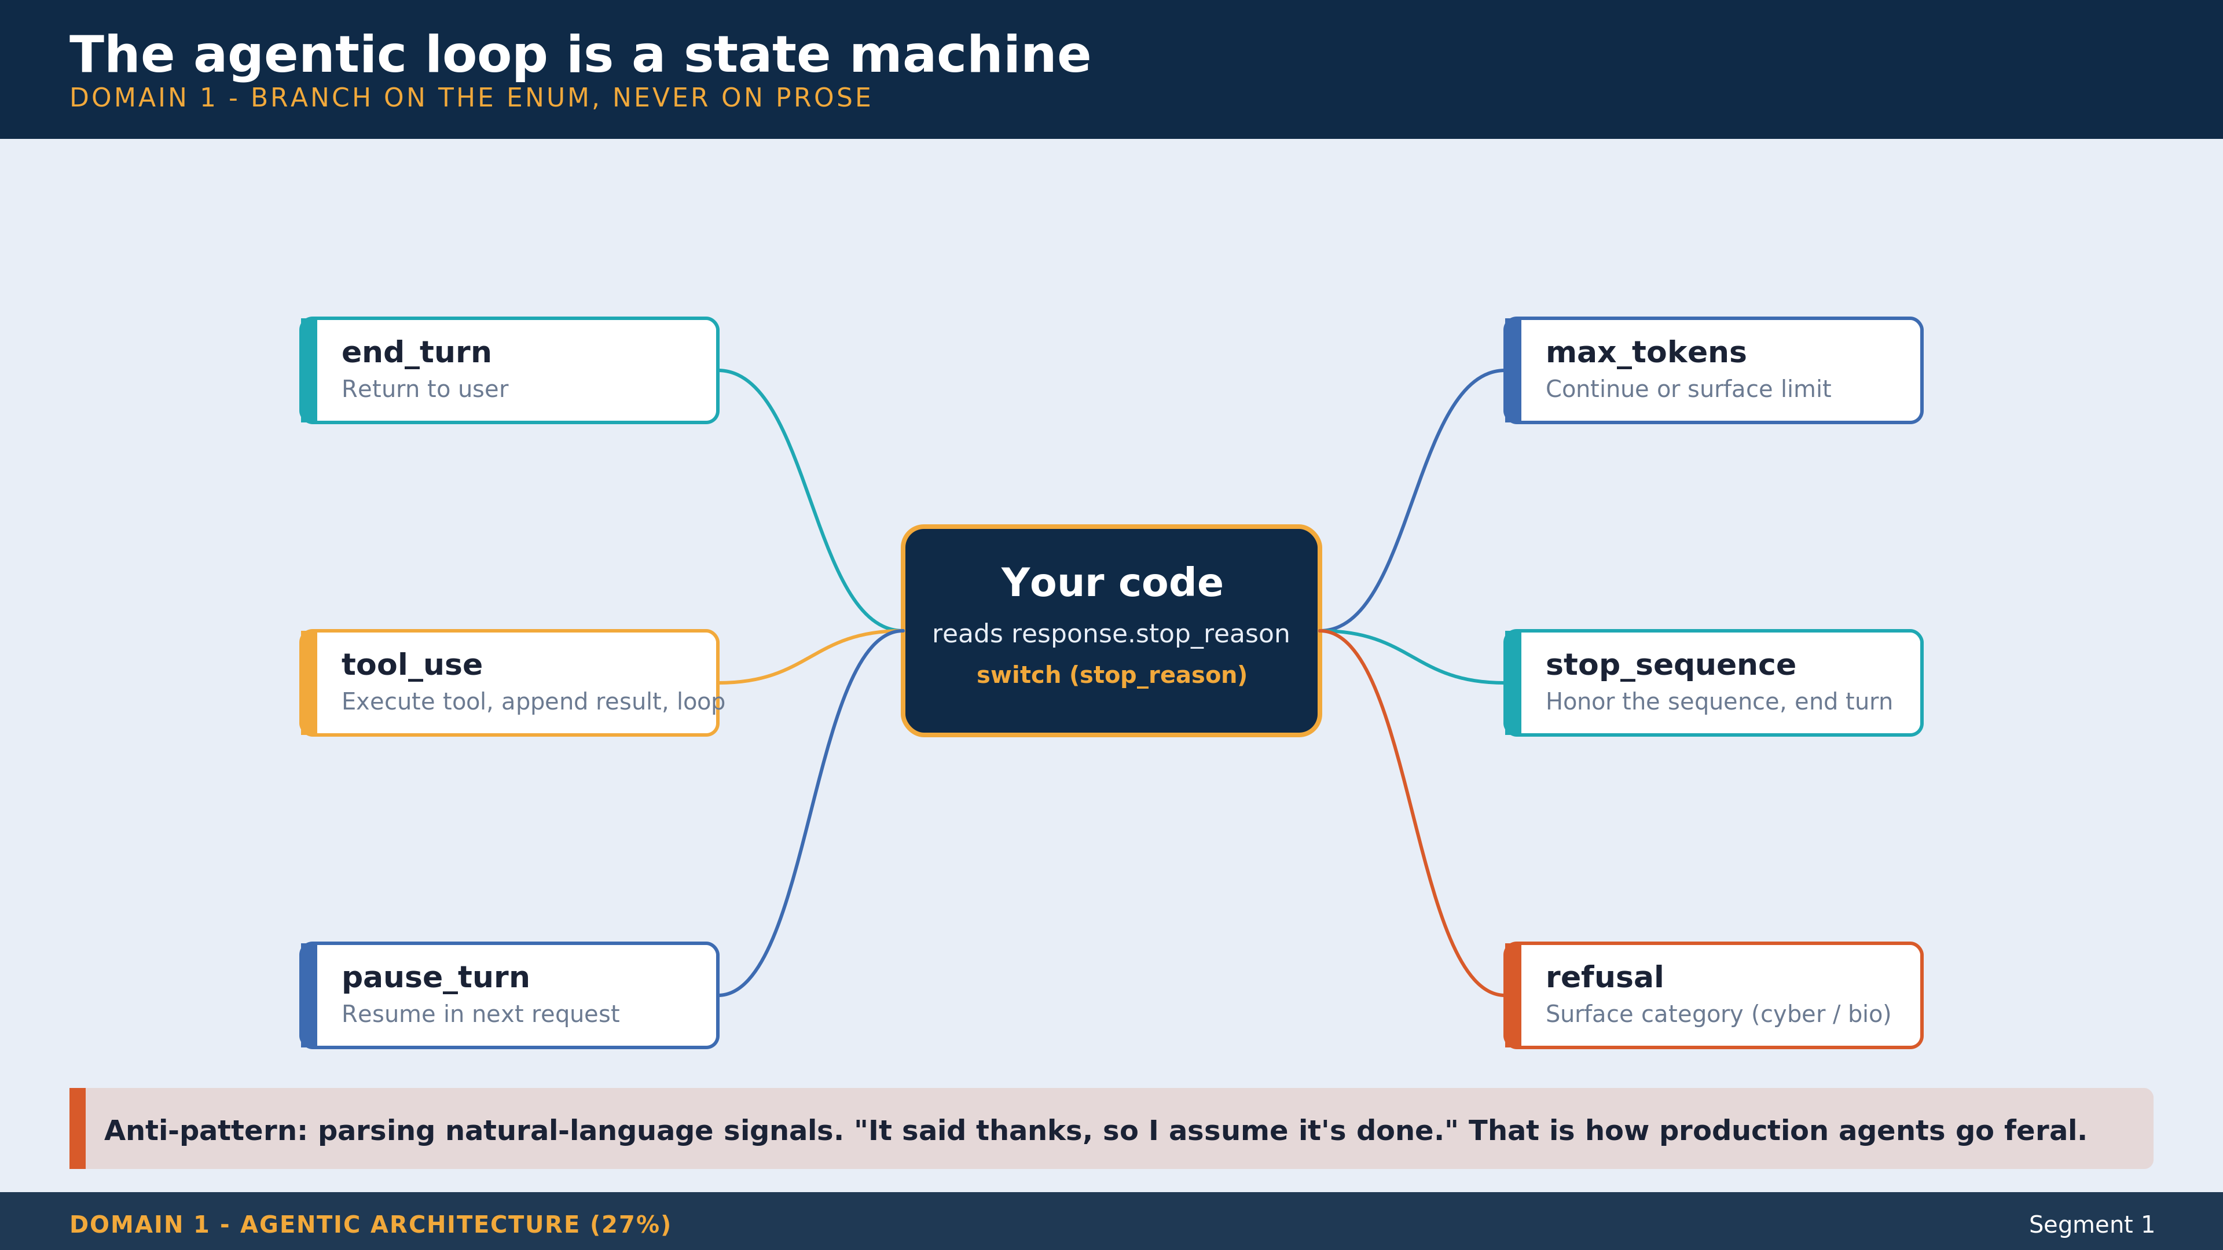
Notes:
FRAMER: this is the slide they screenshot. Walk it twice. First pass: point at the center node ('Your code reads response.stop_reason'), then trace each of the six branches outward. Spend ~5 seconds per branch. Second pass: ask the room which branch they have NEVER handled in production. Most people have never handled 'refusal' or 'pause_turn'. Use that to set up the next slide. Production tip: refusal carries a 'category' field (cyber, bio) when the model flags a policy stop. Surface that category to the human queue verbatim. Do not paraphrase, do not retry, do not 'work around.' The orange anti-pattern band at the bottom is the punchline: branch on the enum, never on prose. Cookbook anchor for further study: claude-cookbooks-main/tool_use/customer_service_agent.ipynb.

Slide 8
The agentic loop
1. Send request - model returns content + stop_reason
2. Read stop_reason - branch on the value, never on prose
3. tool_use? Execute tool, append tool_result, loop
4. end_turn? Return to user, done
5. pause_turn? Resume in the next request, no state change
Six stop_reason values: end_turn, max_tokens, stop_sequence, tool_use, pause_turn, refusal
Notes:
The hard rule: never parse natural language to detect completion. Always branch on the API field. Demo segment-1 prints [iter N] stop_reason= on every iteration so learners see the state transitions live. Refusal is rare; pause_turn shows up with long-running server tools like web_search.

Slide 9
Coordinator + subagents
ONE coordinator holds the user-facing thread
Subagents get ISOLATED contexts via the Task tool
Subagent returns its FINAL answer to the parent, not its working notes
Split when: own success criteria, own tool subset, own context discipline
Don't split for splitting's sake - two coordinators chatting is one slow agent
Notes:
Isolation is the feature. The parent doesn't drown in subagent reasoning, the parent sees a clean return value. Reference cookbook: claude-cookbooks-main/claude_agent_sdk/01_The_chief_of_staff_agent.ipynb. Segment 1 demo notebook contains a stripped-down coordinator-subagent at the end.

Slide 10
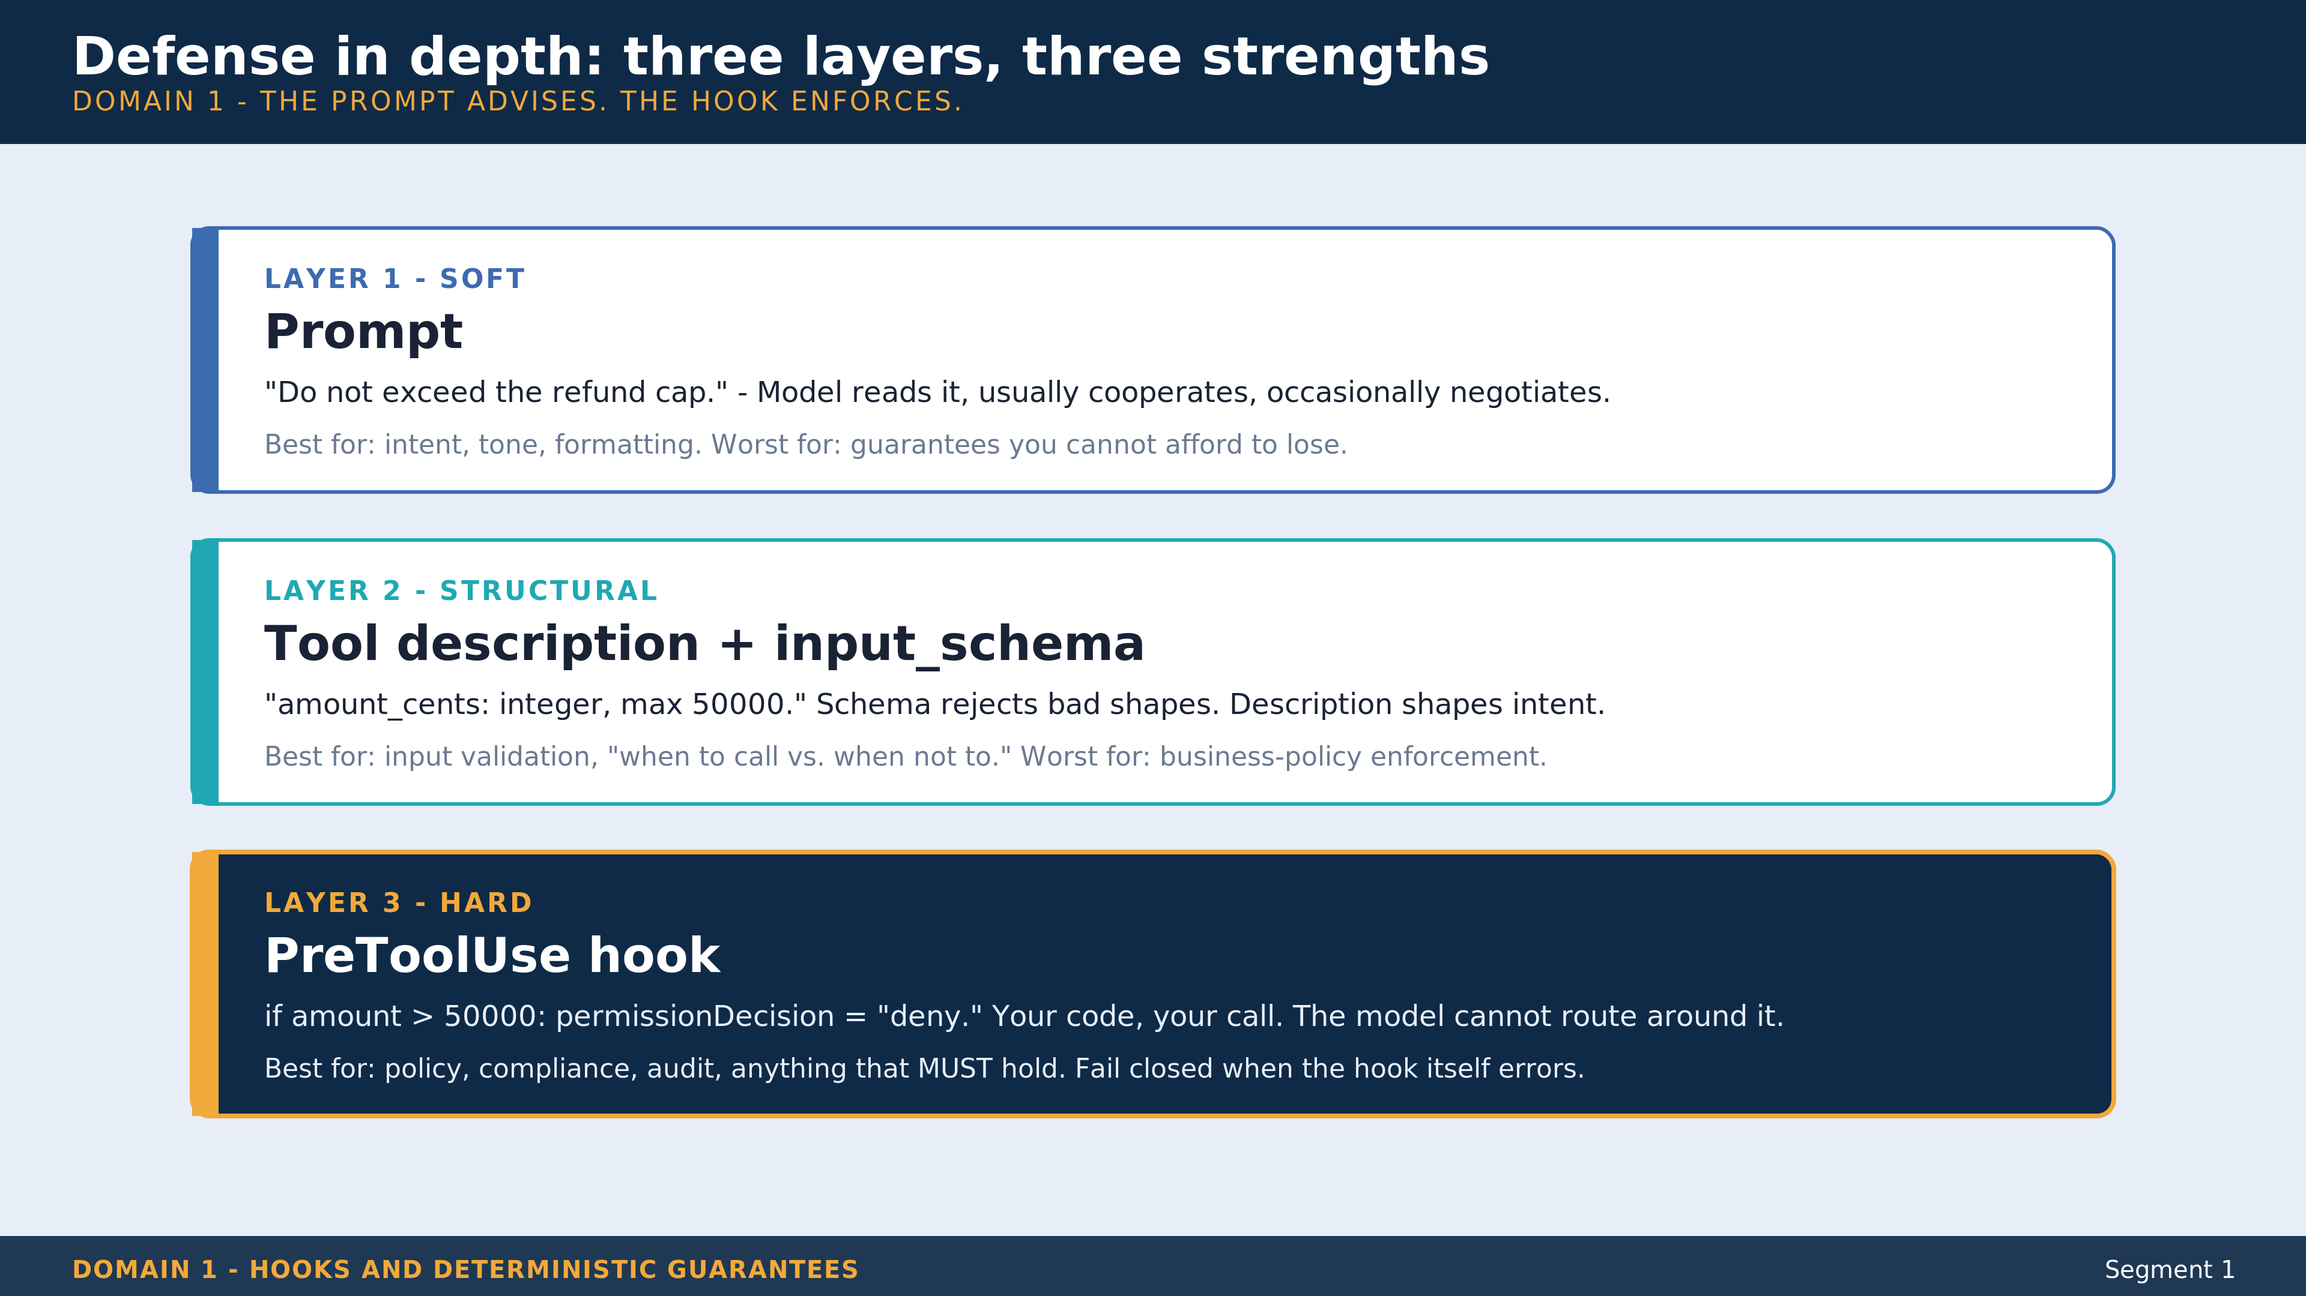
Notes:
FRAMER: this slide answers 'why hooks at all.' The prompt is soft. The schema is structural. The hook is hard. Each layer catches a different class of failure. Walk it top to bottom. Spend extra time on Layer 3 - this is the one that matters when production money is on the line. The orange stripe and dark navy background telegraph 'this is the answer.' Production tip: if the hook itself errors, FAIL CLOSED. Default to deny, log loudly, alert. A silent hook failure is how policy quietly evaporates. Optional callout for the cohort: in the SDK, you can register multiple PreToolUse hooks; the most restrictive decision wins. authorization_check + input_validator + audit_logger run in parallel.

Slide 11
Hooks - deterministic guarantees
PreToolUse - gate a call BEFORE it runs (the bouncer)
PostToolUse - audit, transform, log AFTER (the auditor)
SessionStart - inject context (the briefing room)
Stop - final verification before returning to user
Hooks run as YOUR code, not the model's. Anything that MUST happen, hook it.
Notes:
The prompt advises; the hook enforces. The $500 refund cap is the canonical example: prompt says 'don't exceed cap', tool description says 'cap is 500', and the hook PHYSICALLY blocks anything over. When all three layers agree, the hook never fires - but it's there for when they disagree.

Slide 12
Demo - customer support agent (15 min)
Open notebooks/segment-1-customer-support-agent.ipynb
Wire 4 tools, run Scenario A ($80 refund, in-cap, agent cooperates)
Add the PreToolUse hook from hooks-example.py
Run Scenario B ($750 refund, over-cap, hook blocks, agent escalates)
Coordinator-subagent demo at the bottom of the notebook
Notes:
Live demo, 15 minutes. The aha moment is when the hook fires and the model re-plans to call escalate_to_human with ticket ESC-9001. Have a backup screenshot ready in case the API hiccups. Cookbook reference for further study: claude-cookbooks-main/tool_use/customer_service_agent.ipynb.

Slide 13
Exercise (5 min)
Sketch architecture for a Developer Productivity scenario
On paper or in chat: coordinator + 3 subagents + tool scope per agent
What does each subagent specialize in?
What is each subagent's success criterion?
What tools does each one get? Cap each at ~5.
Notes:
Walk the chat for 90 seconds, then share 2-3 designs out loud. Reinforce: tool descriptions beat tool names, isolation beats shared context, ~5 tools per agent is the floor before selection accuracy degrades.

Slide 14
Segment 1 takeaways
Branch on stop_reason, never on natural-language signals
Coordinator + isolated subagents beats one giant context
Hooks turn 'should' into 'must' - the prompt advises, the hook enforces
Notes:
Bridge: 'You just built an agent that decides what to do. Next we go one level deeper - into the tools themselves and the Claude Code surface where you author them on a real team.'

Slide 15
Segment 2: Tool Design, Integration, Claude Code
Notes:
Domains 2 + 3. 50 minutes. Combined 38% of exam weight - the biggest pairing on the blueprint. Two demos: MCP config walkthrough, claude -p headless mode.

Slide 16
Two domains, one segment
Domain 2 - Tool Design and MCP Integration (18%)
Domain 3 - Claude Code Configuration and Workflows (20%)
Combined = 38% of the cert, the biggest single chunk
Why combined? Claude Code IS the primary MCP-consuming surface
You cannot teach one without the other in production
Notes:
Explain the merge. Tools are the verbs; Claude Code is where you orchestrate them. Different domains in the blueprint, same conversation in real life. Two demos in this segment - MCP config walkthrough first, then claude -p headless second.

Slide 17
Tool definitions - name + description + input_schema
name - how the model invokes the tool
description - STRONGLY recommended, drives tool selection
input_schema - JSON Schema draft 2020-12 (type, properties, required)
Optional: cache_control ephemeral (5m / 1h), strict: true
Tool DESCRIPTIONS do the work, not tool NAMES
Notes:
A tool named get_data with description 'Fetch customer record by ID, returns name, email, status, lifetime value' beats one named getCustomerRecordById with description 'Gets data.' Write descriptions like you're onboarding a junior engineer. The model reads descriptions, not your variable-naming convention.

Slide 18
Structured tool errors
Anti-pattern: raise exceptions from tool implementations
Anti-pattern: return empty strings on failure
Pattern: return tool_result with is_error: true
Add structured fields: errorCategory, isRetryable
The model can then DECIDE: retry, fall back, or escalate
Notes:
Thrown exceptions crash the agent. Structured errors let it recover. This is the entire reliability story for tools in one slide. The three categories we use: transient (retry with backoff), permanent (reformulate or surface), policy (escalate or change approach).

Slide 19
tool_choice modes
auto
Model decides whether to call a tool. Default. May answer in prose. Pick when the model's judgment is the right call.
any
Model MUST call some tool, model picks which. Use when action is required.
tool
Model MUST call THIS specific tool. The structured-output cheat code. {type: tool, name: extract_X}.
none
Tools registered but model CANNOT call them. 'Explain, don't act' turns.
Notes:
The traffic-light analogy from Segment 2.5: auto is green, any is green with a tow truck behind you, tool=X is a forced left turn, none is a red light. disable_parallel_tool_use lives INSIDE the tool_choice object, not as a top-level kwarg. Common multiple-choice trap.

Slide 20
Cap agents at ~5 tools
More tools = worse selection accuracy (well-documented effect)
Beyond 5: split into subagents with scoped tool sets
Specificity in descriptions beats quantity of tools
Anti-pattern: dump 30 tools into one agent because 'flexibility'
Notes:
Mention the analyze_dependencies vs Grep anti-pattern: model defaults to built-in Grep if the custom tool description isn't specific enough. Description is the contract. Tool count is the soft cap.

Slide 21
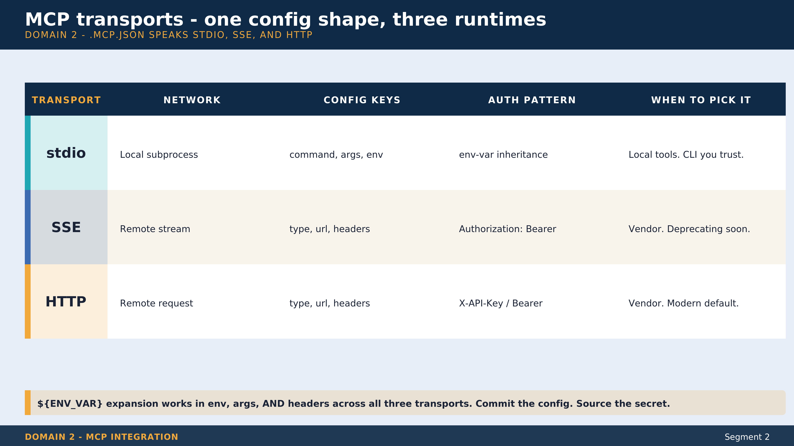
Notes:
FRAMER: the slide they SHOULD screenshot if they're going to configure MCP this week. Walk the four columns left to right for each of the three transports. Mention the SSE -> HTTP deprecation explicitly. Anthropic is moving the ecosystem to HTTP; SSE still works but new vendor integrations should pick HTTP. ${ENV_VAR} expansion is the load-bearing detail. Commit the .mcp.json, source the secrets. Then open the repo's own .mcp.json in Demo A to make the abstract concrete - filesystem (stdio), github (stdio + ${GITHUB_TOKEN}), context7 (HTTP), internal-knowledge-base (SSE + bearer).

Slide 22
MCP server config - .mcp.json
Three transports: stdio, SSE, HTTP
stdio: command + args + env (local subprocess)
SSE / HTTP: type + url + headers (remote)
${ENV_VAR} expansion works in env, args, AND headers
Project scope: ./.mcp.json User scope: ~/.claude.json
Notes:
Show repo's own .mcp.json in the demo. Four servers, three transports, env-var expansion for secrets. The pattern that scales: add a new MCP server to .mcp.json, every MCP-aware agent picks it up on the next list_tools call - no source change.

Slide 23
Demo A - MCP config walkthrough (10 min)
Open C:/github/claude-architect/.mcp.json in VS Code
Walk server-by-server: filesystem (stdio), github (stdio + ${GITHUB_TOKEN})
Show context7 (HTTP + header), internal-knowledge-base (SSE + bearer)
Show what happens when GITHUB_TOKEN is unset
Notes:
Live demo, 10 minutes. Open .mcp.json side-by-side with the notebook so learners see config-as-data. Mention that the file is the same shape Claude Code reads at startup - it's the SDK contract, not a Claude Code convention.

Slide 24
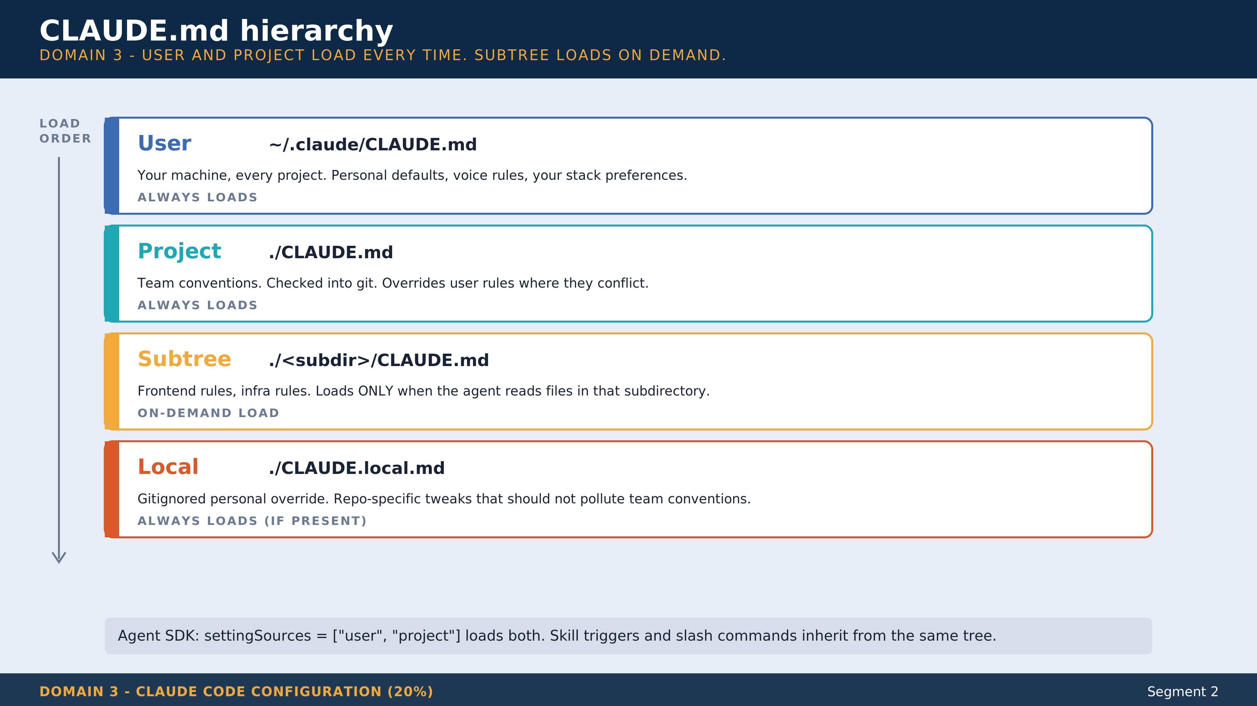
Notes:
FRAMER: this is the diagram the team-lead in the room screenshots and shares in Slack on Monday. The load-order arrow on the left is the load-bearing visual. User and project ALWAYS load. Subtree loads on demand - only when the agent reads files in that subdir. Walk each band: who writes it, what belongs there, what does NOT belong there. Production tip: do NOT put team-specific conventions in user CLAUDE.md - those leak between projects. Do NOT put personal preferences in project CLAUDE.md - those pollute the team's git diff. The gray callout at the bottom is the Agent SDK note - settingSources lets you scope which tiers load.

Slide 25
CLAUDE.md hierarchy
User ~/.claude/CLAUDE.md - your machine, every project
Project ./CLAUDE.md - team conventions, in git
Subtree ./<subdir>/CLAUDE.md - loads on demand when files in subdir are read
Local ./CLAUDE.local.md - gitignored personal override
Agent SDK: settingSources [user, project] loads both
Notes:
Load order matters. User and project are additive. Subtree on-demand keeps the token budget tight (don't load frontend rules when the agent is reading backend code). Local for personal preferences without polluting team conventions.

Slide 26
Plan mode vs. headless mode
Plan mode - interactive, proposes plan, waits for approval (default)
Headless - claude -p 'prompt' - non-interactive, pipe-friendly
- --output-format json|stream-json for parsing
- --allowed-tools 'Read,Edit,Bash' to scope
Headless is THE CI/CD answer - pre-commit hooks, PR review, release notes
Notes:
Three-second demo callout: git log --oneline -20 | claude -p 'summarize these recent commits'. One command, real value. Headless mode unlocks every CI/CD use case learners have but didn't know Claude Code supported.

Slide 27
Demo B - CLAUDE.md hierarchy + claude -p (5 min)
Open this repo's own CLAUDE.md - walk the structure
Run: claude -p 'audit this CLAUDE.md against the documented conventions'
Show the headless output
Pipe a git log into it - get a release-notes draft in seconds
Notes:
Live demo, 5 minutes. Short because it's the 'oh that's just a CLI' beat - the value is obvious once they see it. Have a fallback `claude -p` output saved as text in case the CLI hiccups.

Slide 28
Exercise (5 min)
Design a CLAUDE.md hierarchy for a 3-team monorepo
Teams: backend (Go), frontend (React/TS), infra (Terraform)
Each team has different conventions
Where does each rule go? User, project, subtree, or .claude/rules?
What goes in .claude/rules/ with paths: globs?
Notes:
Target answer: project CLAUDE.md for shared (commit style, security), subtree CLAUDE.md for team-specific conventions, .claude/rules with paths: globs for language-specific lint rules. Hierarchy is the load-bearing concept.

Slide 29
Segment 2 takeaways
Descriptions, not names, drive tool selection
.mcp.json - three transports, ${ENV} expansion, secrets in env never in file
CLAUDE.md hierarchy is additive; claude -p is your CI/CD primitive
Notes:
Bridge: 'Tools give the agent hands. Prompts and schemas decide what comes out. Before we get to structured output in Segment 3, take a 10-minute break - and if you want a deep dive between segments, Segment 2.5 ships as self-study.'

Slide 30
Three tiers tools come from
Tier 1 - Server tools
Anthropic hosts. You register by type (bash_20250124, code_execution_20250522, web_search_20250305). Model invokes, Anthropic executes server-side.
Tier 2 - MCP tools
You (or a vendor) host. Discovered at runtime via list_tools(). The pattern that scales by configuration, not code.
Tier 3 - Harness tools
Claude Code's Read, Edit, Bash, Grep. Harness-private TypeScript. NOT API-reachable. Same noun, different runtime.
Notes:
The 60-second visual: three tiers, three runtimes, three sets of expectations. Most architects conflate Claude Code's Bash (tier 3, harness-private) with bash_20250124 (tier 1, Anthropic-hosted). Same noun, different sandbox model, different streaming semantics. The trap that catches working architects is registering 'bash' in their custom agent and expecting the harness behavior. Segment 2.5 has a live demo proving the spectrum: bash emits a tool_use you still execute; code_execution returns a code_execution_tool_result inside the same response with no client loop.

Slide 31
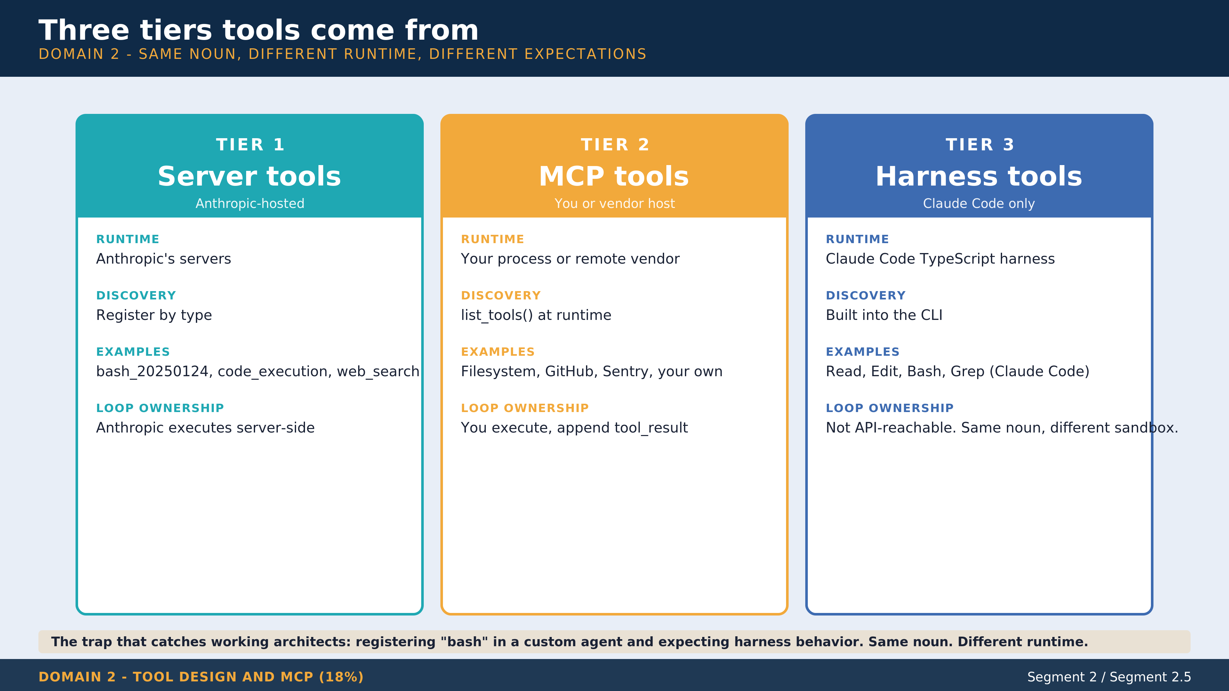
Notes:
FRAMER: this slide LIVES in Segment 2.5 territory but earns a moment in Segment 2 because the trap catches working architects. Walk the three columns: Tier 1 (server tools, Anthropic-hosted), Tier 2 (MCP, you/vendor host), Tier 3 (Claude Code harness, NOT API-reachable). Same noun, different runtime. 'Bash' in Claude Code is a TypeScript harness tool. 'bash_20250124' in the API is an Anthropic-hosted server tool. They behave differently, stream differently, error differently. The trap on the bottom is the punchline. Optional deeper dive: segment-2-5-control-surfaces.ipynb has the live demo.

Slide 32
notebooks/segment-2-5-control-surfaces.ipynb
Three tiers tools come from - server tools, MCP, Claude Code harness
All four tool_choice modes + disable_parallel_tool_use
stop_sequences + max_tokens as control levers + pause_turn + refusal
MCP list_tools runtime discovery
The live Claude Console asset surface - memory_stores, vaults, agents, sessions
Highest exam-objective density in the repo. Walk it for CCA-F prep.
Notes:
Tell learners this is the notebook to re-walk if they're aiming at CCA-F. ~75 minutes if walked end to end against the live API. Not on the 4-hour clock. The Console asset surface section is brand new in 2026-05 and won't be in older study guides - this is where Tim's content has an edge.

Slide 33
Segment 3: Structured Output and Reliability
Notes:
Domains 4 + 5. 50 minutes. Combined 35% of exam weight. Live build: invoice extractor with Pydantic + forced tool_choice + validation retry.

Slide 34
Two domains, one segment (again)
Domain 4 - Prompt Engineering and Structured Output (20%)
Domain 5 - Context Management and Reliability (15%)
Combined = 35% of the cert
Why combined? Structured extraction without context discipline is fragile
Long sessions need context pinning; structured output needs validation retry
Notes:
The merge is honest to production. A well-typed extraction call inside a 50-turn conversation needs both Domain 4 (the call itself) and Domain 5 (context pinning so turn 47 still has the case facts).

Slide 35
What you'll build
An invoice extractor with a Pydantic schema
tool_choice {type: tool, name: extract_invoice} forces valid JSON
Validation-retry loop handles malformed output (max_retries=1)
Three invoices: clean, missing field, ambiguous line item
By the end of the segment: you can extract typed data from anything
Notes:
Set expectations: this is the LONGEST live build (~20 min). Highest demo risk. If anything goes sideways, switch to the markdown walkthrough next to the notebook. Sonnet 4.6 for this segment - the one place reasoning depth earns its tokens.

Slide 36
Precise prompts beat vague prompts
Be specific: format, edge cases, missing-data handling
Plausible hallucinations: model invents values for nullable fields
Fix: explicit 'return null if not directly stated' instruction
Inconsistent formats: 'cotton blend' vs 'Cotton/Polyester mix'
Fix: 2-3 few-shot examples, NOT lower temperature
Notes:
Few-shot beats temperature tuning every time. The model needs examples, not knobs. Temperature is the lever you reach for last, not first.

Slide 37
JSON schema via tool use - the cheat code
1. Define a Pydantic model with your fields
2. Convert to JSON Schema (model.model_json_schema())
3. Register as a tool's input_schema
4. Set tool_choice {type: tool, name: <your_schema>}
5. block.input is now a typed dict matching the schema
Notes:
The Pydantic model is the source of truth for both runtime validation AND the API contract. No JSON parsing, no fence-stripping, no validation rituals. The SDK validated for you. This is the Domain 4 load-bearing pattern.

Slide 38
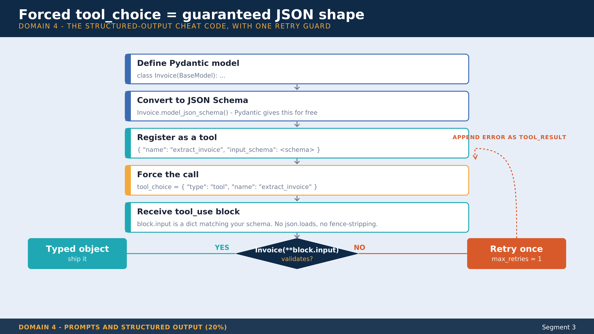
Notes:
FRAMER: this is the architecture in one picture. Trace top-down through the five blue/teal/gold boxes, then the diamond, then YES (typed object, ship it) vs. NO (retry once). Spotlight on the GOLD box ('Force the call'). The forced-tool_choice is the cheat code. The model has no other path; it MUST return data matching your schema or fail. Spotlight on max_retries=1. Format errors get one chance to fix themselves; missing information will NEVER be fixed by retrying. Cap the loop or burn tokens. Cookbook anchors: claude-cookbooks-main/tool_use/tool_use_with_pydantic.ipynb (Pydantic), extracting_structured_json.ipynb (the broader pattern).

Slide 39
The forced-tool_choice pattern in code
Three load-bearing lines. tool_choice={"type": "tool", "name": ...} forces the model to call that exact tool. block.input is a typed dict matching the schema. Invoice(**tool_block.input) is the validation gate. The full retry loop lives in segment-3-invoice-extractor.ipynb; this is the skeleton.
class Invoice(BaseModel):
invoice_number: str
vendor: str
total: float
po_number: Optional[str] = None
EXTRACT_TOOL = {
"name": "extract_invoice",
"description": "Extract invoice fields. Do NOT invent values.",
"input_schema": Invoice.model_json_schema(),
}
resp = client.messages.create(
model=MODEL,
tools=[EXTRACT_TOOL],
tool_choice={"type": "tool", "name": "extract_invoice"},
messages=[{"role": "user", "content": raw_invoice_text}],
)
tool_block = next(b for b in resp.content if b.type == "tool_use")
invoice = Invoice(**tool_block.input) # validated, typed
Notes:
Stay on this slide for 60 seconds. Walk the three load-bearing lines: forced tool_choice, schema-conformant input, Pydantic validation. Mention that block.input is a Python dict not a JSON string - common copy-paste trap is to call json.loads() on it and crash. The full notebook adds a retry loop with max_retries=1 that feeds the validation error back to the model as a tool_result with is_error=True. The model gets one chance to fix its own mistake.

Slide 40
Validation + retry loops
Effective: format errors, JSON parse failures, schema mismatches
-> append the error as a tool_result with is_error: true, retry
-> succeeds in 2-3 attempts
INEFFECTIVE: knowledge gaps, ambiguous source data
-> retries DO NOT help
-> cap at 2-3, then escalate to human review
Notes:
Anti-pattern: infinite retry on missing-info failure. Burns tokens, the model can't invent the data, escalation is the right move. max_retries=1 is the production default - one chance to react to its own error, then fail loud.

Slide 41
Confidence-based routing
Have the model output field-level confidence: high | medium | low
Route: high -> automated, medium -> spot-check, low -> human
CRITICAL: validate accuracy by document type AND field
Aggregate 95% accuracy can mask 60% accuracy on specific segments
Notes:
Per-segment calibration warning. If you don't break it down by doc type, high-aggregate accuracy lies to you. The confidence field is a routing key, not a vanity metric.

Slide 42
Demo - invoice extractor live build (20 min)
Open notebooks/segment-3-invoice-extractor.ipynb
Build the Pydantic schema, register as a tool
Force tool_choice = {type: tool, name: extract_invoice}
Run on 3 invoices: clean, missing PO, ambiguous total
Add validation-retry loop, watch it recover from a parse failure
Notes:
Longest live build of the course. Highest demo risk. Have the markdown walkthrough open as fallback. Cookbook reference for further study: claude-cookbooks-main/tool_use/extracting_structured_json.ipynb and tool_use_with_pydantic.ipynb.

Slide 43
Context preservation in long sessions
Pin case-facts at the top of every turn
Summarize resolved turns into narrative, drop verbatim history
Prune verbose tool outputs - extract the fields you used, drop the rest
Application-side filtering, before the next turn
How lawyers manage case files. Same discipline for long agent sessions.
Notes:
A 48-turn conversation should not have 48 turns of tool_result clutter. The cache demo in segment-3 shows cache_control on the system block - 2019 tokens cached, the vendor policy never re-billed across calls.

Slide 44
Escalation design
Honor explicit human requests IMMEDIATELY
'I want a human NOW' = escalate, don't clarify, don't try one more tool
Pass STRUCTURED summary to the human queue, not the transcript
Never escalate on sentiment alone (frustration != complexity)
Confidence-based escalation: low confidence -> human review
Notes:
Frustrated user with a $5 refund doesn't need a human. Calm user with a multi-account billing dispute does. Sentiment is not complexity. The escalation contract: structured summary, not the transcript - the human picks up faster, the agent's notes are signal.

Slide 45
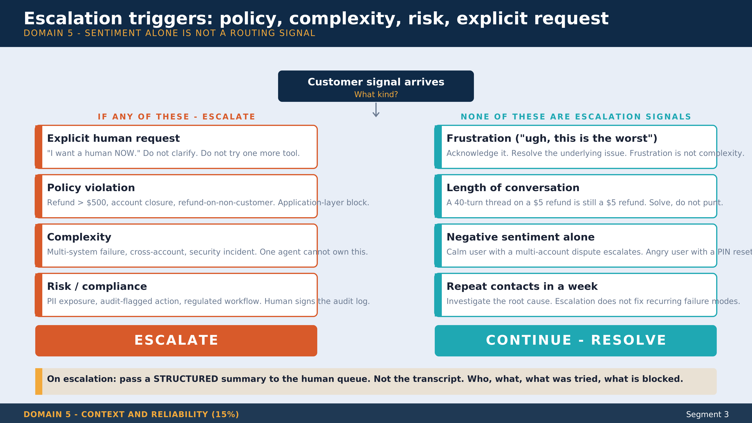
Notes:
FRAMER: this slide is for the engineer in the room whose product manager has been asking 'why do we escalate so much?' Show them the LEFT column (real signals) and the RIGHT column (not signals). Walk the four ESCALATE conditions: explicit request, policy, complexity, risk. Then walk the four NOT-A-SIGNAL conditions: frustration, length, sentiment, repeat contacts. The gold callout at the bottom is the operational rule: pass a STRUCTURED summary to the queue, not the transcript. Human agents pick up faster; the agent's notes are signal not noise. Anti-pattern callout in the room: 'every angry customer gets escalated' is a routing rule that burns the human queue. Sentiment is not complexity.

Slide 46
Exercise (5 min)
Design an extraction schema for a domain you know
Fields: required vs Optional[]
Add a confidence Literal: 'high' | 'medium' | 'low'
Add a notes Optional[str] for ambiguity
Share your schema in chat
Notes:
Reinforces: nullable fields need explicit prompt instructions, confidence is the routing key, notes catches the 'I'm not sure' cases without crashing validation.

Slide 47
Segment 3 takeaways
Pydantic + tool_choice tool = guaranteed valid JSON
Few-shot examples beat temperature tuning every time
Retries help format errors; retries do NOT help missing info
Cache the system block with cache_control - amortize policy across calls
Notes:
Bridge: 'You have agents, tools, prompts, validation, context discipline. Last segment is the cert capstone - what's on the CCA-F exam, how the domain weights map to today's notebooks, and ten weighted practice questions.'

Slide 48
Segment 4: CCA-F Certification Capstone
Notes:
All five CCA-F domains. 50 minutes. 12-minute cert briefing + 28 minutes of 10 weighted practice questions + 10 minutes of Q&A and close.

Slide 49
What CCA-F is
Claude Certified Architect: Foundations - Anthropic's first official certification
Targets architects shipping with Agent SDK, Claude Code, Claude API, MCP
Roughly the 301 skill level - past 'hello world', not yet 'I run distillation pipelines'
Beta product as of 2026 - watch the official cert page for changes
Notes:
Skills-first framing. You already have the skills. The exam is how you signal them. This is the moment to mention CCA-F is currently partner-gated; check claude.com/partners for the current access policy.

Slide 50
Exam mechanics (the load-bearing facts)
Questions: 60 multiple-choice
Time: 120 minutes, single session, no breaks
Scoring: scaled 100-1000, passing = 720, no guess penalty
Delivery: ProctorFree, English
Results: 2 business days
Cost: $99 per attempt
Attempts: ONE - this is the policy that catches people
Notes:
The one-attempt rule is the policy nobody plans around. Tell them: don't schedule until your Anthropic Practice Exam scores are consistently above 900. Treat the $99 as if it were $990 - because the cost of failing is rescheduling and starting prep over.

Slide 51
Domain weights and where each was taught
Domain 1 - Agentic Architecture (27%)
Heaviest. Segment 1 - agents, hooks, coordinator-subagent. Re-walk segment-1.
Domain 2 - Tool Design and MCP (18%)
Segment 2 + 2.5. Tool descriptions, structured errors, MCP list_tools.
Domain 3 - Claude Code (20%)
Segment 2. CLAUDE.md hierarchy, skills, slash commands, claude -p headless.
Domain 4 - Prompts and Structured Output (20%)
Segment 3. Forced tool_choice, Pydantic schemas, few-shot, retry loops.
Domain 5 - Context and Reliability (15%)
Segment 3 + parts of Segment 1. Context pinning, escalation, structured errors.
Notes:
D1 + D3 + D4 = 67% of the exam. Weight your study time the same way. D2 + D3 = 38% - that pairing is why we covered both in one segment. D5 is small but easy to under-teach because it feels like security common sense until scenario questions get specific.

Slide 52
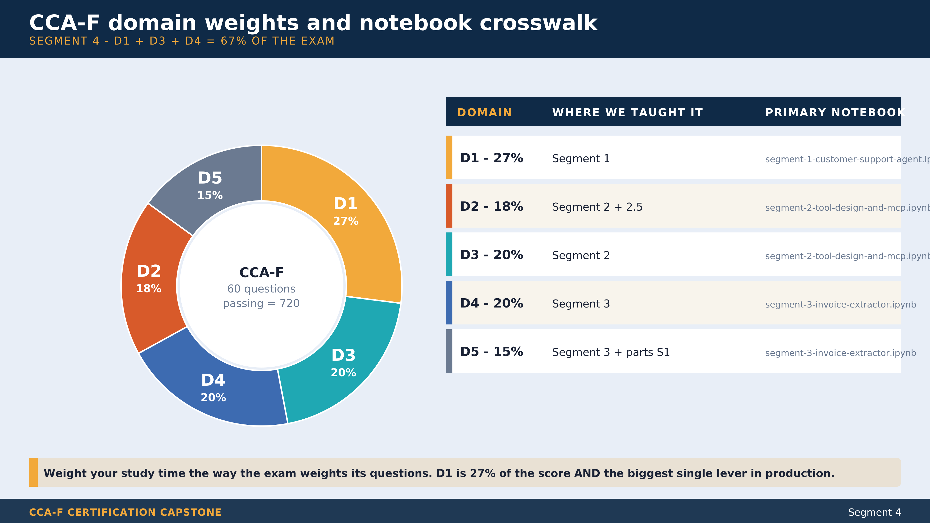
Notes:
FRAMER: the donut on the left tells them the weighting. The table on the right tells them which notebook teaches what. Spotlight on the gold slice (D1, 27%) - biggest single lever, biggest single domain. Then walk the 67% combination of D1+D3+D4. That's two thirds of the exam in three domains. Production framing: the same weighting holds in real life. D1 (agentic) and D3 (Claude Code) show up in every production system; D5 (context) shows up when sessions get long. Take-home punchlist: rebuild segment-1 from memory in 30 minutes before scheduling the exam. If you can't, you're not ready. The Anthropic Practice Exam is the authoritative calibration.

Slide 53
Why the practice sampler is domain-weighted
The naive sampler
Pulls questions evenly across scenario families - which over-tests Claude Code (two scenarios are heavily D3) and under-tests context management (only fits in one).
Our sampler
Draws 3 D1 + 2 D2 + 2 D3 + 2 D4 + 1 D5 - matches the exam's 27/18/20/20/15 weighting exactly. Every cohort sees the SAME 10 questions in the same order (seed=2026) for consistency across deliveries.
Notes:
This is why Segment 4 runs against a freshly-tagged practice-questions.json. The 60-question bank distribution doesn't match exam weights, but the SAMPLER does. Same idea Anthropic uses for the real exam.

Slide 54
Live practice - 10 weighted questions (~28 min)
Open notebooks/segment-4-cca-f-capstone.ipynb
Sampler draws 10 questions by CCA-F domain weight (3/2/2/2/1)
Per question (~2.5 min):
1. Read the situation
2. Cohort votes A/B/C/D in chat
3. Reveal answer + explanation
4. Color with a production tip from the matching domain-N-*.md
Notes:
The community-sourced disclaimer goes here: questions are calibration practice, NOT exam predictors. Use Anthropic's official Practice Exam as the authoritative signal before scheduling. Read the disclaimer out loud once at the start.

Slide 55
Tim's week-before-the-exam punchlist
1. Score >900 on the Anthropic Practice Exam cold
2. Rebuild Segment 1 from memory in 30 minutes
3. Re-read domain-1-agentic.md - the 27% domain
4. Skim domain-3-claude-code.md and domain-4-prompts.md - the 20% domains
5. Verify proctoring setup the night before (camera, mic, ID)
6. Single attempt. Do not schedule until 1-4 are green.
Notes:
Full 13-item version lives in CERT-PROGRAM-BRIEFING.md. Six headlines on the slide. Rebuilding Segment 1 from memory in 30 minutes is the load-bearing readiness test - if you can't, you're not ready to sit the exam.

Slide 56
What you built today
Customer support agent with PreToolUse hook enforcement
Configured Claude Code env with .mcp.json + CLAUDE.md hierarchy
Invoice extractor with Pydantic schema + validation retry
Production reliability mental model - context, escalation, errors, provenance
Plus self-study: control surfaces and the Console asset surface (Segment 2.5)
Notes:
Recap the four live artifacts plus the self-study fifth. Tie back to the cold-open quote: model is non-deterministic, your architecture cannot be. Every artifact today is an instance of that pattern.

Slide 57
Resources and next steps
Repo
github.com/timothywarner-org/claude-architect
Anthropic cookbook (official, MIT, vendored in this repo)
github.com/anthropics/claude-cookbooks | claude-cookbooks-main/
CCA-F study path
EXAM-STUDY-PATH.md - notebook -> CCA-F domain -> scenario mapping
Anthropic Academy
anthropic.skilljar.com - free courses, official Practice Exam
Notes:
If they don't ship something in 7 days, the muscle memory fades. Pick the smallest possible win and ship it. The repo carries EXAM-STUDY-PATH.md which is the post-class anchor for CCA-F prep - notebook to domain to scenario family in one table.

Slide 58
Final Q&A (10 min)
How do I monitor an agent in production?
When do I split a monolithic agent into coordinator + subagents?
What is the cost story for prompt caching?
How do I know when I am ready to sit the exam?
What is the renewal path for CCA-F?
Notes:
Anticipated questions to invite. Pre-answer the renewal one: Anthropic reserves the right to retire and refresh exams; certifications tied to beta products may expire when the production exam goes live. Watch the cert page.

Slide 59
Thank you
Tim Warner | techtrainertim.com
github.com/timothywarner-org/claude-architect
Memento mori. Also, ship the PR.
Notes:
Final close. The 'memento mori, ship the PR' line is the personal sign-off. Open for one last round of questions, then wrap. Recording stops after the chat clears.

