Slide 1
CSE4063 Fundamentals of Data Mining
Anuran Calls
Cem Güleç - 150117828
Kadir Hızarcı - 150116004
Buğra Akdeniz - 150116072

Slide 2
Table of Contents
1. Problem Definition
2. Information About Dataset
3. Data Preprocessing
4. Implementation
5. Model Construction & Performance Results
6. Conclusion

Slide 3
Definition of the Problem
Using Anuran Calls (MFCCs) Data Set:
Determine the species of the frog by using the frequency of their calls from the dataset.
Predict future work for Anuran Call Clasification using different classifiers and evaluation criteria.

Slide 4
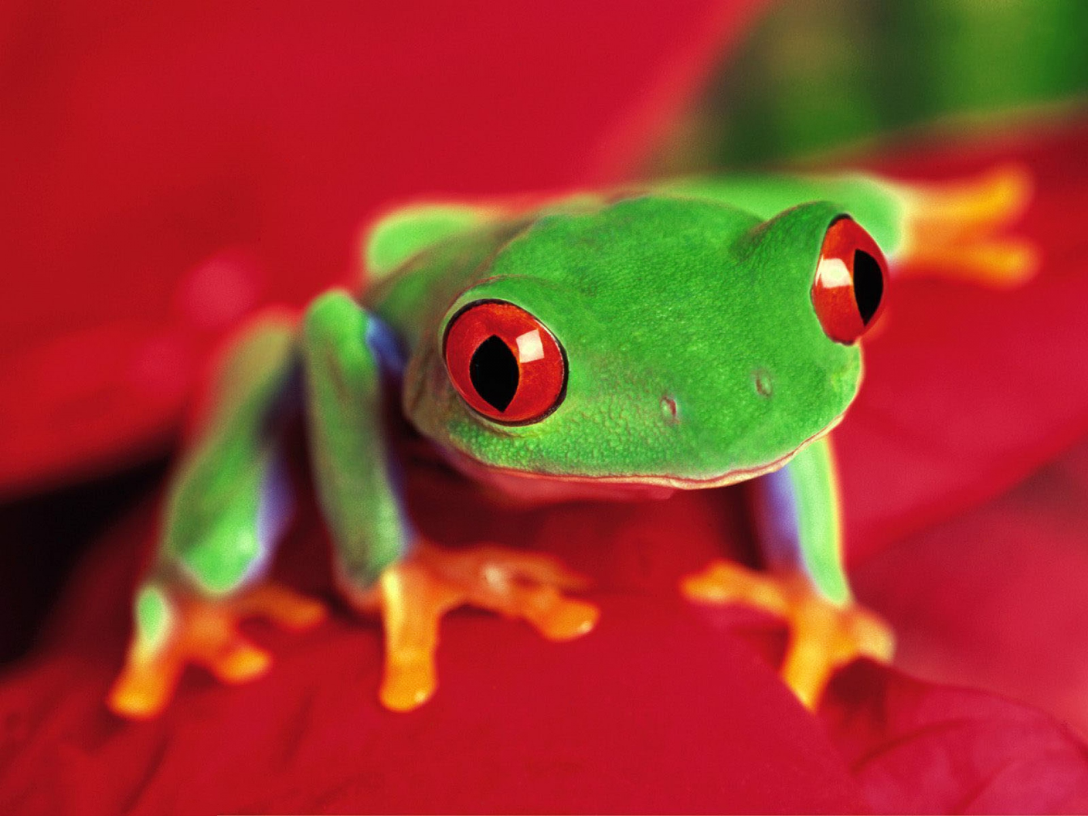
Information About Dataset
Anuran Calls database is used in several classifications tasks related to the challenge of anuran (frog) species recognition through their calls.
Figure 1: Red eyed tree frog.

Slide 5
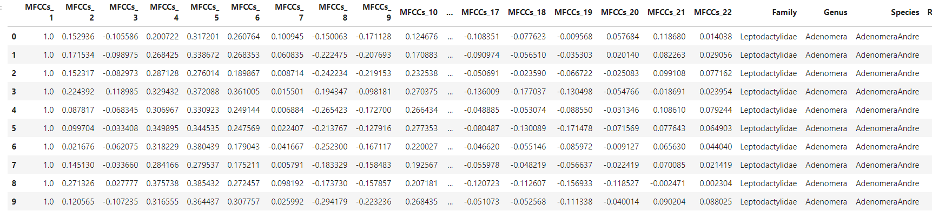
We have 22 types of Mel-frequency cepstral coefficients (MFCCs) as our columns.
Each column represents voice level and the relative frequency range.
*record ID is also included as an extra column.
Number of Instances(rows): 7195
Number of Attributes: 22
Created segmenting 60 audio records belonging to 3 class labels which consist of : 4 different families, 8 genus, and 10 species.

Slide 6
Dataset cont.
Families: Bufonidae 68 Dendrobatidae 542 Hylidae 2165 Leptodactylidae 4420
Genus: Adenomera 4150 Ameerega 542 Dendropsophus 310 Hypsiboas 1593 Leptodactylus 270 Osteocephalus 114 Rhinella 68 Scinax 148
Species: AdenomeraAndre 672 AdenomeraHylaedactâ 3478 Ameeregatrivittata 542 HylaMinuta 310 HypsiboasCinerascens 472 HypsiboasCordobae 1121 LeptodactylusFuscus 270 OsteocephalusOophaâ€¦ 114 Rhinellagranulosa 68 ScinaxRuber 148

Slide 7
Data Preprocessing
Missing values:
No missing values or duplicates obtained.
Feature creation:
A dataframe is created from data.
The target(label) values is encoded.(the data was already scaled.)
Feature and label columns are seperated.

Slide 8
Data Preprocessing cont.
Delete unused columns:
Unnecessary column ‘’recordID’’ deleted which is redundant.
Since our main aim is guessing the Species; Family and Genus are also deleted. (Family and Genus can be determined through Species.)
Transformation and Normalization:
Since there are no nominal or ordinal values and all the values are numerical:
All values are normalized into 0-1 interval.
Training set and test set:
Dataset is splitted -> 70% for training and 30% for testing.

Slide 9
Implementation
Environment/IDE: Python/Jupyter Notebook
Libraries:
Sklearn : It is a Python library aimed at machine learning. We used scikit-learn to create our model.
Panda : We used panda library to import and handle the dataset.

Slide 10
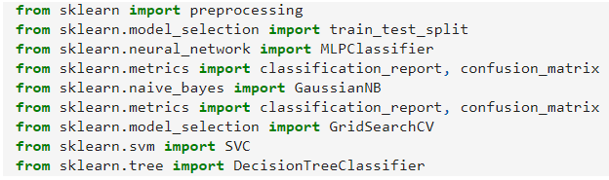
Model Construction & Performance Results
The models were constructed based on 6 different classification methods:
Naive Bayes with Gaussian
Decision Tree using gain ratio (C4.5)
Decision Tree using gini index
Neural Network with 1 Hidden Layer
Neural Network with 2 Hidden Layers
Support Vector Machine

Slide 11
Naive Bayes
Libraries: Sklearn
The Naive Bayes classifier is implemented as GaussianNB() function.
Model evualuation metrics are calculated with Sklearn functions.
Speed: Very Fast
Accuracy: Lowest -- %91

Slide 12
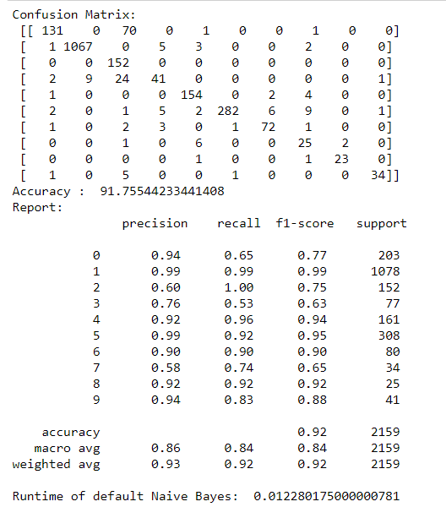
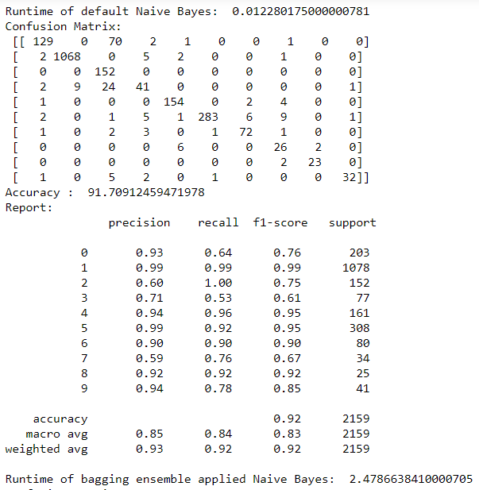
Naive Bayes Results

Slide 13
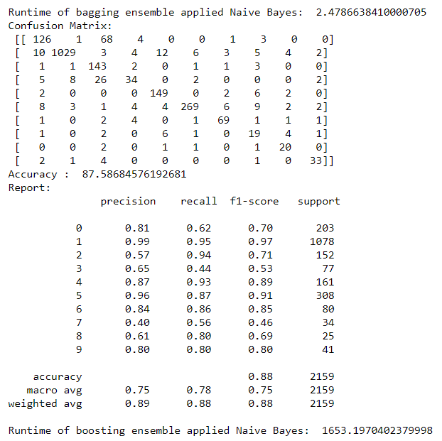
Naïve Bayes Results cont.
Conclusions:
Fastest runtime: Default Naïve Bayes (0.012 secs)
Highest accuracy: Default Naïve Bayes (91.76%)

Slide 14
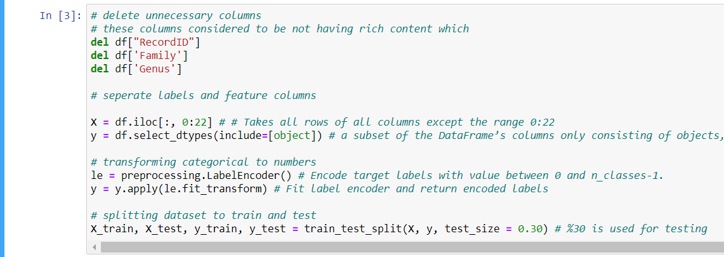
Preprocessing Implementation
- Deleted unnecessary columns.
- Separated labels and feature columns.
- Transformed categorical to numbers.
- Split dataset to train and test segments.

Slide 15
Decision Tree Using Gain Ratio (C4.5)
Libraries: Sklearn
Impurity is calculated using entropy.
Model evualuation metrics are calculated with Sklearn functions.
Speed: Moderate
Accuracy: High – 96.85%

Slide 16
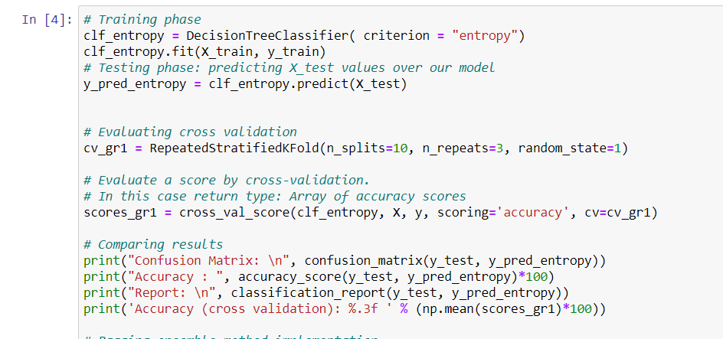
Gain Ratio Cont.
We first trained our model with entropy criterion before fitting it.
Then we evaluated cross validation.
Finally, we printed the results.

Slide 17
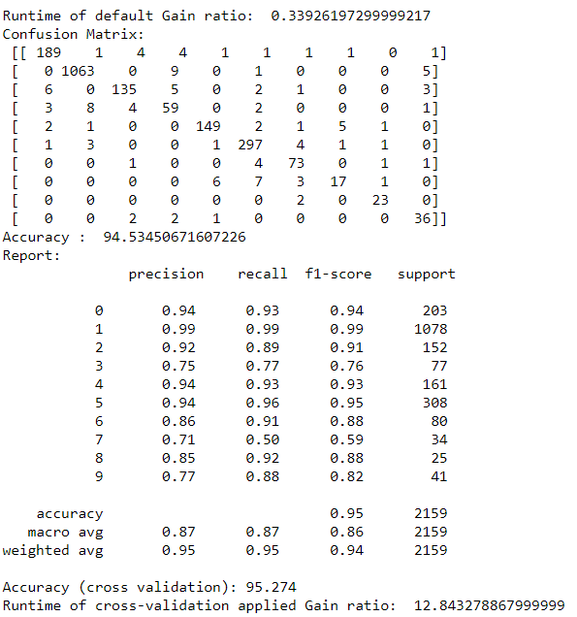
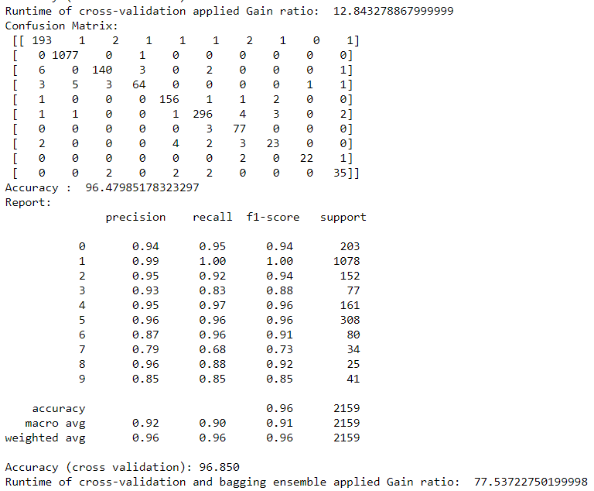
Gain Ratio Results

Slide 18
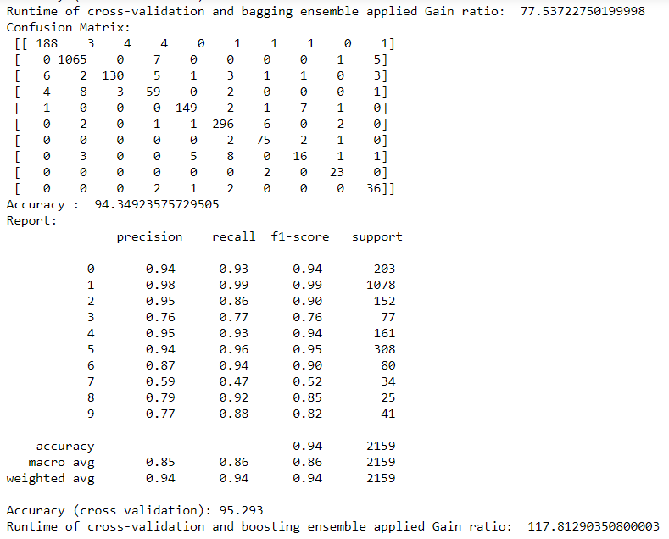
Gain Ratio Results cont.
Conclusions:
Fastest runtime: Default Gain Ratio(12.84 secs)
Highest accuracy: Bagging Ensemble Applied Gain Ratio(96.85%)

Slide 19
Decision Tree Using Gini index
Libraries: Sklearn
Impurity is calculated using gini index.
Model evualuation metrics are calculated with Sklearn functions.
Speed: Moderate
Accuracy: High – 96.66%

Slide 20
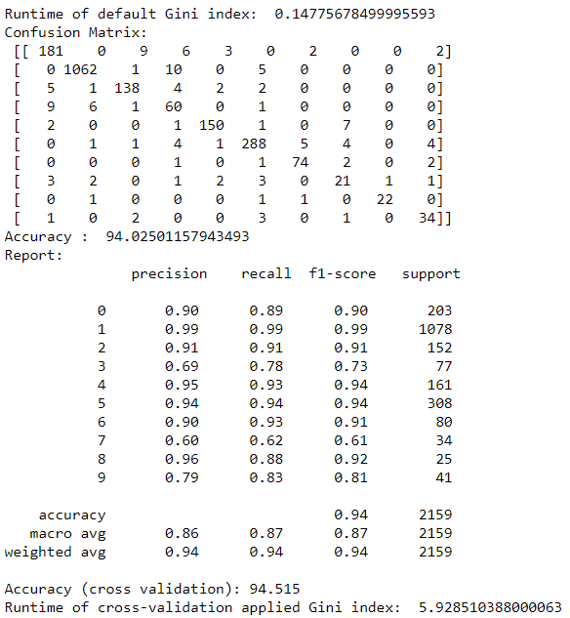
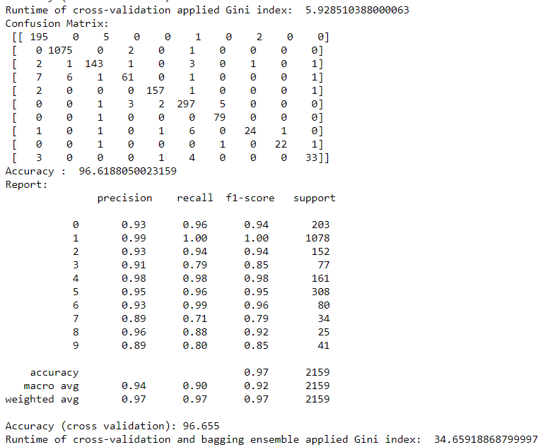
Gini Index Results

Slide 21
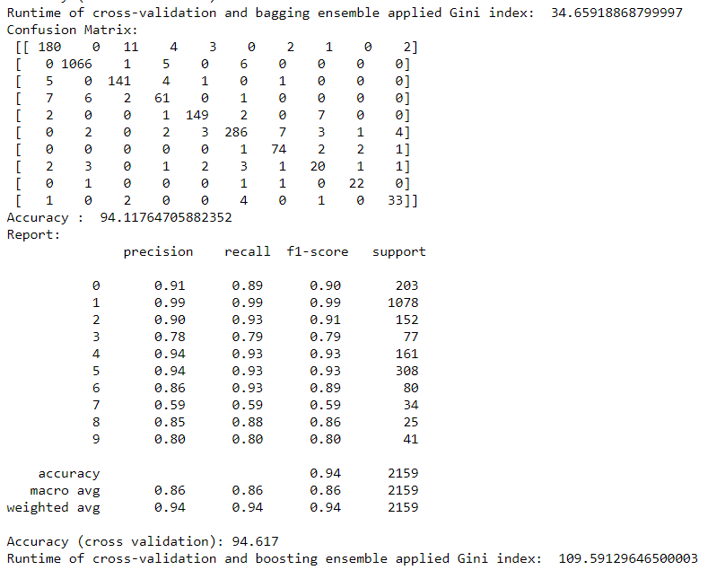
Gini Index Results cont.
Conclusions:
Fastest runtime: Default Gini Index(5.93 secs)
Highest accuracy: Bagging Ensemble Applied Gain Ratio(96.66%)

Slide 22
Neural Networks with 1 Hidden Layer
Libraries: Sklearn
Used 1 hidden layer with size 150.
Model evualuation metrics are calculated with Sklearn functions.
Speed: Slow
Accuracy: High – 98.66%

Slide 23
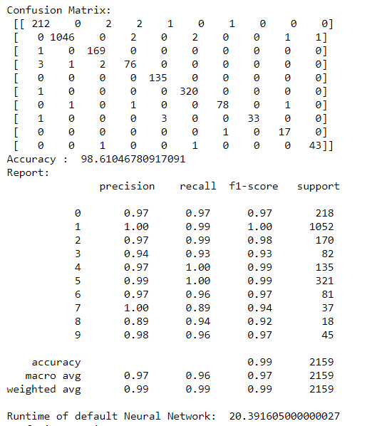
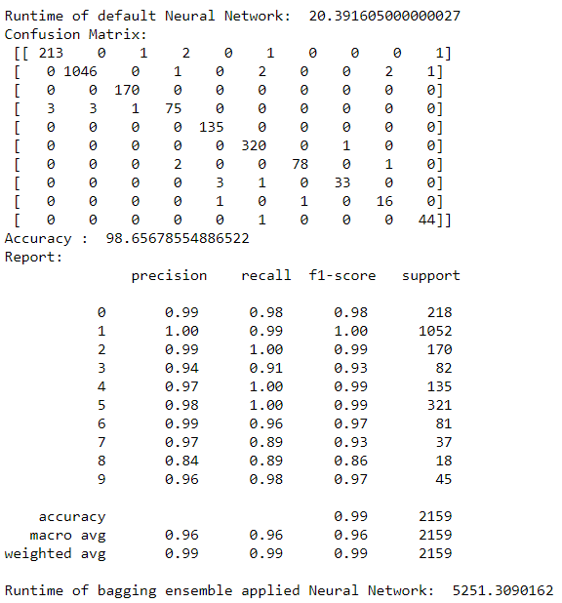
Neural Networks with 1 Hidden Layer Results

Slide 24
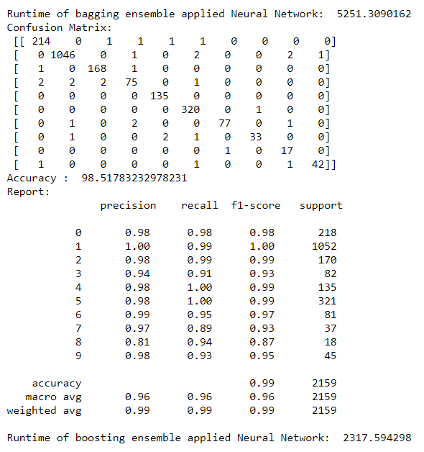
Neural Networks with 1 Hidden Layer Results cont.
Conclusions:
Fastest runtime: Default Gain Ratio(20.39 secs)
Highest accuracy: Bagging Ensemble Applied Neural Network(98.66%)

Slide 25
Neural Networks with 2 Hidden Layers
Libraries: Sklearn
Used 2 hidden layers with size 75 each.
Model evualuation metrics are calculated with Sklearn functions.
Speed: Slowest
Accuracy: High – 98.66%

Slide 26
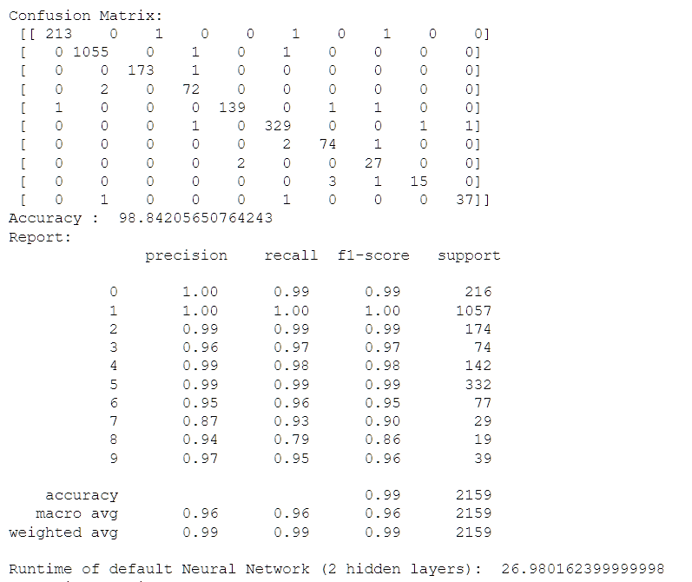
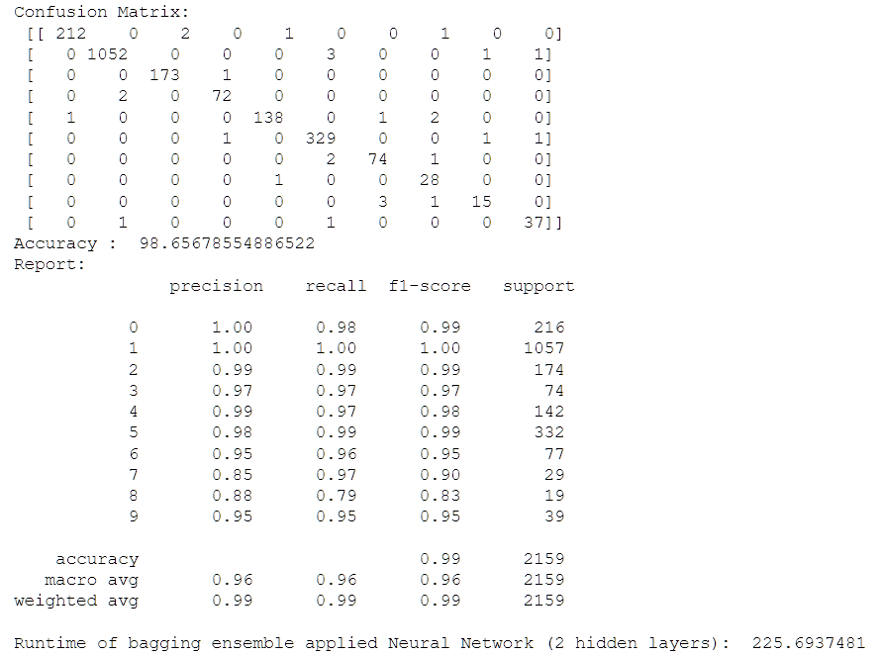
Neural Networks with 2 Hidden Layers Results

Slide 27

Neural Networks with 2 Hidden Layers Results cont.
Conclusions:
Fastest runtime: Default Neural Network(26.98 secs)
Highest accuracy: Default Neural Network(98.84%)

Slide 28
Support Vector Machines
Libraries: Sklearn
Grid search CV parameters are:
For kernel: rbf, ‘poly’, ‘sigmoid’, ‘linear’
For C: [1,10,100,1000]
For gamma: [1, 1e-1, 1e-2, 1e-3, 1e-4]
Model evualuation metrics are calculated with Sklearn functions.
Speed: Fast
Accuracy: High – 98.85%

Slide 29
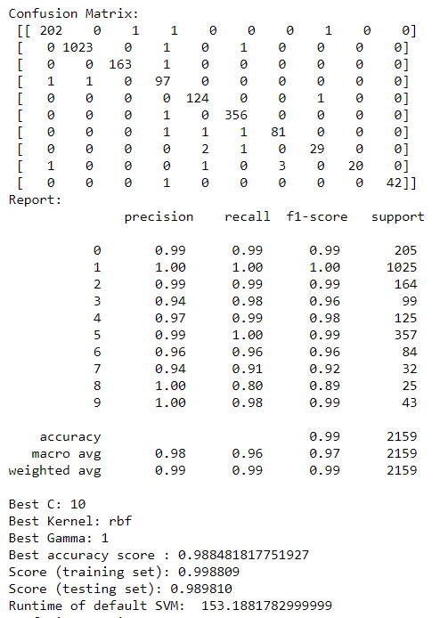
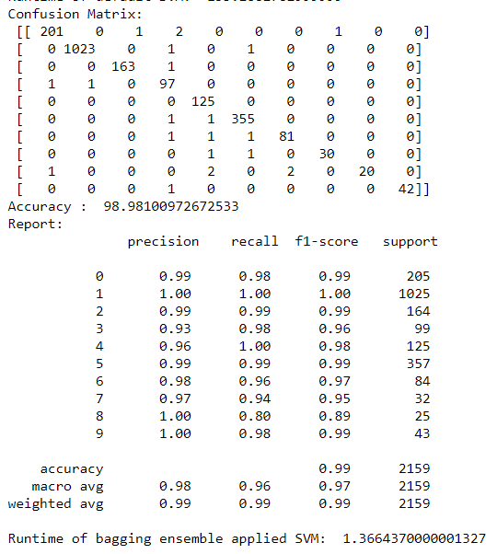
Support Vector Machines Results

Slide 30
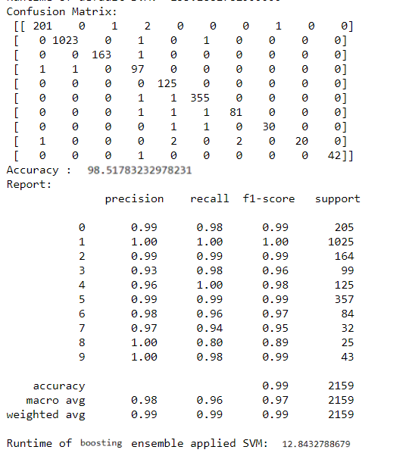
Support Vector Machines Results cont.
Conclusions:
Fastest runtime: Support Vector Machine(5.93 secs)
Highest accuracy: Support Vector Machine(98.85%)

Slide 31
Conclusion
Accuracy: Support Vector Machine > Neural Network > Gain Ratio > Gini Index > Naïve Bayes
Execution Time: Naïve Bayes > Support Vector Machine > Gini Index > Gain Ratio > Neural Network with 1 Hidden Layer > Neural Network with 2 Hidden Layers

Slide 32
Comparison with Other Papers
Upon comparison with other papers, we found that most were, as a matter of fact, similar to our results.
Reference papers:
2) COLONNA, J. G.; GAMA, J.; NAKAMURA, E. F.How to Correctly Evaluate an Automatic Bioacoustics Classification Method.In: 17th Conference of the Spanish Association for Artificial Intelligence (CAEPIA).Lecture Notes in Computer Science. 986ed.: Springer International Publishing, 2016, v. , p. 37-47.
3) COLONNA, J. G.; GAMA, J.; NAKAMURA, E. F.Recognizing Family, Genus, and Species of Anuran Using a Hierarchical Classification Approach.Lecture Notes in Computer Science. 995ed.: Springer International Publishing, 2016, v. 9956, p. 198-212.
4) COLONNA, J. G.; RIBAS, A. D.; SANTOS, E. M.; NAKAMURA, E. F.Feature Subset Selection for Automatically Classifying Anuran Calls Using Sensor Networks.In: International Joint Conference on Neural Networks, 2012, Brisbane.Proceedings of the International Joint Conference on Neural Networks (IJCNN 2012), 2012. p. 1-8. IEEE

