Slide 1
CSE4063 Fundamentals of Data Mining
Shıll bıddıng
Cem Güleç - 150117828
Kadir Hızarcı - 150116004
Buğra Akdeniz - 150116072
Notes:
Good afternoon everyone. We are going to talk about our database, shill bidding.

Slide 2
Table of Contents
1. Definition of the Problem
2. Information About Dataset
3. Data Preprocessing
4. Implementation
5. Model Construction & Performance Results
6. Conclusion

Slide 3
Definition of the Problem
Using Shill Bidding Dataset:
eBay-auctions have attracted serious fraud, such as Shill Bidding (SB), due to the large amount of money involved and anonymity of users. SB is difficult to detect given its similarity to normal bidding behavior.
Using the labelled SB dataset:
Distinguish between legitimate and shill bidders for eBay-auctions based on Model Construction: Frequent Pattern Mining as follows Apriori, FP-Growth, ECLAT and Clustering Analysis as follows k-Means, AGNES, DBSCAN.
Notes:
Shill Bidding is the act of increasing the price of an auction item on purpose, then retracting it once successful. Sites such as eBay are very vulnerable to this method, due to anonymity of the users. Our dataset Shill Bidding’s purpose is to distinguish between legitimate bidders and shill bidders using Frequent Pattern Mining and Clustering Analysis.

Slide 4
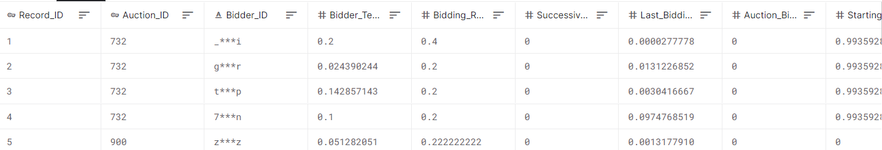
Information About Dataset
Attributes:
Record ID->id
Auction ID->id
Bidder ID-> other
Bidder Tendency-> decimal
Bidding Ratio-> decimal
Successive Outbidding-> decimal
Last Bidding-> decimal
Auction Bids-> decimal
Auction Starting Price-> decimal
Early Bidding-> decimal
Winning Ratio-> decimal
Auction Duration-> integer
Class-> integer
We have 13 types of Shill Bidding dataset as our columns.
# decimal:8 ;# integer:2 ; # id=2 ; # other:1
Number of Attributes: 13
Number of Instances(rows): 6321
Notes:
There exists 13 columns in our dataset, in which, 8 are decimals, 2 are integers, 2 IDs and 1 other. There are six thousand three hundred twenty one rows in our dataset,

Slide 5
Information About Dataset
Attributes:
Record ID: Unique identifier of a record in the dataset.
Auction ID: Unique identifier of an auction.
Bidder ID: Unique identifier of a bidder.
Bidder Tendency: A shill bidder participates exclusively in auctions of few sellers rather than a diversified lot. This is a collusive act involving the fraudulent seller and an accomplice.
Bidding Ratio: A shill bidder participates more frequently to raise the auction price and attract higher bids from legitimate participants.
Successive Outbidding: A shill bidder successively outbids himself even though he is the current winner to increase the price gradually with small consecutive increments
Notes:
Here are some information about the columns of the dataset. Top 3 are unique identifiers. Bidder Tendency is how likely a shill bidder is to join the auction. Bidding Ratio is how frequent participation of the shill bidder is and successive outbidding is ??

Slide 6
Information About Dataset
Last Bidding: A shill bidder becomes inactive at the last stage of the auction (more than 90\% of the auction duration) to avoid winning the auction.
Auction Bids: Auctions with SB activities tend to have a much higher number of bids than the average of bids in concurrent auctions.
Auction Starting Price: a shill bidder usually offers a small starting price to attract legitimate bidders into the auction.
Early Bidding: A shill bidder tends to bid pretty early in the auction (less than 25\% of the auction duration) to get the attention of auction users.
Winning Ratio: A shill bidder competes in many auctions but hardly wins any auctions.
Auction Duration: How long an auction lasted.
Class: 0 for normal behavior bidding; 1 for otherwise.
Notes:
I am going to skip this part I think everybody got the point of the database.

Slide 7
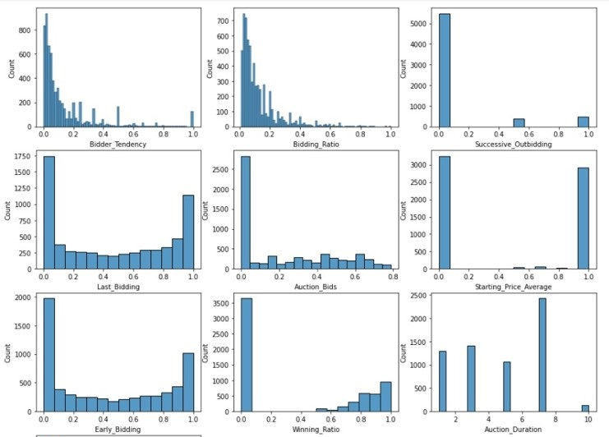
Histogram of Raw Data
Notes:
Here is an outlook on the values of our dataset.

Slide 8
Data Preprocessing
Missing values:
No null values or duplicates obtained. Therefore no need to remove them.
Feature creation:
A dataframe is created from data.
The target(label) values are encoded.(the data was already scaled.)
Feature and label columns are seperated.
Notes:
We found no null variables or duplicates in our dataset.

Slide 9

Preprocessing Implementation
- Only necessary columns are taken.
Notes:
We did not use the record ID and auction ID, therefore we did not take those columns into our dataframe. Simply because they were IDs that had no significance to our process.

Slide 10
Implementation
Environment/IDE: Python/Jupyter Notebook
Libraries:
sklearn : Used for DBSCAN, k-means and AGNES methods.
panda : Used to import and handle the dataset.
mlxtend: Used for initializing the algorithms.
matplotlib: Used for creating related plots.
Notes:
Here are the most significant libraries we used in our project:

Slide 11
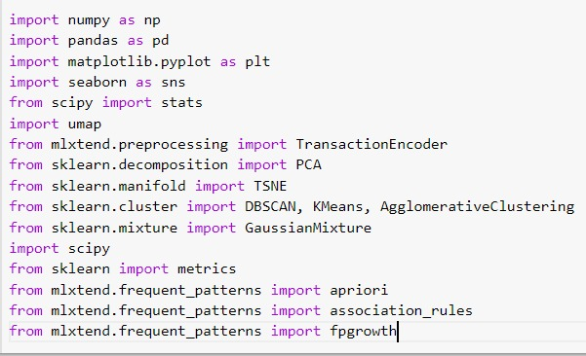
Model Construction & Performance Results
The models were constructed based on
3 frequent pattern mining models as follows:
Extracting frequent itemsets from a data set by constructing 3 different models.
i) Apriori.
ii) FP-Growth.
iii) ECLAT.
3 clustering analysis methods as follows:
Dividing the dataset into groups such that data points in the same group are more similar than the data points in other groups.
i) K-Means.
ii) AGNES.
iii) DBSCAN.
Notes:
Here is a look at the full version of our imported libraries. Also, I’d like to mention that in our database support values we obtained were too low. As a solution, we summed up similar support values in the same set and came up with optimized support values. We used that in all of our algorithms.

Slide 12
Apriori
Frequent items found by Apriori algorithm with min_support = 0.05
Libraries used: mlxtend
Search method used: Breadth first search
Notes:
We used minimum support of 5%to work the best. We implemented the pattern using mlextend.frequent_patterns apriori library. Apriori uses breadth first search method. Despite being simple Apriori works best on larger datasets.
* Minimum-Support is a parameter supplied to the Apriori algorithm in order to prune candidate rules by specifying a minimum lower bound for the Support measure of resulting association rules.

Slide 13
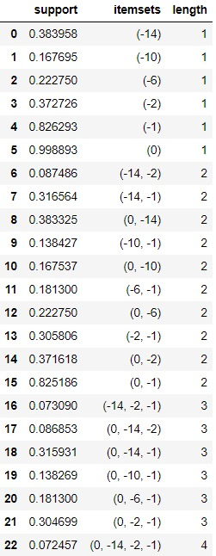
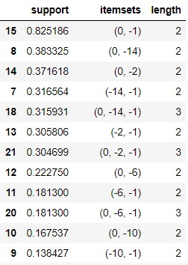
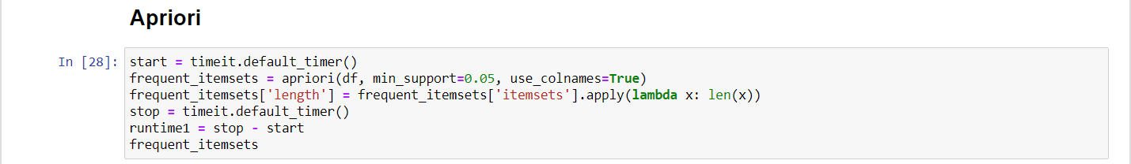
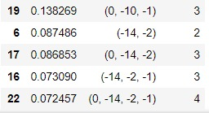
Apriori
Results: (with min_support = 0.05)
Runtime: 0.082 secs
Notes:
Support refers to items' frequency of occurrence; confidence is a conditional probability. Length is how many items there exists. The support of an itemset is how many times the itemset appears in the transaction database.

Slide 14
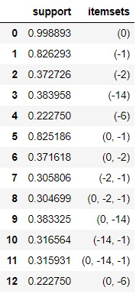
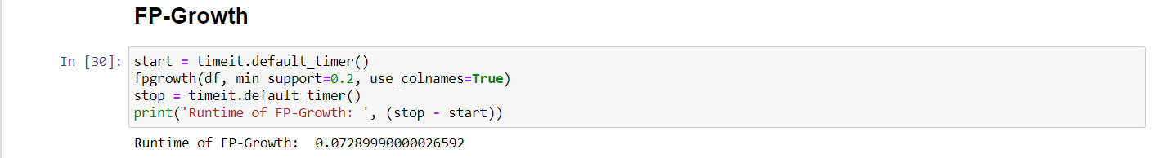
FPGROWTH
Results: (with min_support = 0.05)
Runtime: 0.073 secs

Slide 15
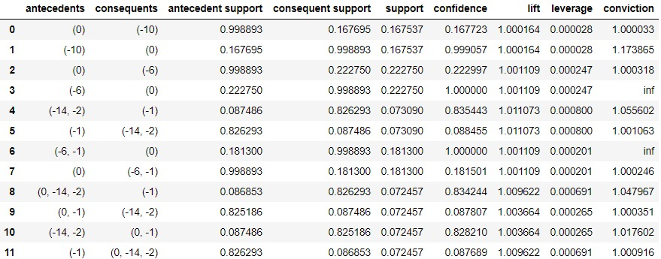
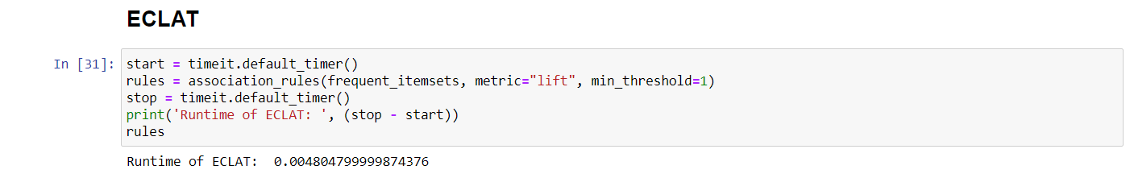
ECLAT
Results: (with min_support = 0.05)
Runtime: 0.005 secs

Slide 16
k-means
Visualization methods we used for k-means are PCA, umap, t-SNE.
We run k-means for range of 10 clusters.
In order to pick the best cluster number, we ran it multiple times with different cluster numbers (ranged from 1 to 15).
We visualize clusters in 3-dimensions using t-SNE. We found that 10 clusters work the best.

Slide 17
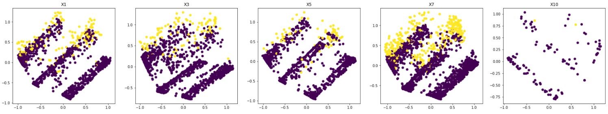
PCA Visualization

Slide 18
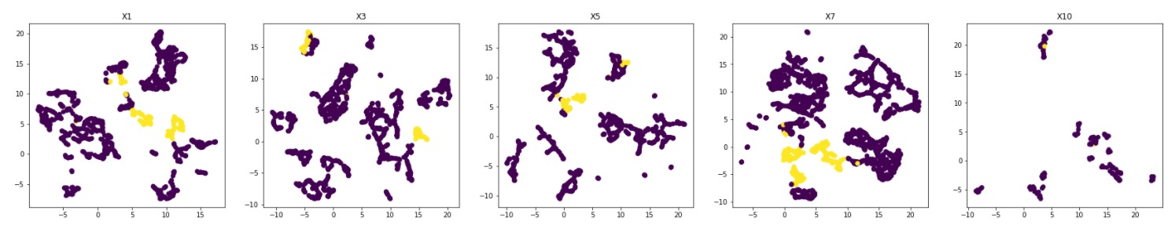
UMAP visualization

Slide 19
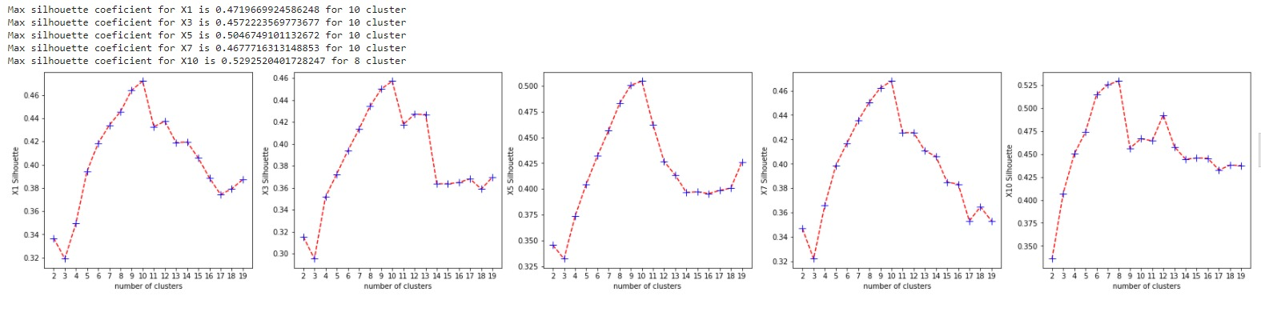
k-means Results

Slide 20
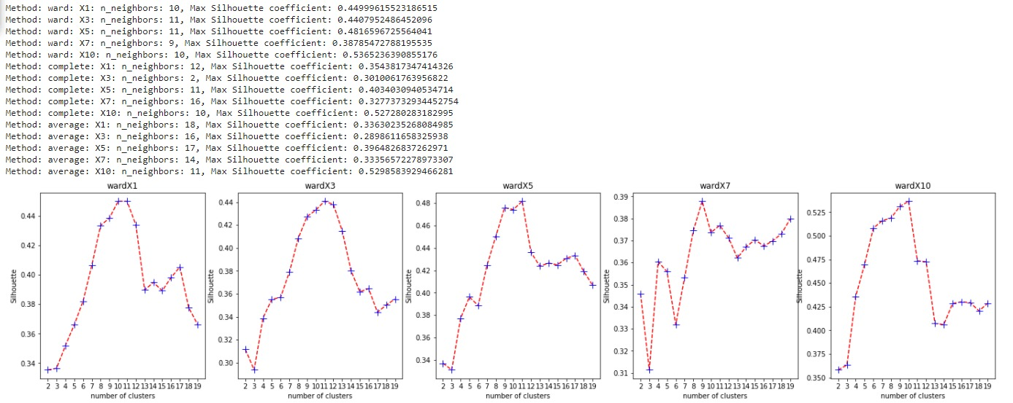
AGNES

Slide 21
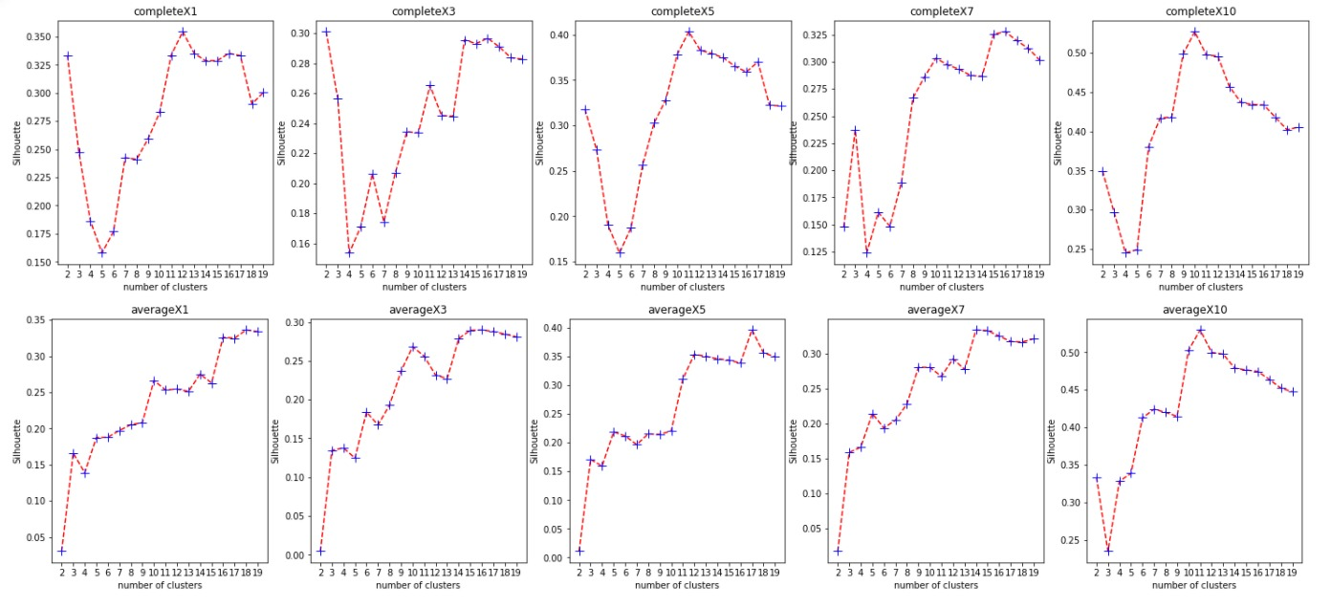
AGNES

Slide 22
DBSCAN
For DBSCAN clustering, we fed the model with 2 different parameters:
Epsilon(eps): the maximum distance btw two samples to be considered as neighbours.
min_samples: the minimum number of samples needed for a point to be considered as core point.
Different combinations of values are used for parameters and resulsts are compared.

Slide 23
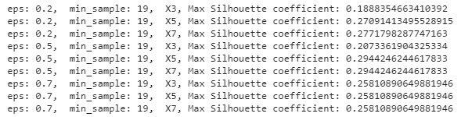
DBSCAN

Slide 24
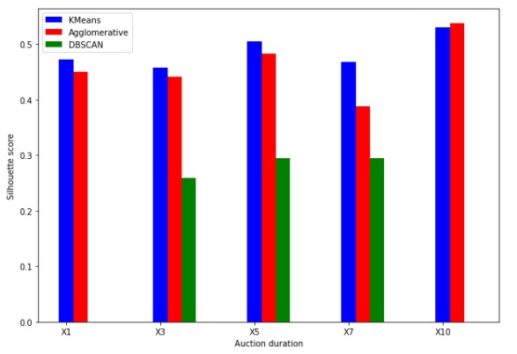
Comparison of Clusters

Slide 25
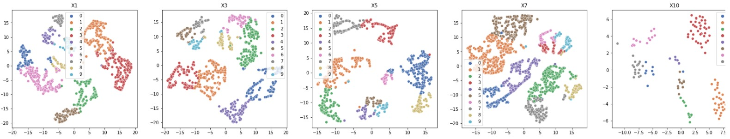
Clusters obtained by using k-means

Slide 26
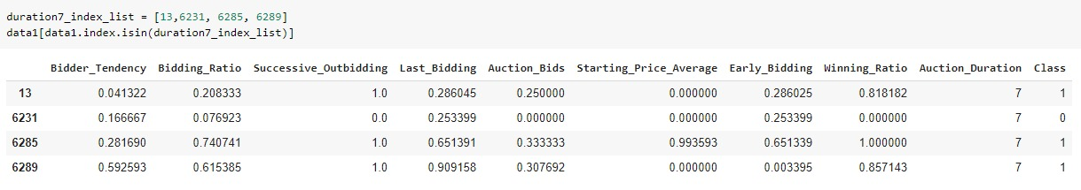
Analysis

Slide 27
Conclusion
Different methods for selecting cluster number exists. We should be careful about the result, because selecting process is a bit arbitrary.
Cluster number affects the performance of clustering dramatically.
K-means and AGNES worked well for our dataset. However, results could very well depend on an another dataset.
Runtime Performance Comparison: k-means > DBScan > AGNES (Clustering)
Runtime Performance Comparison: ECLAT > Apriori > FPGrowth (Frequent Pattern)

