Slide 1
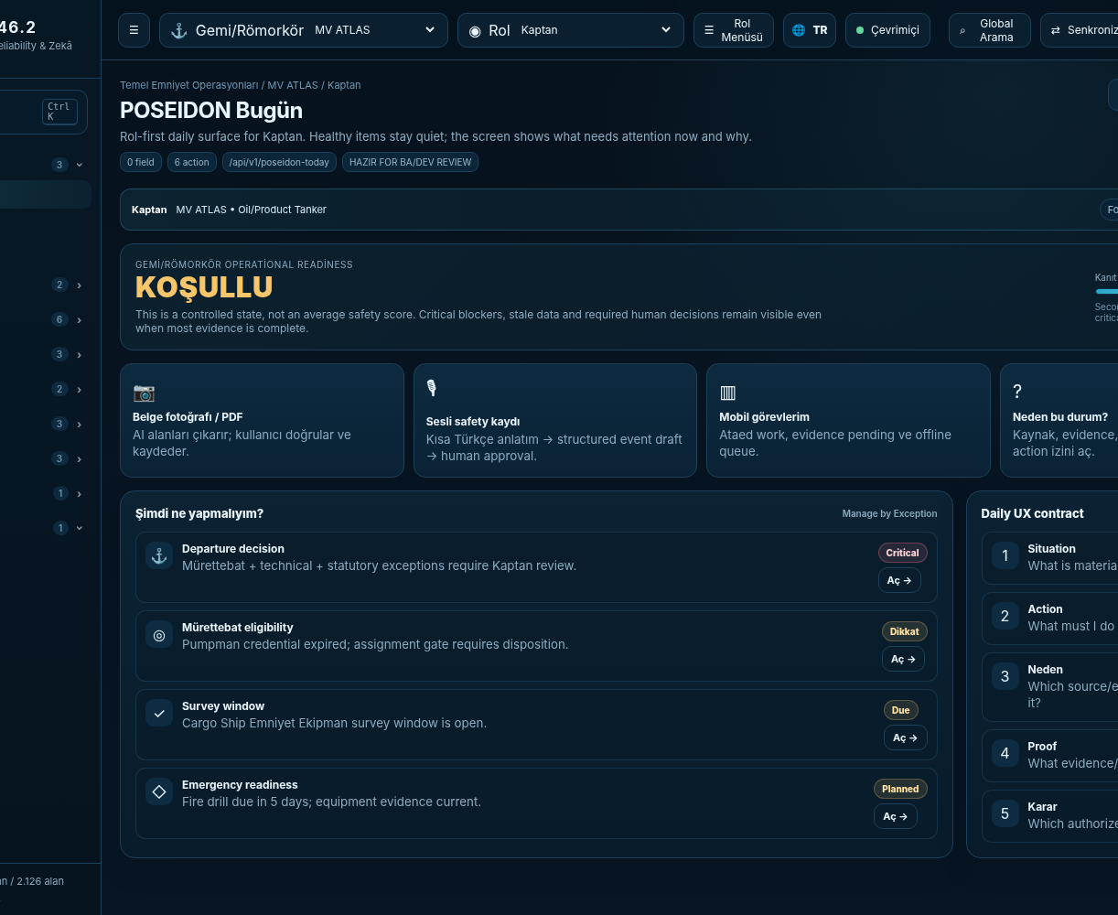
POSEIDON v46.3
Gemi + Römorkör Emniyet, Uyum, Güvenilirlik ve Zekâ İşletim Sistemi
Yönetim • Satış • Teknik • Controlled Candidate Sunumu
196 EKRAN
2.316 ALAN
128 KAYNAK
13 TUG
Ship Safety, Compliance, Reliability & Intelligence OS
Scope freeze: GEMİ + RÖMORKÖR. Fleet/Company yönetim bağlamıdır; Port/Terminal/Berth/VTS yönetimi kapsam dışıdır.

Slide 2
Yönetici Özeti
Ürün analizini yeniden açmadan Foundation geliştirmeye geçilecek kontrollü baseline.
GO
196
2.316
128
2 MOD
Sprint 0 / Foundation
Kontrollü ekran
Alan sözleşmesi
Mevzuat kaynak evreni
Gemi + Römorkör
Analiz baseline hazır
Role/context ile sadeleşir
API + entity + FR + test izi
Applicability ile aktive olur
Eşit first-class çalışma modu
Bugün ne hazır?
Ne paralel kapanacak?
Freeze kuralı
Master Product Spec • PRD/SRS • 196 ekran • 2.316 alan • TR/EN prototip • Backlog • Test/UAT gates • Legal register • Applicability engine • Tug crew/equipment rule pack
Final ERD • ürün geneli API/Integration Spec • 196 ekran görselli katalog • AI Governance/Data Strategy • external flag/class/legal sign-off • pilot data reconciliation • CI/DB gate
Ana kapsam değişmeyecek. Yeni ihtiyaçlar Change Control / MOC üzerinden değerlendirilecek. Critical UNKNOWN hiçbir zaman sahte “uyumlu/hazır” sonucu üretmeyecek.
Scope
Requirement
Screen/Field
API/Entity
FR/Test
Development

Slide 3
Neyi çözüyor?
Denizcilik operasyonunda bilgi var; sorun, doğru anda doğrulanmış karar ve kanıta dönüşmemesi.
Dağınık operasyon
Reaktif emniyet
İzlenebilirlik açığı
Çözüm
SMS dokümanları, crew belgeleri, PMS, class/flag cert, HSE kayıtları ve operasyon kanıtları farklı yerlerde.
Kritik signal çoğu zaman audit, arıza veya olaydan sonra görünür. Tekil “yeşil KPI” gerçek blocker’ı maskeleyebilir.
Requirement → control → operation → evidence → verification → human decision zinciri tek yerde değil.
POSEIDON doğru role yalnız bugünkü istisnayı ve yapılacak işi gösterir; nedenini, kaynağını, sahibi ve kanıtıyla birlikte.
Operate. Comply. Predict. Decide.

Slide 4
Kontrollü Kapsam: Gemi + Römorkör
İki operasyon modu aynı güvenlik/compliance çekirdeğini paylaşır; iş ritimleri farklıdır.
GEMİ MODU
RÖMORKÖR MODU
Departure • Voyage • Arrival • Cargo/Tanker • Crew • PMS • Certificates • Emergency • Safety • Assurance • Compliance • Mobile/Offline
Job Intake • Job Board • Assignment • Crew/Equipment Readiness • Towage Plan • Risk & Briefing • Execution • Daily Log • History
ORTAK
ÇEKİRDEK
Fleet / Company = tenant, yönetim, toplulaştırma ve karma filo context’i
Kapsam dışı: Port/Terminal/Berth allocation, VTS/Port Traffic, liman kaynak planlaması. Port/berth bilgisi yalnız operasyon context’i olabilir.

Slide 5
Ürün Mimarisi
Role-first daily UX üzerinde 16+ domain; kullanıcıya 196 ekranı ezberletmeyen yapı.
Command
Fleet
People
Operations
Today / Inbox / Role Dashboards
Vessel / Readiness / Passport
Crew / Competence / Work-Rest
Ship / Tanker / Tug
Safety
Technical
Knowledge
Assurance
HSE / Emergency / Events
PMS / Asset / Defect / Spares
SMS / Procedure / Notices
Audit / PSC / Class / Certification
Regulatory
Intelligence
Mobile
Administration
Requirement / Applicability / Evidence
Why / Risk / Copilot / Decision
Tasks / QR / Offline / Sync
Workflow / Integration / Data Trust

Slide 6
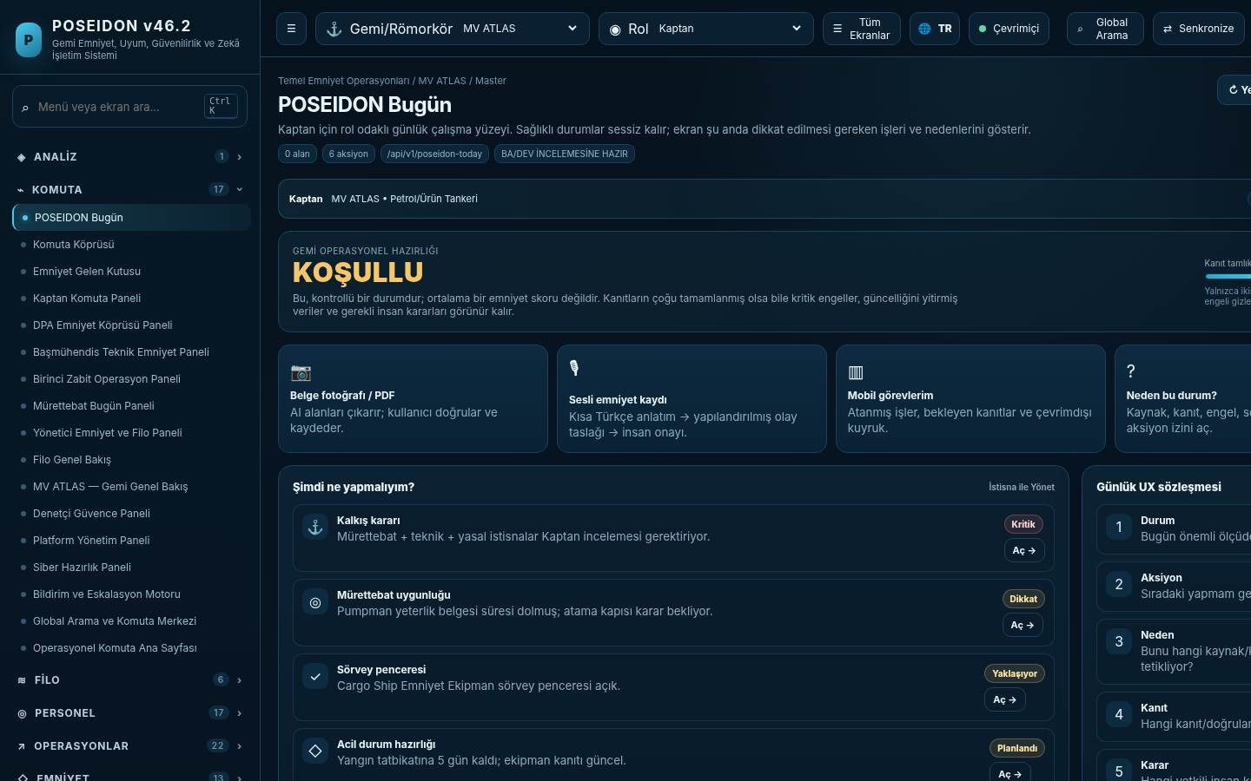
Role-First UX: POSEIDON Bugün
“Normal” sessiz kalır; yalnız bugün karar/aksiyon gerektiren istisnalar görünür.
Situation
Bugün maddi olarak ne farklı?
Action
Şimdi ne yapmalıyım?
Why + Proof
Hangi kaynak/kanıt/blocker bunu sürüklüyor?
Decision
Hangi yetkili insan karar vermeli?

Slide 7
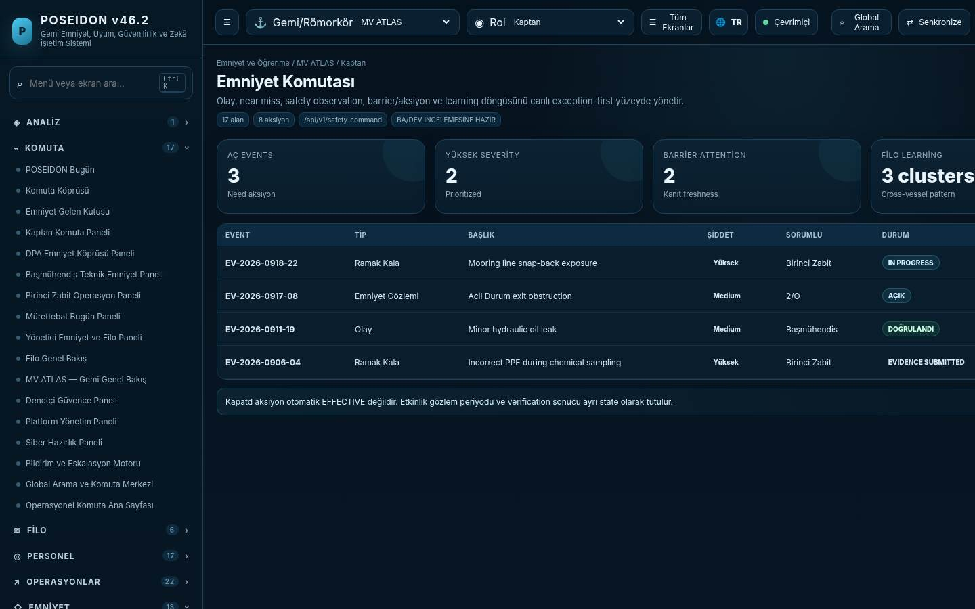
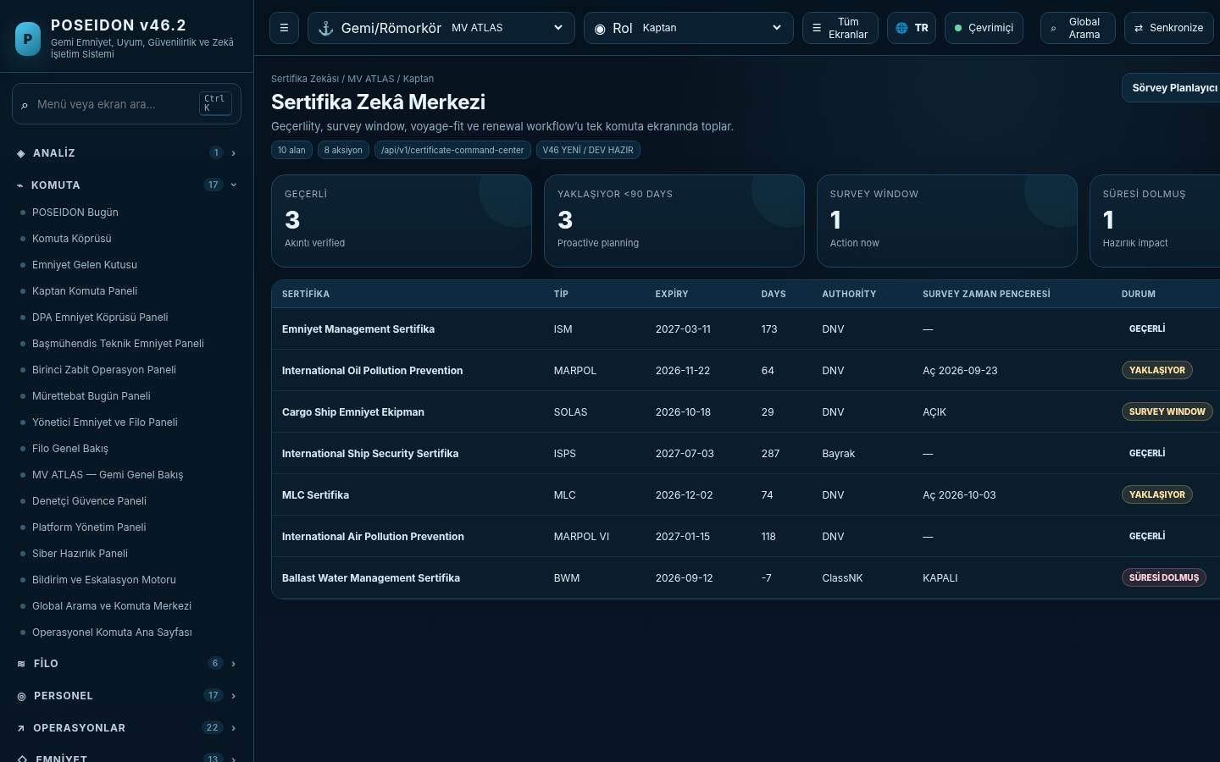
Gemi Uçtan Uca Yolculuk
Voyage readiness artık günlük operasyon verisiyle beslenir: Noon + Deck/Engine Logs + Fuel/ROB + evidence → readiness.
Today
Departure
Crew
Technical
Certificates
Operation
Evidence
Master Decision
Örnek: Critical maintenance + crew eligibility + survey window + emergency readiness aynı Master kararında görünür.

Slide 8
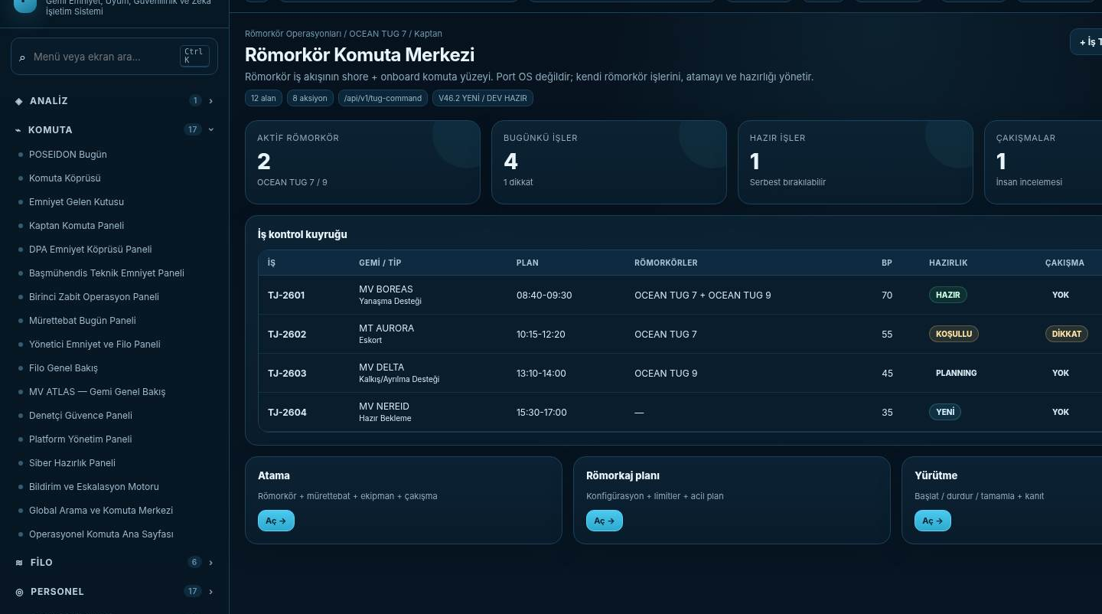
Römorkör Uçtan Uca Yolculuk
Römorkör artık profile değil; kendi kısa/sık iş ritmi ve emniyet kapıları olan tam operasyon modudur.
Job Intake
Job Board
Assignment
Readiness
Towage Plan
Briefing
Execution
Log / History
Shore Planner
Atama yapar; overlap/BP/crew/equipment/PMS/cert kontrollerini görür.
Master / Tug Master
Final onboard safety authority. Start / suspend / abort / complete kararını verir.
Port OS değil
Kendi tug işlerini yönetir; berth/VTS/terminal kaynak yönetimi yapmaz.

Slide 9
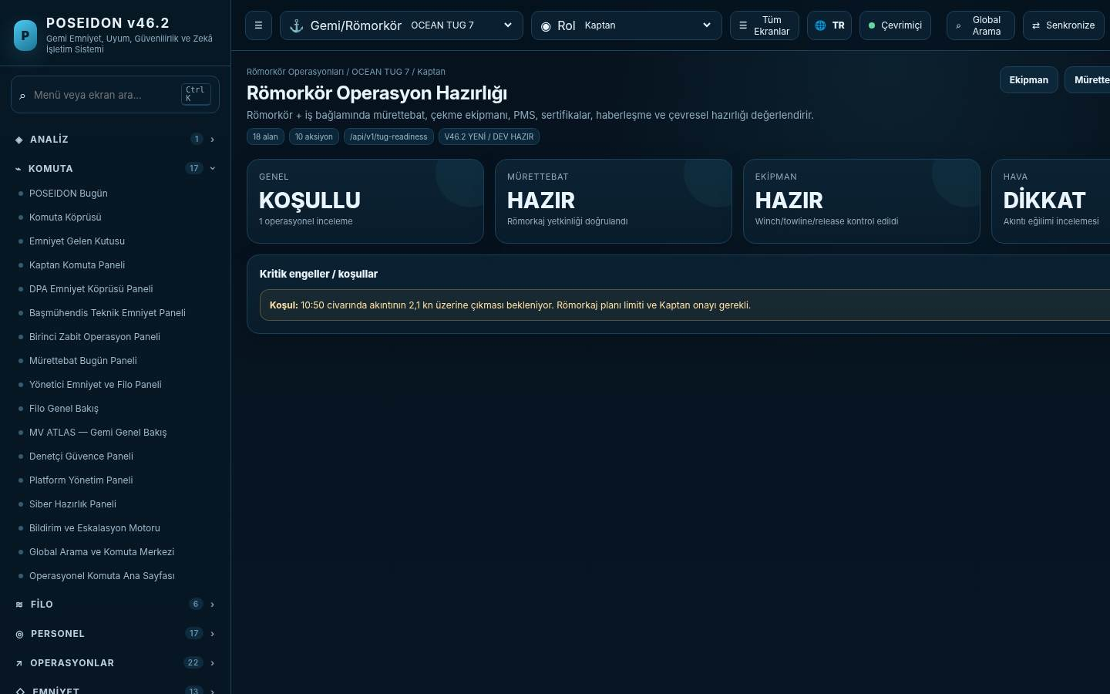
Römorkör Readiness
Crew + towing equipment + PMS + certificate + weather/comms koşulları açıklanabilir şekilde birleşir.
CONDITIONAL
Overall state
1 operational review
Crew
MSMD + certificate + medical + competence + work/rest
Equipment
Winch • towline • tow hook • ERS • FiFi • PMS
Human Gate
Shore ataması onboard Master kararını bypass etmez.

Slide 10
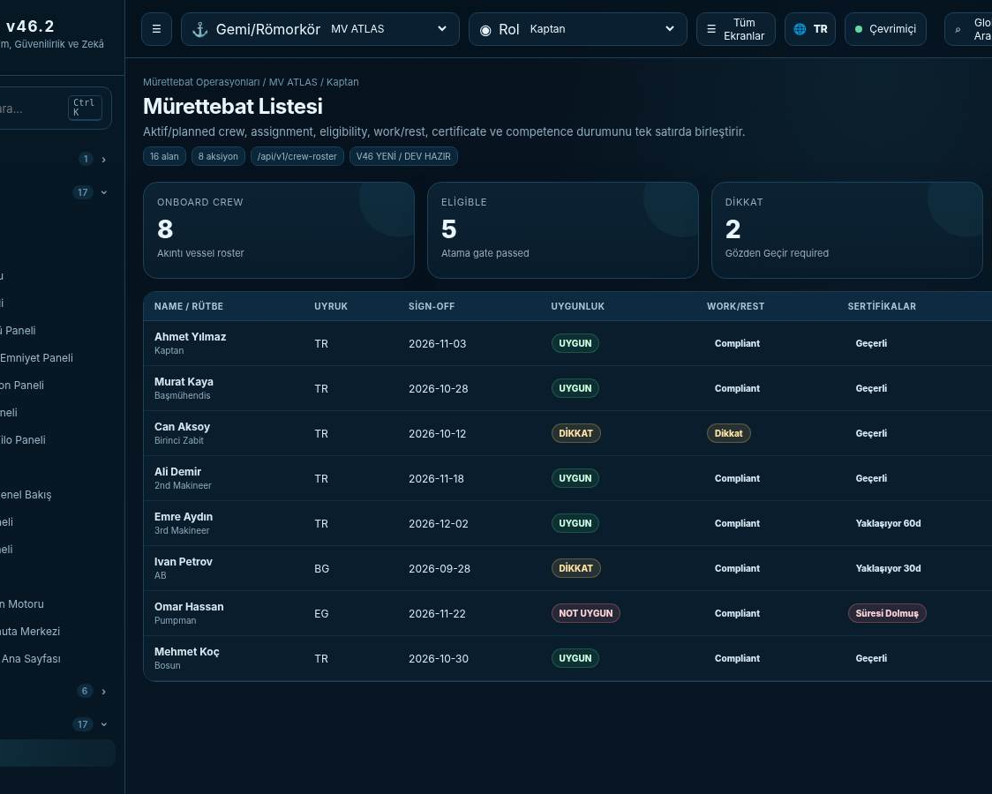
Crew & Competence
Person → Position → Qualification → Certificate → Competence → Training → Experience.
Eligibility Engine
MSMD → GT/kW → capacity → limitations → medical → training → competence → familiarization → work/rest → briefing
Safe Manning
Required profile vs actual crew; vessel/tug-specific authority document is primary evidence.
Assignment Gate
Expired/missing mandatory credential = NOT_ELIGIBLE; uncertainty = REVIEW_REQUIRED.
Fleet Insight
Repeated rest/competence gaps feed Safety Intelligence without exposing unnecessary sensitive health data.

Slide 11
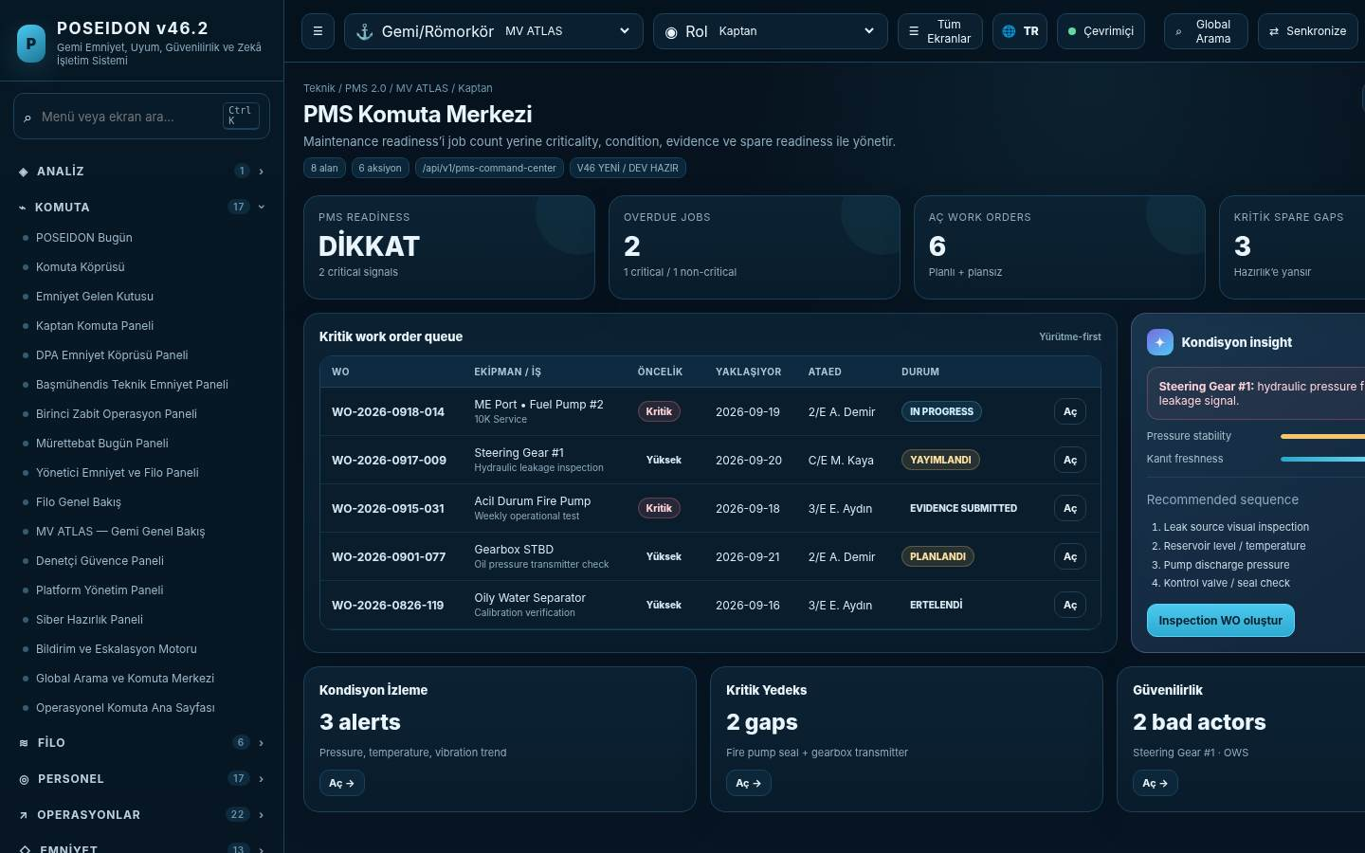
Technical / PMS 2.0
Vessel → System → Equipment → Component; critical defects readiness’e doğrudan etki eder.
Asset Reliability
Criticality • running hours • condition • failure history • redundancy
Work Order
Permit/risk/evidence/verifier olmadan kritik iş “tamamlandı” sayılamaz.
Critical Spares
Minimum qty + stock + reorder + asset risk; eksik kritik yedek Safety Readiness’i düşürür.
Class / Survey
Defect, PMS ve survey evidence aynı equipment lineage içinde.

Slide 12
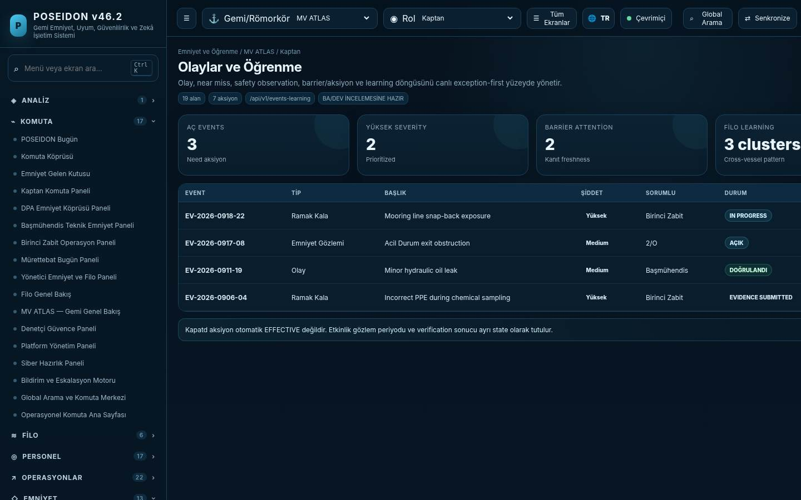
Safety & Learning
Event → immediate action → evidence → investigation → barrier/root cause → action → effectiveness → lesson.
HSE bağımsız domain
Quality/CAPA altına gömülmez; PTW, risk, PPE, observations, stop-work, contractor safety.
Barrier Health
Preventive / mitigating barriers Healthy • Degraded • Failed olarak izlenir.
Learning Loop
Bir gemideki lesson → fleet notice/procedure/training → acknowledgement → effectiveness.
Protected Reporting
Confidential/anonymous workflow, restricted reviewer ve minimum-data principle.

Slide 13
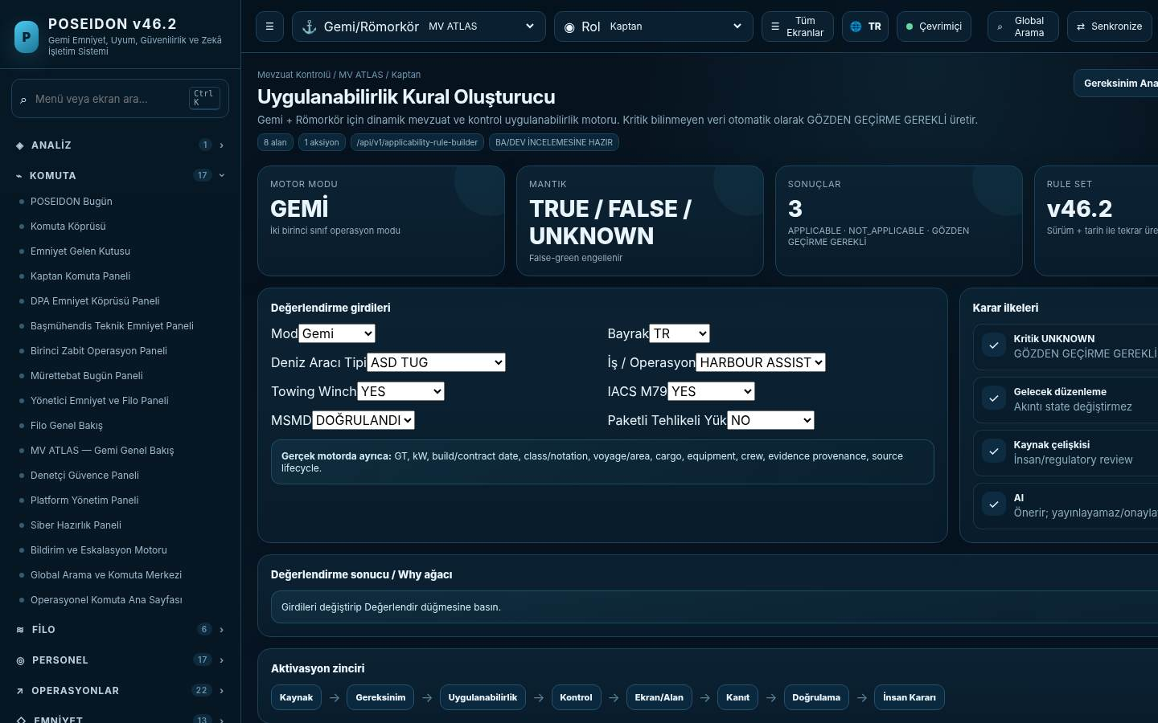
Dynamic Applicability Engine
Regülasyon deposu değil: belirli gemi/römorkör + operasyon + tarih için aktif kontrolü hesaplayan karar altyapısı.
3-Değerli Mantık
TRUE • FALSE • UNKNOWN
3 Sonuç
APPLICABLE • NOT_APPLICABLE • REVIEW_REQUIRED
Girdi
Flag • Class • GT/kW • Build • Voyage/Area • Cargo/Job • Equipment • Crew • Tarih
Çıktı
Requirement • Control • Screen/Field • Evidence • Verification • Test • Notification

Slide 14
Yasal / Regülatif Kaynak Evreni
Master register “her satır her gemiye uygulanır” listesi değil; Dynamic Applicability için kontrollü source universe.
128
41
13
12
5
Uluslararası
Türkiye
AB/AEA
Tug / Industry
Future / Monitor
IMO/ILO sözleşme-kod-guidance
Kanun/yönetmelik/yönerge/talimat
MRV/ETS/FuelEU/GDPR/Cyber/AI
IACS/Class + ISGOTT/SIRE/TMSA
MLC 2025, IMO net-zero, CRA full etc.
P0 Kök Kaynaklar
Applicability
Production Legal Gate
ISM / SOLAS / STCW / MARPOL / MLC / ISPS / IMDG / Türk ISM / 2024 crew / 2025 tug / KVKK / Cyber / regional rules
Flag + class + vessel type + GT/kW + build + voyage/area + cargo/job + equipment + crew + date + contract.
Pilot ship/tug actual docs + class/RO + flag/legal SME sign-off olmadan “tam yasal uyum” iddiası yapılmaz.
Master register: POSEIDON_v46.3_Gemi_Romorkor_Master_Yasal_Regulatif_Mevzuat_Register_TR.xlsx

Slide 15
Assurance, Class & Certificate Intelligence
Requirement → Certificate → Vessel/Tug → Survey Window → Evidence → Readiness.
Statutory & Class Register
DOC/SMC • Load Line • MARPOL • MLC • BWM • class status/conditions • BP evidence
Survey Planner
Annual/intermediate/special/docking + HSSC windows + equipment-specific survey packs.
PSC / Vetting Memory
Deficiency recurrence, root cause, evidence readiness and fleet learning.
Audit Pack
Requirement → control → evidence → verification export; immutable provenance.

Slide 16
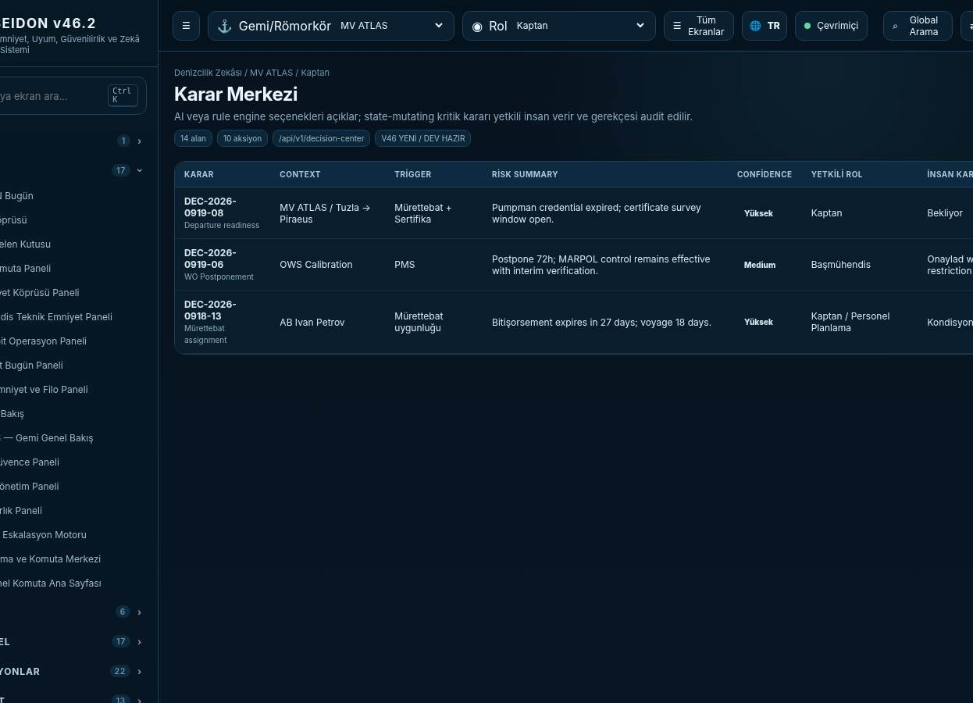
Maritime Intelligence ve AI Sınırları
AI chatbot değil; source-aware pattern detection ve decision support.
Detect
Explain
Recommend
Authorized Human Decision
Source-aware
Her öneri kaynak/kanıt/confidence ve etkilenen control ile açıklanır.
No silent action
AI compliance publish, safety approval, closure veya Master override yapamaz.
Data boundaries
Tenant isolation, sensitive crew/reporting minimization, provider/transfer controls.
Examples
Repeat steering defect + overdue PMS + near miss + audit finding → systemic risk signal.

Slide 17
Data & Evidence Architecture
Operational truth; evidence provenance ve effective-dated master data üzerine kurulur.
Master Data
Operational
Compliance
Company • Vessel/Tug • Asset • Person • Position • Reference
Job • Voyage • Permit • Event • Work Order • Audit
Source • Requirement • Rule • Control • Certificate • Survey
Evidence
Decision
Intelligence
Document • Photo • Voice • Measurement • Signature • Hash
Verification • Exception • Master/DPA decision • Effectiveness
Why tree • trends • risk clusters • recommendations
Source
Requirement
Control
Operation
Evidence
Verification
Decision

Slide 18
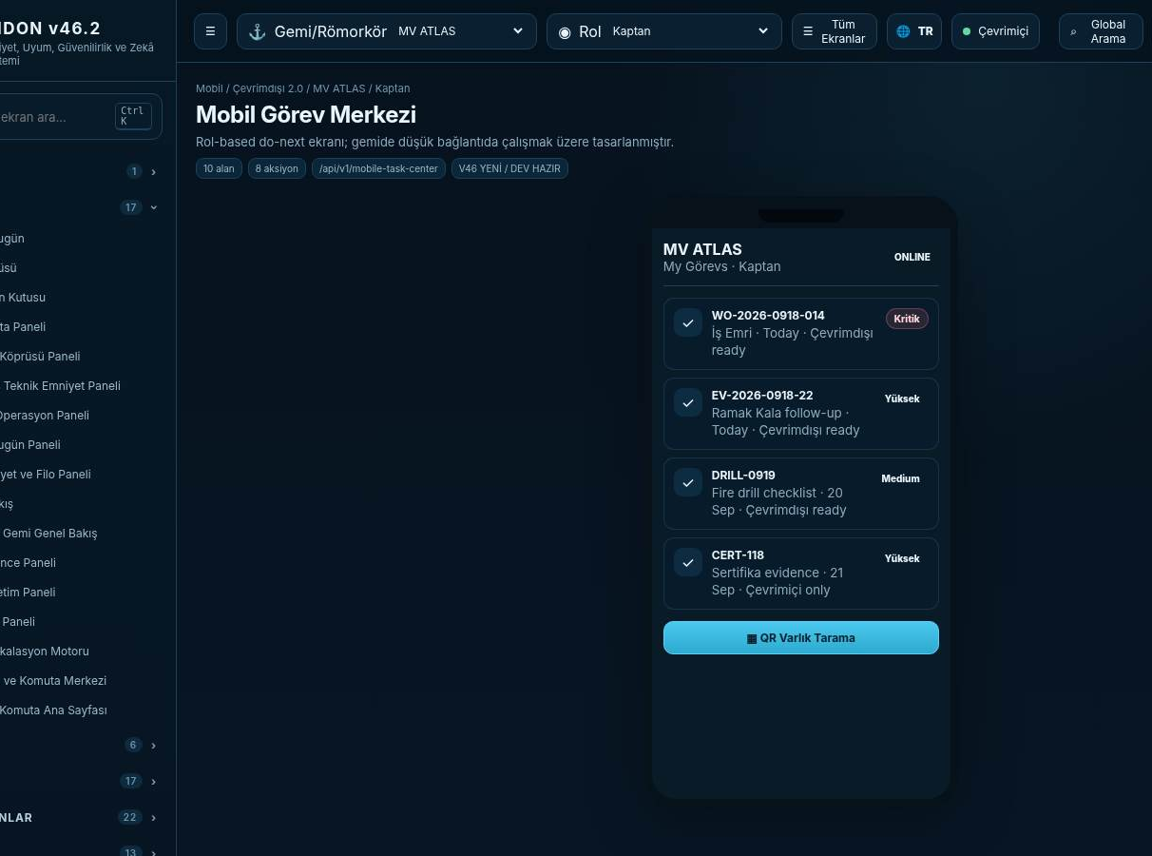
Mobile / Offline-First
Shipboard ve tugboard-critical desteklenen akışlarda bağlantı kaybı emniyet bilgisini görünmez yapmaz.
Client UUID + base version
Offline create/update kayıtları idempotent sync için kendi kimliği ve base version taşır.
Conflict policy
Material conflict silent last-write-wins kullanmaz; human resolution center’a gider.
Evidence capture
Photo/PDF/voice/measurement/QR; source time/device/user/provenance korunur.
Critical stale data
Rule/evidence freshness aşılırsa offline istemci false READY üretmez.

Slide 19
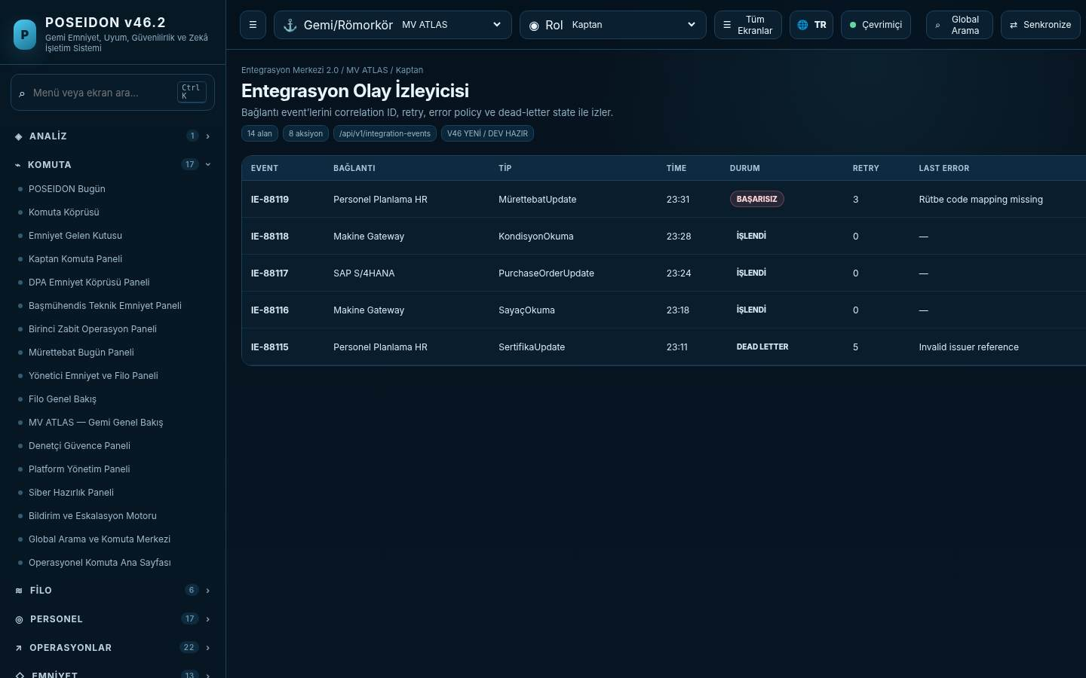
Integration Hub 2.0
ERP/HR/Crewing/IoT/Class/RO/AIS gibi sistemlerle adapter + mapping + event + provenance modeli.
Connectors
REST/SFTP/file/webhook/queue/IoT adapters
Mapping
Source schema → canonical entity + validation + transformation
Eventing
Outbox/idempotency/retry/dead-letter/correlation
Source of truth
Her alan için authoritative source + provenance + reconciliation policy

Slide 20
Development Traceability
“Ekran tasarımı” değil; requirement’tan teste kadar kontrollü delivery contract. v46.3: 196 ekran / 2.316 field contract.
196
2.316
128
13
P0
Screen
Field
Legal Source
Tug Screen
Golden Tests
Controlled inventory
Validation/role/offline trace
Versioned register
First-class mode
Critical invariants
Business Need
Requirement
Screen
Field
API
Entity
FR
Test
Evidence
Definition of Ready
Definition of Done
Release Gate
Scope + actor + states + validations + source + API/entity + offline + audit + acceptance.
Code + tests + evidence trace + security + performance + accessibility + documentation.
No unresolved P0 safety blocker; regulatory review and pilot evidence captured.

Slide 21
Ticari Paketleme
Tek platform; müşterinin operasyon profiline göre modüler satılabilir yapı.
Core Safety Management
Technical / PMS
Crew & Competence
SMS • Safety • Emergency • Events • Controlled Knowledge • Assurance
Asset • PMS • Defects • Spares • Condition • Drydock • Reliability
Roster • assignment • certificate • training • safe manning • work/rest
Tug Operations
Advanced Assurance
Regulatory Intelligence
Job board • assignment • readiness • towage plan/briefing/execution
PSC/Class/ISM/MLC readiness • evidence packs • management review
Source governance • applicability • change radar • future sandbox • AI decision support

Slide 22
Kim Satın Alır / Kim Kullanır?
Karar vericiye risk görünürlüğü; operasyon ekibine doğru günlük iş; audit tarafına kanıt izi.
CEO / Fleet Manager
DPA / HSEQ
Master / Tug Master
Fleet pulse • risk • investment priorities
ISM • incidents • audit • regulatory change
Readiness • authority • today actions
Technical Superintendent
Crewing Manager
Auditor / Compliance
PMS • defects • class/survey • spares
eligibility • rotation • training • safe manning
requirement → control → evidence trace
Tek veri modeli; role göre farklı günlük yüzey.

Slide 23
Geliştirme Yol Haritası
Scope freeze sonrası yeniden analiz yerine kontrollü delivery.
Foundation
Auth/RBAC • tenant • master data • audit • offline shell • rule/evidence core
0
Ship Core
Today • crew • PMS • cert • safety • controlled knowledge
1
Tug Core
Job/assignment/readiness/towage execution + crew/equipment rules
2
Assurance
Audit/PSC/Class/ISM/MLC + evidence packs + management review
3
Intelligence
Why • change radar • risk clusters • AI decision support
4
Pilot → Release
1 ship + 1 tug / mixed fleet • UAT • legal/class sign-off • release gates
5

Slide 24
Pilot, UAT ve Release Gate
Tek ship demo yeterli değil: Gemi + Römorkör dual-mode gerçek veriyle doğrulanacak.
Pilot Minimum
Evidence Baseline
P0 Gates
≥1 gerçek gemi journey + ≥1 gerçek römorkör/towage journey veya gerçek mixed-fleet operator.
Certificates • MSMD • crew • class • assets/PMS • SMS/plans • defects • BP/winch/ERS.
Master authority • false-green prevention • offline conflicts • regulatory applicability • critical PMS/evidence.
UAT
Legal / Class
Release
Role-based journeys; exception-first UX; performance/accessibility/security; mobile/offline.
Actual vessel+tug applicability reviewed by flag/class/SME/legal owner.
No unresolved P0; controlled source versions frozen; audit pack and rollback ready.

Slide 25
Controlled Candidate: Eksikler Nasıl Kapatılıyor?
Rakip benchmark delta’sı Master Spec, PRD/SRS, prototype, traceability, backlog ve test setine işlendi; v46.3 artık kontrollü aday baseline’dır.
Final PPT
BU DOSYA
CLOSED
Product-wide ERD
Yeni doküman + ERD diagram
CLOSED
API / Integration Spec
Yeni docx + OpenAPI/catalog
CLOSED
196 ekran görselli katalog
Yeni 196 screenshot manual
CLOSED
AI Governance + Data Strategy
Yeni controlled policy
CLOSED
External legal/class sign-off
Template + checklist hazır
EXTERNAL
Real pilot data reconciliation
Workbook/template hazır
CUSTOMER DATA
CI build / live DB gate
Checklist/scripts hazır
ENGINEERING

Slide 26
Karar
v46.3 controlled candidate onaya hazır. PO/Marine SME/Regulatory/Engineering/QA sign-off sonrası geliştirme baseline’ı olarak dondurulur.
Geliştirmeye geç.
Tek Platform • İki Mod • Tek Kaynak İzi • İnsan Otoritesi
Requirement
Applicability
Control
Operation
Evidence
Verification
Human Decision
Learning
GEMİ
RÖMORKÖR
ORTAK ÇEKİRDEK
Safety + Crew + Technical + Assurance
Job + Assignment + Readiness + Towage
Regulatory + Evidence + Decision + Learning
POSEIDON v46.3 — Controlled Candidate Candidate

Slide 27
NOZZLE Benchmark → Ürün Kararı
Rakibi kopyalamak yerine doğru boşlukları kapatıp farklılaştırıcı çekirdeği büyütüyoruz.
AL
NOZZLE
Rakip güçlü: Ship Operations, PMS/Survey, mobile execution, ERP breadth.
KORU
POSEIDON
Tug lifecycle + Applicability + Readiness/Why + Evidence/Human Decision.
SINIR
OUT / INTEGRATE
Finance, payroll, full procurement, warehouse, chartering ve Port OS build edilmiyor.
v46.3 Delta
+11 ekran
Noon, Deck/Engine Daily Logs, Fuel/BDN/ROB, SOF, Downtime; Service Report, Pre-Survey, Risk Templates/High-Risk Work.
Controlled Inventory
196 ekran • 2.316 alan
Rakip analizi sonucunda yeni business capability’ler trace, field, API ve test contract’ına işlendi.
POSEIDON v46.3 • 27

Slide 28
Ship Operations 2.0
NOZZLE’dan alınan en önemli ders: günlük veriyi tek kez gir, voyage/technical/compliance/readiness boyunca yeniden kullan.
Noon Report
Position • activity • weather • speed • fuel/ROB • Master review
Deck Daily Log
Watch • nav • pilot/tug • port/cargo • handover
Engine Daily Log
Hours • fuel/lube • measurements • alarms • defects/WO
Fuel / Bunker / BDN
Consumption • delivery/transfer • ROB • sulphur • evidence
Port Activity / SOF
Timestamp timeline • delays • cargo • Letter of Protest — Port OS değil
Operational Downtime
Cause • defect/WO/event • impact • Loss-of-Hire candidate
POSEIDON v46.3 • 28

Slide 29
Neyi Kopyalamıyoruz? Neyi Daha Derin Yapıyoruz?
Ürün odağı: maritime ERP breadth değil, güvenli operasyon karar derinliği.
BİLİNÇLİ KAPSAM DIŞI
• Full finance / AP-AR / budget / FX
• Crew payroll / expenses
• Full RFQ / PO / supplier lifecycle
• Enterprise warehouse
• Full chartering
• Port / terminal / berth / VTS management
Müşteride varsa adapter/connector ile entegre edilir.
ANA WEDGE
• Dedicated Tug Operations
• Dynamic Applicability
• UNKNOWN → REVIEW_REQUIRED
• Readiness + Why tree
• Barrier health + effectiveness
• Evidence → Verification → Human Decision
• Offline durable queue + conflict center
• Human-gated AI
POSEIDON v46.3 • 29

Slide 30
v46.3 Controlled Candidate — Go / No-Go
Bu sürüm “rakipte var” diye değil, business value + traceability + safety authority doğrulandığında freeze edilir.
PRODUCT / BA
PASS
196 ekran / 2.316 alan; scope boundary ve requirement trace orphan P0 = 0.
ENGINEERING / QA
PASS
New Ship Ops + PMS/Risk delta E2E; Tug ve Applicability non-regression; offline conflicts explicit.
MARINE / REGULATORY
SIGN-OFF
No false-green; real ship+tug UAT; external flag/class/legal gates where applicable.
Final karar
DEVELOPMENT GO
Sign-off sonrası v46.3 geliştirme baseline’ı olur. Sonrasında her değişiklik Change Control / MOC ile Requirement → Screen → Field → API → Entity → FR → Test zincirine işlenir.
POSEIDON v46.3 • 30

