Slide 1

IPv4 vs IPv6
IPv4: Current Standard
Address Format: 32-bit numeric addresses (e.g., 192.168.1.1)
Address Space: Approximately 4.3 billion unique addresses
Configuration: Primarily manual or DHCP-based
Security: IPsec is optional, not inherently built-in
Features: Widely deployed, supports NAT for address conservation
IPv6: Future-Proof Protocol
Address Format: 128-bit hexadecimal addresses (e.g., 2001:0db8:85a3::370:7334)
Address Space: Vastly larger, effectively infinite (3.4 x 10^38 addresses)
Configuration: Supports stateless auto-configuration (SLAAC)
Security: IPsec built-in and mandatory for compliance
Features: Improved routing efficiency, better multicast support

Slide 2
What is Subnetting?
Subnetting is the practice of dividing a larger network into smaller, more manageable subnetworks (subnets). This division allows for more efficient use of IP addresses, improved network performance, and enhanced security within an organization.
1. Logical Division
2. Enhanced Efficiency
3. Subnet Mask
Subnetting logically splits a single network ID into multiple, smaller segments. This enables better organization of connected devices and more controlled routing of data traffic.
It reduces network congestion by localizing traffic within its respective subnet. This minimizes the broadcast domain, leading to faster data processing and improved network responsiveness.
A critical component, the subnet mask, works with an IP address to differentiate the network portion from the host portion. It dictates how large each subnet is and how many hosts it can accommodate.

Slide 3
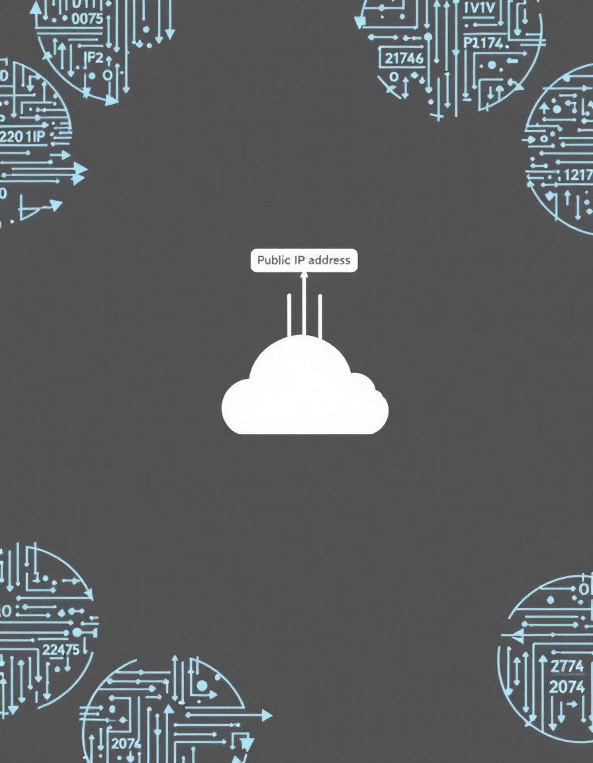
Network Address Translation (NAT)
Network Address Translation (NAT) is a method of remapping an IP address space into another by modifying network address information in the IP header of packets while they are in transit across a traffic routing device. It's crucial for both IP conservation and network security.
IP Address Conservation
Enhanced Security
Allows multiple devices on a private network to share a single public IP address for external communication, effectively delaying IPv4 address exhaustion.
By hiding internal network topologies and private IP addresses from external networks, NAT adds a significant layer of security against direct attacks.

