Slide 1

Networking
Networking refers to the practice of connecting two or more computers or devices so they can share data, resources, and information. It allows communication between systems through wired or wireless connections.
Importance of Networking
1. Enables data sharing between devices
2. Allows resource sharing (printers, files, applications)
3. Supports communication (emails, messaging, video calls)
4. Helps in business operations, cloud services, and the internet

Slide 2
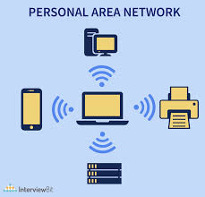
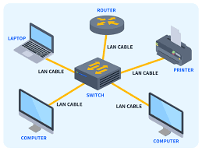
Types of Networks
Personal Area Network (PAN)
A PAN is a very small network around a person.
It connects personal devices like smartphones, smartwatches, earbuds, and laptops.
Bluetooth is the most common example.
2. Local Area Network (LAN)
A LAN is a small network used within a limited area like a home, school, or office.
It connects computers and devices to share data and resources.
LANs offer high speed and low cost.

Slide 3
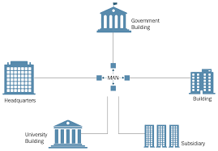
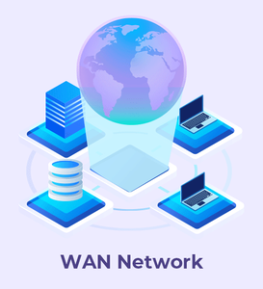
3. Metropolitan Area Network (MAN)
A MAN covers a city or a large campus.
It is bigger than a LAN but smaller than a WAN.
Used by telecom companies to provide internet across a city.
4. Wide Area Network (WAN)
A WAN covers a large geographical area such as cities, states, or countries.
The best example is the Internet.
WANs are slower and more expensive compared to LANs.

