Slide 1
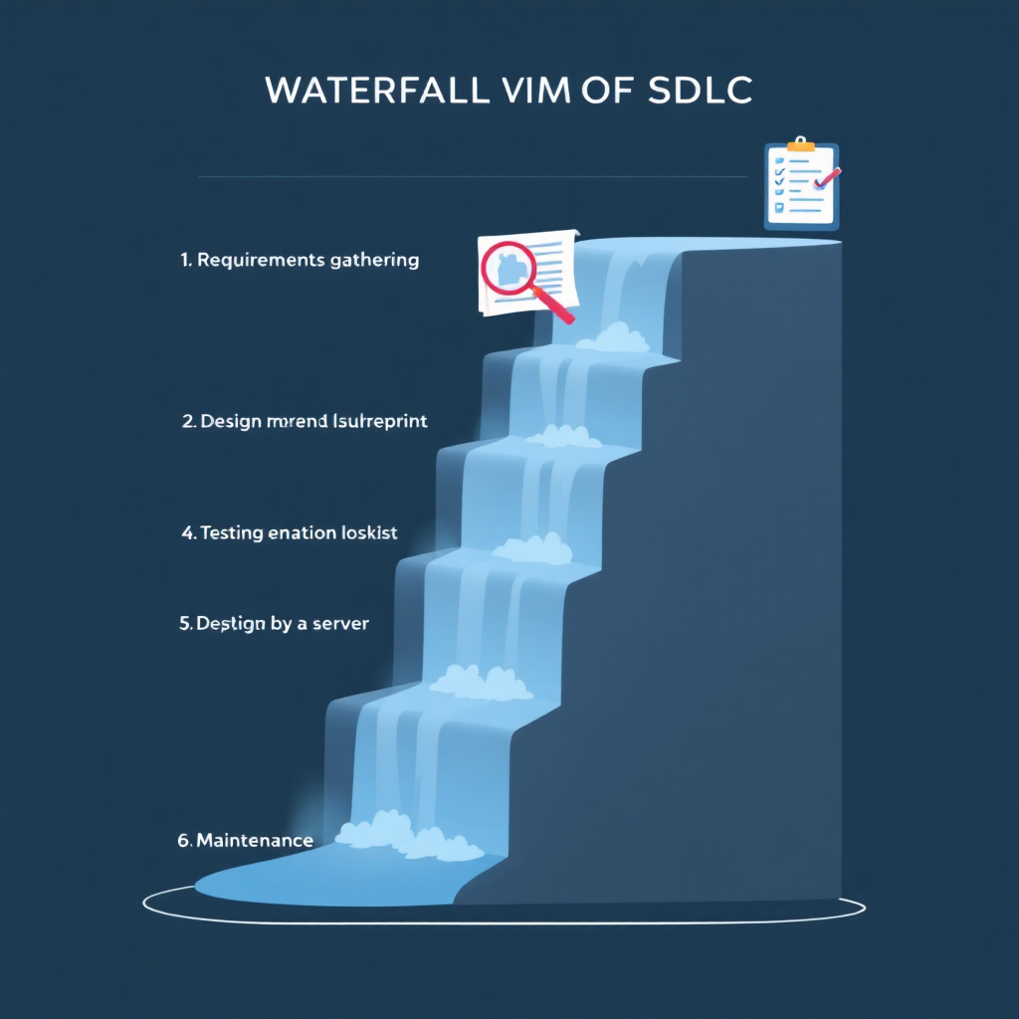
Waterfall Model
The Waterfall Model is a linear and sequential SDLC model. Each phase must be completed before moving to the next. Requirements are fixed and clear from the beginning.
Key Features
Phases follow one after another with no overlap.
Strict documentation.
Suitable for projects with stable requirements.
Phases
Requirement Gathering
System Design
Implementation (Coding)
Testing
Deployment
Maintenance

Slide 2
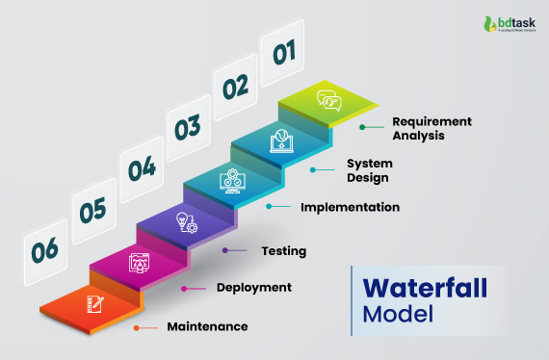
Waterfall Model
Advantages
Simple and easy to understand
Clear documentation
Easy to manage for small projects
Disadvantages
Changes are difficult once a phase is completed
Testing happens late
Not suitable for dynamic or complex projects
Example
A company wants to develop software for school result generation, where requirements are fixed (marks input, grade calculation). Waterfall works well because requirements will not change frequently.

Slide 3
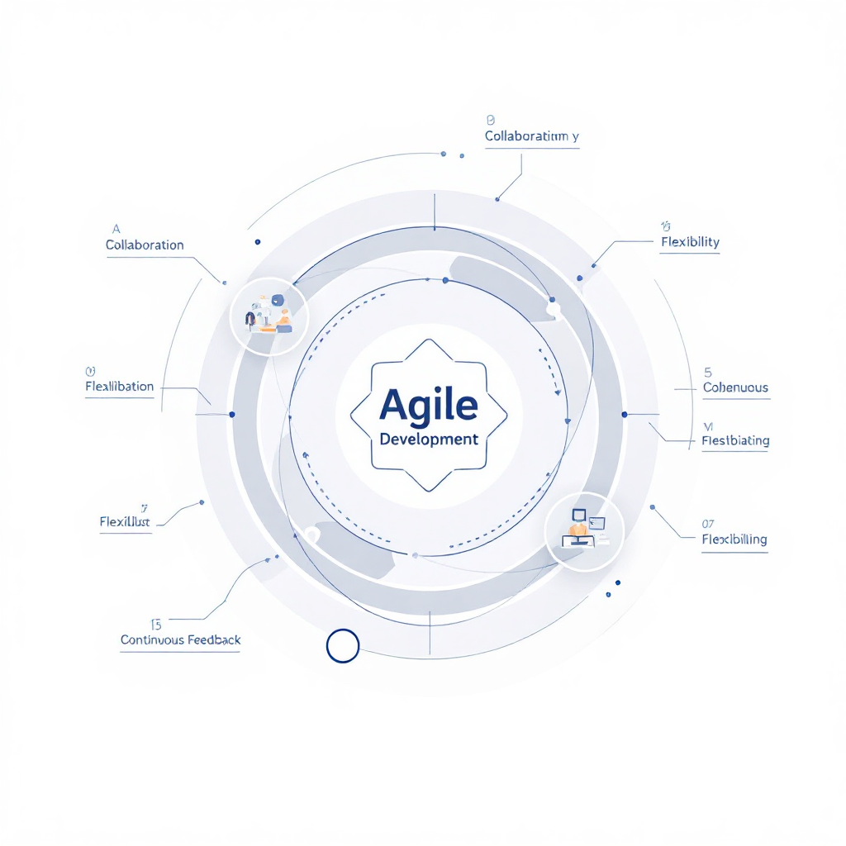
Agile Model
The Agile Model is an iterative and incremental approach where software is developed in small cycles called Sprints (usually 1–4 weeks). Requirements are flexible and can change throughout the development process. Agile focuses on delivering working software quickly and continuously.
Key Features
Development and testing occur simultaneously.
Continuous customer involvement.
Requirements can change at any stage.
Short development cycles.
High collaboration among developers, testers, and clients.
Process Flow
Requirement discussion (user stories)
Sprint planning
Development + testing
Sprint review
Retrospective
Next sprint begins

Slide 4
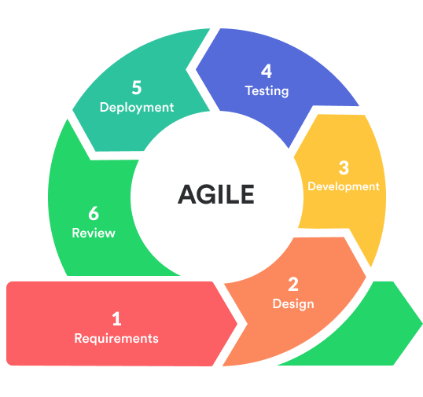
Agile Model
Advantages
Quick delivery of working software
Flexible to requirement changes
Customer satisfaction is high
Early detection of defects
Disadvantages
Requires experienced team members
Difficult to predict exact time and cost
Example
A company wants to develop a shopping mobile app but is unsure about final features. They decide to use Agile. They create small sprints:
Sprint 1: Login, Signup
Sprint 2: Product listing
Sprint 3: Cart & Checkout
Sprint 4: Payment integration
After each sprint, the client gives feedback and updates requirements.

Slide 5
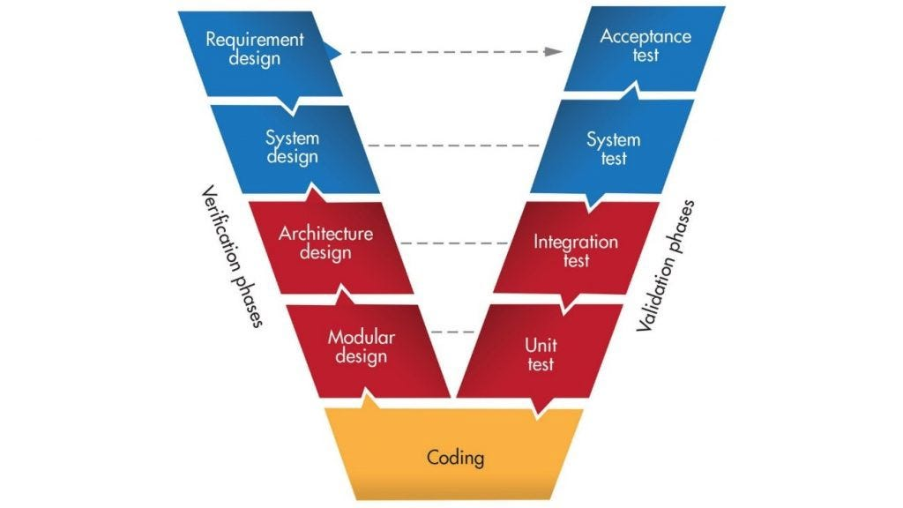
V-Model (Verification and Validation Model)
The V-Model is an extension of the Waterfall Model where testing is planned in parallel with development. For every development phase, there is a corresponding testing phase.
Phases
Verification (Left Side)
Requirement Analysis
System Design
Architecture Design
Module Design
Validation (Right Side)
User Acceptance Testing (UAT)
System Testing
Integration Testing
Unit Testing

Slide 6
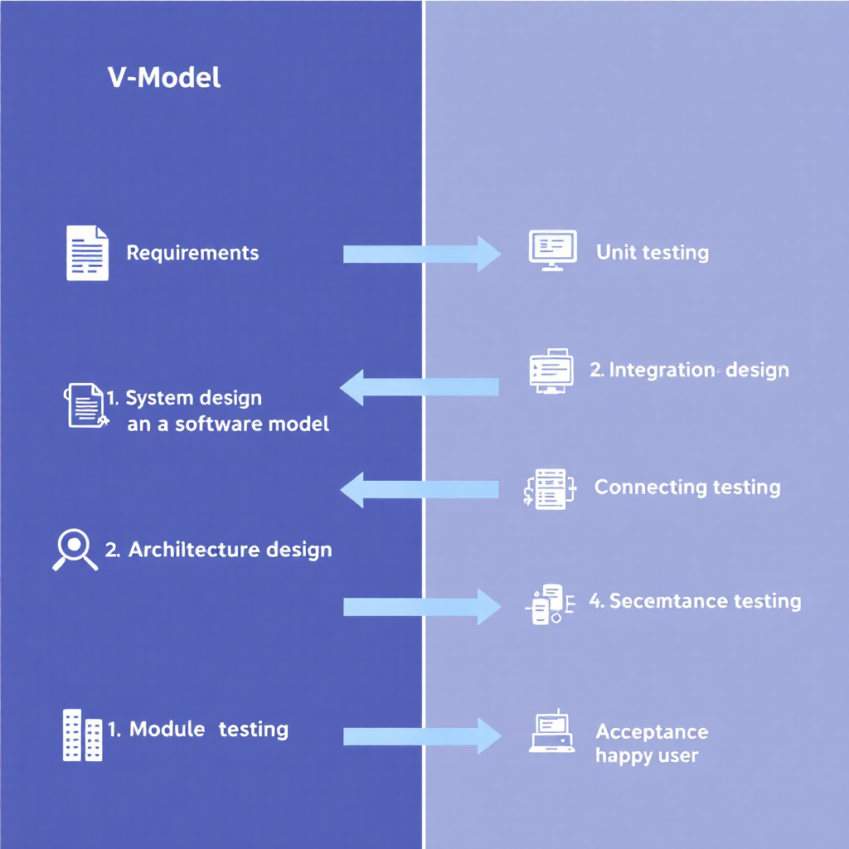
V-Model (Verification and Validation Model)
Advantages
Defects found early
Clear mapping between development and testing
High quality output
Disadvantages
Rigid model
Not suitable for changing requirements
Example
Developing a banking login module:
Requirements + UAT test cases
System design + system tests
Module design + unit tests
Everything is tested at each level.

Slide 7
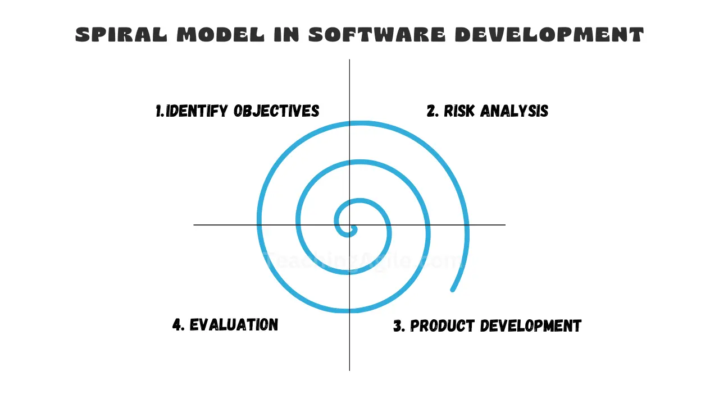
Spiral Model
The Spiral Model combines the iterative nature of Agile with risk analysis. It focuses heavily on identifying and minimizing risks in each phase.
It follows a spiral path with four main quadrants:
Planning
Risk Analysis
Development
Evaluation
Key Features
Best for high‑risk, complex projects
Focus on identifying risks
Development happens in iterations (spirals)

Slide 8
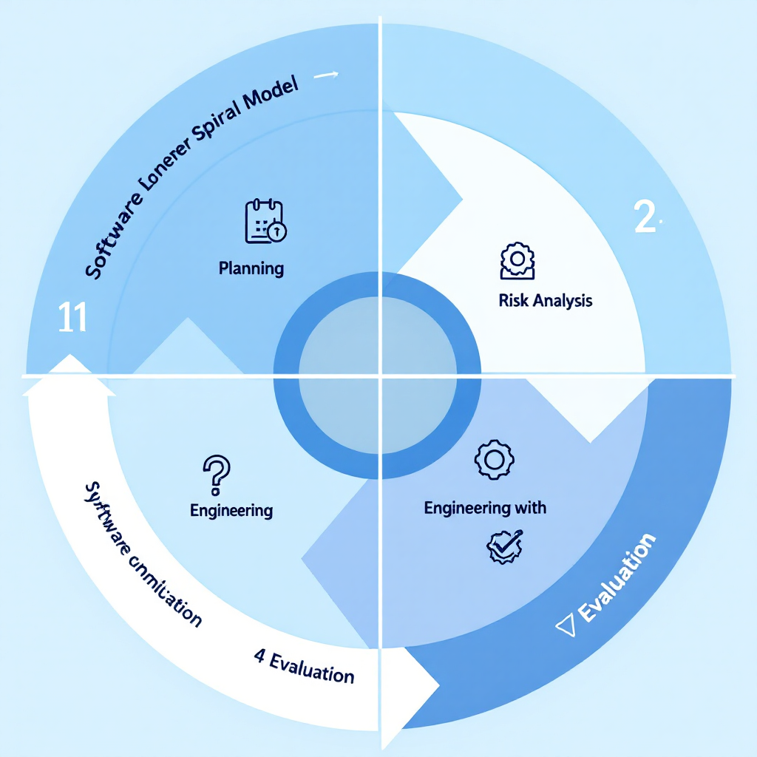
Spiral Model
Advantages
Very good risk handling
Suitable for large, expensive projects
Flexible to requirement changes
Disadvantages
Costly and complex
Not suitable for small projects
Example
Developing aircraft control software or medical system software, where repeated risk analysis and prototyping are necessary.

