Slide 1
Meetings in Agile
Agile methodology emphasizes collaboration, transparency, and continuous improvement. Meetings in Agile are structured events designed to ensure that teams stay aligned, identify challenges early, and continuously improve their processes and outcomes. Unlike traditional long and infrequent meetings, Agile meetings are time‑boxed, focused, and purpose‑driven. They help teams communicate effectively, adapt to change, and deliver value incrementally.
This document explains three important Agile meetings:
Daily Standup Meeting
Sprint Planning Meeting
Retrospective Meeting
Each meeting plays a unique role in the Agile lifecycle and contributes to the overall success of the project.

Slide 2

Daily Standup Meeting
The Daily Standup Meeting, also known as the Daily Scrum, is a short, time‑boxed meeting held every working day. It is usually conducted at the same time and place to create consistency and discipline within the team. The meeting typically lasts 10–15 minutes and involves all development team members.
Purpose of Daily Standup
The Daily Standup helps the team:
- Understand the current progress of the sprint
- Identify blockers or issues early
- Improve communication and collaboration
- Stay focused on sprint goals
Structure of the Meeting
Traditionally, each team member answers three key questions:
What did I work on yesterday?
What will I work on today?
Are there any blockers or challenges?
These questions help the team track progress and quickly identify problems that need attention after the meeting.

Slide 3
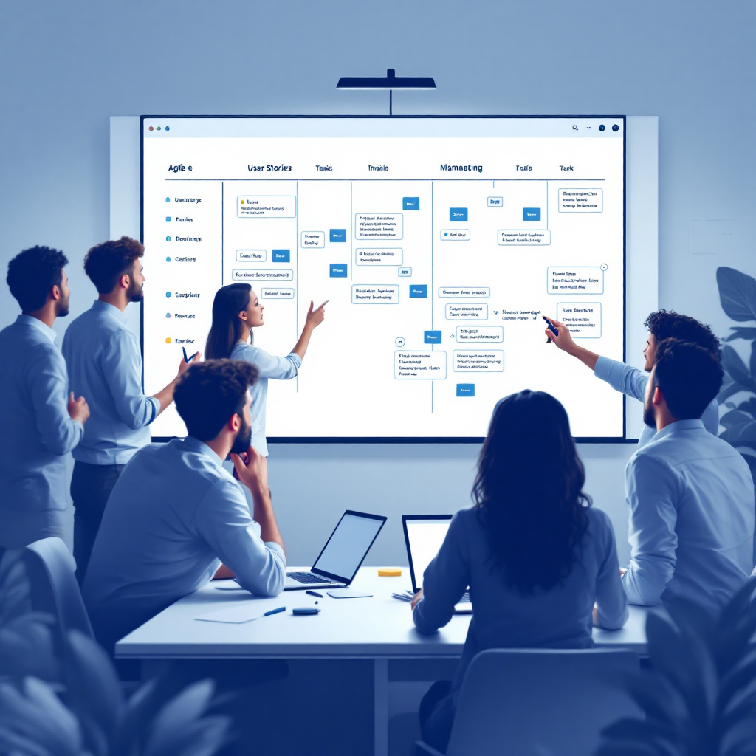
Sprint Planning Meeting
The Sprint Planning Meeting marks the beginning of a sprint. It is a collaborative session where the team decides what work will be completed during the upcoming sprint. This meeting ensures that everyone has a shared understanding of the sprint goals and deliverables.
Objectives of Sprint Planning
The Sprint Planning Meeting aims to:
- Define the sprint goal
- Select backlog items to be completed
- Plan how the selected work will be done
- Ensure alignment between business priorities and team capacity
Key Activities
Sprint Planning is generally divided into two main parts:
1. What will be done
2. How will it be done?

Slide 4

Retrospective Meeting
The Retrospective Meeting is held at the end of each sprint. It provides the team with an opportunity to reflect on the sprint and identify areas for improvement. The focus is on processes, collaboration, and performance rather than blaming individuals.
Purpose of Retrospective
The Retrospective helps the team:
- Identify what went well
- Understand what did not go well
- Decide on actionable improvements for the next sprint
Outcomes of Retrospective
- Identified improvement areas
- Action items for process enhancement
- Better team collaboration and morale

