Slide 1












PostPartum
Depression
Data Analysis
1

Slide 2

Postpartum Depression Detection Using Ensemble Machine Learning
Content:
We aim to identify individuals potentially experiencing postpartum depression using categorical features.
Our primary target variable is “Feeling anxious,” a common early symptom.
Dataset includes emotional and behavioral indicators collected via survey.
2

Slide 3
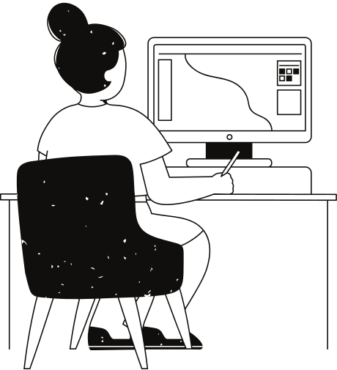
Dataset Summary
Total records: 1503
Features: Emotional distress indicators (e.g., bonding issues, suicidal thoughts, appetite loss)
Our Hypothesis
“Participants who report symptoms such as insomnia (trouble sleeping), loss of appetite, and difficulty bonding with the baby are more likely to feel anxious, which may be associated with an increased risk of Postpartum Depression (PPD).”
3

Slide 4


Data Cleaning
Normalized all Yes/No answers to lowercase and stripped whitespace.
Converted target to binary.
Checked for missing/NaN values and handled them appropriately (e.g., filtering out rows if necessary).
Within the total 1503 rows in our dataset, we grouped as 1202 rows to train 301 rows to test.
We decided to select the “Feeling Anxious” column as target column.
We used “Simple Imputing” to fill the NULL values in the dataset.
4

Slide 5


Feature Selection and Training
All categorical variables were label encoded to prepare for ML algorithms.
We initially considered several survey-based features. While we had planned to limit the model input to a few key indicators — such like "Felt down ,Little interest, Sleep problems, and Lack of energy".
However, since most additional features were either redundant or highly sparse, they did not significantly affect the model. In future work, a stricter feature selection process could be applied.
5

Slide 6


To prevent overfitting and improve model generalization, we applied SMOTE (Synthetic Minority Over-sampling Technique).
This helped balance the number of "yes" and "no" samples in the target variable, ensuring fairer model training.
SMOTE was applied to rebalance the dataset, improving minority class representation and model generalizability.
6

Slide 7

Outcomes of Our Project
We trained multiple classifiers: Logistic Regression, Decision Tree, Random Forest, CatBoost, LightGBM and Stacking Classifier.
We combined the best-performing base models with Logistic Regression as the meta-classifier.
Among all models, Stacking Classifier performed the best, achieving the highest accuracy, precision, recall, and F1-score.
7

Slide 8
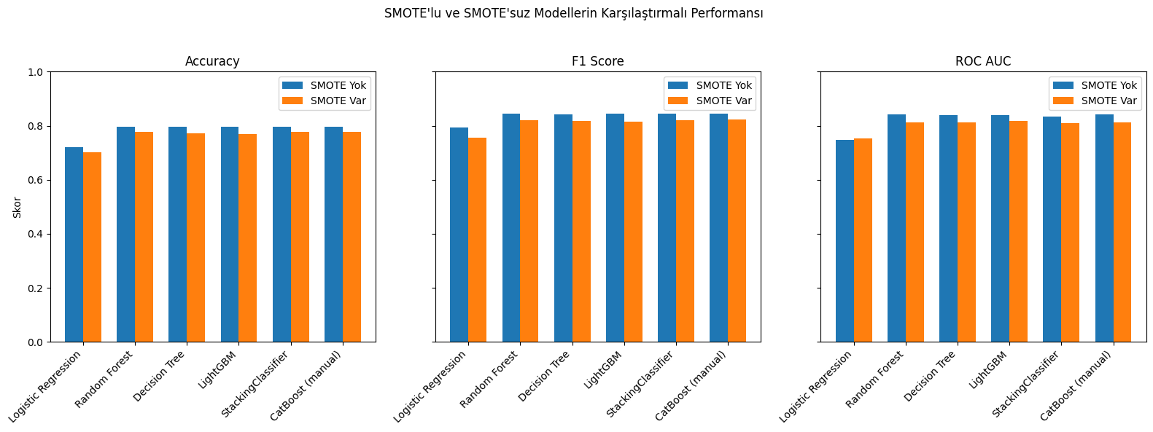

Outcomes of Our Project
This result demonstrates the advantage of ensemble learning, especially when dealing with imbalanced health datasets.
8

Slide 9
Outcomes of Our Project
The correlation matrix shows positive correlations between “feeling anxious” and:
Irritability towards baby & partner (0.31),
Bonding problems with baby (0.23),
Appetite problems (negative, -0.18), suggesting inverse patterns.
In the Random Forest feature importance plot:
Irritability towards baby & partner and appetite-related issues have the highest importance scores in predicting anxiety.
Bonding problems also contribute meaningfully.
The data supports our hypothesis. Symptoms like irritability, appetite loss, and bonding difficulties are important predictors of anxiety, which is known to correlate with Postpartum Depression.
9

Slide 10


Previous Research on Algorithm Combining Bayesian Network Model with Causal Reasoning
Article Link
Results
Sleep quality has a significant causal effect on postpartum depression, with poor sleep quality increasing the likelihood of depression by approximately 17.4%.
Symptoms such as feelings of guilt, overeating or loss of appetite, and suicide attempts interact in complex ways, with some symptoms responding to changes in others and potentially worsening the overall condition
10

Slide 11
THANK YOU
152120211072 Resul EVLEKSİZ
152120221051 Elif Suna GEGİN
152120221094 Kadriye HARMANCI
11

