Slide 1
16-QAM-OFDM Transmitter and Receiver Simulation in MATLAB
Name – Akshay Modak
Reg no – 180907722
Roll no- 55

Slide 2
Objectives
To understand the working of different parts in an OFDM system.
To simulate a simple transmitter and receiver that uses OFDM with 16-QAM as the modulation scheme over a wireless channel.

Slide 3
OFDM
Multi-carrier modulation scheme that allows us to send data parallelly over multiple frequency channels.
Widely used in modern communication systems such as,
4G-LTE
5G
WiMax

Slide 4
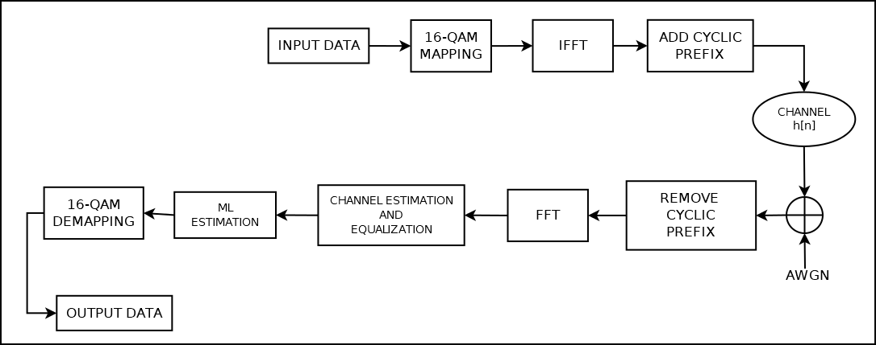
Simplified Block Diagram for an OFDM system

Slide 5
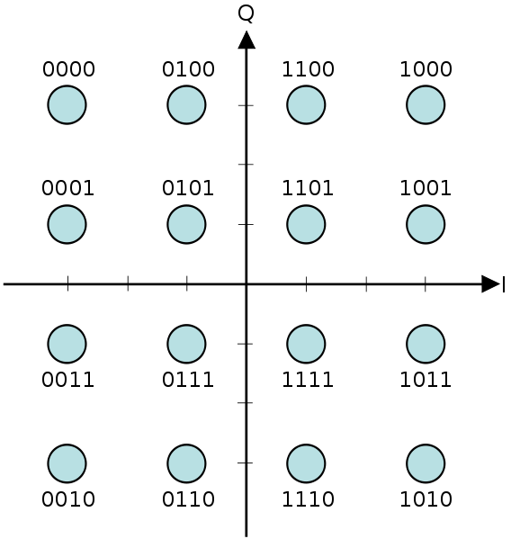
16-QAM Symbol Mapping
Each 16-QAM symbol is 4-bits in length.
The symbols are mapped as shown in the constellation diagram.
Notice that the bit-pattern for a point differs by only one bit from the adjacent point. This ensures that if an error occurs and a symbol is mapped to any of the adjacent symbols then there is an error in only one bit.

Slide 6
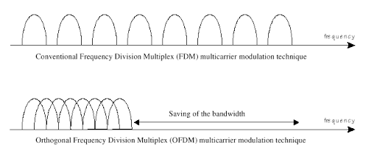
OFDM and The IFFT
Using OFDM ensures that the bandwidth is used as efficiently as possible.
We can see that OFDM uses about half the bandwidth of FDM.
The computation to produce the orthogonal sinusoids can be done using the IFFT.
The main advantage of OFDM is that it can increase the data received per unit time without increasing the symbol rate which prevents inter symbol interference(ISI)

Slide 7
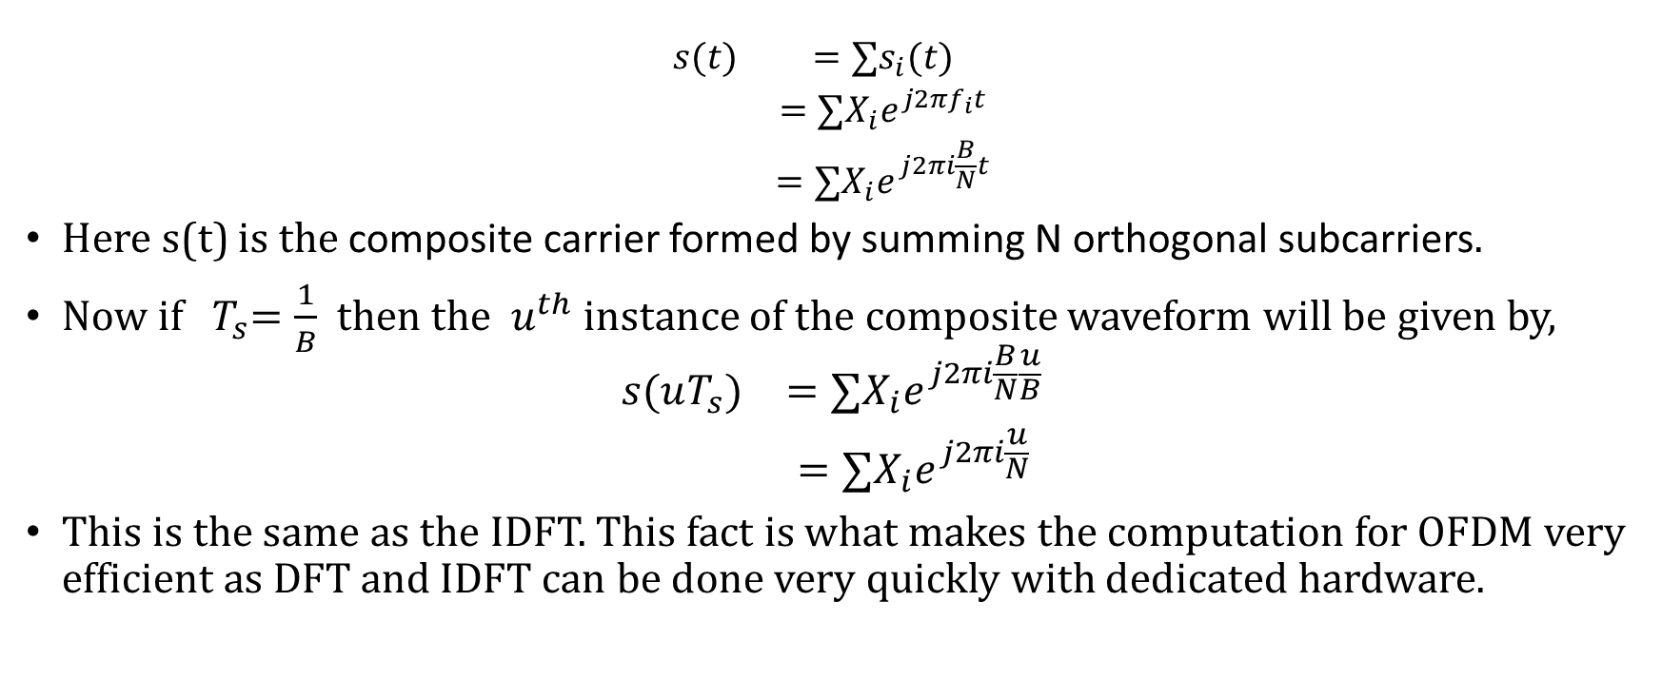
OFDM and the IFFT
$$\begin{matrix}s(t) & =∑s_{i}(t) \\ & =∑X_{i}e^{j2πf_{i}t} \\ & =∑X_{i}e^{j2πi\frac{B}{N}t}\end{matrix}$$
Here s(t) is the composite carrier formed by summing N orthogonal subcarriers.
Now if${ T}_{s}=\frac{1}{B}$ then the $u^{th}$ instance of the composite waveform will be given by,
$$\begin{matrix}s(uT_{s}) & =∑X_{i}e^{j2πi\frac{B}{N}\frac{u}{B}} \\ & =∑X_{i}e^{j2πi\frac{u}{N}}\end{matrix}$$
This is the same as the IDFT. This fact is what makes the computation for OFDM very efficient as DFT and IDFT can be done very quickly with dedicated hardware.

Slide 8
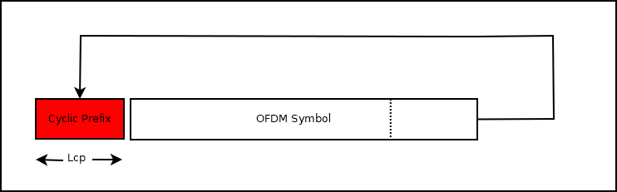
Cyclic Prefix
It is possible for the OFDM symbols to interfere which is why we need a guard band between consecutive OFDM symbols.
A cyclic prefix is one of the ways of providing a guard band for OFDM.
After taking the IFFT the last few outputs are prepended to the signal before transmission.
The length of the cyclic prefix depends on the how much ISI is expected.

Slide 9

Cyclic Prefix
We can see From the equation that as The length of the OFDM symbol increases the loss in efficiency becomes smaller.
This implies as the number of subcarriers increases the loss in throughput due to the cyclic prefix decreases.
$$\begin{matrix}Loss in efficiency & =\frac{Cyclic prefix length}{total OFDM symbol length} \\ & =\frac{Lc}{N + Lc}\end{matrix}$$
$\begin{matrix}\underset{N→∞}{\text{lim}}\frac{Lc}{N + Lc}→0\end{matrix}$

Slide 10
Channel Estimation and Equalization
Channel equalization is the process by which we invert the effects of a channel.
To do this we first need to know what the channel is.
This is why we need to estimate the channel.

Slide 11
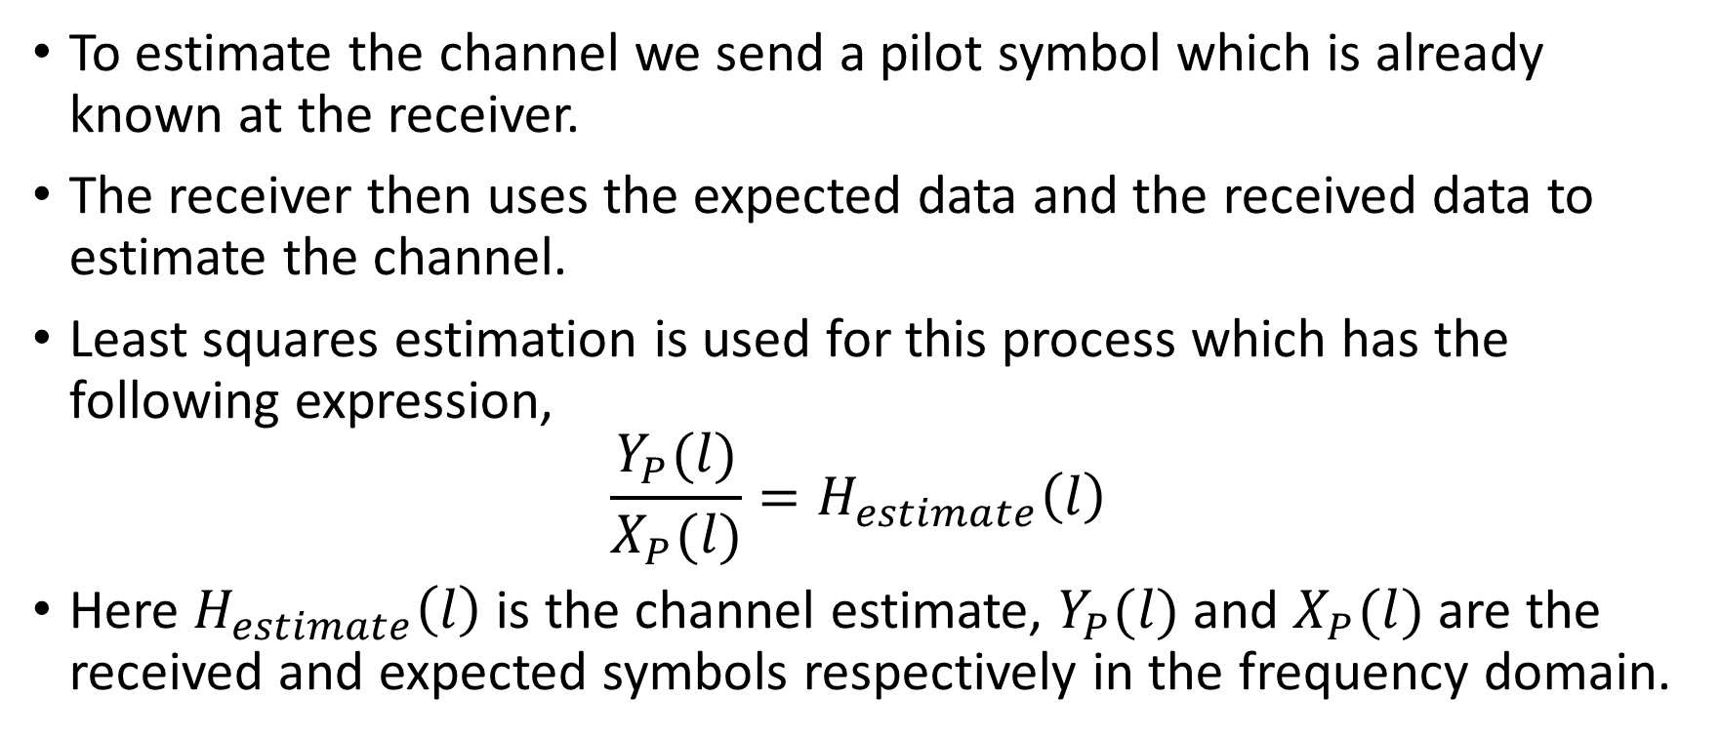
Channel Estimation and Equalization
To estimate the channel we send a pilot symbol which is already known at the receiver.
The receiver then uses the expected data and the received data to estimate the channel.
Least squares estimation is used for this process which has the following expression,
$$\frac{Y_{P}(l)}{X_{P}(l)}=H_{estimate}\left(l\right)$$
Here $H_{estimate}\left(l\right)$ is the channel estimate, $Y_{P}(l)$ and $X_{P}(l)$ are the received and expected symbols respectively in the frequency domain.

Slide 12
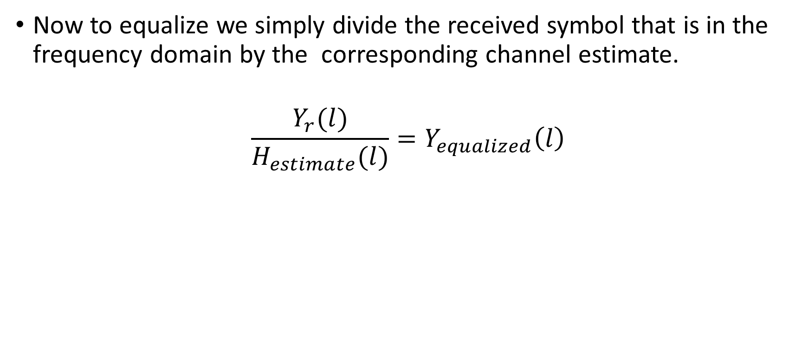
Channel estimation and equalization
Now to equalize we simply divide the received symbol that is in the frequency domain by the corresponding channel estimate.
$$\frac{Y_{r}(l)}{H_{estimate}(l)}=Y_{equalized}\left(l\right)$$

Slide 13

ML Estimation Of Received Symbols
In maximum likelihood estimation Euclidian distance is used to find the most probable symbol that was transmitted.
More precisely, the estimate $\hat{I}+j\hat{Q}$ is found by minimizing$\sqrt{(\overset{‾}{I}−I)^{2}−(\overset{‾}{Q}−Q)^{2}}$ where $\overset{‾}{I}$ and $\overset{‾}{Q}$ are the in-phase and quadrature components of the received symbol.

Slide 14
Transmitter Implementation
%TRANSMITTER
%transmit pilot
x = randi([0 , 15] , 64 , 1)';
q = qammod(x , 16);
tx = ifft(q , 64);
cp_length = 16;
tx = [tx(: , end-cp_length+1:end) tx]; % cyc. prefix
%transmit data
x_signal = randi([0 , 15] , 64 , 1)';
q_signal = qammod(x_signal , 16);
tx_signal = ifft(q_signal , 64);
tx_signal = [tx_signal(: , end-cp_length + 1 : end) tx_signal]; % cyc. prefix

Slide 15
example of a transmitted signal

Slide 16
Channel
%CHANNEL
% 3-tap channel
h = [1 , 0 , 0 , sqrt(10^(-17/10)) , sqrt(10^(-21 / 10))]; % power delay profile
r = randn(1 , length(h)) + 1i*randn(1 , length(h)); % random complex numbers with rayleigh distributed amplitude
h = h .* r; % impulse response of channel
% convolve with transmitted signal
tx_ray = conv(h , tx);
tx_signal_ray = conv(h , tx_signal);
%add awgn
snr = 30;
tx_noisy = awgn(tx_ray , snr);
tx_signal_noisy = awgn(tx_signal_ray , snr);

Slide 17
transmitted signal with noise

Slide 18
20 dB SNR
30 dB SNR
This better shows what noise does to the transmitted symbols.

Slide 19
Receiver Implementation
%for pilot symbol
rx = tx_noisy(1 : 80);
rx = rx(cp_length + 1 : end);
q_r = fft(rx , 64);
%for data symbol
rx_signal = tx_signal_noisy(1 : 80);
rx_signal = rx_signal(cp_length + 1 : end);
q_r_signal = fft(rx_signal , 64);
%channel estimation
H_est = q_r ./ q;
% channel equalization
q_r_signal = q_r_signal ./ H_est;

Slide 20
Actual and Estimated frequency response

Slide 21
Effect of equalization

Slide 22
Receiver Implementation(contd.)
%ML estimation
points = (qammod((0 : 15) , 16)); % 16-QAM points
mindist = inf; % initially distance is infinity
minpt = 0;
q_r_signal_estimate = (zeros(1 , 64));
for k = 1 : length(q_r_signal)
mindist = inf;
for m = 1 : length(points)
if norm(q_r_signal(k) - points(m)) < mindist
mindist = norm(q_r_signal(k) - points(m));
minpt = points(m);
end
end
q_r_signal_estimate(k) = minpt;
end
rx_data = qamdemod(q_r_signal_estimate , 16);

Slide 23
Comparison of transmitted and received data.

