Slide 1
Cookies, Session & JWT

Slide 2
AGENDA
Introduction HTPP​
Website
​client-server
Cookies
​Session & Work Flow
Drawback in Session (load balancer)
Solution
JWT
Structure
​

Slide 3
Introduction HTTP
HTTP (Hypertext Transfer Protocol) is a communication protocol used by web browsers and web servers to exchange information on the internet.
HTTP is a stateless protocol, which means that each request and response is independent and doesn't remember previous interactions

Slide 4
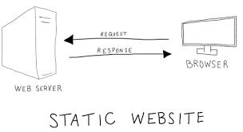

Slide 5
Cookies
Cookies are small pieces of data stored by a website on a user's browser.
They are typically used to store user-specific information, such as login credentials, user preferences, or shopping cart data.
Cookies can be set by the server and retrieved by the server with subsequent requests, allowing the server to maintain stateful interactions with the user.
Cookies can have an expiration date, after which they are automatically removed from the browser.
Cookies can be manipulated and read by both the server and client-side scripts.
Cookies have a limited storage capacity (typically 4KB) per domain.

Slide 6
Example Cookies
Add to Cart: When you click the "Add to Cart" button for a product, the website's server sets a cookie in your browser. The cookie contains information about the product, such as its ID or quantity.
User Authentication: Cookies are commonly used for user authentication. When you log in to a website, a session Id is created and stored in Cookies
Personalization: Websites may use cookies to personalize the user experience. For example, a news website might use cookies to remember your preferred language
Remember Me: When you check the "Remember Me" option on a login form, a persistent cookie is usually set.

Slide 7
Session
It is way to keep track of information about a user
When a user Vitis on a web application a session is created for them on server and session ID stored in a cookie on user’s browser
The Server uses the session id to store and retrieve data
Session is use for authentication and authorization aut
Session is use to know information about the use and their role

Slide 8
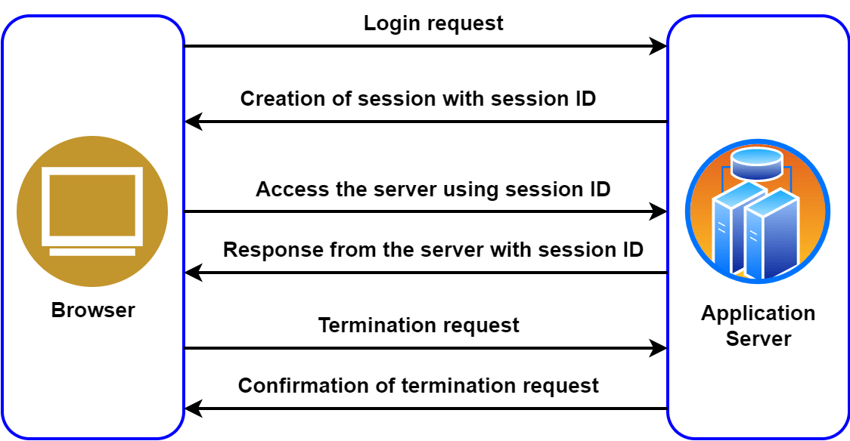

Slide 9
Cookies and sessions are both used in web development to store and manage data related to user interactions, but there are some key differences between them:
1. Storage Location:
- Cookies: Cookies are stored on the user's browser as small text files. They can be accessed and manipulated by both the client-side (JavaScript) and server-side code.
- Sessions: Session data is typically stored on the server. Only a session identifier (session ID) is stored on the client-side, usually as a cookie or passed through other means. The server uses this session ID to retrieve and manage the corresponding session data.
2. Data Storage:
- Cookies: Cookies are typically used to store small amounts of data, usually in key-value pairs. They can hold user-specific information such as login credentials, preferences, or shopping cart items.
- Sessions: Sessions can store more extensive and dynamic data compared to cookies. They are commonly used to hold larger amounts of user-specific data, such as authentication status, session variables, and other session-related information.
3. Lifespan:
- Cookies: Cookies can have a specified expiration time or be set to persist indefinitely. They can remain on the user's browser even after closing it and can be accessed in subsequent visits until they expire or are deleted.
- Sessions: Sessions are typically short-lived and exist only for the duration of a user's active browsing session. They are often terminated after a period of inactivity or when the user closes the browser.

Slide 10
4. Data Access:
- Cookies: Cookies are accessible both on the client-side and server-side. JavaScript running in the user's browser can access and modify cookies, and the server can read and set cookies in HTTP responses.
- Sessions: Session data is stored and accessed on the server-side. The session ID, which is typically stored in a cookie or passed through other means, is used by the server to identify and retrieve the corresponding session data.
5. Security:
- Cookies: Cookies can potentially be manipulated or tampered with on the client-side, making them less secure for storing sensitive data. However, cookie values can be encrypted or signed to enhance security.
- Sessions: Since session data is stored on the server, it is generally considered more secure than cookies. Session data is not directly accessible or modifiable by the user, reducing the risk of unauthorized access.

Slide 11
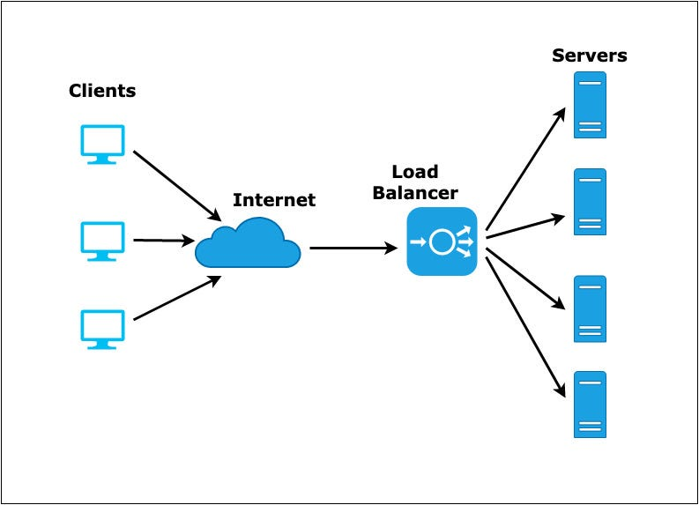

Slide 12
Jwt(JSON Web Token)
JWT, which stands for JSON Web Token, is a way to securely transmit information between parties using a token format. It is commonly used in web applications for authentication and authorization purposes.
JWT is a popular and widely used method for securely transmitting information between parties in web applications. It provides a way to authenticate and authorize users without the need for server-side storage, making it a flexible and efficient solution

Slide 13
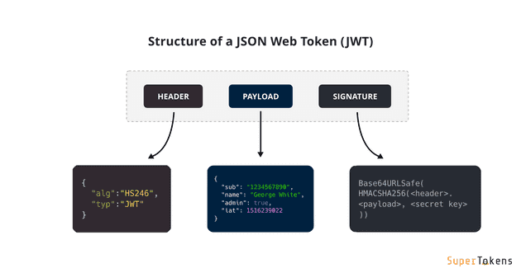
Header: Consists of two parts:
The signing algorithm that’s being used.
The type of token, which, in this case, is mostly “JWT”.
Payload: The payload contains the claims or the JSON object.
Signature: A string that is generated via a cryptographic algorithm that can be used to verify the integrity of the JSON payload.

Slide 14
Any Questions?

