Slide 1

TWITTER SENTIMENT ANALYSIS
Big Data Project
Inflation - Dataset
Adnan

Slide 2
Objective / Topic
Project Plan
EDA / Feature Engineering
ML Models & Evaluation
Dashboard and Features
Next Steps
Agenda

Slide 3
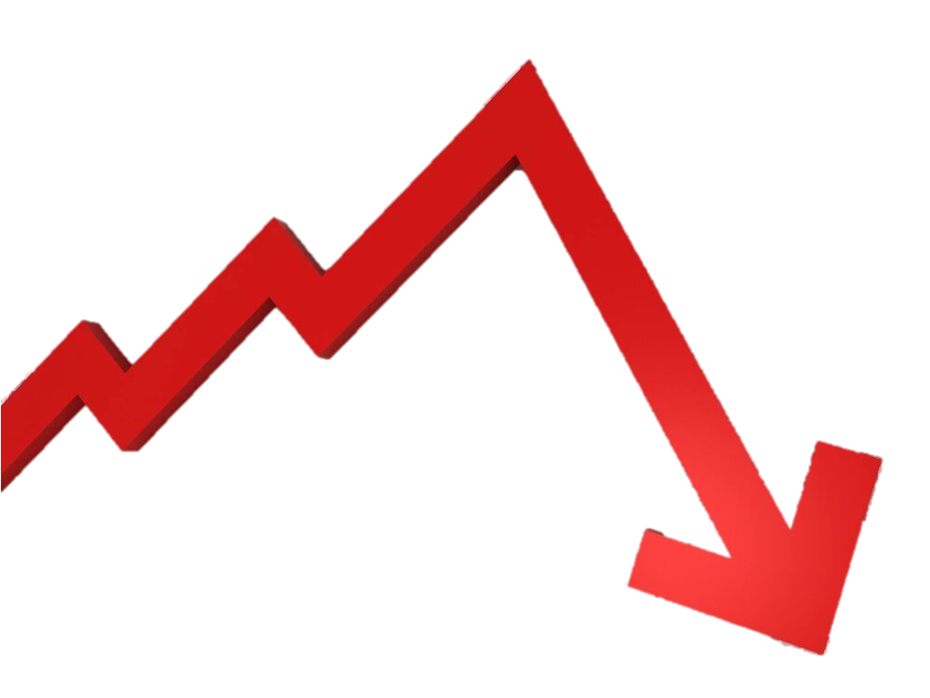


Objective
Why do Twitter Sentiment Analysis?
Understanding Public Opinion
Crisis Management
Market Research
Political Analysis
Why Inflation?
Economic Insights
Crisis Management
Consumer Sentiment and Confidence
Job Market
Why F1?
Emphasizing Correct Predictions
Multi Classification for sentiment
Trade-off between Precision and Recall

Slide 4






PROJECT PLAN
TWITTER
AWS – S3
DATABRICKS (SPARK)
AWS -QUICKSIGHT
AWS - KINESIS
AWS -ATHENA (SQL)

Slide 5
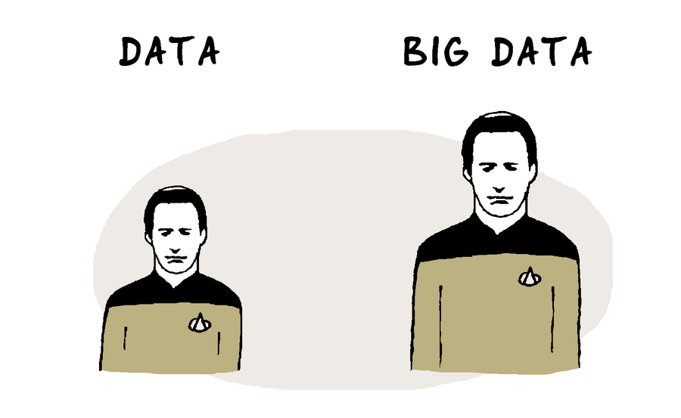
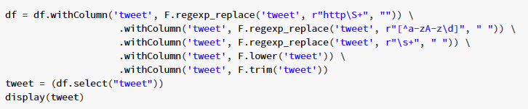

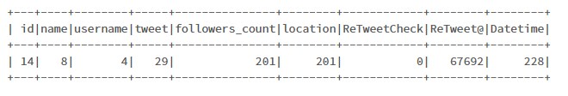
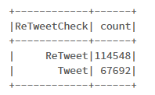
DATA CLEANING

Slide 6
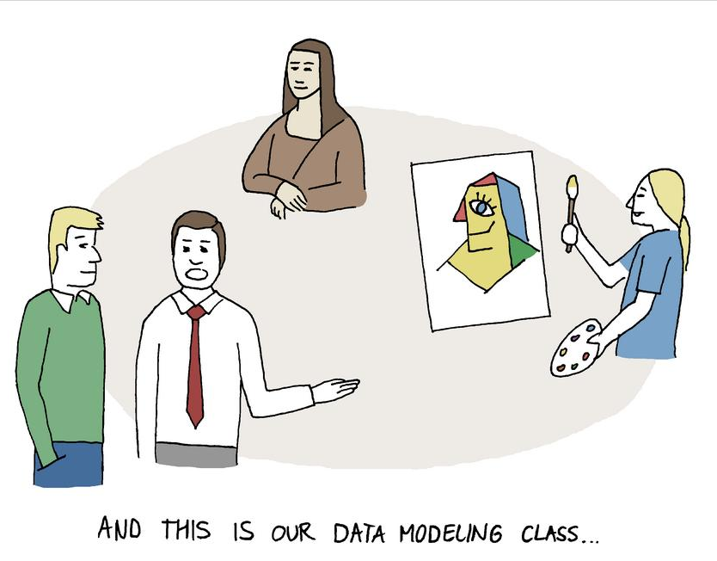
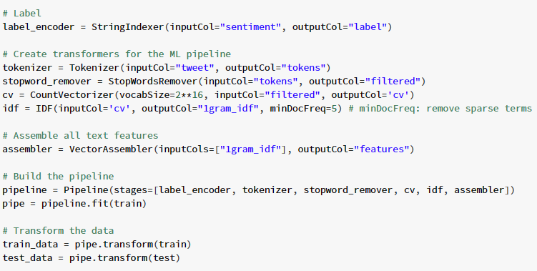
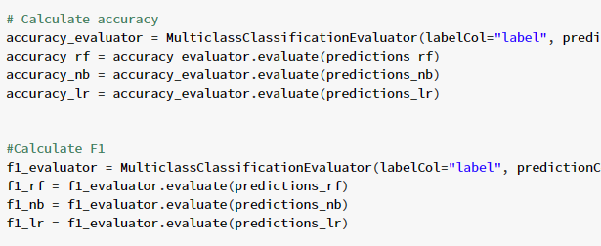



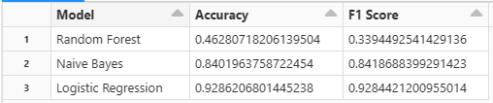

MODELING

Slide 7
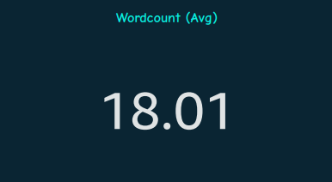
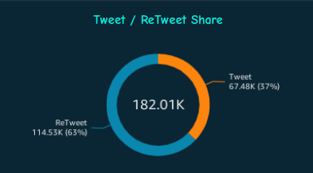
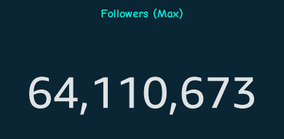
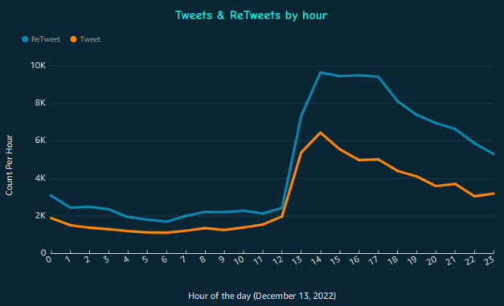
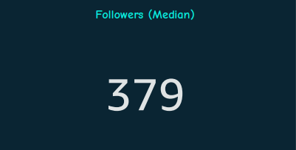
Preliminary Analysis

Slide 8
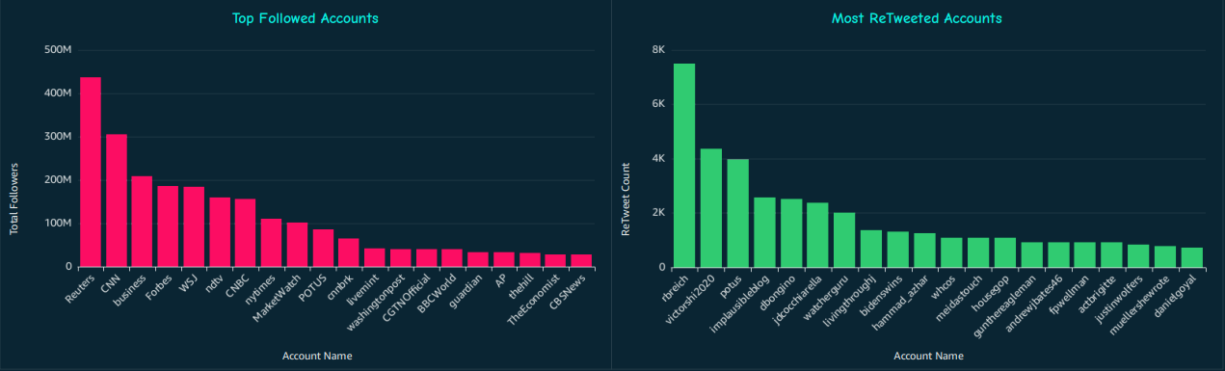
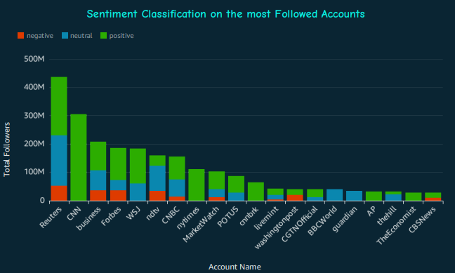
Analysis

Slide 9
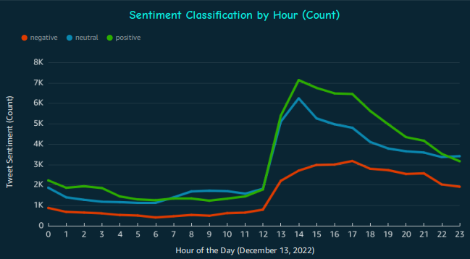
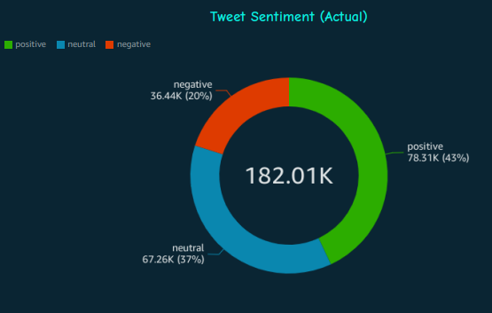
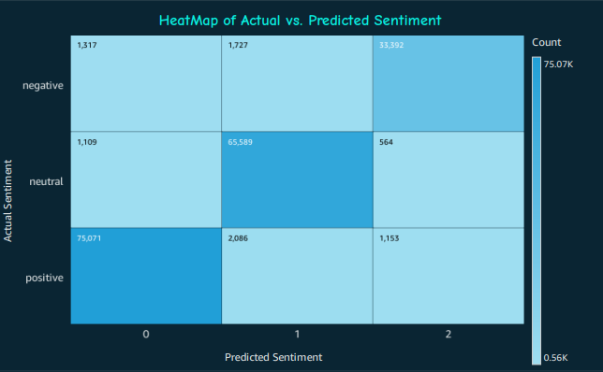
Sentiment analysis

Slide 10
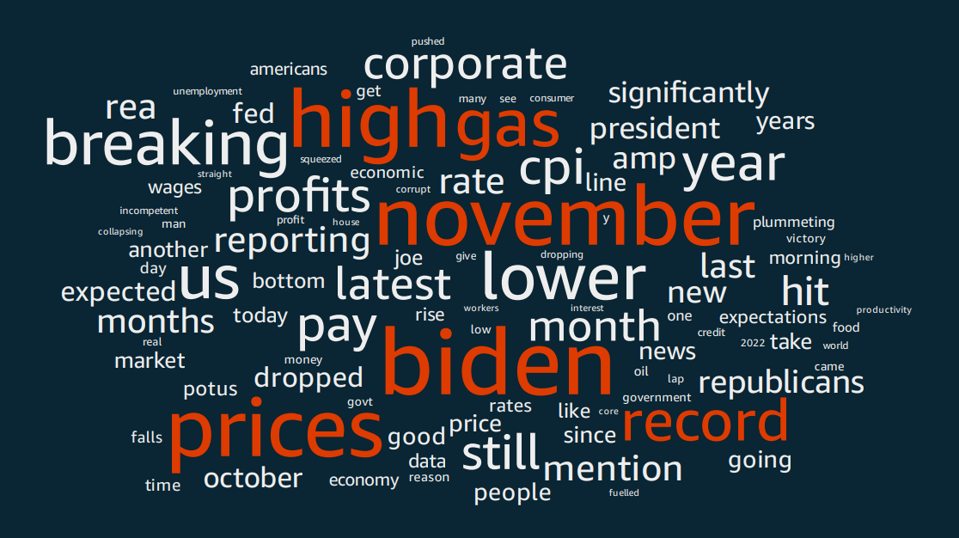
W O R D C L O U D

Slide 11
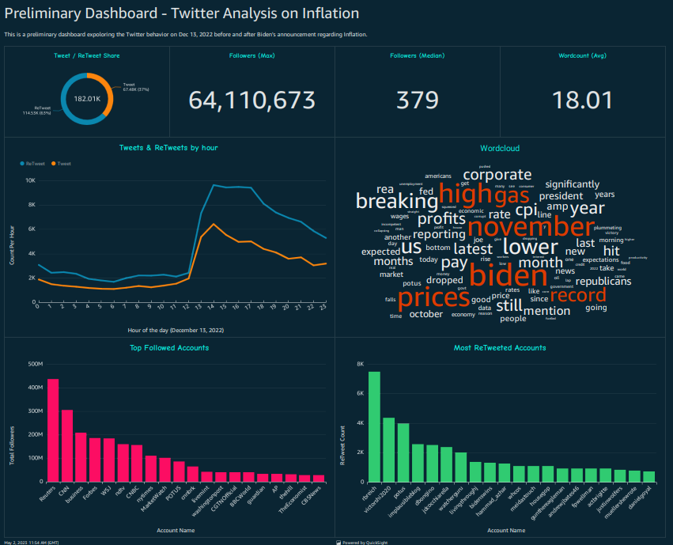
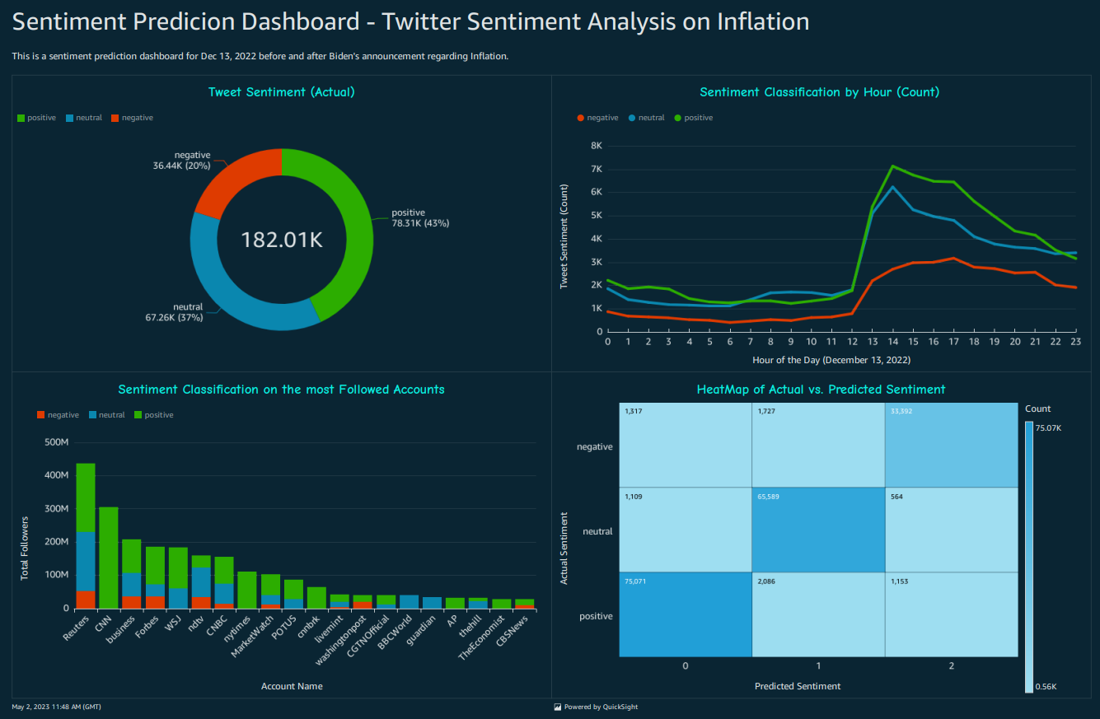
DASHBOARDS

Slide 12

Conclusions / next steps
INSIGHTS
NOW WHAT?
AWS
0.93 F1 Score
Potential DL Algorithms
Databricks Bottlenecks
QuickSight
Use more Data
Location Based analysis
Twitter API
Model for AUC_ROC

