Slide 1
SportsStalk Recommender System for Sports Events
Krusha Patel (A20424020)
Kripa Patel (A20449132)

Slide 2
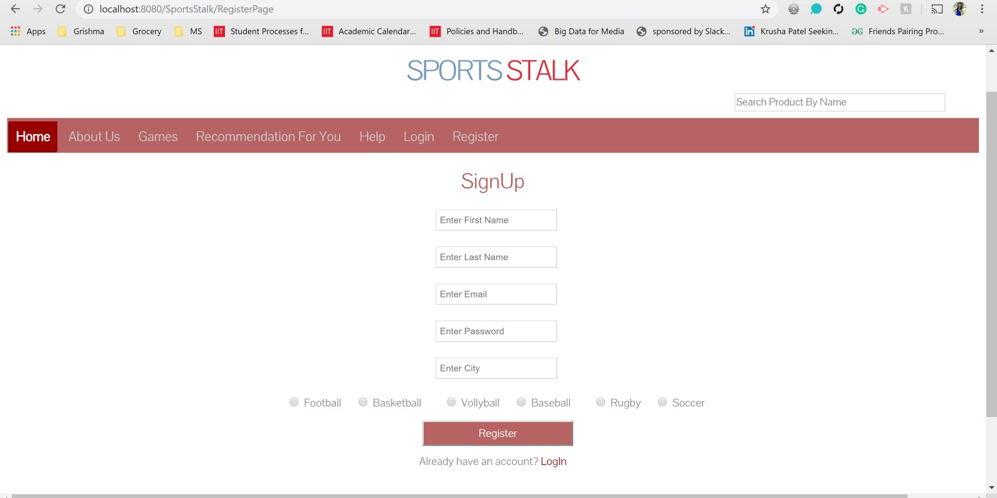

Slide 3
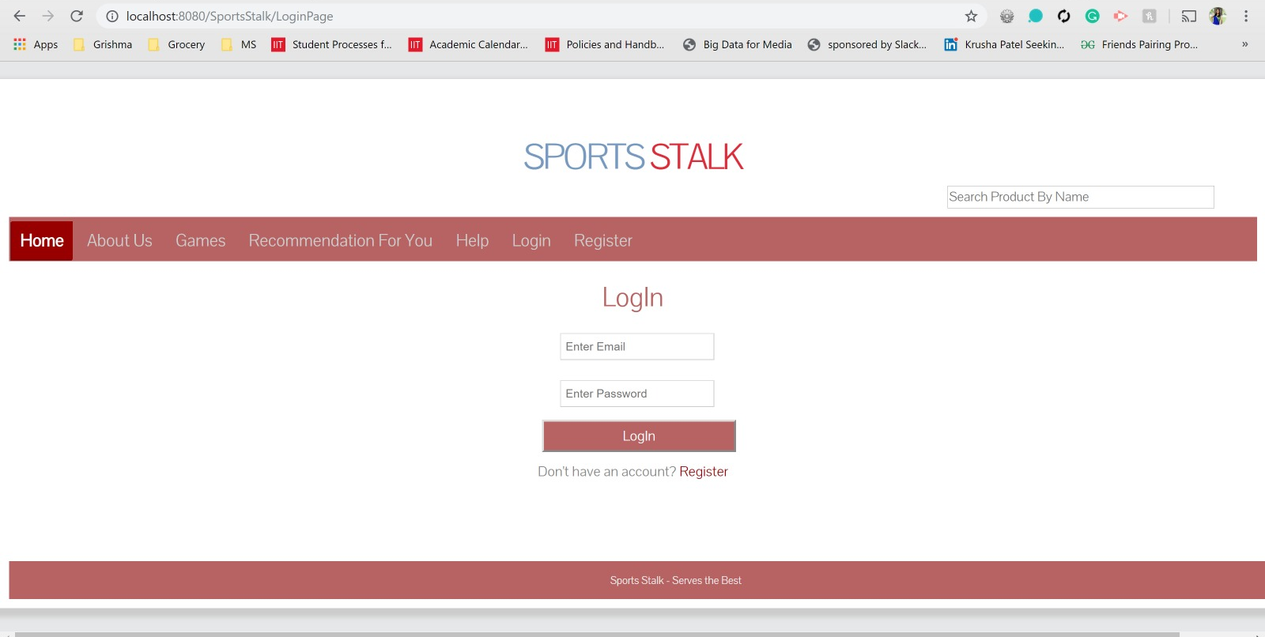

Slide 4
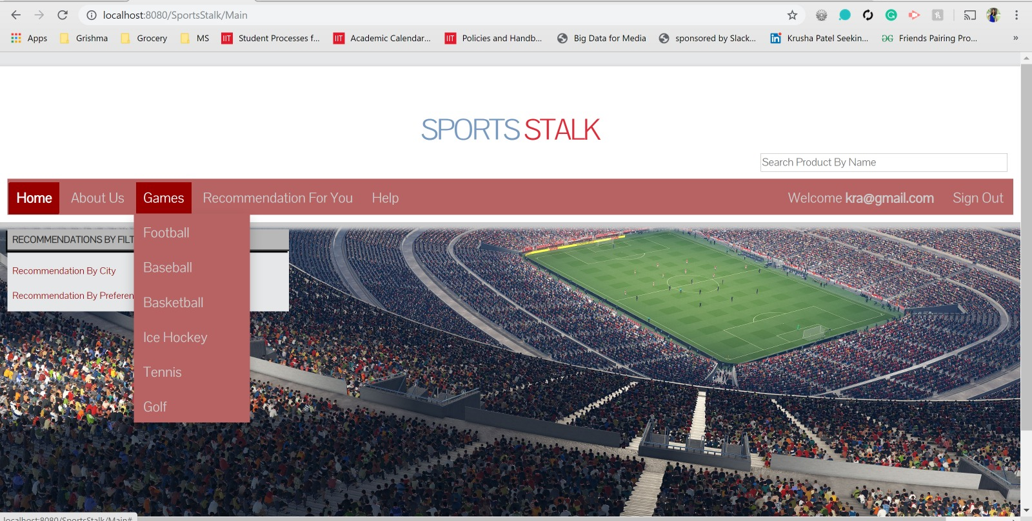

Slide 5
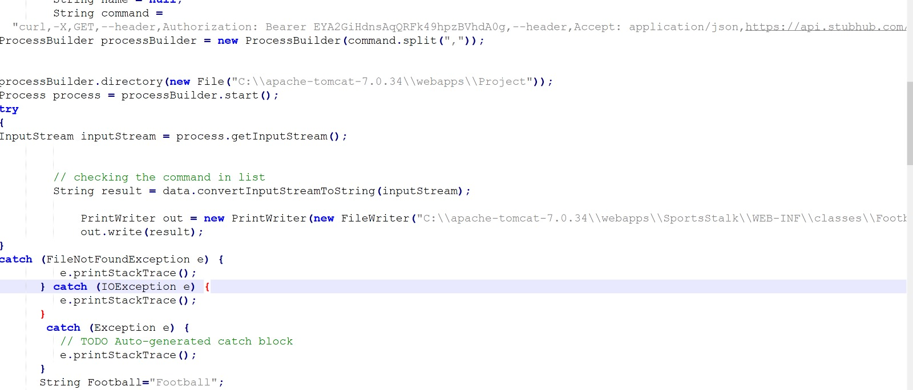
Code Screenshot
Live data is fetched using stubhub API and stored in json files

Slide 6
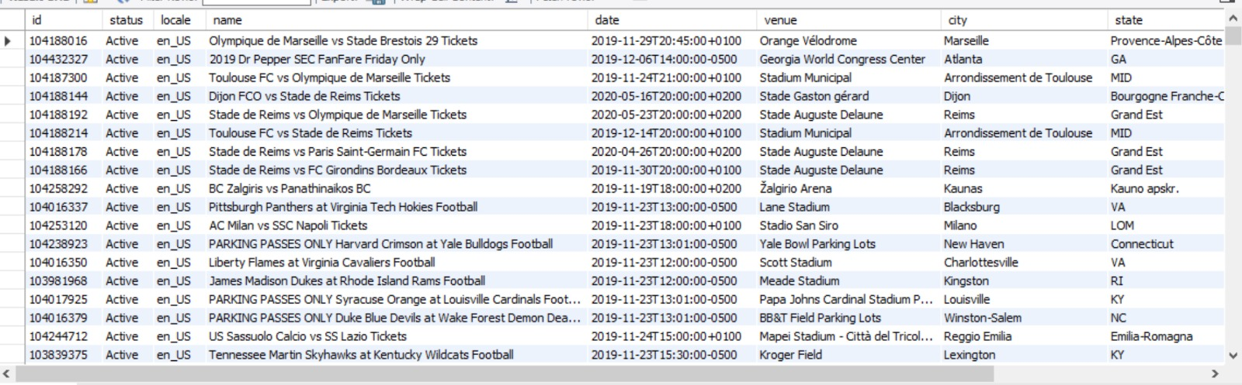
MySQL Database Screenshot

Slide 7
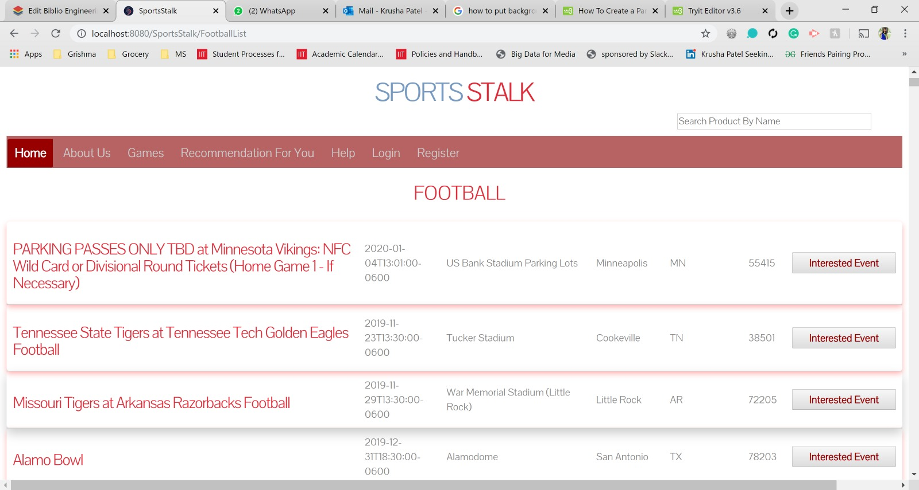

Slide 8
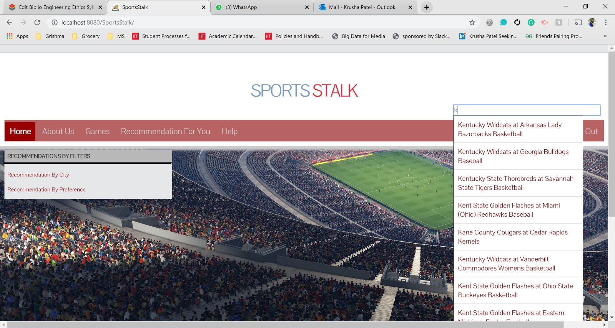

Slide 9
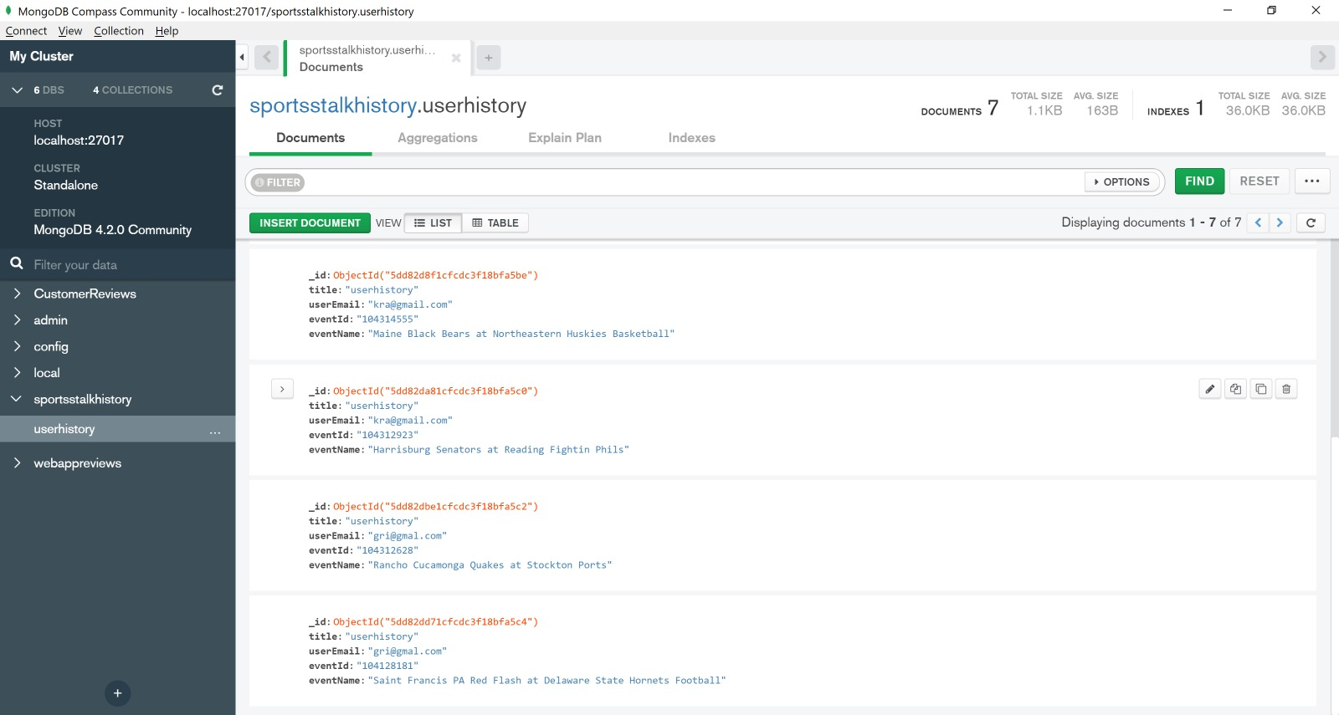
MongoDB database Screenshot
Search history is stored in Mongodb

Slide 10
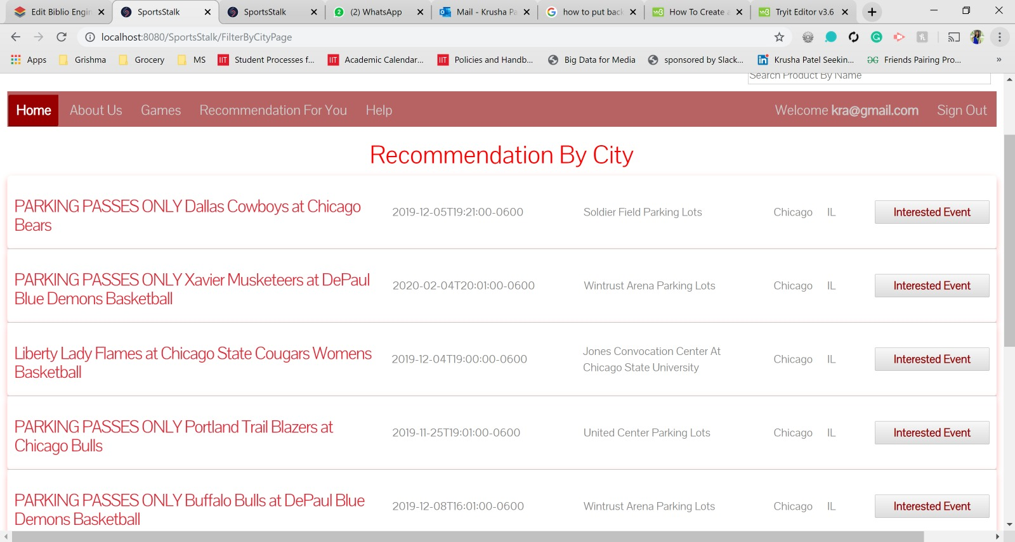

Slide 11
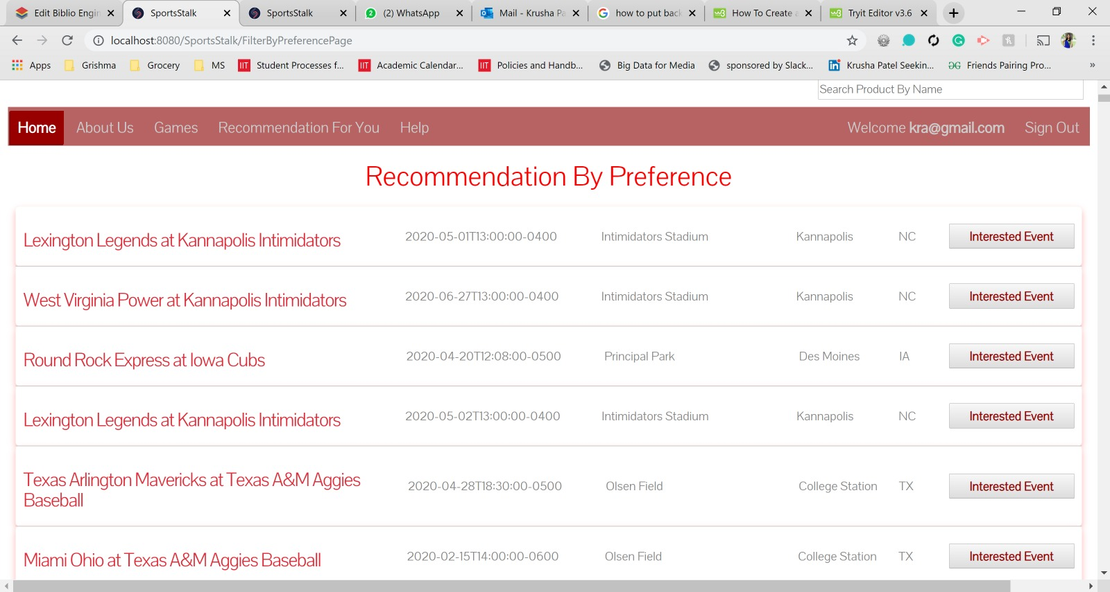

Slide 12
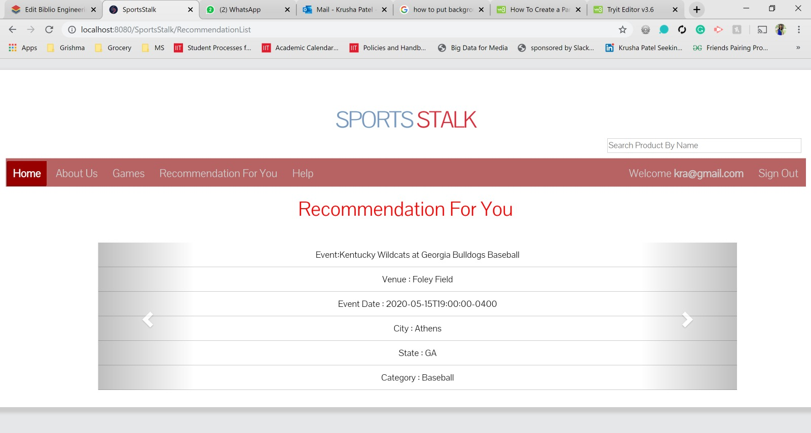

Slide 13
TECHNOLOGIES
Third Party API And Recommendation:
Stubhub API’s for Data [https://developer.stubhub.com/products/advanced-event-catalog]
SVD for Recommendation : Passing userID event names and counts as parameters

Slide 14

THANK YOU!!

