Slide 1
SportsStalk Recommender System for Sports Events
Krusha Patel (A20424020)
Kripa Patel (A20449132)

Slide 2
PROJECT OVERVIEW STATEMENT
SportsStalk is a sports event recommendation web application. It allows the user to register, search events based on the type of sports or location.
User will be get recommendations of events based on user's search history and location.
In addition to that users will get the recommendations on the basis of other users views if one Sport is the same for both of them.
Get the details about the event such as location, Tickets website and much more.

Slide 3
TECHNOLOGIES
HTML5
CSS3
JavaScript
Java
Servlets
Python
MongoDB
MySQL
Third Party API:
Ticketmaster API’s for Data [https://developer.ticketmaster.com/products-and-docs/tutorials/events-search/search_events_with_discovery_api.html]
Recombee API for Recommendation [https://docs.recombee.com/]

Slide 4
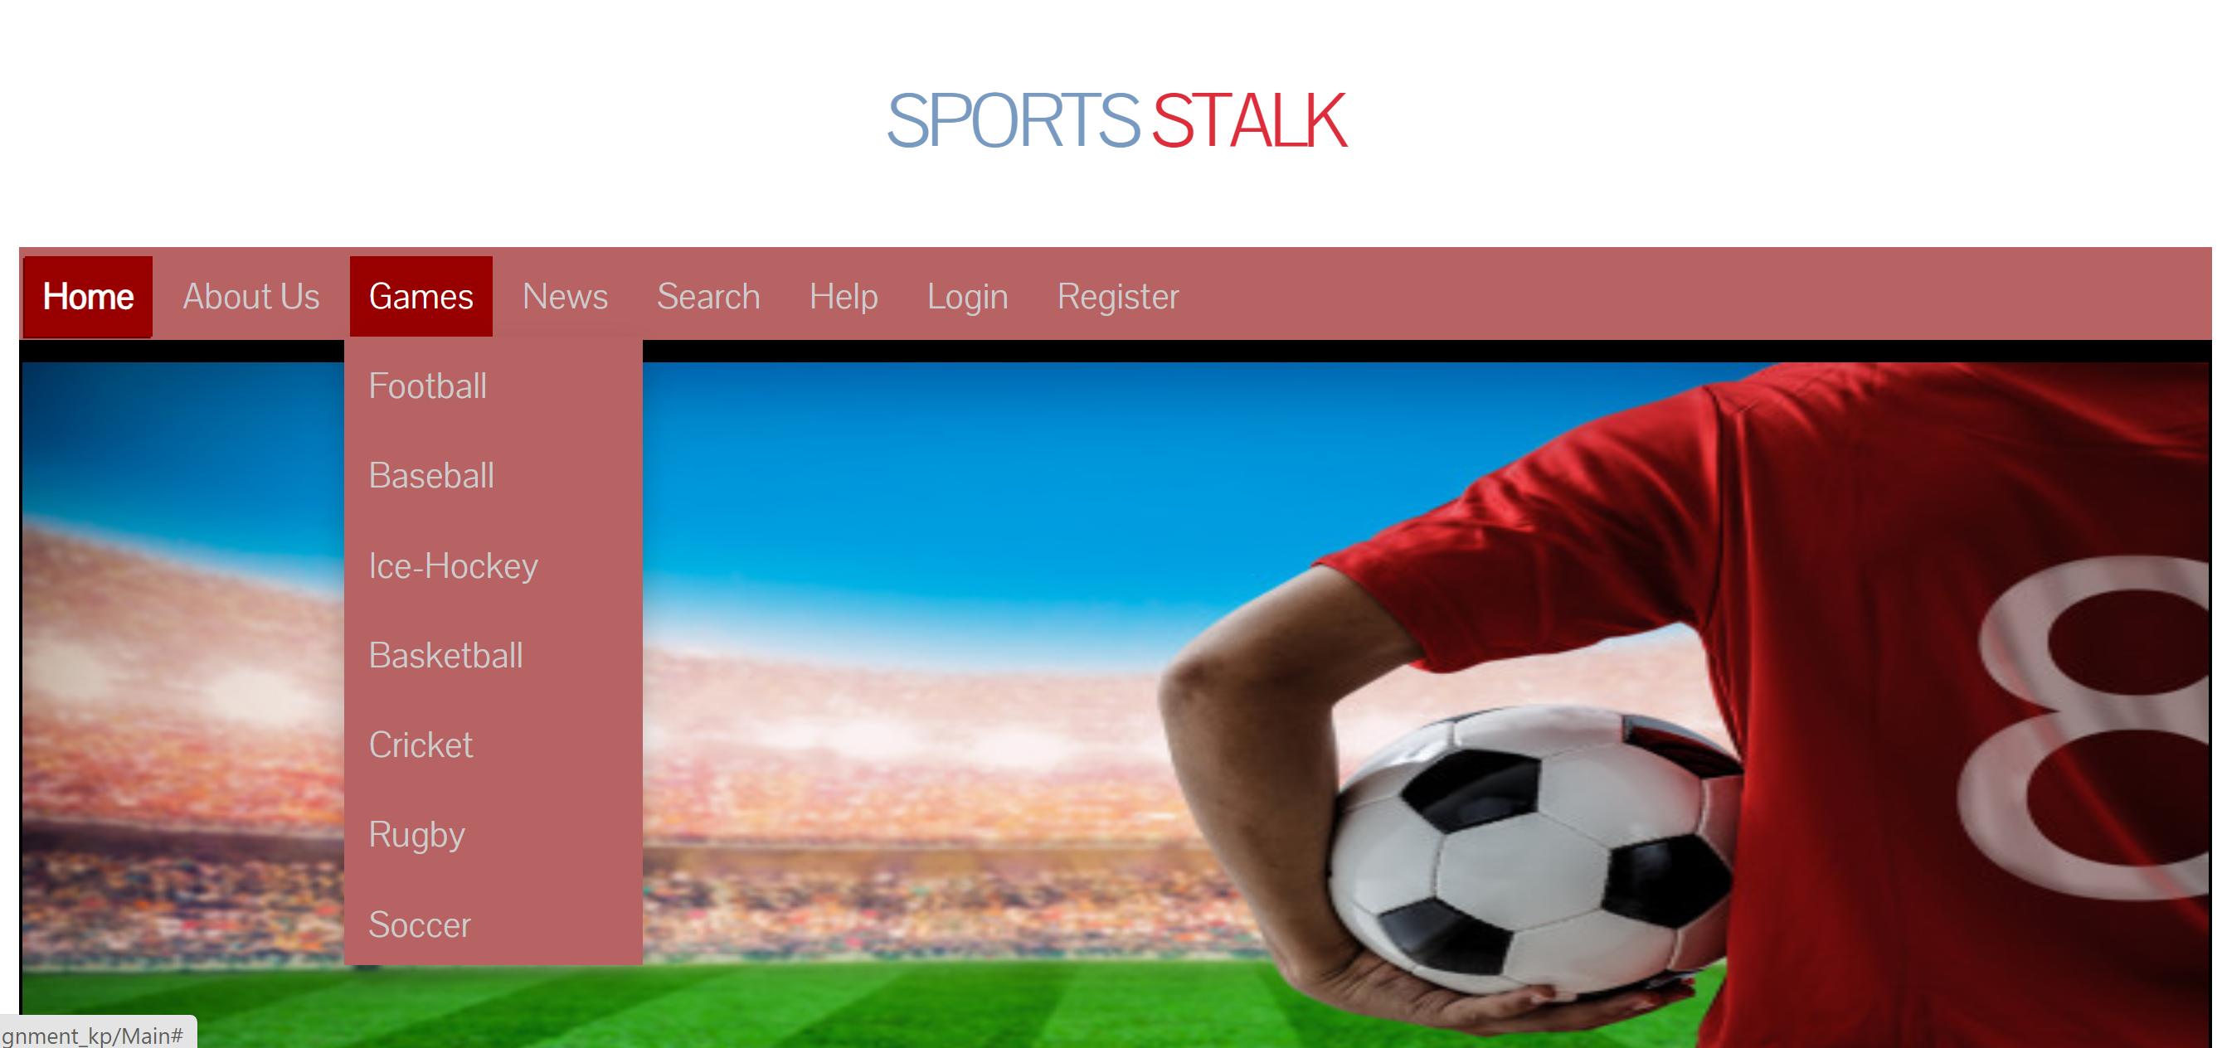
SCREENSHOTS

Slide 5
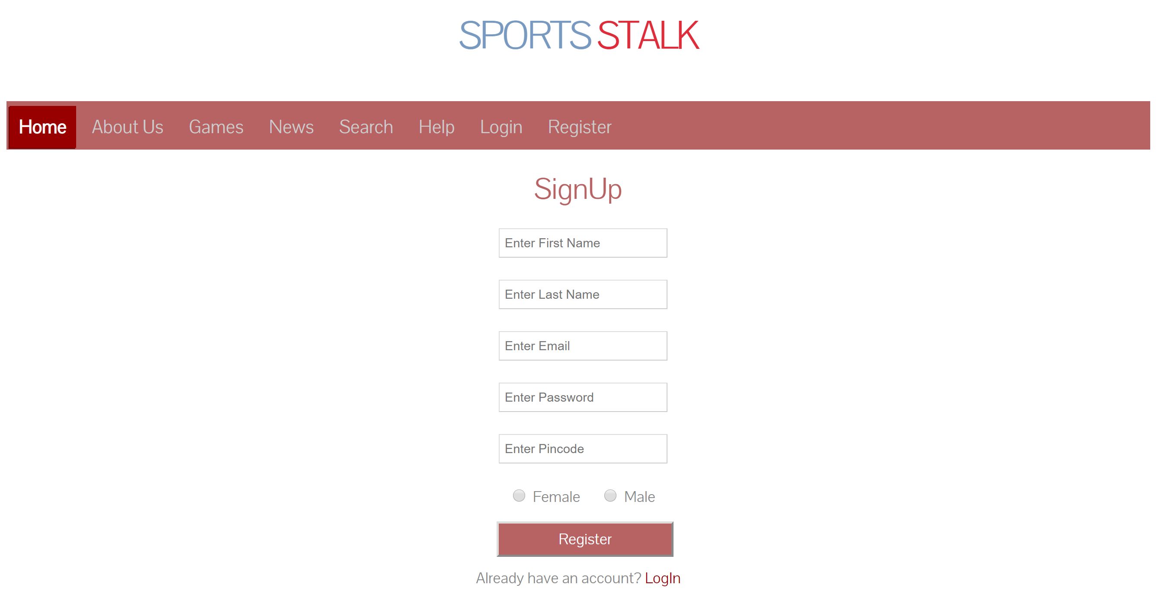
SCREENSHOTS

Slide 6
USE CASE DIAGRAM

Slide 7

THANK YOU!!

