Slide 1
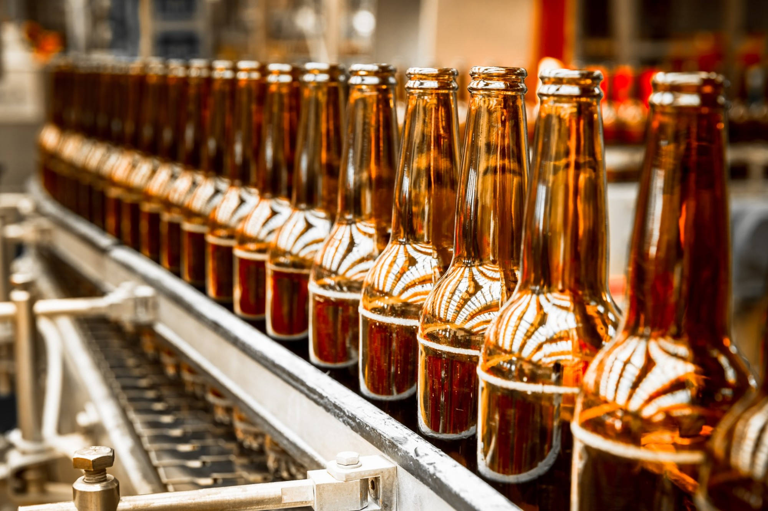
BEER RCMMNDR

Slide 2

THE MAGIC
Thank you

Slide 3

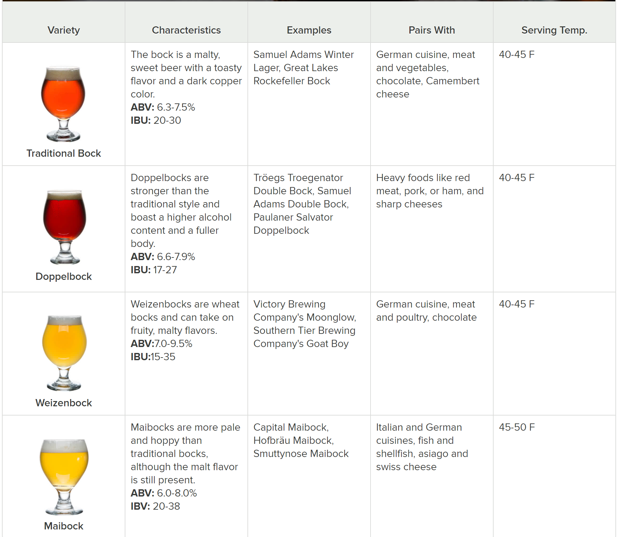
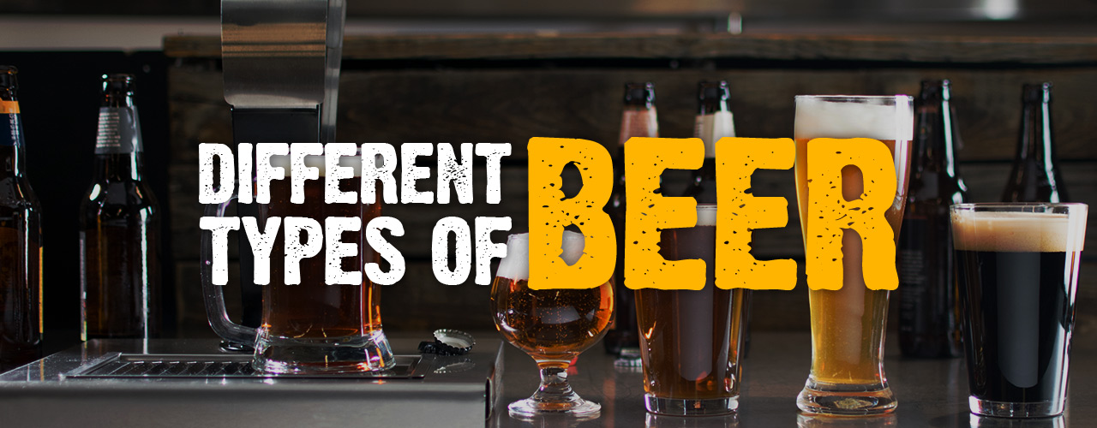
BEER STYLE FEATURES

Slide 4
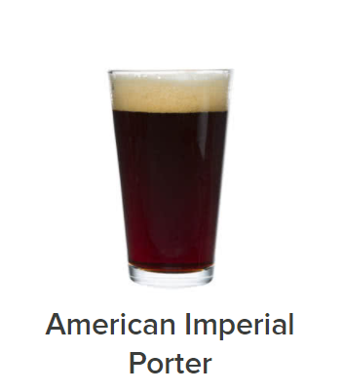
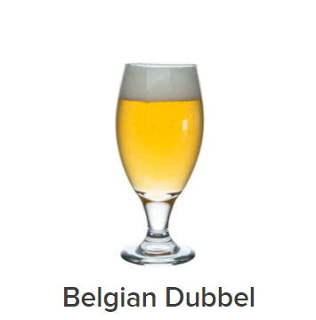
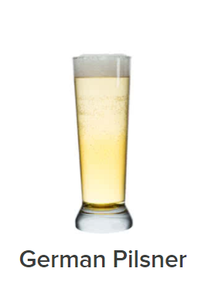
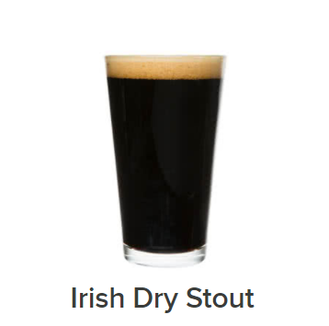
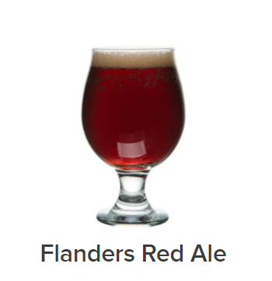
COLOR
BLACK | DARK | AMBER | GOLD | PALE

Slide 5
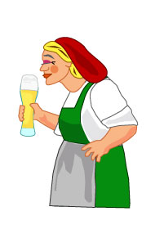
AROMA & CUSTOM FLAVOR
Caramel, floral & fruit
Banana, brown sugar, burnt, caramel, chocolate, earthy, herbal, pumpkin, roasted, smoke, toasted

Slide 6
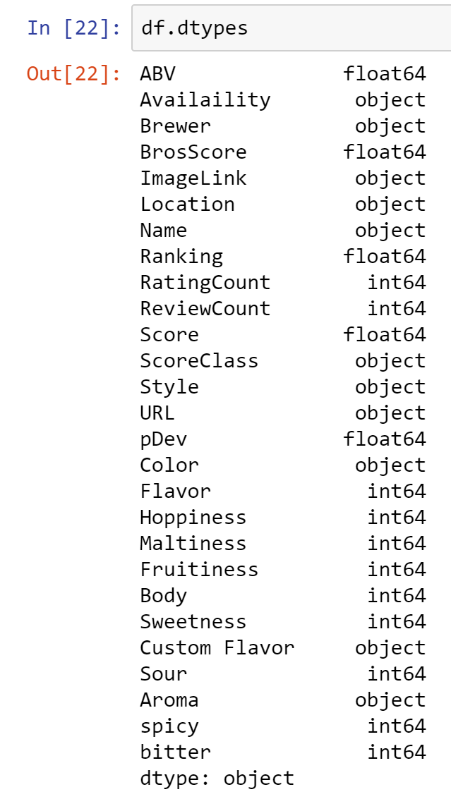

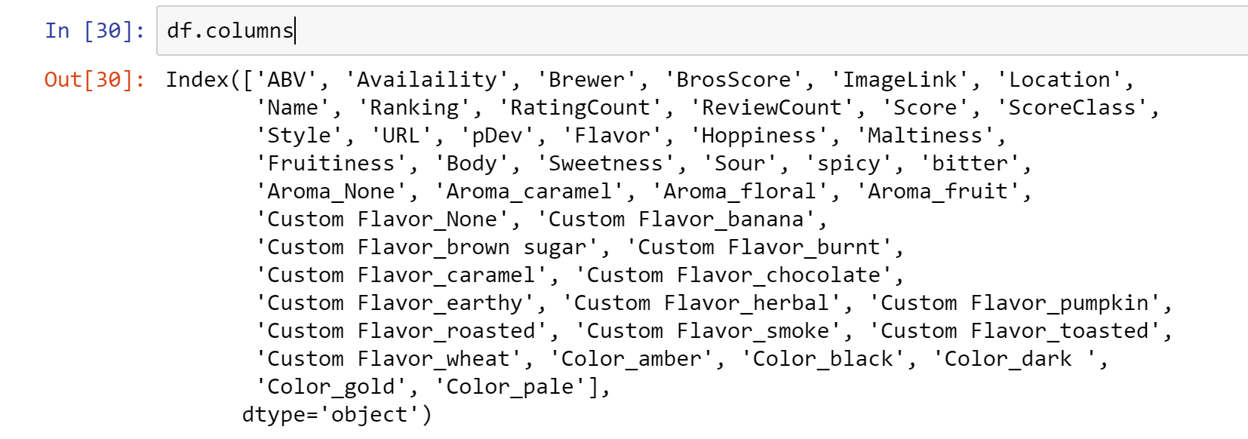
ONE HOT ENCODING, THE PANDAS WAY

Slide 7
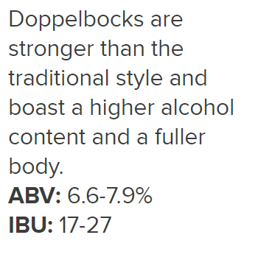
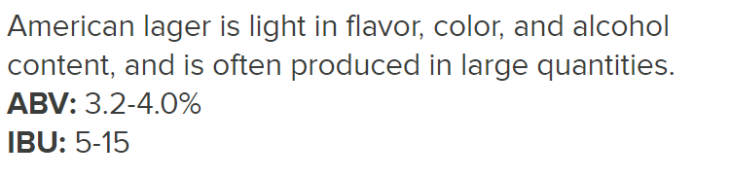
FLAVOR & BODY SCALE
1 | 2 | 3
LIGHT | NEUTRAL | STRONG

Slide 8

OTHER FEATURES
Hoppiness
Maltiness
Fruitiness
Sweetness
Sour
Spicy
Bitter
Not | A Little | Moderately | Very
0 | 1 | 2 | 3

Slide 9
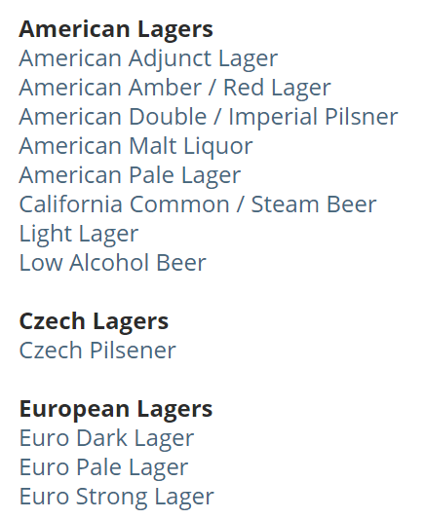
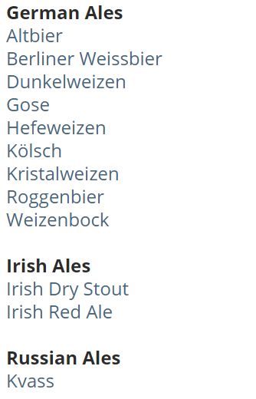
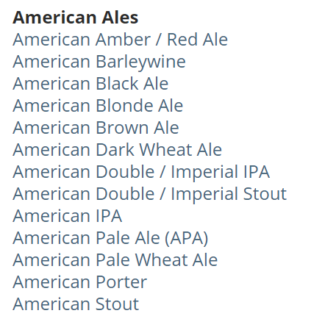
SCRAPE
BEER STYLES

Slide 10
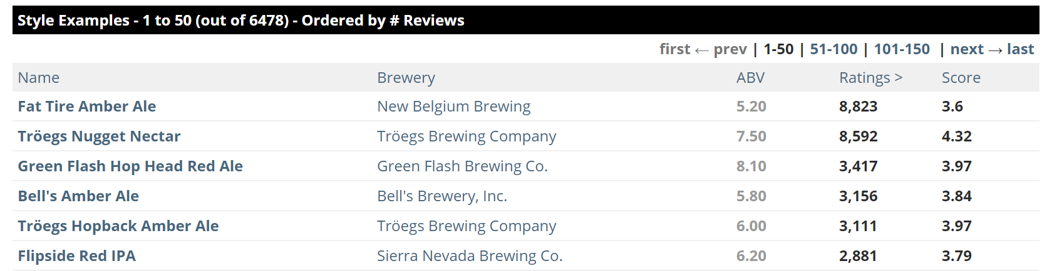
SCRAPE
Ratings > = 10
BEERS OF EACH STYLE

Slide 11
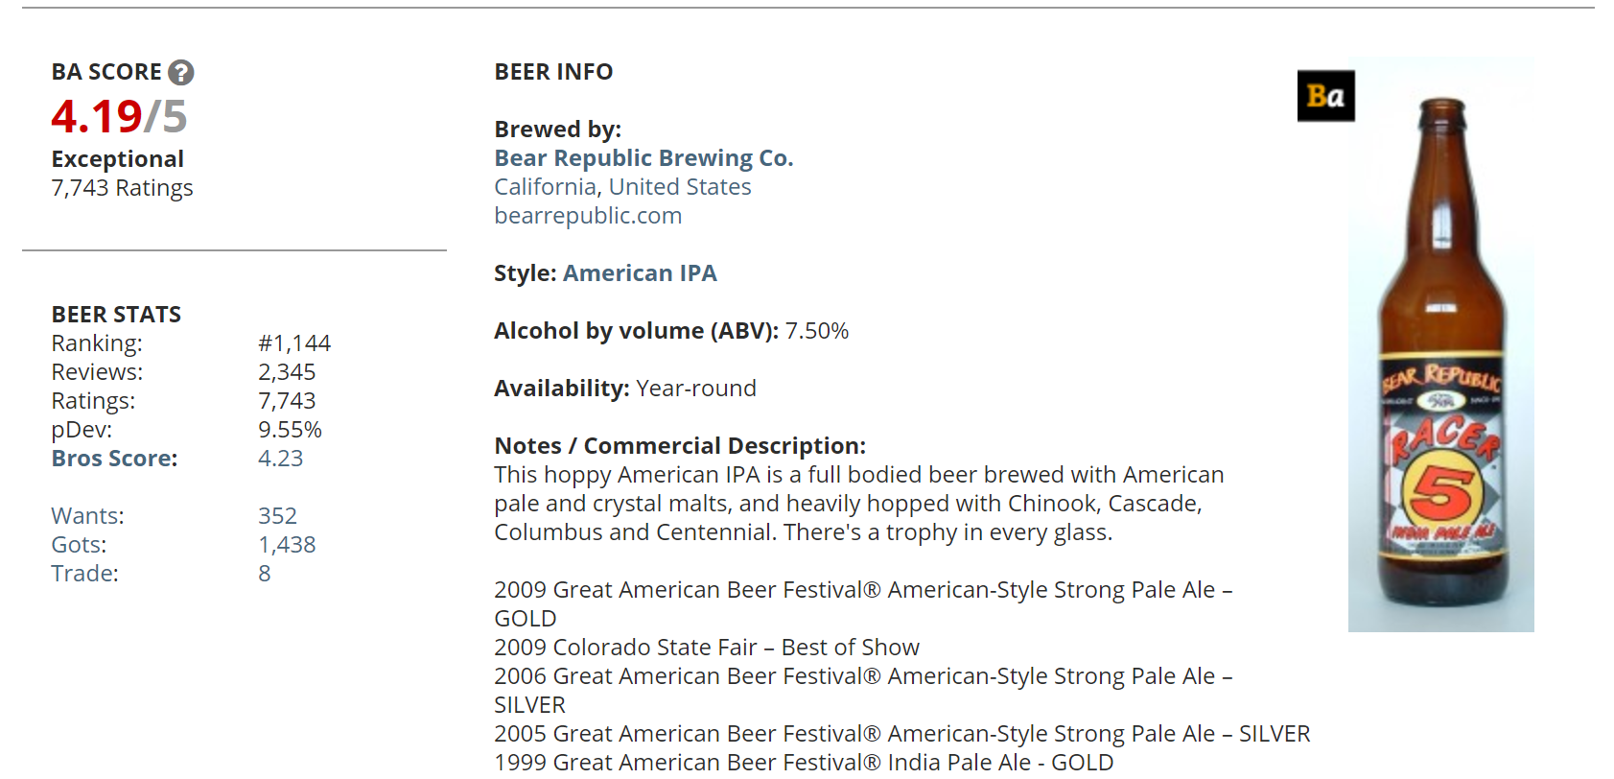
AND SCRAPE SOME MORE
BEER FEATURES

Slide 12

POSTGRES BEER FEATURE TABLE
Free and open-source database
Object-relational database management system (ORDBMS) with an emphasis on extensibility and standards compliance
Can handle workloads ranging from small single-machine applications to large Internet-facing applications (or for data warehousing) with many concurrent users
Has updatable views and materialize views, triggers, foreign keys
Supports functions and stored procedures, and other expandability

Slide 13
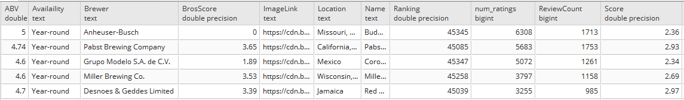
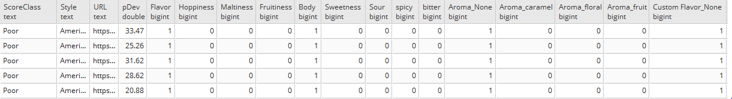
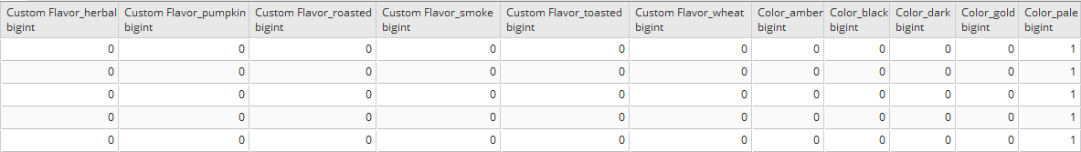

Slide 14
JING?
CREATE TABLE beer.beer_feature_all
(
"ABV" double precision,
"Availaility" text COLLATE pg_catalog."default",
"Brewer" text COLLATE pg_catalog."default",
"BrosScore" double precision,
"ImageLink" text COLLATE pg_catalog."default",
"Location" text COLLATE pg_catalog."default",
"Name" text COLLATE pg_catalog."default",
"Ranking" double precision,
num_ratings bigint,
"ReviewCount" bigint,
"Score" double precision,
"ScoreClass" text COLLATE pg_catalog."default",
"Style" text COLLATE pg_catalog."default",
"URL" text COLLATE pg_catalog."default",
"pDev" double precision,
"Flavor" bigint,
"Hoppiness" bigint,
"Maltiness" bigint,
"Fruitiness" bigint,
"Body" bigint,
"Sweetness" bigint,
"Sour" bigint,
spicy bigint,
bitter bigint,
"Aroma_None" bigint,
"Aroma_caramel" bigint,
"Aroma_floral" bigint,
"Aroma_fruit" bigint,
"Custom Flavor_None" bigint,
"Custom Flavor_banana" bigint,
"Custom Flavor_brown sugar" bigint,
"Custom Flavor_burnt" bigint,
"Custom Flavor_caramel" bigint,
"Custom Flavor_chocolate" bigint,
"Custom Flavor_earthy" bigint,
"Custom Flavor_herbal" bigint,
"Custom Flavor_pumpkin" bigint,
"Custom Flavor_roasted" bigint,
"Custom Flavor_smoke" bigint,
"Custom Flavor_toasted" bigint,
"Custom Flavor_wheat" bigint,
"Color_amber" bigint,
"Color_black" bigint,
"Color_dark " bigint,
"Color_gold" bigint,
"Color_pale" bigint
)
WITH (
OIDS = FALSE
)
TABLESPACE pg_default;

Slide 15
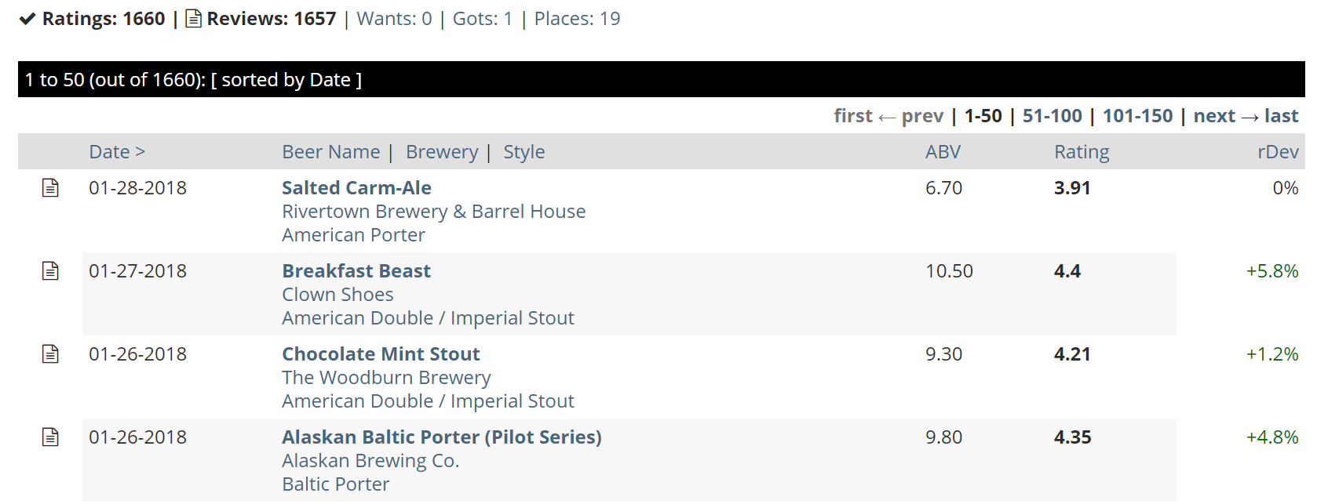
ONE MORE BEER! SCRAPE
USER RATINGS
https://www.beeradvocate.com/user/beers/?start={ratings_count}&ba={username}&order=dateD&view=R

Slide 16
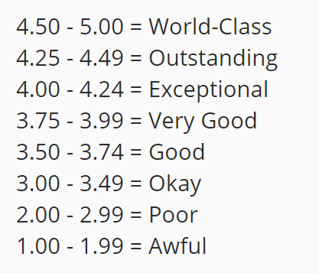
YES NO MAYBE SO - RONESSA
Top 5% of User Rated beers?
Rating over 4?

Slide 17
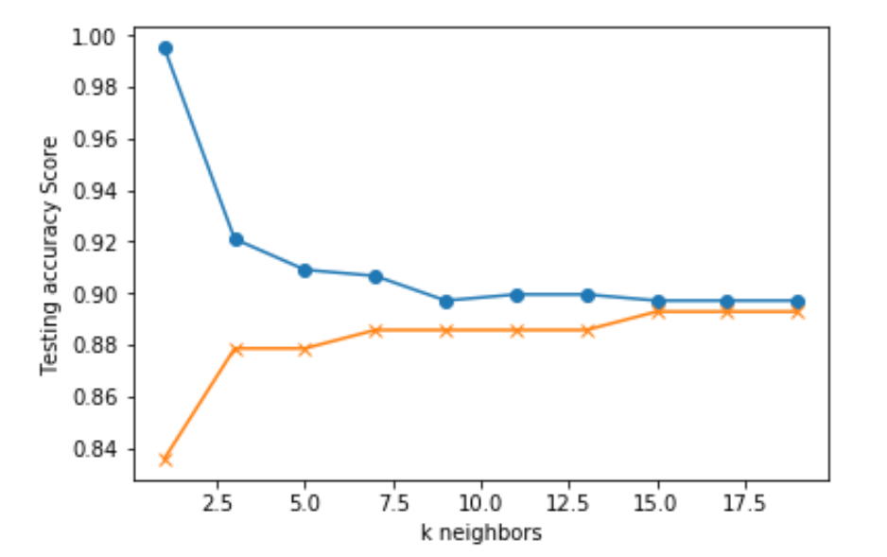
MACHINE LEARNING MODELS
KNN
LOGISTIC REGRESSION
DECISION TREES
RANDOM FOREST

Slide 18
TESTING AND TWEAKING - RONESSA
MERGE WITH BEER FEATURES
2 DATASETS (TRIED AND NOT TRIED)
TRIED - SPLIT TRAIN TEST
USED TO FIT THE MODEL
10%

Slide 19
LET’S TRY IT!
http://beer-rcmmndr.herokuapp.com/

