Slide 1
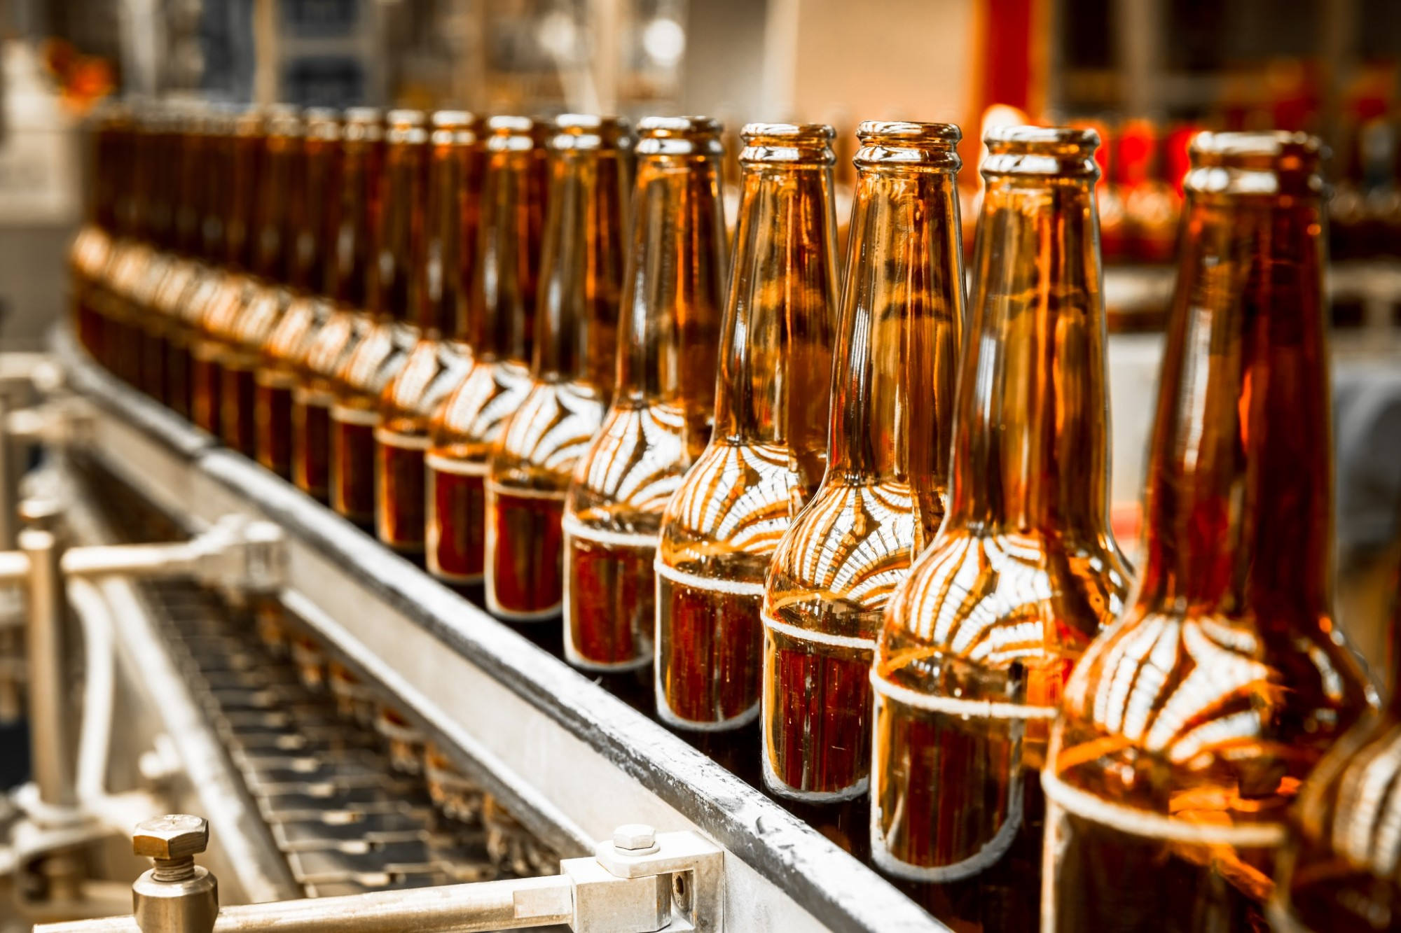
BEER RCMMNDR

Slide 2

THE MAGIC
Thank you

Slide 3

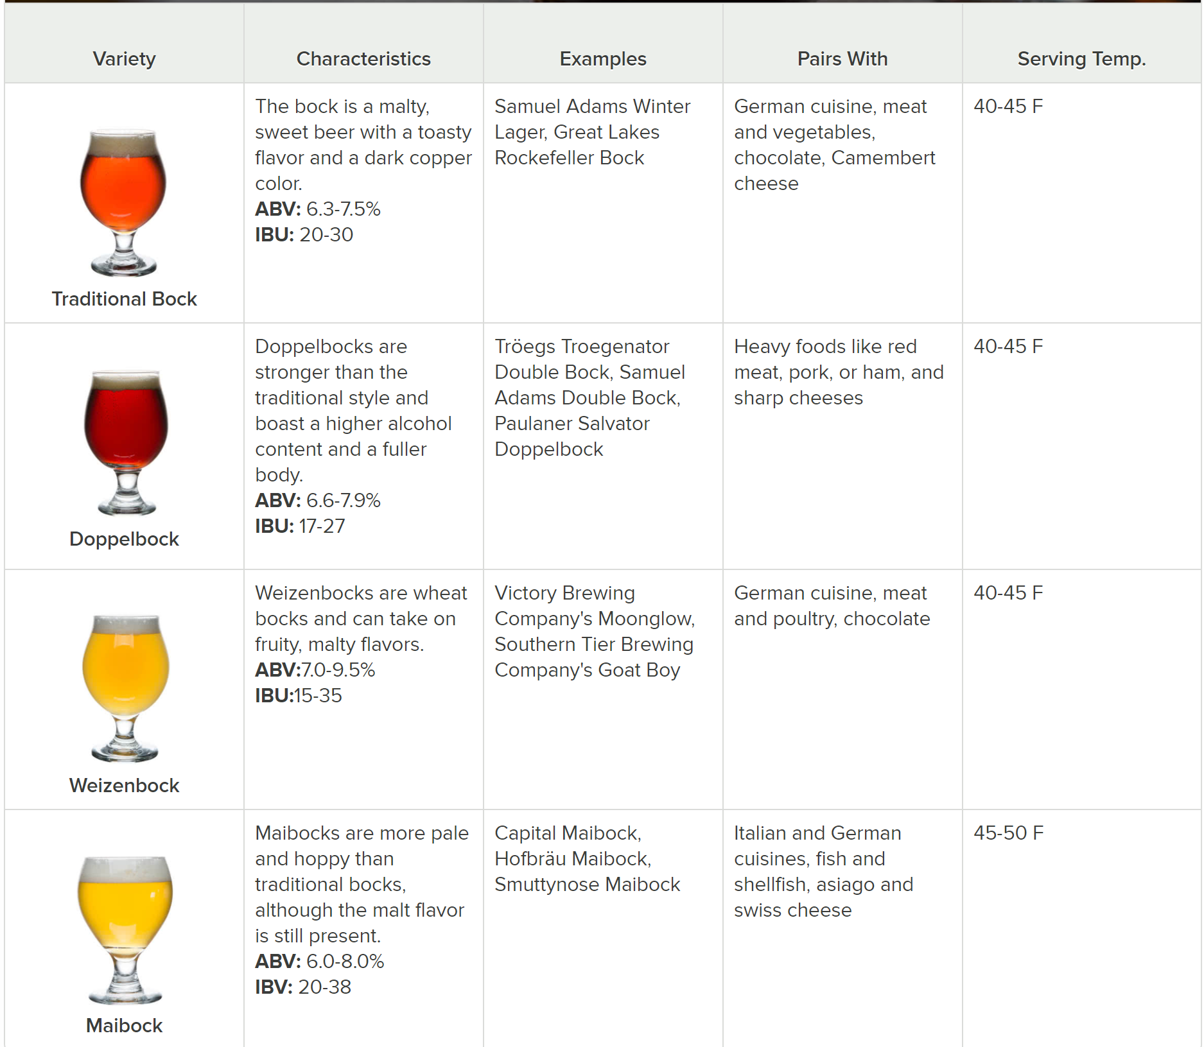
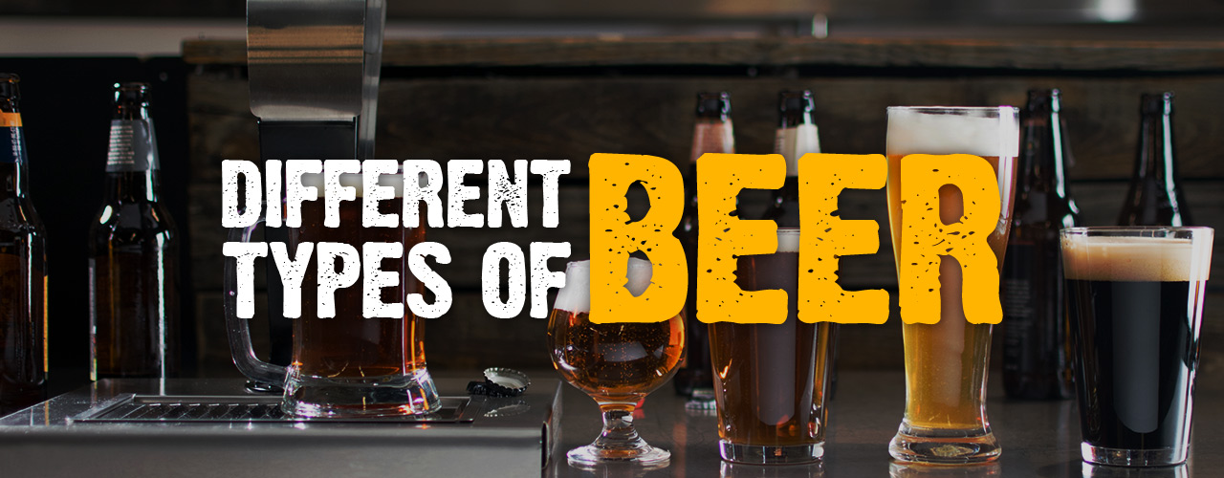
BEER STYLE FEATURES

Slide 4
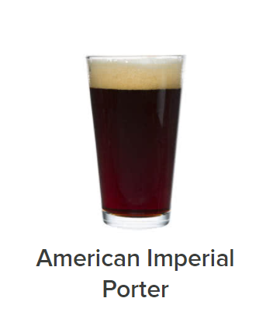
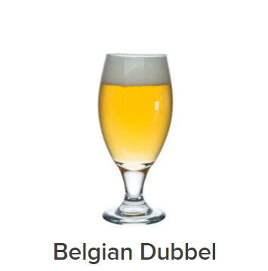
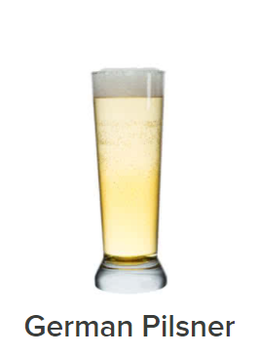
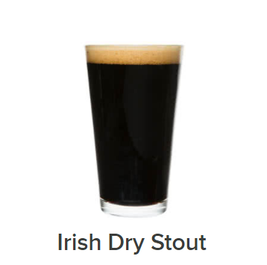
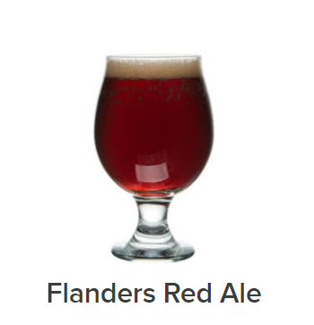
COLOR
BLACK | DARK | AMBER | GOLD | PALE

Slide 5
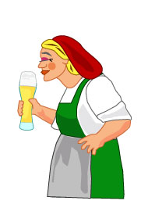
AROMA & CUSTOM FLAVOR
Caramel, floral & fruit
Banana, brown sugar, burnt, caramel, chocolate, earthy, herbal, pumpkin, roasted, smoke, toasted

Slide 6
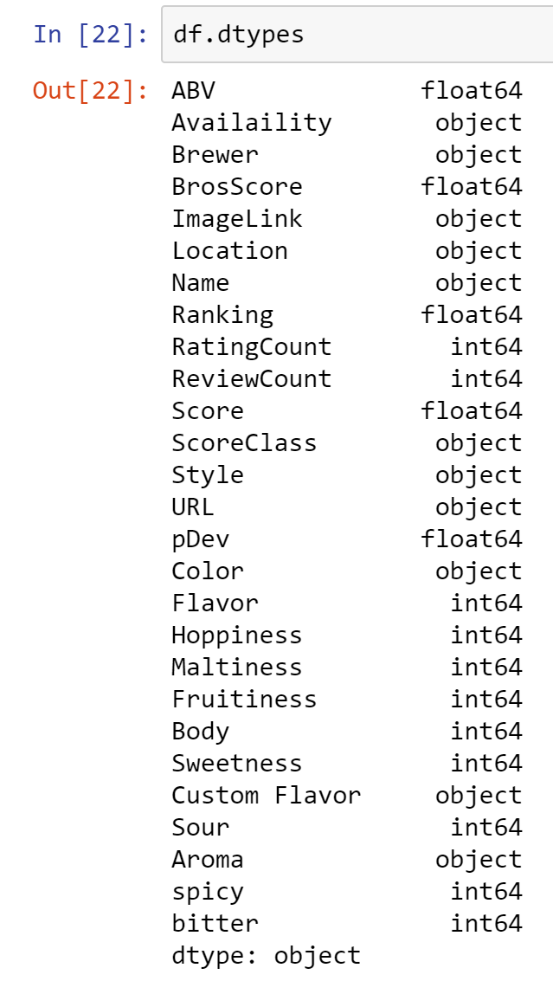

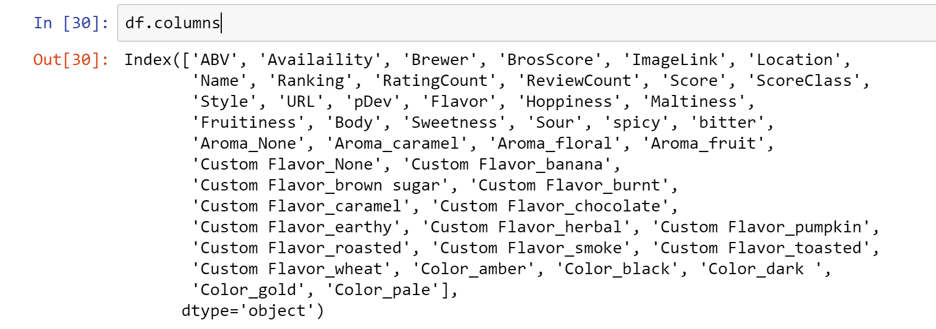
ONE HOT ENCODING, THE PANDAS WAY

Slide 7
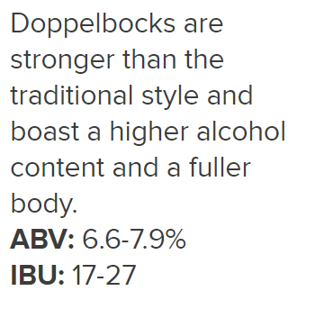
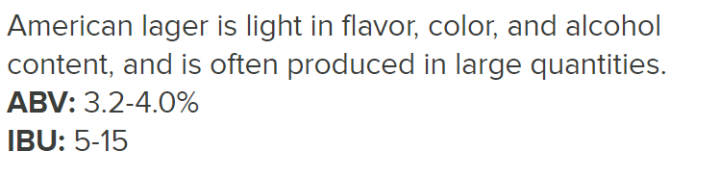
FLAVOR & BODY SCALE
1 | 2 | 3
LIGHT | NEUTRAL | STRONG

Slide 8

OTHER FEATURES
Hoppiness
Maltiness
Fruitiness
Sweetness
Sour
Spicy
Bitter
Not | A Little | Moderately | Very
0 | 1 | 2 | 3

Slide 9
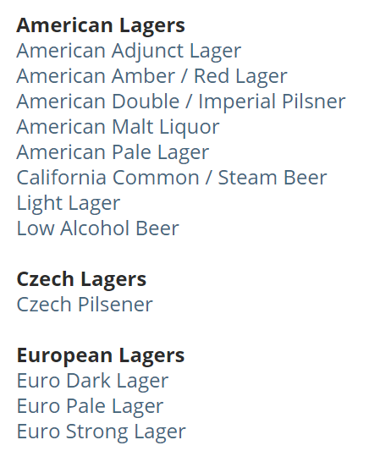
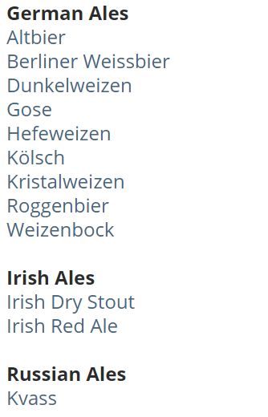
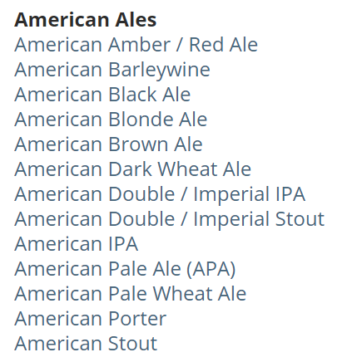
SCRAPE
BEER STYLES

Slide 10
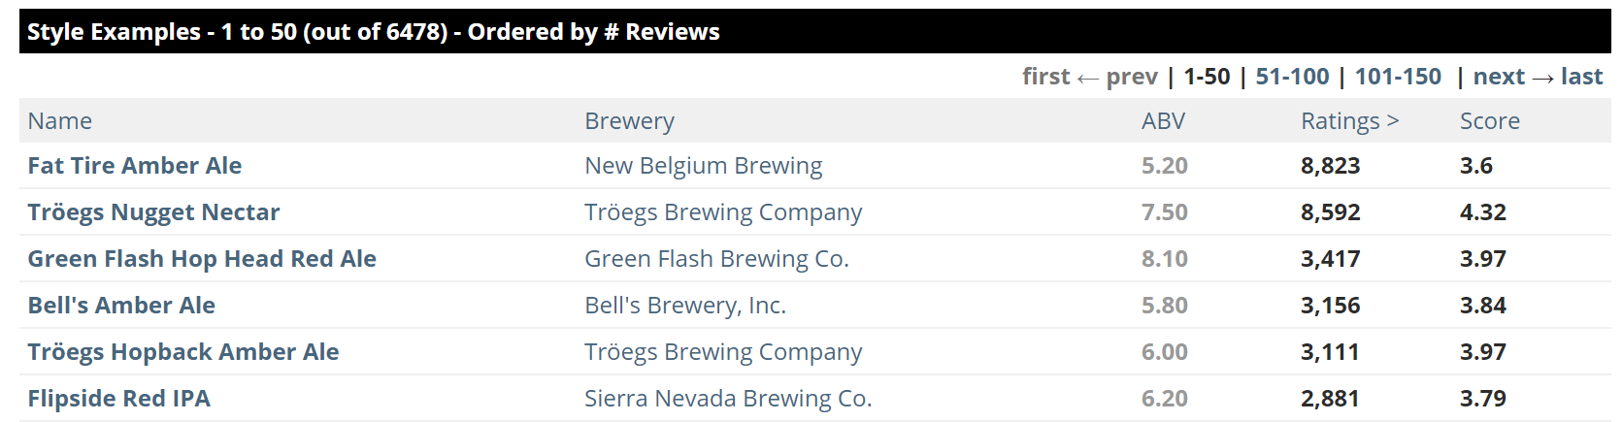
SCRAPE
Ratings > = 10
BEERS OF EACH STYLE

Slide 11
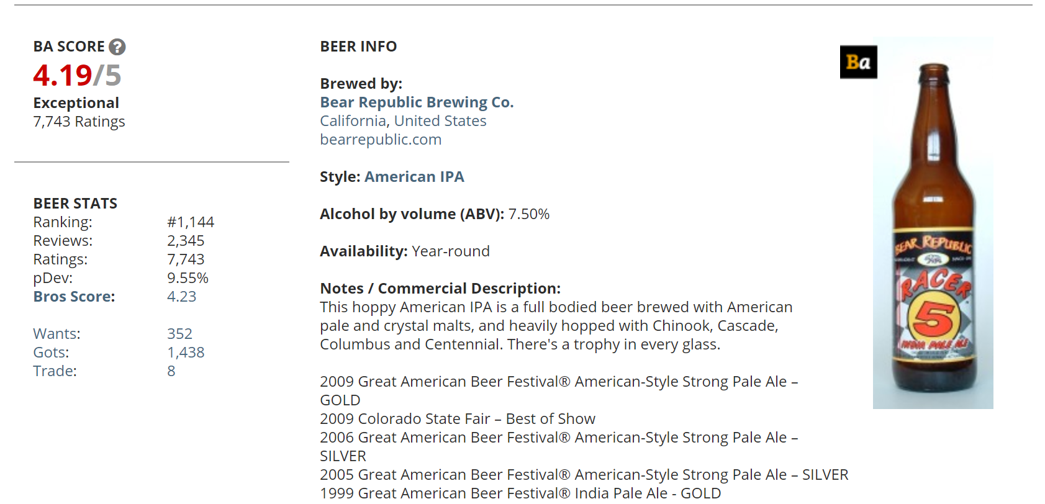
AND SCRAPE SOME MORE
BEER FEATURES

Slide 12

POSTGRES BEER FEATURE TABLE
Free and open-source database
Object-relational database management system (ORDBMS) with an emphasis on extensibility and standards compliance
Can handle workloads ranging from small single-machine applications to large Internet-facing applications (or for data warehousing) with many concurrent users
Has updatable views and materialize views, triggers, foreign keys
Supports functions and stored procedures, and other expandability

Slide 13
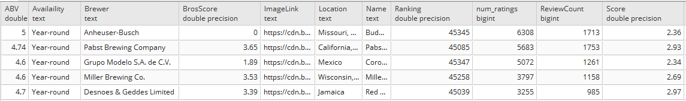
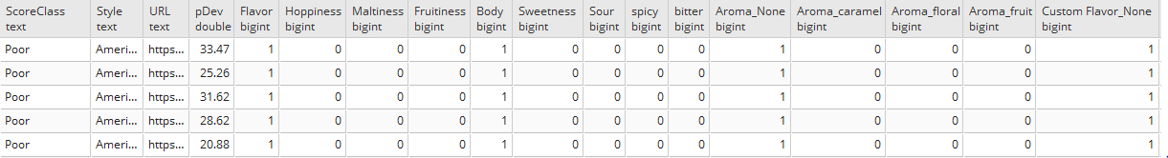
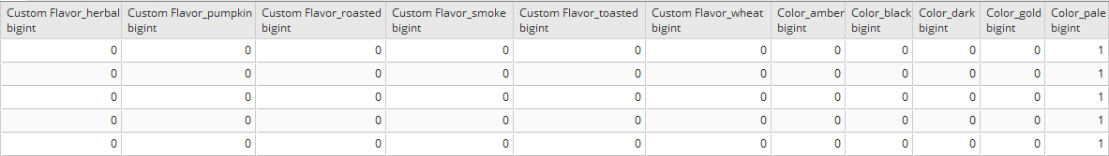
POSTGRES BEER FEATURE TABLE

Slide 14
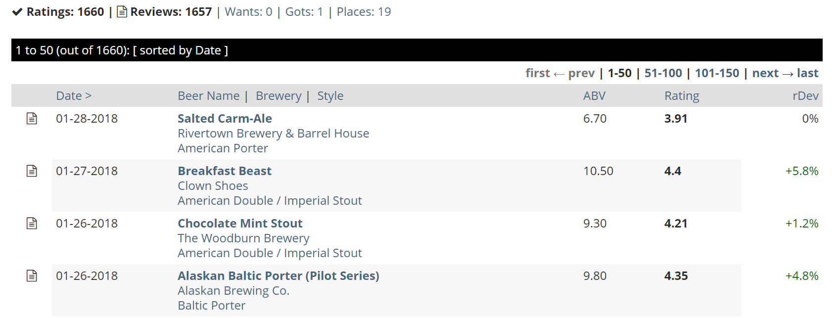
ONE MORE BEER! SCRAPE
USER RATINGS
https://www.beeradvocate.com/user/beers/?start={ratings_count}&ba={username}&order=dateD&view=R

Slide 15
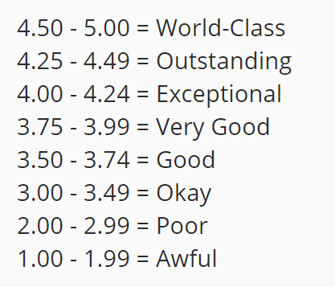
INITIAL MODEL TESTING
Merged with DB to apply features.
Scores over 4
OR
Top 5% of User’s Ratings

Slide 16
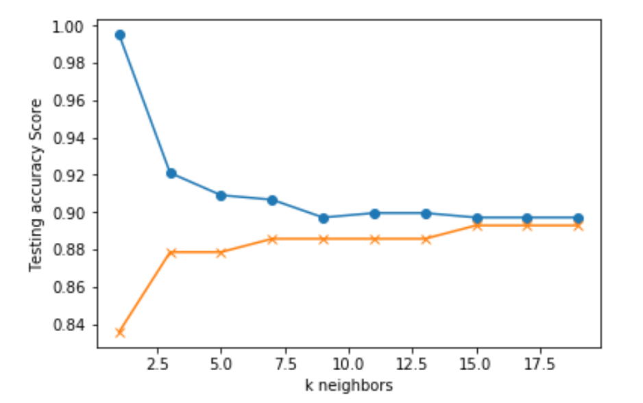
MACHINE LEARNING MODELS
KNN
LOGISTIC REGRESSION
DECISION TREES
RANDOM FOREST

Slide 17
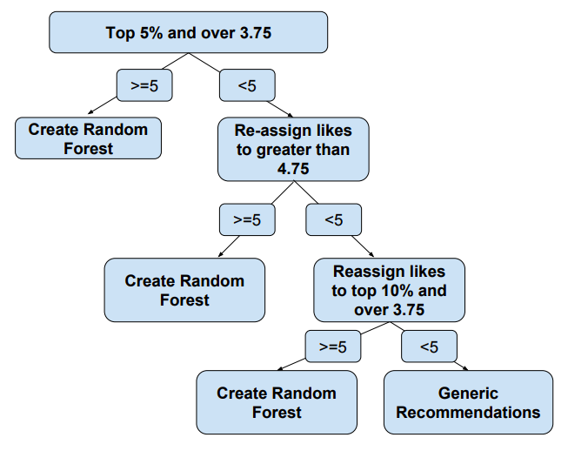
SAMPLE SIZE

Slide 18
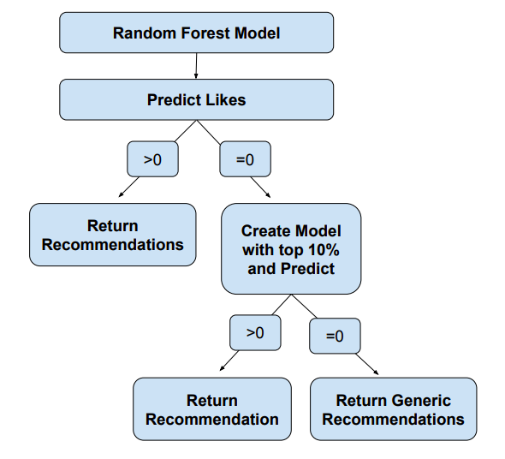
MAKING RECOMMEDATIONS

Slide 19
LET’S TRY IT!
http://beer-rcmmndr.herokuapp.com/

