Slide 1

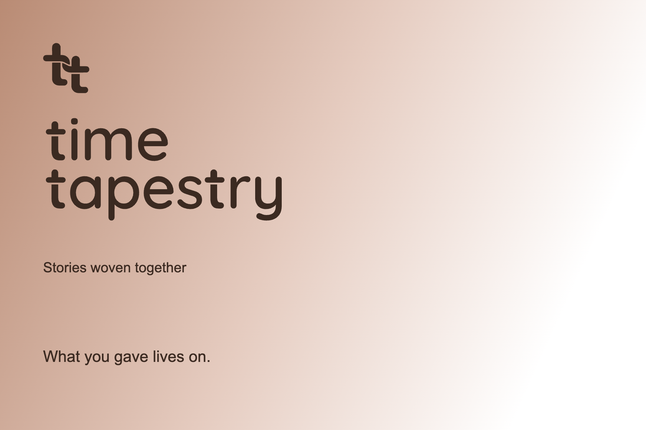
TIME TAPESTRY / DESIGN KIT 39
Stories woven together
A warm, modern identity for the stories of faith and generosity that connect generations.
01

Slide 2



TIME TAPESTRY / DESIGN KIT 39
One icon, one master
Every color and application uses the same restored outline and woven crossover.
Espresso
Peach
White on dark
02
Notes:
Icon traced from the approved original screenshot. Source overlap measured 99.33%. This is a reconstruction, not a recovered original vector.

Slide 3


TIME TAPESTRY / DESIGN KIT 39
A matching stacked wordmark
Equal type size on both lines. The same custom t appears three times, with a separated crossbar and compact rounded foot.
Quicksand 600 for the outlined wordmark. Manrope for supporting text.
Use the supplied SVG instead of retyping the logo.
03

Slide 4
TIME TAPESTRY / DESIGN KIT 39
Warm color, a clean white canvas
These roles give the colors meaning through their use. They are design intentions, not universal psychological claims.
Espresso
Peach
Moss
Walnut
White
#3B2A21
#B98B74
#868973
#6A5747
#FFFFFF
The lasting foundation.
Primary logo and readable text.
Human warmth.
Accents and postcard gradients.
Growth and connection.
Supporting patterns and surfaces.
Material depth.
Secondary graphic accents.
Room for the story.
Website and writing surfaces.
04

Slide 5


TIME TAPESTRY / DESIGN KIT 39
Two locked patterns
The interlocking repeat creates tapestry. The broad crossing threads create movement and connection.
05
Notes:
Patterns traced from the approved board. Use intact supplied assets. Do not replace them with repeated disconnected t symbols.

Slide 6



TIME TAPESTRY / DESIGN KIT 39
A gentle gradient system
Peach, moss and white blend into soft supporting forms. Keep the logo solid and keep text outside decorative gradients.
A subtle peach-to-white gradient also belongs on the postcard front.
06

Slide 7
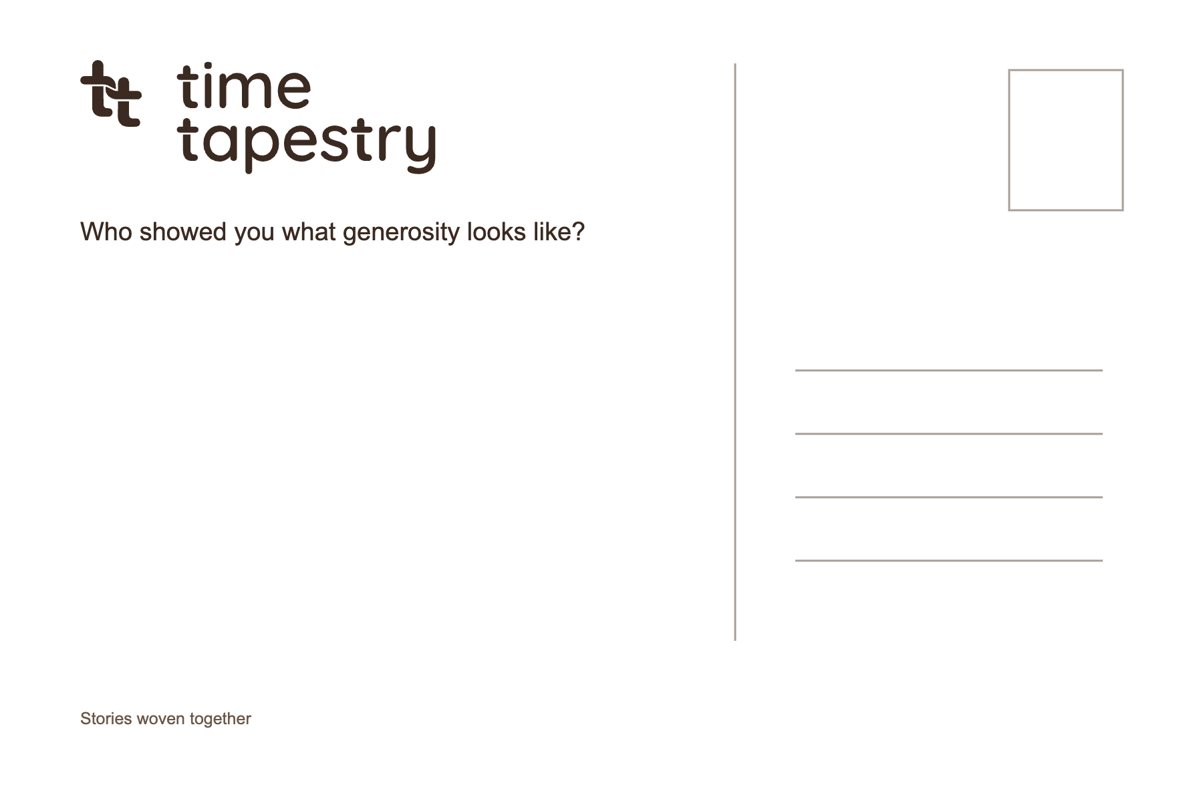
TIME TAPESTRY / DESIGN KIT 39
A postcard that feels personal
A warm front, a clean white back, and space for a real story.
07
Notes:
6 x 4 inch proof artwork. 0.125 inch bleed variants supplied. RGB files are not certified CMYK or PDF/X. Confirm physical proof and printer requirements before a production run.

Slide 8
TIME TAPESTRY / DESIGN KIT 39
Ready to use
The folder separates master assets, applications and evidence so the identity stays consistent.
assets/logos Icons and primary logos
assets/wordmarks Matching stacked wordmarks
assets/patterns Interlocking tapestry and flowing thread
assets/gradients Transparent supporting forms
print Postcard artwork and bleed proofs
web Tokens and responsive website preview
source Fonts, licenses and approved references
verification Export and consistency checks
08
Notes:
Transparent SVG is preferred for websites and scaling. PNG is a compatibility fallback. White variants need a dark background. Logos are embedded images with source SVGs supplied separately; slide text and layout are editable.

