Slide 1
CONCEPT / PRODUCT · 20%
01
The stories behind a life are worth passing on.
43%
51%
20%
of Americans 50+ named
life lessons and values
among their most
important legacies.
of surveyed Protestant
senior pastors were very
concerned about younger
Christians’ financial support.
greater likelihood of giving
among children whose
parents discussed giving
with them.
Edward Jones / Age Wave, 2021
Barna, 2023 report
IU Women Give, 2013
Different studies: legacy preferences, pastor concern and an association. None proves our product works.
time tapestry / Gloo AI Hackathon / October 2026 / Editable draft v3
Notes:
TAYLOE: Forty-three percent of Americans over 50 name life lessons and values among the important things they want to leave behind. That is the legacy we want to help a family carry.
EVIDENCE LIMITS: Edward Jones/Age Wave/Harris Poll online U.S. study, August 12–16, 2021, n=2,020 overall; older subgroup size not disclosed. Barna surveyed 516 U.S. Protestant senior pastors March 25–April 5, 2022, published October 25, 2023. Concern is not measured youth behavior. Women Give 2013 follows 903 children with 2002–03 and 2007–08 data; the 20% is an association, not percentage points or our predicted effect. For the short pitch, speak only the first statistic. The others support questions.
SOURCES
Edward Jones / Age Wave, 2021
https://www.prnewswire.com/news-releases/pandemic-prompted-first-time-legacy-planning-conversations-for-44-5-million-americans-edward-jones-finds-301398039.html
Barna, 2023 report
https://www.barna.com/research/future-generosity/
IU Women Give, 2013
https://philanthropy.indianapolis.iu.edu/news-events/news/_news/2013/women-give-2013.html

Slide 2
CONCEPT / PRODUCT · 20%
02
Time Tapestry
Make room for the stories
that shaped a life.
01
Answer in your own time.
Four sections. Voice, video or typing.
02
Choose what you share.
A Christian legacy gift that helps families pass on faith, character and generosity through personal stories.
Saved takes and storyteller approval.
03
Give them a reason to return.
A story collection, postcards and replies.
Families are the users. Churches and organizations are potential sponsors to validate in a pilot.
time tapestry / Gloo AI Hackathon / October 2026 / Editable draft v3
Notes:
TAYLOE: Time Tapestry helps someone put that legacy into four stories for the people they love. A family can participate together, or the storyteller can answer when they have time. They decide what to keep and approve before sharing.
CURRENT SCOPE: Time Tapestry is the current project name. Do not return to grandchild-only wording. Christian faith and lived values are the fixed framing for new interviews. There is no framing dropdown. Church-sponsored cohorts are a proposed distribution model, not an implemented organization dashboard or a signed customer.
SOURCES
Build and QA evidence
https://github.com/kae-creative-apps/time-tapestry/pull/1

Slide 3
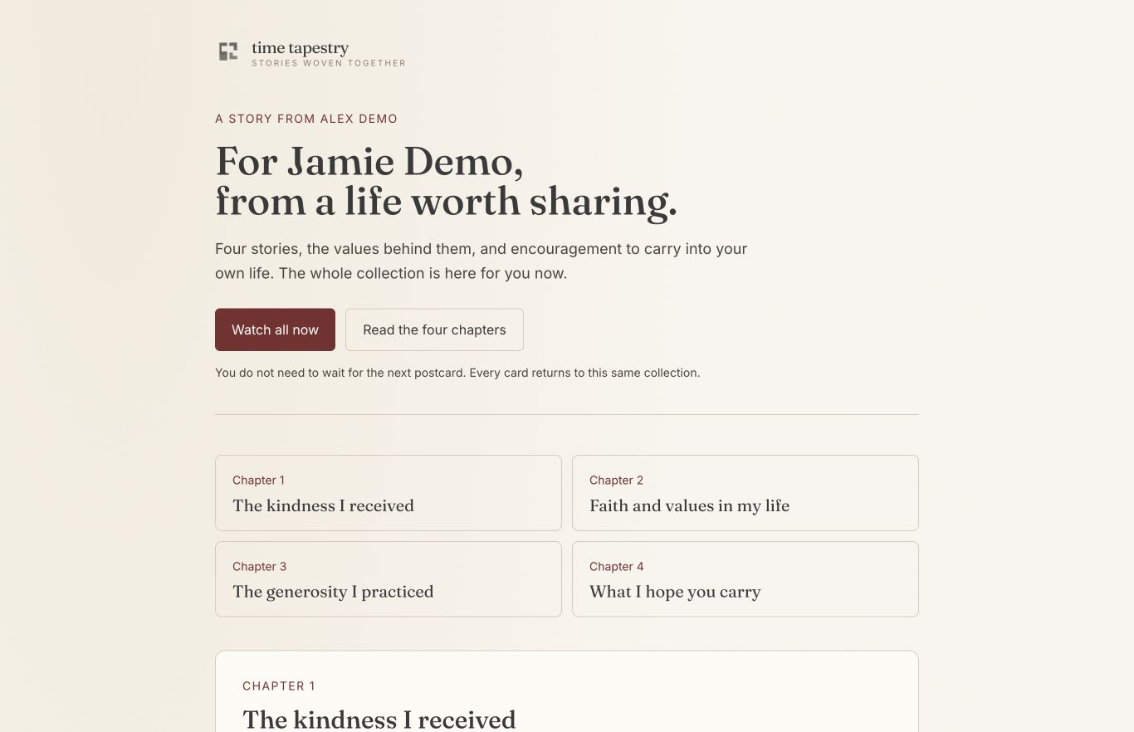
CONCEPT / PRODUCT · 20%
03
The storyteller keeps the final say.
Four focused conversations
01
Kindness I received
02
Faith and values I lived
03
Generosity I practiced
04
What I hope you carry
Replay. Rerecord. Review. Approve.
Actual local collection screen with synthetic test content. Real-device capture still needs validation.
time tapestry / Gloo AI Hackathon / October 2026 / Editable draft v3
Notes:
KAELYN: The working browser journey lets a storyteller answer four sections and review each chapter. The prototype includes saved takes and transcript correction. Source changes invalidate the review, so an older approval cannot silently cover a new answer.
SCREEN EVIDENCE: Screenshot is the October 2 local QA collection, with synthetic Alex Demo and Jamie Demo content. Typed answers, editing, approval, private synthetic-video playback and text replies were browser-tested. Voice/video code exists, but actual camera, microphone and phone recovery need a live check before claiming them demonstrated. Ten-minute per-take cap; suggest two to five minutes. Typed answers do not create footage of that person.
SOURCES
Build and QA evidence
https://github.com/kae-creative-apps/time-tapestry/pull/1

Slide 4
INNOVATION · 20%
04
Connection should not depend
on a shared calendar.
A FAMILIAR BEHAVIOR
Marco Polo
Record when you can. Watch and respond later.
A PAID CATEGORY
Storyworth + Remento
Family storytelling already has paid offers.
OUR FOCUS TO TEST
Time Tapestry
Christian legacy, tangible encouragement and a reply.
These establish an analogy and an adjacent category. Completion, willingness to pay and sponsorship remain to test.
time tapestry / Gloo AI Hackathon / October 2026 / Editable draft v3
Notes:
KAELYN: I use Marco Polo to stay connected with people who live far away. We do not have to be free at the same time. Time Tapestry brings that same flexibility to stories of faith and generosity.
TAYLOE, IF ASKED ABOUT MARKET: Marco Polo makes the behavior familiar. Storyworth and Remento show paid offers in the family-story category. Our hypothesis is that a focused Christian legacy gift, with physical encouragement and a response loop, gives families and sponsoring churches a reason to choose this experience.
Do not claim Marco Polo proves our demand, people are more disconnected than ever, or that AI interviews and QR memories are unique. Remento already offers spoken-to-written chapters, QR recordings and immediate sharing; Storyworth offers guided interviews and family calls. Posted prices are not verified sales or our TAM.
SOURCES
Marco Polo, official fact sheet
https://www.marcopolo.me/docs/marco-polo-fact-sheet.pdf
Storyworth, pricing help
https://help.storyworth.com/en_US/book-pricing
Remento, pricing guide
https://help.remento.co/en/articles/8365892-remento-s-pricing-guide

Slide 5
INNOVATION · 20%
05
The first card opens the whole story.
Later cards bring a chapter back into everyday life, with the storyteller’s own encouragement.
01
02
03
04
05
06
Invite
→
Answer
→
Approve
→
Receive
→
Return
→
Reply
MONTH 0
MONTH 3
MONTH 6
MONTH 9
The introduction
A story to revisit
A word to carry
Another invitation
Four approved chapter cards. All content available upfront. Print, delivery and email need live provider checks.
time tapestry / Gloo AI Hackathon / October 2026 / Editable draft v3
Notes:
TAYLOE: The first postcard introduces the gift and opens all four approved chapters. The next three invite the recipient back at months three, six and nine. The encouragement can include Scripture the storyteller supplied and approved. The recipient can send a message back.
SCOPE: Four cards span nine months after the first, not twelve. Shipping starts after approval and a confirmed address. Delayed mailing shifts later cards. A recipient fallback email is eligible fourteen days after confirmed mailing, subject to preferences and replies. No immediate recipient completion email spoils the gift. Mail and email adapters have local tests but no real delivery was performed. Do not show a fabricated scan or mailed status.
SOURCES
Build and QA evidence
https://github.com/kae-creative-apps/time-tapestry/pull/1

Slide 6
IMPACT AND EXECUTION · 20%
06
Relationships and character.
Generosity made personal.
PROPOSED PILOT
WHAT WE WOULD MEASURE
1 church. 10 families.
Interviews finished and stories approved
Meaningful family conversations and replies
Test whether families finish, return and respond, and whether a church will sponsor the next group.
Paid demand or a concrete sponsor commitment
Time, support and delivery cost per family
Build evidence: 55 automated tests and a local browser journey passed. No pilot outcomes or donation lift claimed.
time tapestry / Gloo AI Hackathon / October 2026 / Editable draft v3
Notes:
TAYLOE: We will pilot with one church and ten families, measuring completed stories, meaningful conversations and whether families or sponsors value it enough to pay. Relationships and character are the intended impact; increased giving would need a separate study.
VALIDATION: The pilot size is a proposed plan, not recruitment or a signed partnership. Compare follow-through with a simple interview-question sheet where feasible; a small exploratory pilot cannot prove causality. Track price and cost assumptions explicitly. Potential buyers are the family gift purchaser and a church or nonprofit sponsoring families. A church-led multi-family dashboard, billing and sponsor controls are not built. Do not promise access to private stories as a sponsor benefit.
SOURCES
Build and QA evidence
https://github.com/kae-creative-apps/time-tapestry/pull/1

Slide 7
AI · 20%
07
AI helps prepare the story.
A person approves what it means.
TOOL
ROLE
EVIDENCE TODAY
Gloo
Follow-ups and source-based chapter drafts
Integrated; live check pending
ElevenLabs
Spoken interview questions
Integrated; voice audition pending
Whisper
Editable recording transcripts
Integrated; live check pending
HyperFrames + Remotion
Titles, timed captions and a branded closer
Synthetic local render passed
Editing and caption timing currently need an operator. No automatic professional-editing claim.
time tapestry / Gloo AI Hackathon / October 2026 / Editable draft v3
Notes:
KAELYN: The AI connections for questions, transcription and story drafting are implemented. Live validation remains. Our local video workflow combines HyperFrames and Remotion, with a person reviewing the edits, captions and meaning.
ACTUAL CODE: Gloo default model gloo-google-gemini-2.5-flash; ElevenLabs default model eleven_turbo_v2_5; OpenAI Whisper transcription. No keys means source-text drafts and explicitly labelled device speech. The October 2 local demo did not have an ElevenLabs key. The hosted preview requires Vercel login, so the actual configured voice has not been auditioned. Never describe the device fallback as ElevenLabs. Video originals remain archived. Optional ElevenLabs audio isolation exists but was not tested on real speech. Only replace these status labels after a recorded working provider check.
SOURCES
Build and QA evidence
https://github.com/kae-creative-apps/time-tapestry/pull/1

Slide 8
PRESENTATION · 20%
08
Two voices. One family journey.
Tayloe
Kaelyn
The human need
The family experience
The intended impact
The working build
The AI and review boundaries
The demonstrated evidence
For a 90-second summary: use slides 1 → 2 → 4 → 6 → 7 → 10.
The separate demo-video limit is 90 seconds. Confirm the run of show before assuming extra stage time.
time tapestry / Gloo AI Hackathon / October 2026 / Editable draft v3
Notes:
TEAM REHEARSAL NOTES: This is an editable master deck, not a recommendation to rush through every slide. The current official rules call for a 90-second solution summary and a demo video no longer than 90 seconds. They do not give us permission to add a long pitch on top. The condensed script is supplied alongside the deck and in notes on the selected slides. Slides 3 and 5 support a longer walkthrough or questions; 8 and 9 are production cues. Time the actual delivery and leave room for one short screen action. Kaelyn fills out the form.
SOURCES
Gloo, official rules
https://docs.google.com/document/d/1jmH6lnQkI_B9YQeHT12pCanQI8W4yoE_yK3EO2IWaeQ/edit

Slide 9
PRESENTATION · 20%
09
Show the journey, with one human moment.
Record these moments
Demo video slot
One answer
One review decision
The complete collection
A recipient response
Maximum 90 seconds · Approved footage pending
No finished video is embedded. Replace this slot after real-device and provider checks.
time tapestry / Gloo AI Hackathon / October 2026 / Editable draft v3
Notes:
DEMO EDIT: Show a consenting person answering one meaningful question, selecting their take, reviewing a chapter, opening the approved collection and responding. Do not film or record a third party without consent. Use the actual working typed path if live voice/video is not yet validated, and label it honestly. Existing render samples are synthetic technical fixtures, not family testimony. Show scheduled postcards as scheduled. A QR destination can be demonstrated without implying a physical card was delivered. Include readable captions and the approved logo closer. Keep the final video at or below 90 seconds.
SOURCES
Gloo, official rules
https://docs.google.com/document/d/1jmH6lnQkI_B9YQeHT12pCanQI8W4yoE_yK3EO2IWaeQ/edit
Build and QA evidence
https://github.com/kae-creative-apps/time-tapestry/pull/1

Slide 10
PRESENTATION · 20%
10
A story they can return to.
A conversation they can continue.
Concept / Product
A guided legacy gift families control
Innovation
Faith and values, physical reminders and a reply loop
Impact and Execution
Relationships and character; measurable pilot plan
AI
Source-based assistance with human review
Presentation
One real, understandable journey
Five criteria, each worth 20%. Evidence over promises. Time Tapestry, editable project name.
time tapestry / Gloo AI Hackathon / October 2026 / Editable draft v3
Notes:
TAYLOE: We want families to have stories they can return to and a conversation they can continue. That is the legacy we are building for.
JUDGING MAP: Concept is the controlled journey; innovation is the focused combination rather than an invented claim that other products lack recording or QR codes; impact is a testable family and sponsor hypothesis; AI is the implemented assistance with explicit validation limits; presentation is the actual working demonstration. End with the family outcome, then answer questions with the appendix.
SOURCES
Gloo, official rules
https://docs.google.com/document/d/1jmH6lnQkI_B9YQeHT12pCanQI8W4yoE_yK3EO2IWaeQ/edit

Slide 11
APPENDIX · JUDGE QUESTION
11
“Why not interview your parent yourself?”
We encourage that. The gap we are testing
is follow-through when life gets in the way.
A place to start
Control over the story
A reason to return
Thoughtful prompts focused on lived values.
Answer over time, choose takes and approve.
A complete gift, physical reminders and replies.
A simpler question sheet is a credible alternative. The pilot should test whether this experience adds value.
time tapestry / Gloo AI Hackathon / October 2026 / Editable draft v3
Notes:
SUGGESTED ANSWER: We encourage families to have those conversations themselves. Time Tapestry gives them a way to begin when they cannot be in the same room or find the same free hour. A parent can answer thoughtful questions in their own time, approve what they share, and give family stories they can revisit and respond to. The postcards create another invitation to return. We will test whether that structure helps families finish and whether it is worth paying for.
OPTIONAL PERSONAL OPENING: Kaelyn can describe how she actually uses Marco Polo for long-distance relationships. Do not make up a testimonial, a family emergency or a paying customer. This expanded answer replaces part of a longer presentation; do not add it to the full 90-second script.
SOURCES

Slide 12
APPENDIX · MARKET EVIDENCE
12
The category exists. Our demand is still to test.
REFERENCE
EVIDENCE
WHAT IT DOES NOT PROVE
Marco Polo
Asynchronous video exchange
Our product demand or market size
Storyworth
Paid plans: $69 / $99 / $199
Our conversion rate or sales
Remento
A $99 year/book package with QR stories
An exclusive feature advantage
Pew Research
1 in 5 had no extended family within an hour
Increasing loneliness or willingness to pay
U.S. research and official product sources. Prices checked October 2, 2026; details and caveats in speaker notes.
time tapestry / Gloo AI Hackathon / October 2026 / Editable draft v3
Notes:
SOURCES AND LIMITS: Marco Polo fact sheet is undated. Use its functionality, not its unmethodologized daily-user claim. Storyworth dated help article updated September 10, 2026 lists $69, $99 and $199 plans; a marketing FAQ contains conflicting prices, so cite the dated help source. Remento pricing guide was checked October 2, 2026; the $99 package includes one year and a book credit, with optional continuation. A posted offer does not establish sales volume. Do not extrapolate TAM from these prices. Pew published May 18, 2022, with October 18–24, 2021 American Trends Panel fieldwork, n=9,676 U.S. adults, weighted. Extended family excludes household members. The 20% measures distance only.
NEXT DEMAND EVIDENCE: Seek completed stories, comparative feedback against a prompt sheet, an actual paid purchase or a written sponsor commitment, and real support/fulfillment costs. Church cohorts remain a hypothesis.
SOURCES
Marco Polo, official fact sheet
https://www.marcopolo.me/docs/marco-polo-fact-sheet.pdf
Storyworth, pricing help
https://help.storyworth.com/en_US/book-pricing
Remento, pricing guide
https://help.remento.co/en/articles/8365892-remento-s-pricing-guide
Pew Research Center, 2022
https://www.pewresearch.org/short-reads/2022/05/18/more-than-half-of-americans-live-within-an-hour-of-extended-family/

Slide 13
APPENDIX · SOURCES AND FINAL CHECKS
13
What supports the story, and what comes next.
PRIMARY SOURCES
BEFORE THE FINAL RECORDING
Edward Jones / Age Wave, 2021
Kaelyn: live voice, transcription, phone recording and cloud playback.
Tayloe: approved logo, consenting story and editorial review.
Together: provider tests and a timed rehearsal.
Barna, 2023 report
IU Women Give, 2013
Marco Polo, official fact sheet
Pew Research Center, 2022
Storyworth, pricing help
Remento, pricing guide
Gloo, official rules
Build and QA evidence
Research supports the problem and the hypothesis. Product outcomes require product evidence.
time tapestry / Gloo AI Hackathon / October 2026 / Editable draft v3
Notes:
EDITORIAL HANDOFF: The original True Legacy Editable Pitch Draft v2 remains unchanged. This version updates the project name, removes assumed grandchild language, reinstates the requested reply feature, uses immediate access with four cards, and adds Kaelyn’s asynchronous-connection argument. All text, diagrams and tables are editable. The app screenshot is a placed image. The video slot is not an embedded movie.
Design reference: existing Time Tapestry product at October 2, using warm paper, ink, oxblood, editorial serif titles and restrained sans-serif supporting text. Georgia and Arial are used as portable presentation fonts; they are not a new brand decision. The existing v2 deck supplies the rubric order and data-first structure. Refero audit references supplied earlier informed the product design.
Do not remove live-provider status labels until the relevant check passes. Claims in earlier notes about removing replies or locking quarterly content are superseded.
SOURCES
Edward Jones / Age Wave, 2021
https://www.prnewswire.com/news-releases/pandemic-prompted-first-time-legacy-planning-conversations-for-44-5-million-americans-edward-jones-finds-301398039.html
Barna, 2023 report
https://www.barna.com/research/future-generosity/
IU Women Give, 2013
https://philanthropy.indianapolis.iu.edu/news-events/news/_news/2013/women-give-2013.html
Marco Polo, official fact sheet
https://www.marcopolo.me/docs/marco-polo-fact-sheet.pdf
Pew Research Center, 2022
https://www.pewresearch.org/short-reads/2022/05/18/more-than-half-of-americans-live-within-an-hour-of-extended-family/
Storyworth, pricing help
https://help.storyworth.com/en_US/book-pricing
Remento, pricing guide
https://help.remento.co/en/articles/8365892-remento-s-pricing-guide
Gloo, official rules
https://docs.google.com/document/d/1jmH6lnQkI_B9YQeHT12pCanQI8W4yoE_yK3EO2IWaeQ/edit
Build and QA evidence
https://github.com/kae-creative-apps/time-tapestry/pull/1

