Slide 1
CS101 Computer Programming I
Chapter 1: Introduction to Computers and Java
Lecture 1

Slide 2
Topics
1.1 Introduction
1.2 Computers: Hardware and Software
1.4 Computer Organization
1.5 Computer Languages
1.6 Introduction to Object Technology
1.9 Programming Languages
1.9 Java and a Typical Java Development Environment

Slide 3
1.1 Introduction
Java, developed by Sun Microsystems, is one of today’s most popular languages for developing software.
You’ll learn structured programming and an exciting newer methodology, object-oriented programming.(Why both?)
Java has become the language of choice for implementing Internet-based applications and software for devices that communicate over a network.
Java has two other editions:
The Java Enterprise Edition (Java EE) → for developing large scale distributed networking applications and web-based applications.
The Java Micro Edition (Java ME) → for developing applications for small, memory constrained devices (cell phones and PDAs)

Slide 4
1.2 Computers: Hardware and Software
A computer is a device that can perform computations & make logical decisions faster than humans can.
Computer program:
A set of instructions for a computer to follow.
Computer software:
The collection of programs used by a computer.
Computer hardware:
The actual physical machines that make up a computer.
Software | Hardware
The parts that can’t be touched are called “Software”. Characteristics: It has no physical existence. They can be realized through mind and feeling only . E.g. translators, editors, programs. | Things that can be touched are called “Hardware”. Characteristics: They have physical existence, weight, color & they can be damaged or broken. E.g. monitor, mouse, printer.

Slide 5
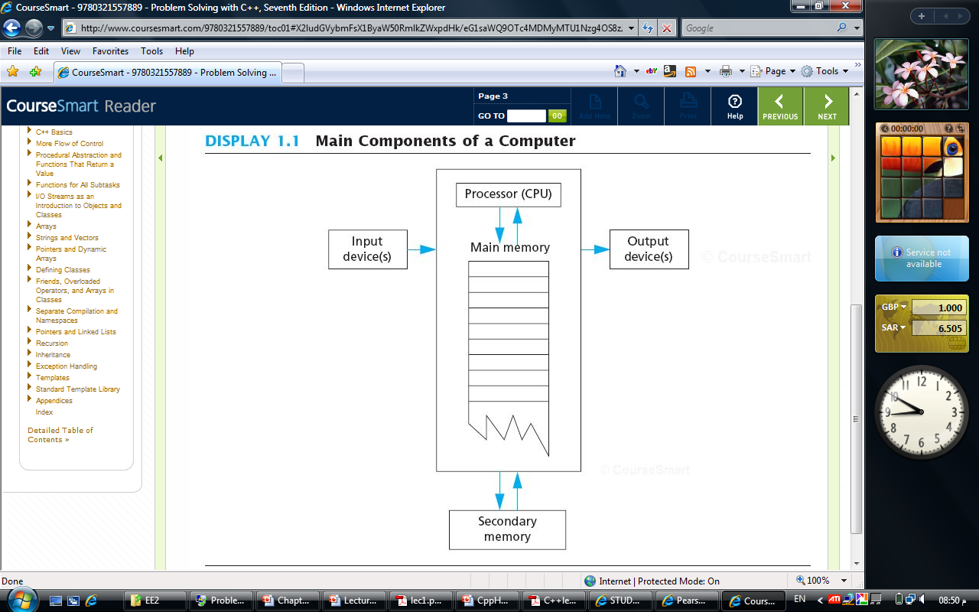
1.4 Computer Organization

Slide 6
1.4 Computer Organization (Cont.)
Five main components
Input unit
Allows a person to communicate data to the computer.
Obtains information from input devices for other units so that it can be processed.
Examples?
Output unit
Allows the computer to communicate information to the user.
Takes information that the computer has processed and places it on various output devices.
Memory (Main Memory/ Primary Memory)
Often referred to as RAM (Random Access Memory) since the computer can immediately access the data in any memory location.
Contains information that has been entered through the input unit to make it available for processing when needed.
Also retains processed information until it can be placed on output devices by the output unit.
Volatile → information is lost when power is off.

Slide 7
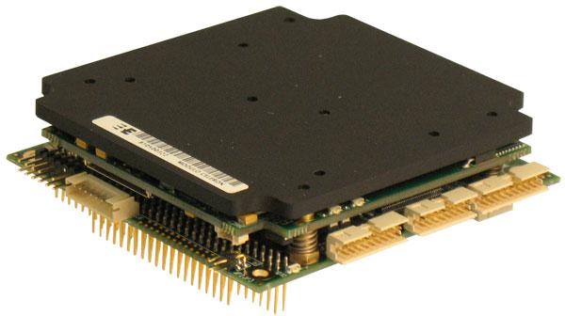
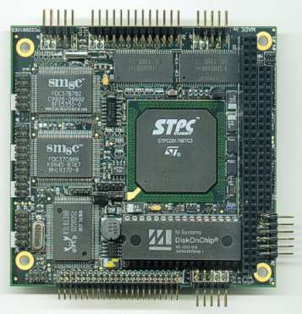
1.4 Computer Organization (Cont.)
Processor (CPU)
The CPU (Central Processing Unit) is the brain of the computer.
Coordinates and supervises the operation of other sections.
The CPU follows the instructions in a program and performs the calculations specified by the program.
The processor of a modern computer can have as many as several hundred available instructions.
Consists of two main units:
The Arithmetic and Logic Unit (ALU)
The Control Unit (CU)

Slide 8
1.4 Computer Organization (Cont.)
Secondary Memory/Storage
Main memory is only used while the computer is actually following the instructions in a program.
Secondary memory is the memory that is used for keeping a permanent record of information.
Information on secondary storage devices is said to be persistent, it is preserved even when the computer’s power is turned off.
Alternative terms: secondary storage, auxiliary memory/ storage, external memory/ storage.
Information in secondary storage takes much longer to access than information in primary memory, but the cost per unit of secondary storage is much less than that of primary memory.
Examples: hard disk, CD’s, DVD’s, Flash memory drives, etc.

Slide 9
1.5 Computer Languages
There are many languages for writing programs. The different categories include:
Machine Languages
Assembly Languages
High-level Languages

Slide 10
1.5 Computer Languages: Machine Languages
Programs written in the form of 0’s and 1’s are said to be written in machine language.
This is because it is the version of the program that the computer can directly read and follow.
Machine languages are machine dependant (what does this mean?)
The difference between assembly and machine language is not important, they are almost the same.
However the important distinction is between machine-language and high-level language like Java

Slide 11
1.5 Computer Languages: Assembly Languages
Instead of using strings of numbers, programmers began using English-like abbreviations to represent elementary operations.
These abbreviations formed the basis of assembly language.
A low-level command such as: ADD X Y Z
means add the values found at x and y in memory, and store the result in location z.
It must be translated to machine language (zeros and ones) before the computer can understand it. 0110 1001 1010 1011

Slide 12
1.5 Computer Languages: High-level Languages
High-level languages were developed in which single statements could be written to perform a substantial task.
Common programming languages include: C, C++, Java, Visual Basic, etc.
Characteristics
Resemble human languages.
Designed to be easy to read and write.
Use more complicated instructions than the CPU can follow.
Must be translated to zeros and ones for the CPU to execute a program (by a compiler).

Slide 13
An Overview Of Computer Languages
Machine Language Assembly Language High-Level Language
Collection of binary Symbolic form of machine Combines algebraic
numbers language (I.e. symbolic expressions & symbols taken
names are used to represent from English language
operations, registers & (ex. C++, Pascal,
memory locations FORTRAN, …etc)
Ex. Ex. Ex.
10100001 00000000 00000000 MOV AX,A A = A + 4
00000101 00000100 00000000 ADD AX,4
10100011 00000000 00000000 MOV A,AX
Assembler
converts to machine language
Directly understood by a
computer but cumbersome
for humans
Compiler (or interpreter) converts to machine language
Easier to use
More Powerful

Slide 14
1.6 Introduction to Object Technology
Object Oriented Programming OOP has taken the best ideas of procedural (structured) programming and has combined them with several powerful concepts that allows us to organize our programs more effectively.
The benefits of OOP are higher for complex programs.
All OOP languages have three characteristics:
Encapsulation.
Polymorphism.
Inheritance.

Slide 15
1.6 Introduction to Object Technology: The ‘Cup Of Coffee’ Example
Customer and kitchen/cook don’t know each other. The waiter is the
intermediary. (encapsulation)
Waiter and kitchen/cook act differently to the request ‘a black coffee’. (polymorphism)
Both waiter and kitchen/cook supply coffee. (inheritance).
A coffee
Milk?
Sugar?
A black
coffee
A black
coffee
Two fifty
please
Cook /
Customer Waiter Kitchen

Slide 16
1.6 Introduction to Object Technology: Encapsulation
Encapsulation means ‘hiding’ information.
Objects contain their own data and algorithms.
Encapsulation keeps programs flexible. Suppose the waiter will brew the coffee himself. The customer won’t notice any difference.

Slide 17
1.6 Introduction to Object Technology: Polymorphism
A single name with multiple meanings (depending
on its context), this is polymorphism.
Polymorphism reduces complexity by allowing the same name to be used to specify multiple meanings. It is the compiler’s job to select the specific action as it applies to each situation. The programmer need not do this selection manually.

Slide 18
1.6 Introduction to Object Technology: Inheritance
Objects can inherit characteristics from other objects.
Both waiter and cook are employees. So they both have an employee number. (inherits it from Employee)
Both return a cup of coffee to the request ‘a black coffee’.
However, There are some exceptions. Waiter and cook have
different methods to get a cup of coffee.
Without the use of hierarchies, each object would have to explicitly define all of its characteristics.
Using inheritance, an object needs to define only those qualities that make it unique within its class.
Employee
employeeNo
aBlackCoffee()
Waiter
aBlackCoffee()
Cook
aBlackCoffee()

Slide 19
1.8 Programming Languages: History of C and C++
There was a B programming language derived from BCPL language.
The C language was derived from the B language.
The C++ language was derived from the C language.

Slide 20
1.9 Java and a Typical Java Development Environment
In 1991, Sun Microsystems funded an internal corporate research project which resulted in a C++-based language.
Its creator, James Gosling, called Oak after an oak tree outside his window at Sun.
The name Oak was already taken so the name Java was suggested by a group of Sun people.
Sun saw the potential of using Java to add dynamic content to web pages(interactivity and animation) with the web popularity in 1993.

Slide 21
Characteristics of Java
Java is simple
Java is object-oriented
Java is distributed
Java is interpreted
Java is robust
Java is secure
Java is architecture-neutral
Java is portable
Java’s performance
Java is multithreaded
Java is dynamic

Slide 22
1.9 Java and a Typical Java Development Environment: Java Class Libraries
Java programs consist of pieces called classes.
Classes include pieces called methods.
Methods perform tasks and return information when the tasks complete.
Java class libraries are rich collections of already existing classes. Also called Java APIs (Application Programming Interfaces).
You have to learn both: the Java language itself and the classes in the Java class libraries.

Slide 23
1.9 Java and a Typical Java Development Environment (Cont.)
Java programs normally undergo five phases
Edit
Programmer writes program using an editor program (and stores program on disk)
A file name ending with .java extension indicates that the files contains Java code.
Compile
Compiler creates bytecodes from Java source code
Bytecodes are executed by the Java Virtual Machine (JVM) a part of the JDK.
Java’s bytecodes are portable, without recompiling the source code, the same bytecodes can execute on any platform containing a JVM that understands the version of Java on which the bytcodes were compiled.
Load
Class loader stores the .class file containg the bytecodes in primary memory.

Slide 24
1.9 Java and a Typical Java Development Environment (Cont.)
Verify
Bytecode Verifier confirms bytecodes are valid and do not violate Java’s security restrictions.
Java enforces strong security to make sure that Java programs arriving over the network do not damage your files or your system.
Execute
JVM translates bytecodes into machine language in order to perform the actions specified by the program.

Slide 25
Compilers
A compiler is a program that translates a high-level language program to a machine language program that the computer can directly understand and execute.
Source code/program
The original program in a high level language
Object code
The translated version in machine language
The word code refers to a program or part of a program.

