Slide 1

Bank Customer Segmentation
Name:Madoka Fujii
Date: Jan 27, 2025

Slide 2
Agenda
Problem Description
Data Understanding
Data Cleaning
EDA for Business
Recommendations for Technical

Slide 3
Batch:LISUM39
Week13: EDA & Modeling presentation
Project: Bank Customer Segmentation
Group name: Apple Analytics
Name: Madoka Fujii
Email address: mdkfji@gmail.com
Country: United States
Company: Omdena
Specialization: Data Analytics

Slide 4
Problem Description
XYZ Bank plans to enhance its marketing campaign as Christmas offers for its customers. However, instead of offering the same deal to all customers as generic, the bank wants to provide personalized offers to specific customer groups to fit their preferences. Identifying customer categories manually would be inefficient and fail to uncover hidden patterns in the data that could inform better segmentation. To address this, the bank has sought the assistance of Apple Analytics. Additionally, the bank has specified that customer segmentation should result in no more than 5 groups to ensure the campaign's efficiency.

Slide 5
Data Understanding
Tabular data details: cust_seg.csv.zip
Total number of observations | 1,000,000
Total number of files | 1
Total number of features | 48
Base format of the file | csv.zip
Size of the data | 19,483KB

Slide 6
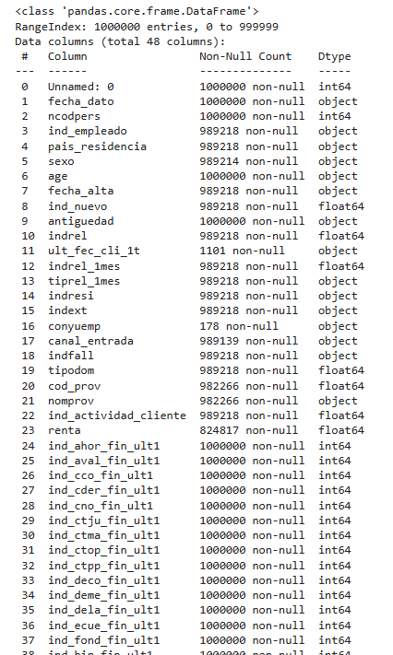
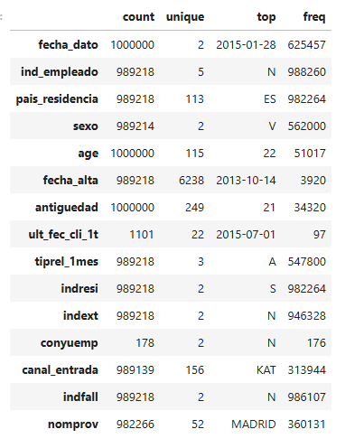
Data Understanding
There are missing values.
Check the unique values and frequencies.

Slide 7
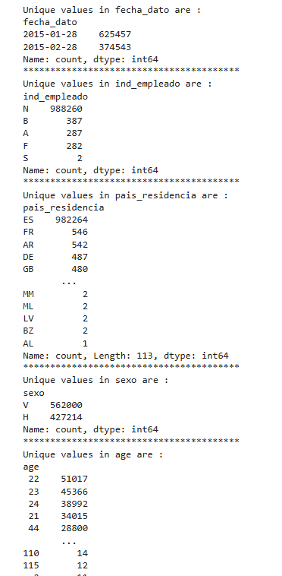
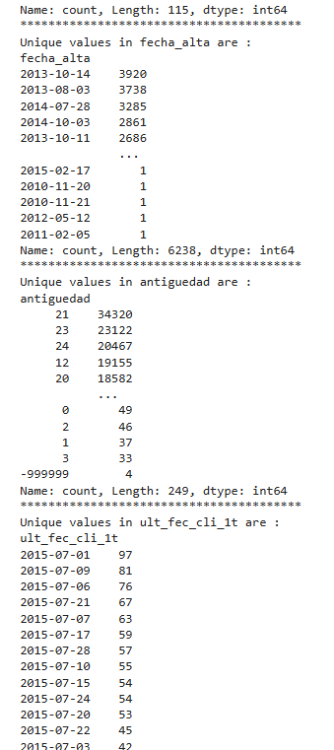
Data Understanding
Check the unique values each variables.

Slide 8
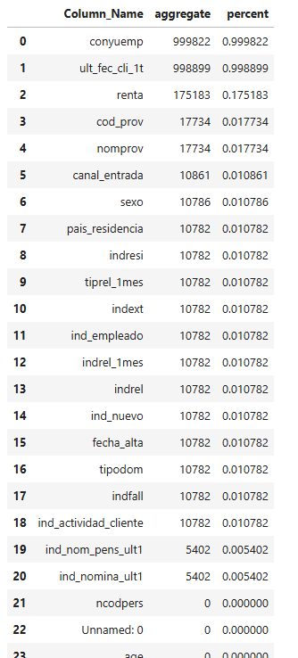
Data Understanding
Check how many percent each variable has the missing values.

Slide 9
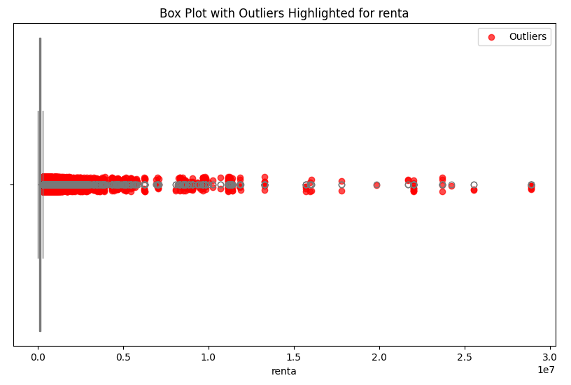
Data Understanding
The variable ‘renta’ contains numerous outliers, with many of them representing individuals with high gross incomes.

Slide 10
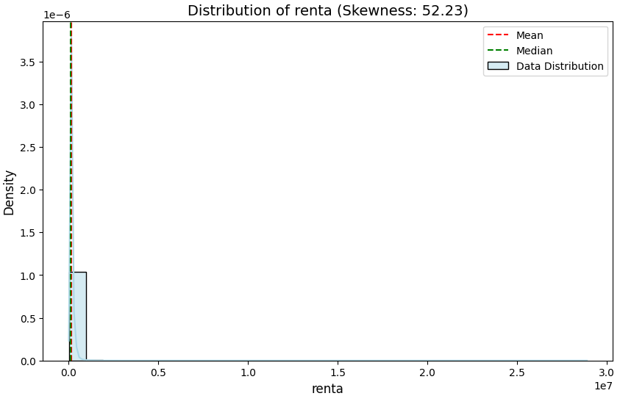
Data Understanding
In the variable ‘renta’, Median and Mean is almost same point while there are many outliers.

Slide 11
Data Cleaning
Examined the outliers and skewness in the visualizations in the previous slide. It appears that the 'renta' variable, which represents the gross income of households, contains many outliers above the median and mean. These outliers correspond to high-income customers. Retaining these outliers may be beneficial for identifying specific trends within the high-income group, which could be useful for targeted campaigns. Therefore, while I am checking for outliers, I do not plan to omit them.

Slide 12
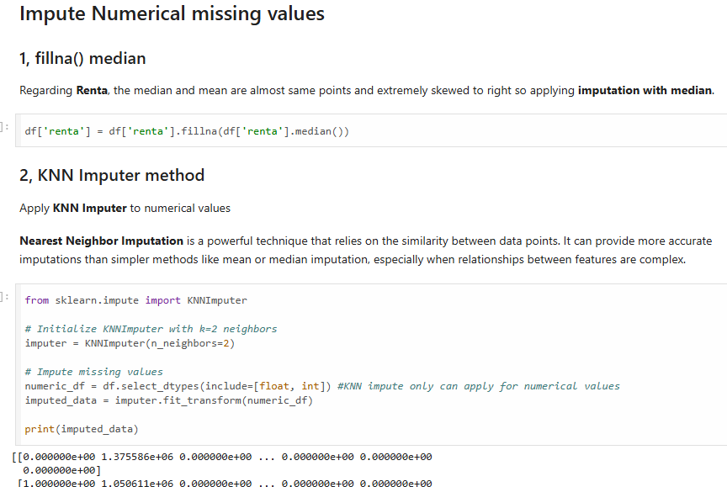
Data Cleaning
Regarding ‘renta’, applied the method fillna() median.
Regarding other numerical missing values, applied KNN Imputation.

Slide 13
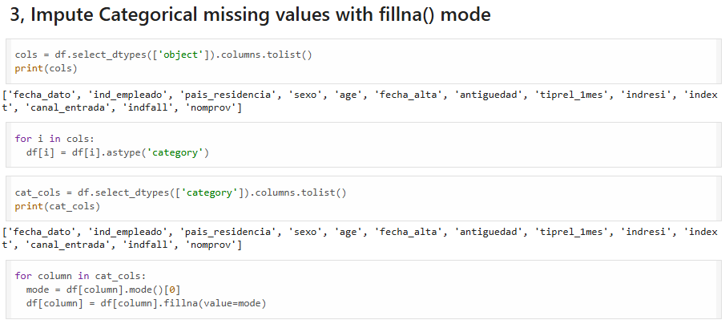
Data Cleaning
Regarding Categorical missing values, applied fillna() mode method.

Slide 14
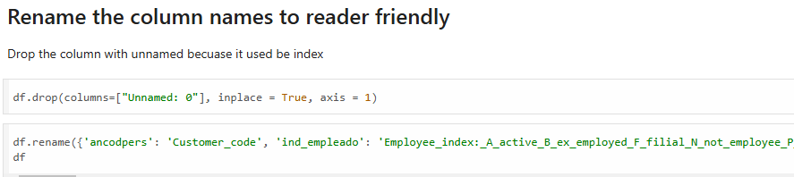
Data Cleaning
For readability in English, renamed the column name if it is hard to understand.

Slide 15
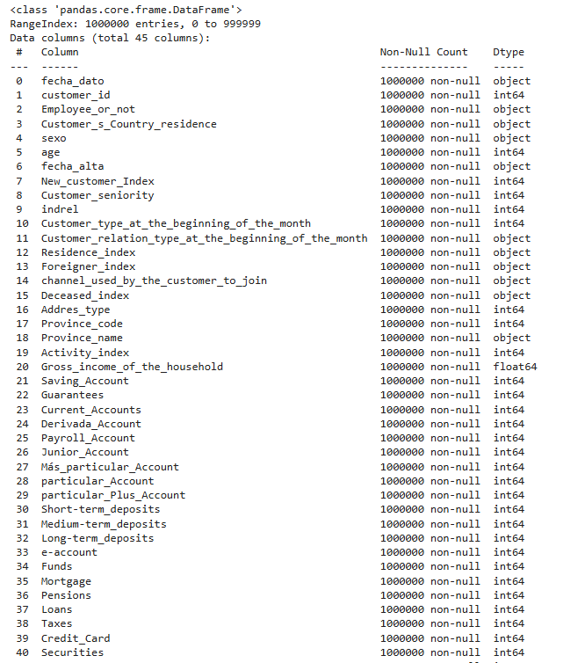
EDA
Make sure the data type each variable and the number of data each variable.

Slide 16
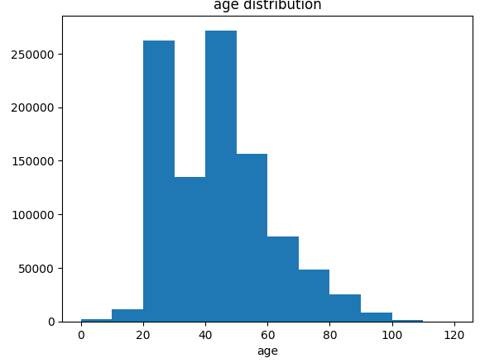
EDA
In the plot of Age Distribution, the majority of age group is from 20 years old to 60 years old.

Slide 17
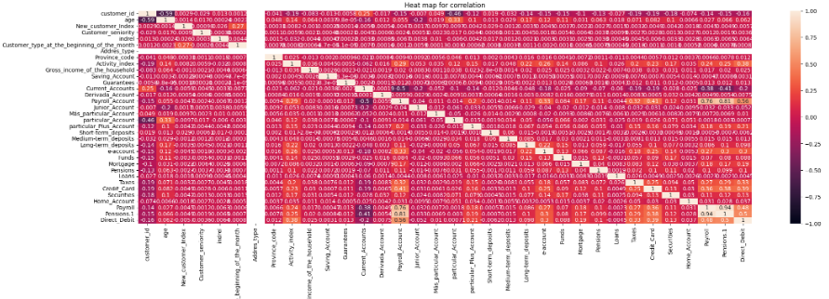
EDA
There is no significantly related correlation.

Slide 18
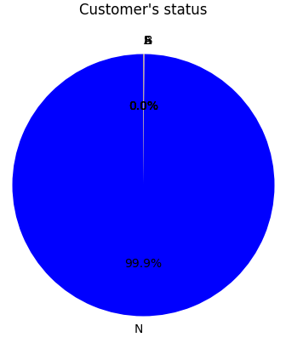
EDA
Employee index:
A active
B ex employed
F filial
N not employee
P passive
Most of the customers are N as not employees.

Slide 19
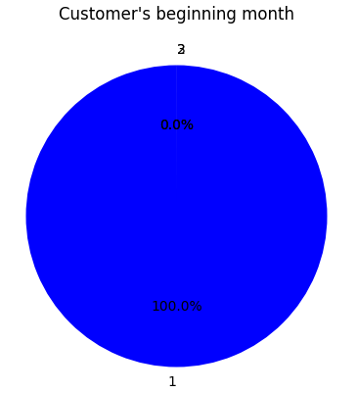
EDA
Customer type at the beginning of the month
1 (First/Primary customer)
2 (co-owner )
P (Potential)
3 (former primary)
4(former co-owner)
Most of customers are 1 (First/Primary customer)

Slide 20
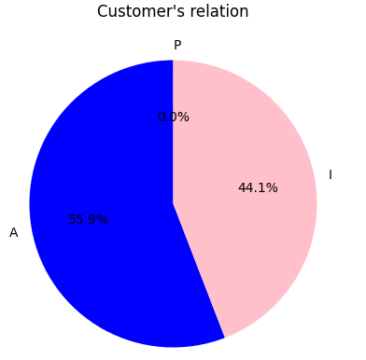
EDA
Customer relation type at the beginning of the month
A (active)
I (inactive)
P (former customer)
R (Potential)
In Customer’s relation, 55.9% of customers are active while 44.1% of customers are inactive.

Slide 21
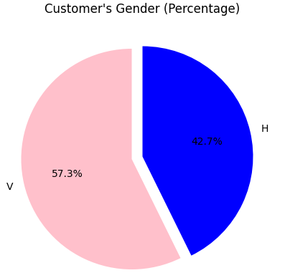
EDA
Age distribution of customer are Make(H) shares 42.7% and Female(V) shares 57.3%.

Slide 22
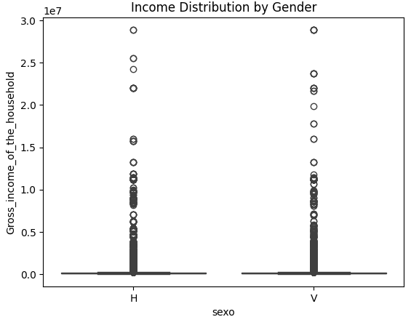
EDA
Checking the Outliers of Gender Distribution.
There are no significant differences in the distribution of gross income between Male(H) and Female(V). However, it seems slightly Female has more outliers concentrated above the median.

Slide 23
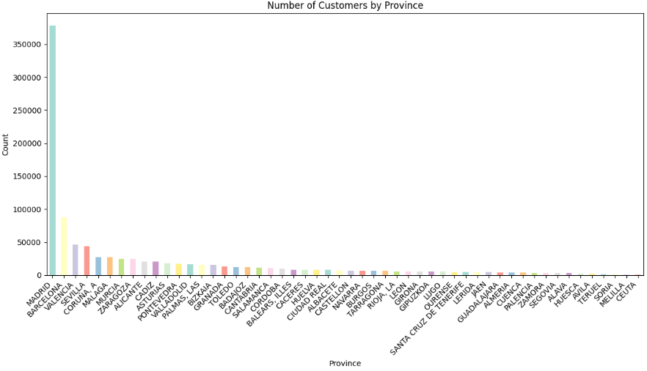
EDA
Madrid has the highest population of customers and the highest gross income household.

Slide 24
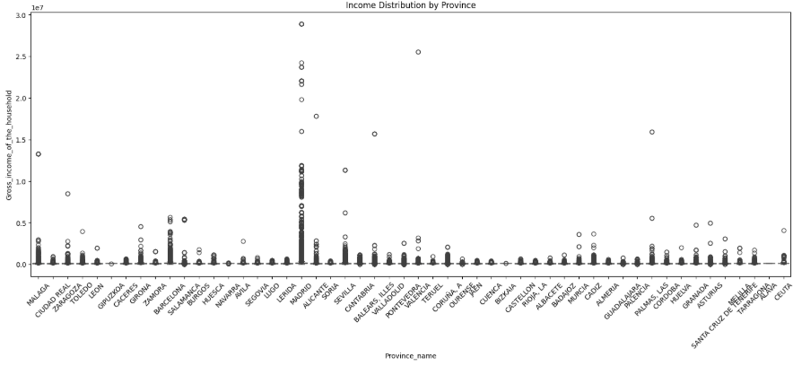
EDA
Regarding Income Distribution by Province in terms of outliers, Madrid has significant of amount of outliers.
.

Slide 25
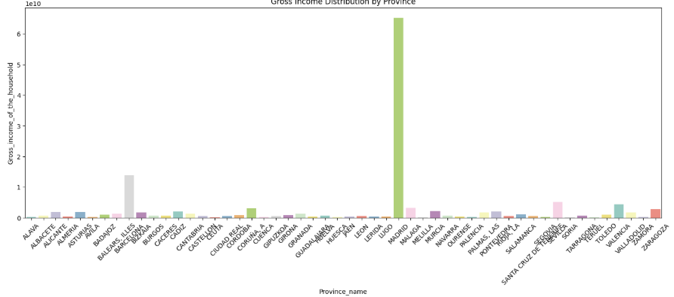
EDA
Regarding Gross Income distribution by Province, Madrid has significant amount of income compared to other cities.

Slide 26
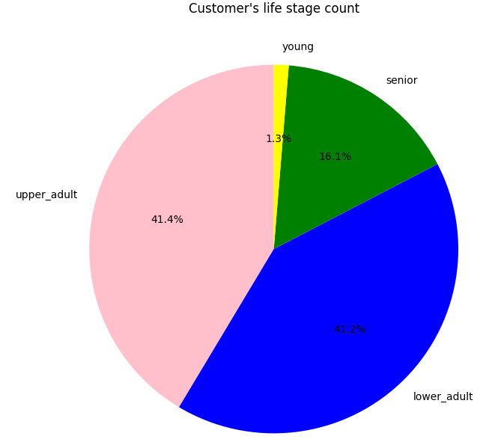
EDA
Majority of this bank customer is Adult(20-60 years old). On the other hand, Young( under 20 years old) is only 1.3% shared.

Slide 27
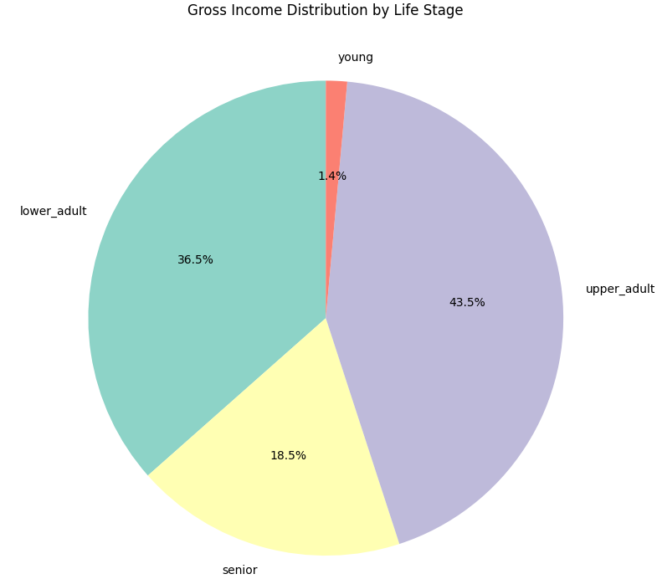
EDA
In term of the Gross Income Distribution by Life Stage, 43.5% is shared by Upper Adult and 36.5% is shared by Lower Adult.

Slide 28
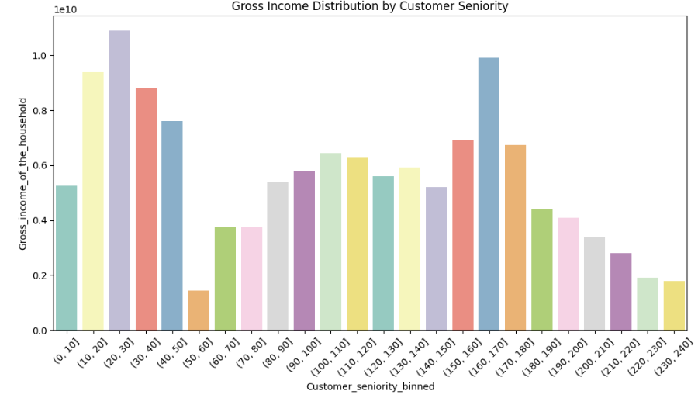
EDA
The highest group of customer seniority is 20-30 months. The next highest group is 160-170 months. The lowest group is 50-60 months. It may be some restrictions existing in this term such as some promotions being ended. From 180-240 months(15-20 years), there is a trend to decrease the number of seniority that indicates this bank cannot retain customers for the long term.

Slide 29
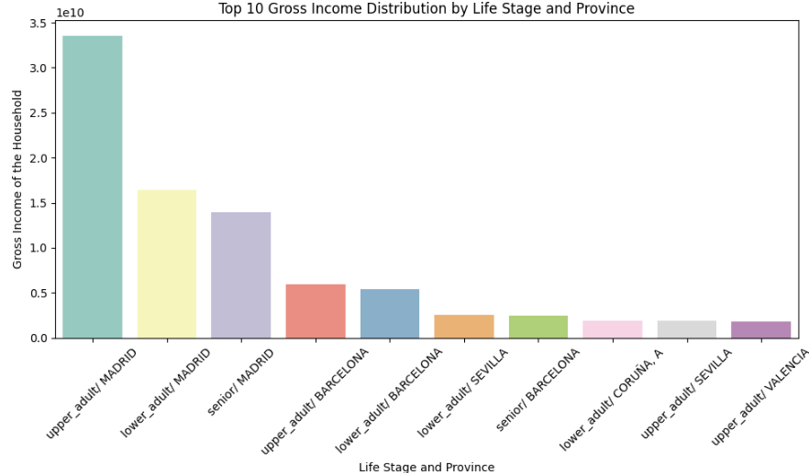
EDA
Regardless of the life stage group, customers who live in MADRID have the highest income. The customers who live in BARCELONA seem 2nd highest income group. But the life stage of the young is the minority in the any of provinces. There are no young life stage groups in this observation.

Slide 30
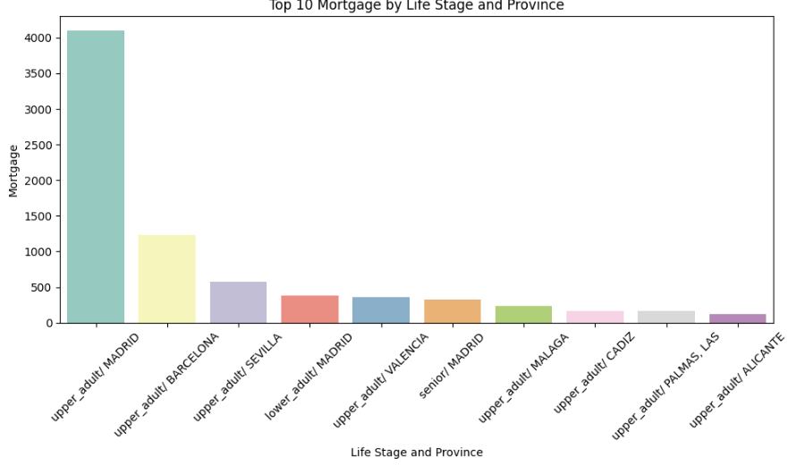
EDA
High income customers also have more Mortgage compared to low income customers. This plot relatively correlated to the plot of Gross Income Distribution by Life Stage and Province.

Slide 31
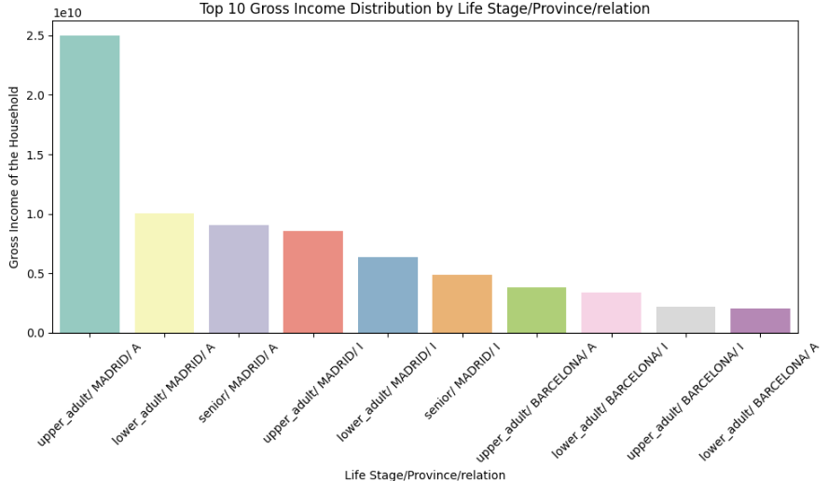
EDA
The group of Upper Adult/ Madrid is the most sharing the Active customers. Also, Upper Adult/ Madrid is the most sharing the Inactive customers.

Slide 32
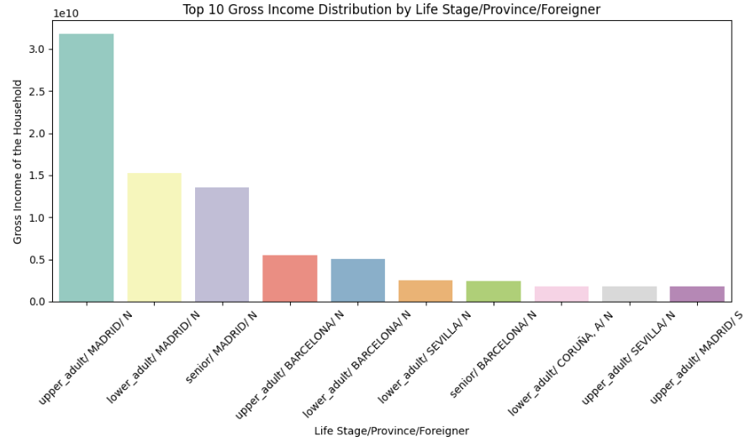
EDA
The majority of high-income customers are from Residence (no foreigners) while upper_adult/MADRID/S shows they are foreigners.

Slide 33
Recommendation for technical users
K-Means Clustering Overview
K-Means Clustering is an unsupervised machine learning algorithm used to group data into K clusters based on their features. The algorithm iteratively assigns data points to clusters to minimize the variance within each cluster while maximizing the distance between clusters.
How It Works
Initialization:
Randomly select KKK initial cluster centroids (starting points for each cluster).
Assignment:
Assign each data point to the cluster whose centroid is closest based on a distance metric, typically Euclidean distance.
Update:
Recalculate the centroids as the mean of all data points assigned to each cluster.
Repeat:
Repeat the assignment and update steps until the centroids stabilize (i.e., no significant change in their positions) or a maximum number of iterations is reached.
Key Features
Number of Clusters:
The number of clusters KKK must be specified beforehand. Techniques like the Elbow Method can help determine the optimal value of KKK.
Centroid-Based:
Each cluster is represented by its centroid, which is the mean position of all points in the cluster.
Iterative Process:
The algorithm continues to refine cluster assignments and centroids iteratively to minimize the within-cluster sum of squares (WCSS).

Slide 34
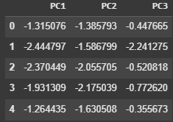
Modeling
Before applying Kmeans, decided to apply PCA because the variables are many and there are not significantly correlated each variable.
By applying PCA, the variables can be efficient in terms of the calculation and it can reduce noises which would improve the result of Kmeans.

Slide 35
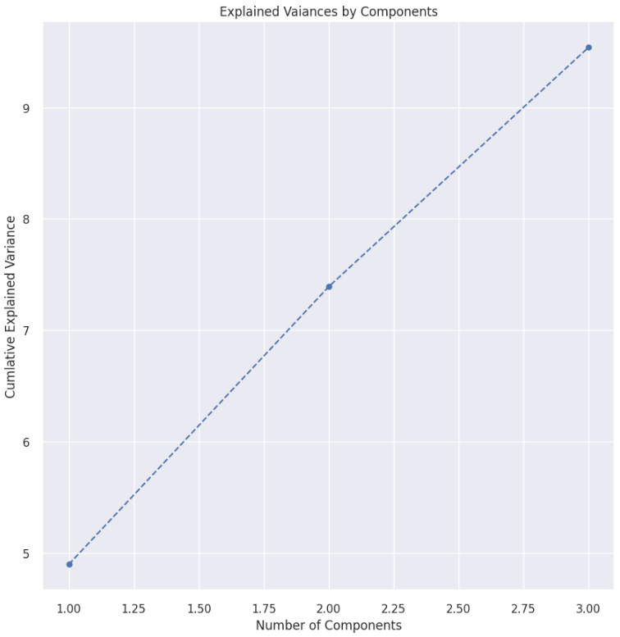
PCA
I have tried 3 components of PCA.

Slide 36
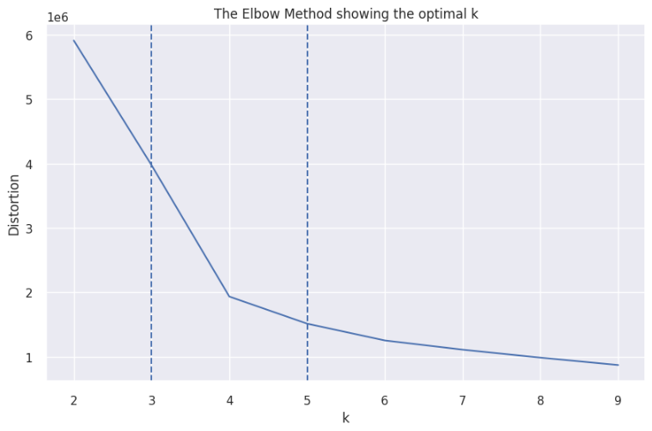
Elbow Method
The point that the elbow vending is the best for the segment. In this case, k = 4.

Slide 37
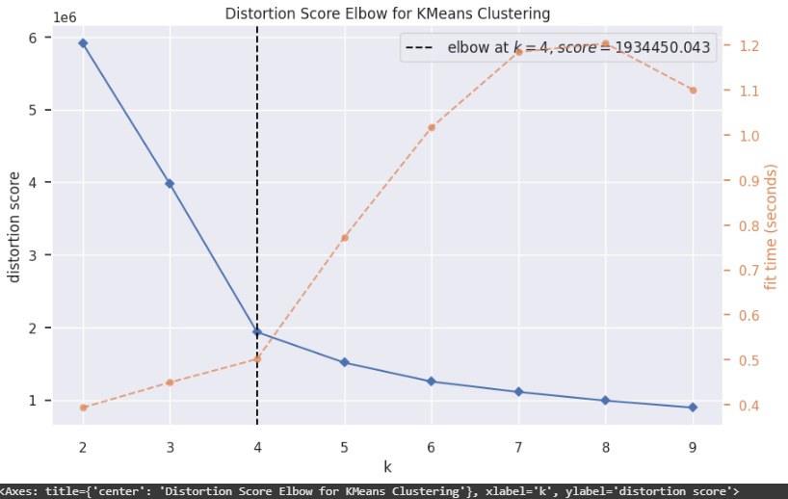
Elbow Method
With fit time, we can see how the fit time is getting longer if there is more clusters is increasing.

Slide 38
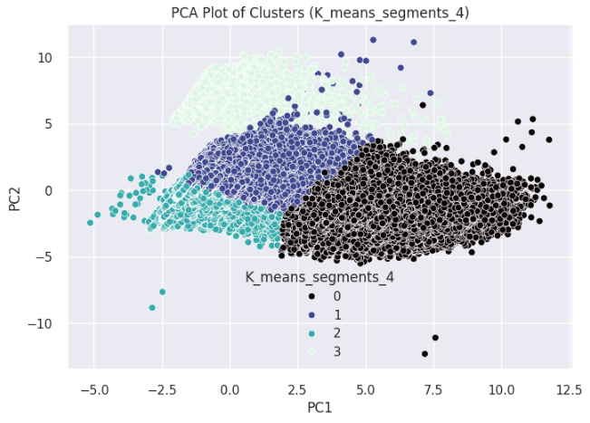
PCA
Separated segments by 4, there are clearly 4 segments between PC1 and PC2.

Slide 39
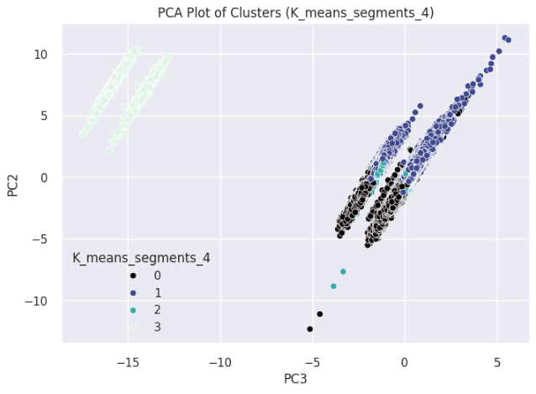
PCA
Separated segments by 4, there are clearly 4 segments between PC3 and PC2.

Slide 40
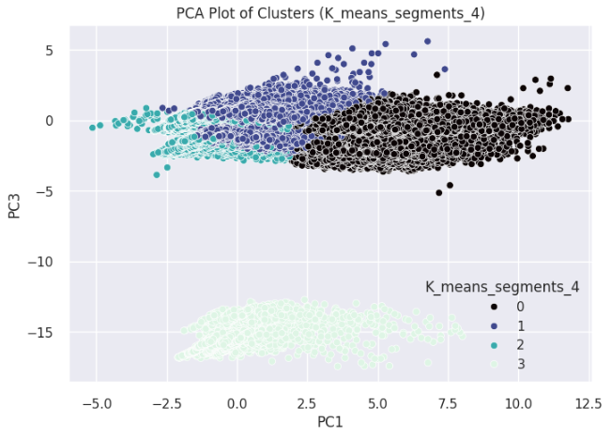
PCA
Separated segments by 4, there are clearly 4 segments between PC1 and PC3.

Slide 41
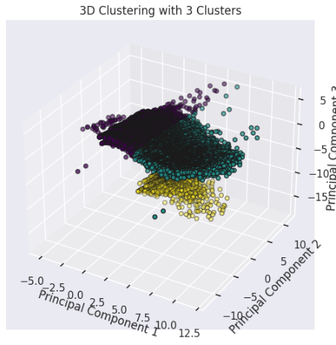
PCA
I have selected 3 segments in this 3D clustering.

Slide 42
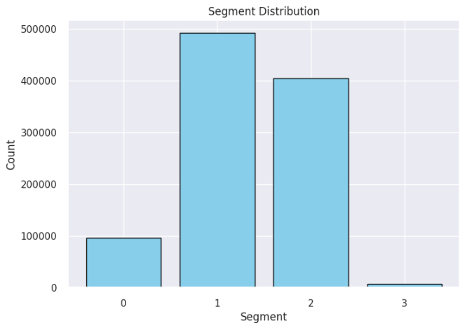
Segment Analysis
The amount of each segment, 1 is the largest segment. 3 is the smallest.

Slide 43
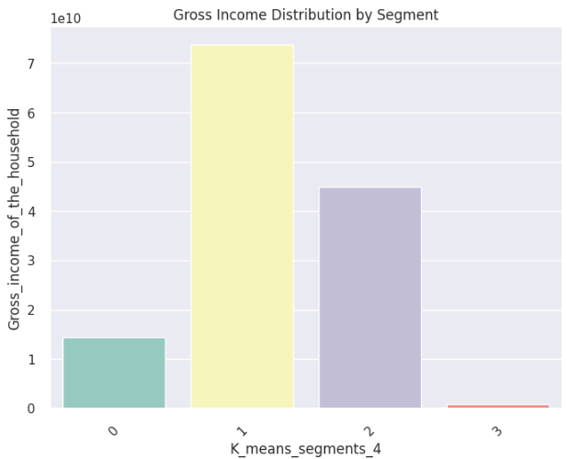
Segment Analysis
In the distribution of Gross income of the household, there is almost same result as the amount of the segments in the previous plot.

Slide 44
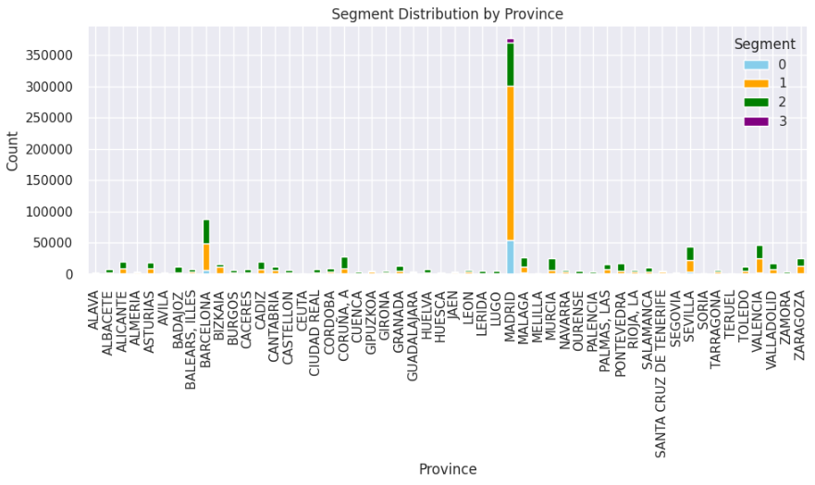
Segment Analysis
Madrid includes most of the segments regardless of the different type of the segments.

Slide 45
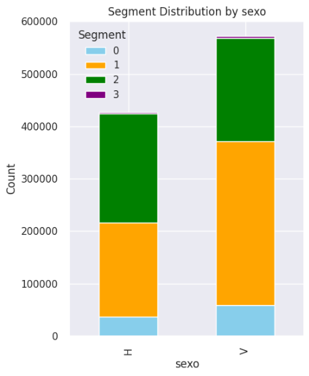
Segment Analysis
Female(V) has more segments compare to Male(H).

Slide 46
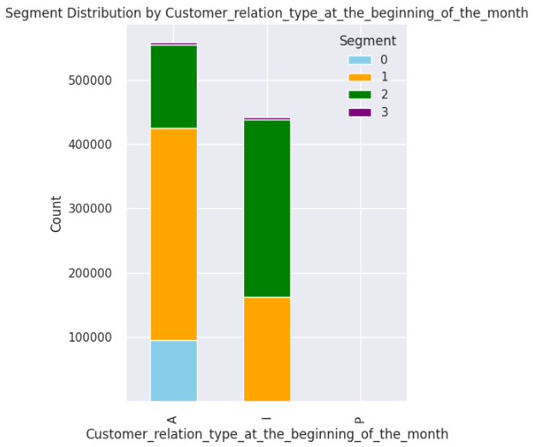
Segment Analysis
Activated customer has more segments.
Segment 0 located at activated bar.

Slide 47
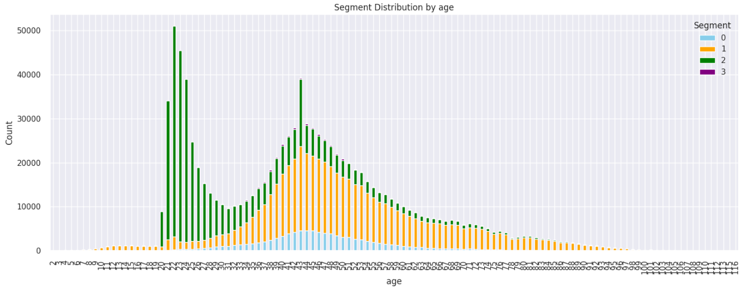
Segment Analysis
Regardless the range of the age, each segment parse all over. But there is specific trends that segment 1 is located majority. And most of segment 2 located between age 20 and 40.

Slide 48
Conclusion
Utilizing unsupervised learning techniques, we applied Principal Component Analysis (PCA) and K-Means clustering to perform customer segmentation on the dataset. These methods proved highly effective due to the high dimensionality of the dataset and the absence of significant correlations among features.
Through the Elbow Method, we determined that the optimal number of customer segments is four. Based on these insights, the segmentation successfully identified four distinct customer groups. These groups provide actionable targets for the bank to implement more efficient and tailored marketing campaigns, optimizing resource allocation and improving campaign effectiveness.

Slide 49
Thank You

