Slide 1

G2M insight for Cab Investment firm
Name:Madoka Fujii
Date: Nov 20, 2024

Slide 2
Agenda
Executive Summary
Problem Statement
Approach
EDA
A/B Testing
Future Engineering
Hypothesis Testing
Recommendations

Slide 3
Executive Summary
Our Client XYZ is planning to invest a cab service company because recently the market is growing.
-Objective: Using the two cab company as examples in dataset, provide the findings and insights to them to know and understand the industry and the market for the preparation of investment.
-Out Client XYZ needs to know the important key points to identify which cab company is right and profitable to invest.
-We provide our analysis and insights so that Our Client can invest a right company.
-Yellow Cab is larger business size than Pink Cab in terms of the numbers of customers, the profit, locations, and transactions.

Slide 4
Problem Statement
Our Client need to know what kind of cab service is worth to invest.
We provide recommendations, analysis, and insights to them to choose right cab service.

Slide 5
Approach
-Merge and join 4 data sets to analyze.
-Cab_Data.csv
-City.csv
-Customer_ID.csv
-Transaction_ID.csv
-Data joining and cleaning through SQL.
-Data type check to analyze.
-A/B testing and Data Analysis through Tableau.
-Explorer Data Analysis.
-Creation Profit variable as Feature Engineering.
-Profit Analysis.
-Hypothesis Analysis.

Slide 6
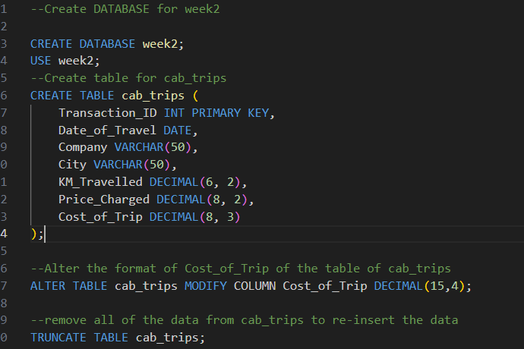
MySQL Data Cleaning and Formatting
-There were no missing values so no needed to impute or drop for that.
-Casting certain columns to their appropriate types and joining and cleaning up the data through MySQL.

Slide 7
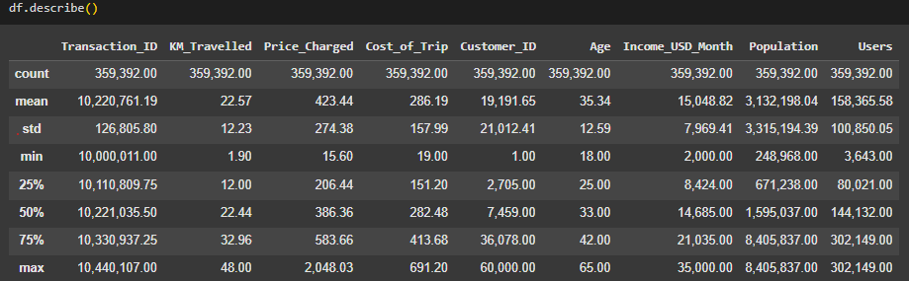
EDA (Exploratory Data Analysis)
-KM_Travelled: Min:1.90, Max:48, Mean and Median are almost same that means normal distribution.
-Price_Charged: Min:15.60, Max:2048.03, Mean > Median means long right tail. High price raised the Mean. The std is large that means Price_Charged are scatter broadly.
-Cost_of_Trip: Mean and Median are almost same that means normal distribution.

Slide 8
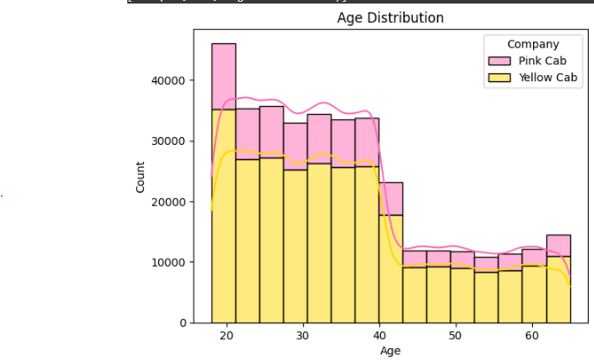
Age Distribution
-It seem around 20 years old customers is the most using the cab services.
-The user with Pink Cab is less than Yellow Cab in general.
-After 40 years old, the user both Pink and Yellow are significantly reduced. It may be affected some restriction such as other better service.

Slide 9
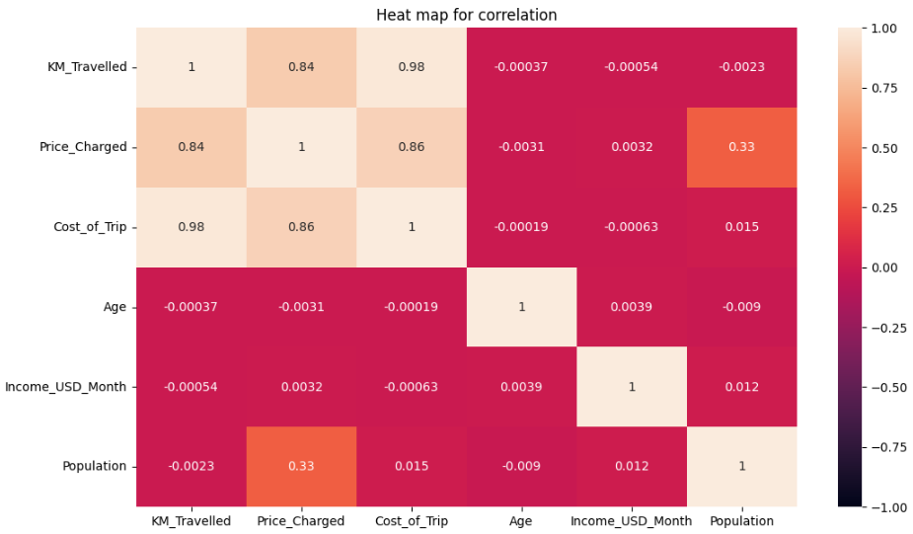
Correlation
-There are correlation 0.84 between Price_Charged and KM_Travelled that absolutely makes sense.
-Also, the correlation 0.86 between Price_Charged and Cost_of_Trip.
-Other than that, we don’t see much correlations.
-The 0.33 between Population and Price_Charged may be correlated slightly.

Slide 10
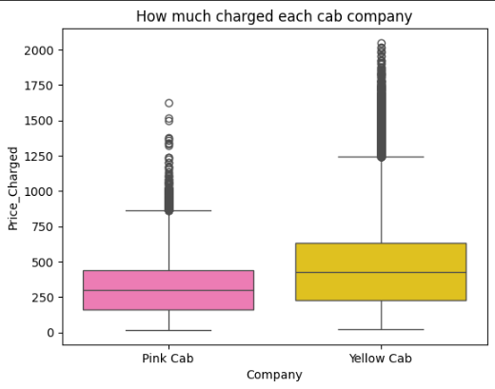
Degree of Price Charged 1
-Yellow cab charges more than Pink cab.
-Both of cab company has a lot of outliers.

Slide 11
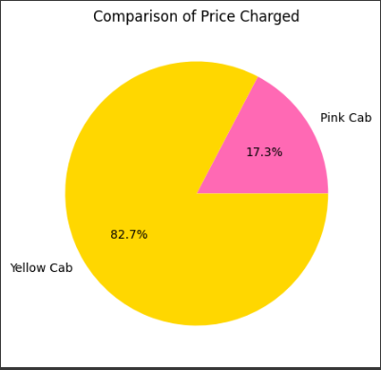
Degree of Price Charged 2
-Yellow cab shares the charge more than 80% and the charge of Pink cab is only apex. 17%.

Slide 12
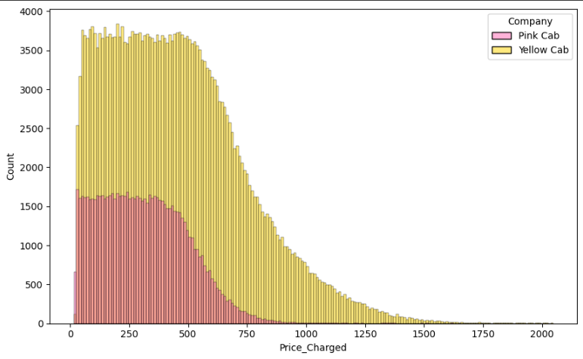
Degree of Price Charged 3
-From this visualization, Yellow cab charges more than double of Pink cab at any point of price.

Slide 13
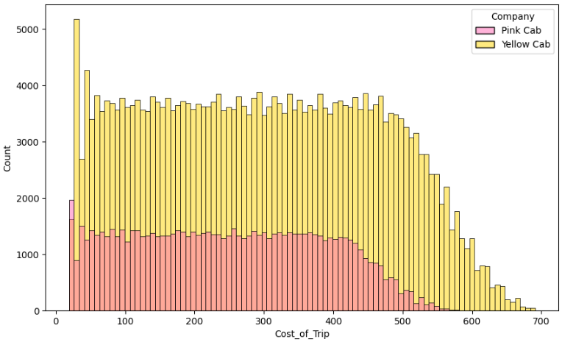
Cost of Charged
-Yellow Cab has more than double of cost compared to Pick Cab. Yellow Cab may include many optional things in cost of charged other than necessary stuff.

Slide 14
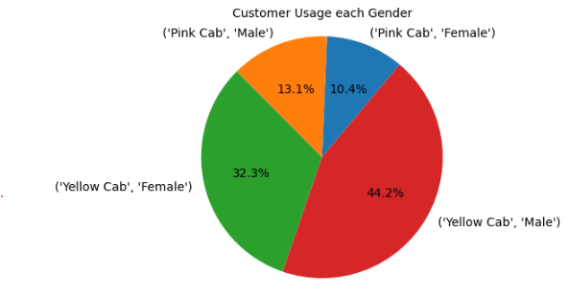
Customer Usage per Gender
-The male customers in Yellow Cab shares 44% of the market.
-The 2nd group of sharing is the female customers in Yellow Cab.
-Both male and female customers in Pink Cab has small portions of the share as 25% as total.

Slide 15
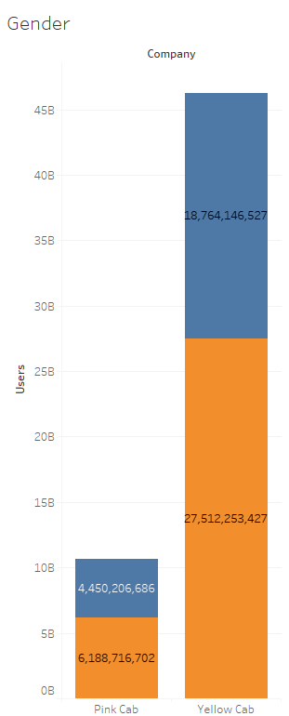

A/B testing in Gender

Slide 16
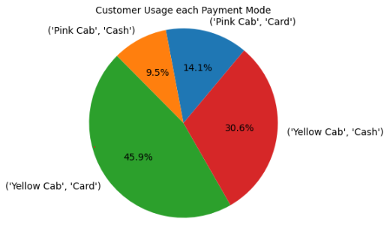
Customer Usage per Payment Mode
-The customers using Card in Yellow Cab shares 46% of the market.
-The 2nd group of sharing is the customers using Cash in Yellow Cab as 30%.
-Both male and female customers in Pink Cab has small portions of the share as 24% as total.

Slide 17
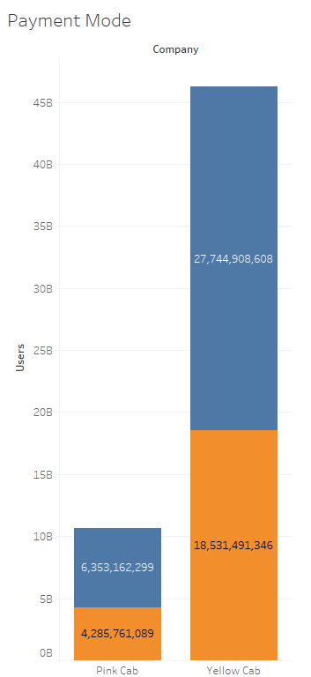

A/B testing in Payment Mode

Slide 18
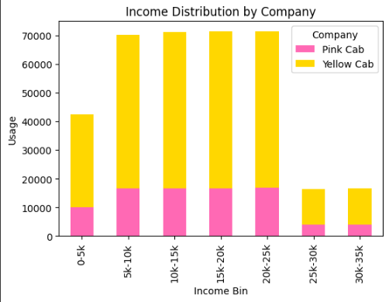
Income Distribution by Company
-The income range between 5k-25k is the most largest group.
-In all of the range, the usages of Pink Cab are significantly low compared to Yellow Cab.

Slide 19
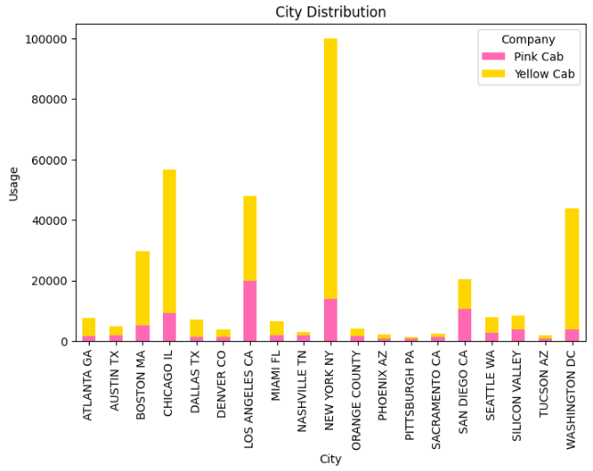
Distribution by Usage by City
-New York City has the largest number of customers using it.
-In most cities, the usage of Pink Cabs is lower than Yellow Cabs.

Slide 20
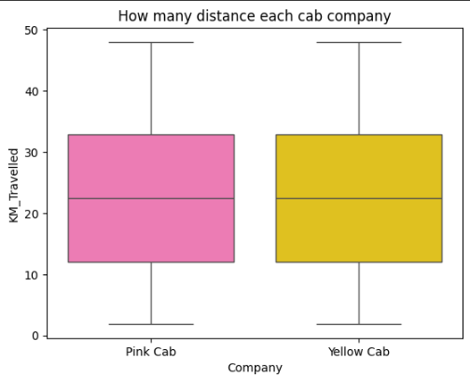
KM Travelled per Company
-Both companies have almost the same KM travel.

Slide 21
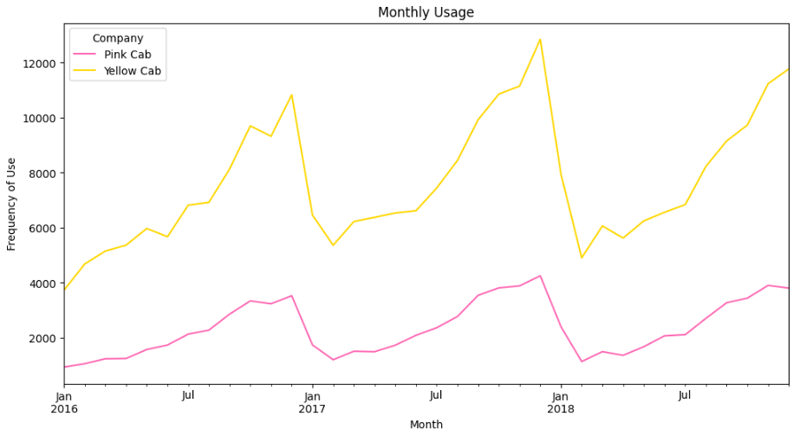
Monthly Usage
-Yellow Cabs have higher usage than Pink Cabs overall.
-There is an annual trend that from the beginning of the year to the end, the usage is going up and then around the end of year the usage significantly goes down.

Slide 22
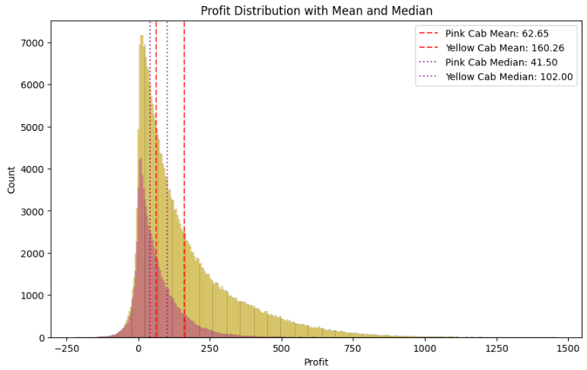
Profit
-Overall, the profit of Pink Cab is significantly lower than Yellow Cab.
-The Mean of Pink Cab: 62.62
-The Mean of Yellow Cab: 160.26
-The Median of Pink Cab: 41.5
-The Median of Yellow Cab: 102
-Both of them are skewed to the right(positive) side with a long tail on the left. That means a few higher profit transactions raise the Mean.

Slide 23
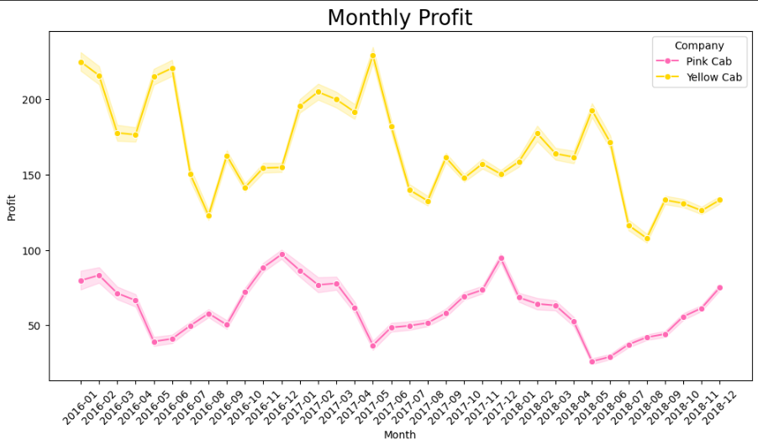
Monthly Profit
-Yellow Cabs have higher profit than Pink Cabs overall.
-It looks going to lower the profit of both of them gradually.
-Yellow Cab has some trend that the profit goes down every Summer around July and August. Likewise, Pink Can is around Spring, April and May.

Slide 24


Hypothesis Testing1
Is there any difference in profit in terms of Gender?
H0 : There is no difference in profit regarding gender.
H1: There is a difference in profit regarding gender.
Yellow Cab:
There is a difference in profit regarding gender.
Pink Cab:
There is no difference in profit regarding gender.

Slide 25


Hypothesis Testing2
Is there any difference in profit in terms of Age?
H0 : There is no difference in profit regarding age.
H1: There is a difference in profit regarding age.
Yellow Cab:
There is no difference in profit regarding age.
Pink Cab:
There is no difference in profit regarding age.

Slide 26


Hypothesis Testing3
Is there any difference in profit in terms of Payment Mode?
H0 : There is no difference in profit regarding payment mode.
H1: There is a difference in profit regarding payment mode.
Yellow Cab:
There is no difference in profit regarding payment mode.
Pink Cab:
There is no difference in profit regarding payment mode.

Slide 27
Recommendation: Yellow Cab is good for investments
-Profitability: Yellow Cab has more than double margin compared to Pink Cab.
-Customer Reach: Yellow Cab sees higher usage than Pink Cab in most cities, although there are a few cities where Pink Cab outperforms Yellow Cab.
-Age Distribution: Across all age groups, Yellow Cab enjoys higher usage compared to Pink Cab. Notably, customers over 40 years old show a preference for Yellow Cab, even though this age group represents a smaller portion of the overall customer base compared to those under 40. This is a significant observation.
-Income-Based Reach: Yellow Cab attracts the majority of customers across all income levels. In particular, it is increasingly popular among customers with an income of over $25,000, presenting a great opportunity to boost profits.
-Gender-Based Reach: Both cab companies have more male customers than female. Male customers, especially those using card payments, contribute significantly to profits through cab services.

Slide 28
Thank You

