Slide 1

EDA and
Multivariate Time Series
with PySpark
<Retail Forecasting >
<Oct 14, 2023>

Slide 2

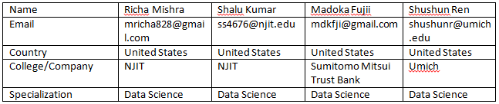
Batch: LISUM23: 30
Week13: Final Project Report and Code
Project: Retail Forecasting
Problem Description:
This major Australian beverage corporation operates within the beverage industry. Their product distribution spans across multiple supermarket chains, and they actively conduct robust promotional campaigns year-round. The demand for their products is subject to fluctuations driven by factors such as holidays and seasonal trends. They require a weekly item-level forecast for each of their products, categorized into weekly intervals.

Slide 3
Data Preparation
EDA
Models
Process:

Slide 4
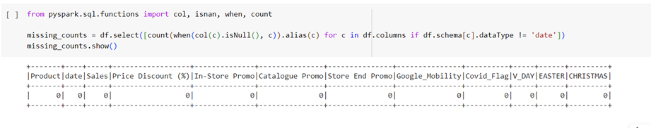
Data Preparation:
-Check if there is NULL existing.
-

Slide 5
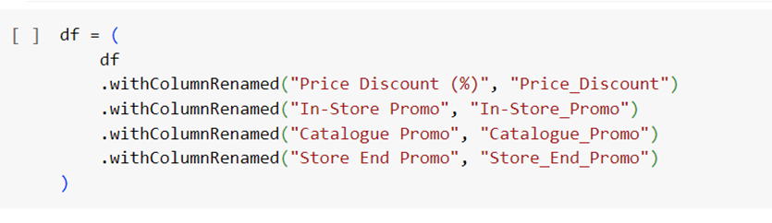
Data Preparation:
-Validate the name of columns.

Slide 6
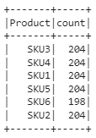
Finding: SKU6 has 198 counts while others are 204 counts.

Slide 7
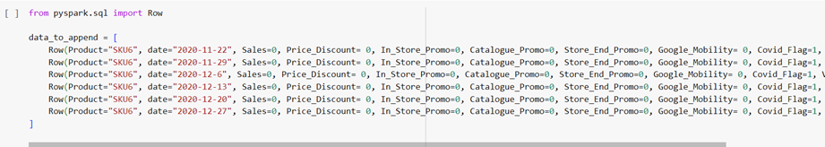
Data Preparation:
-Balancing dataset. Add extra date to SKU6.

Slide 8
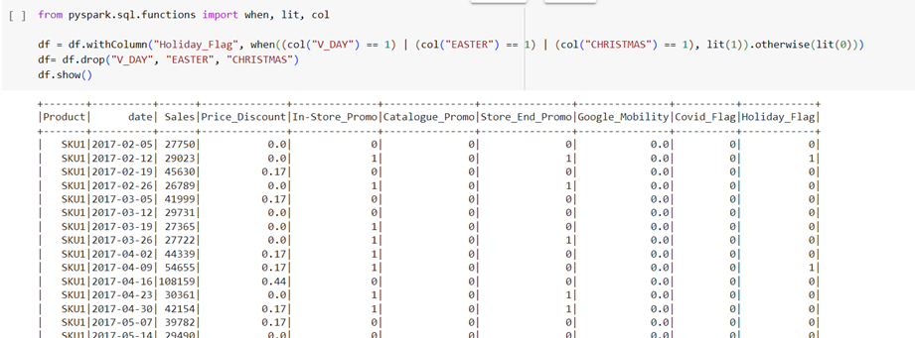
Data Preparation:
-Combine 3 holidays to 1 variable.

Slide 9
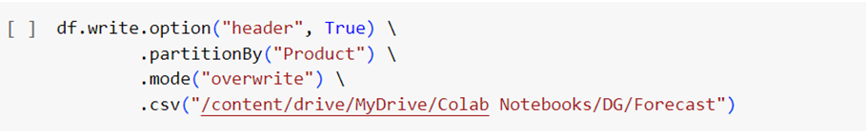
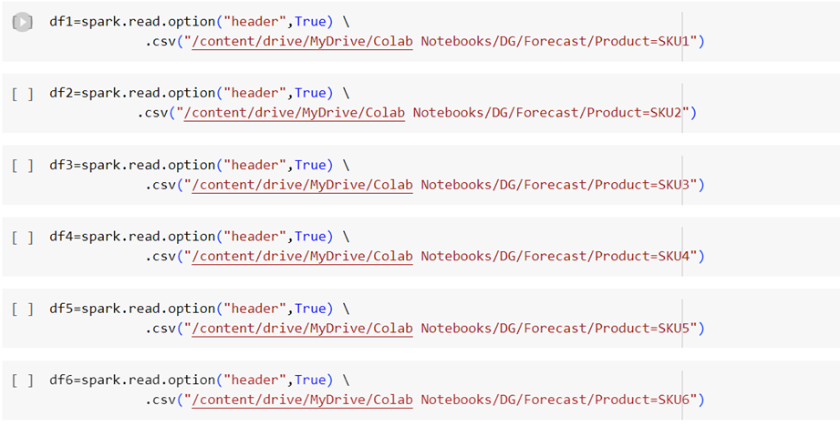
Data Preparation:
-Divided data into 6 in order to forecast the each SKU’s sales.
.

Slide 10
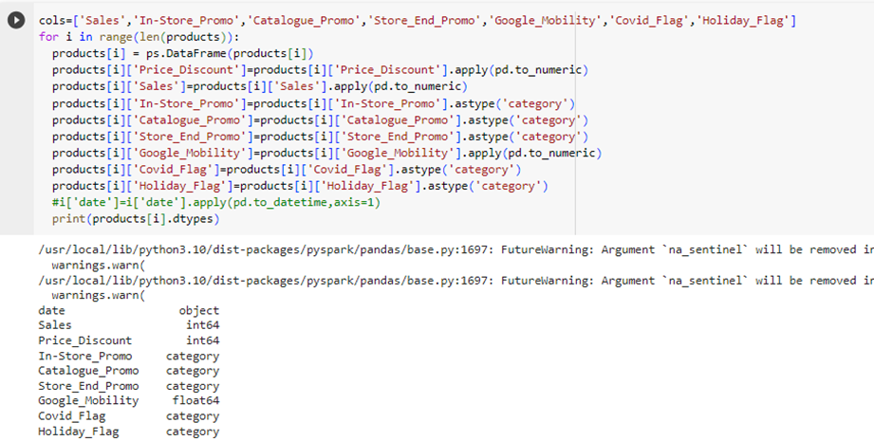
Data Preparation:
Validate the data type

Slide 11
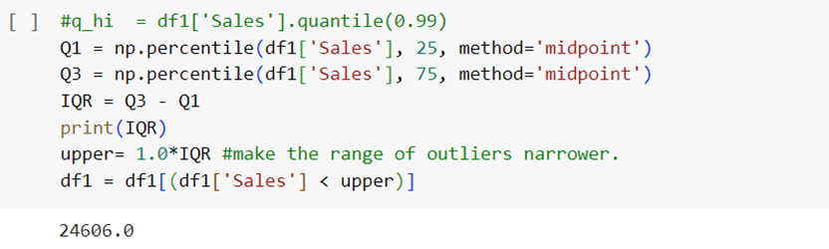
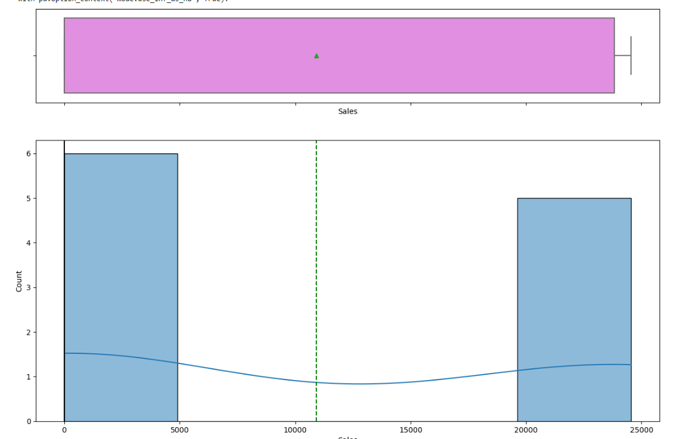
Data Preparation:
Remove outlier with narrow range

Slide 12
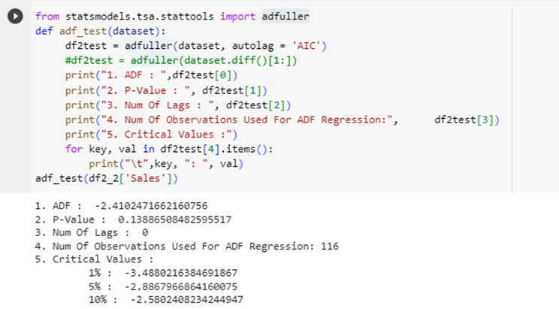
Data Analysis / EDA:
Adfuller test

Slide 13
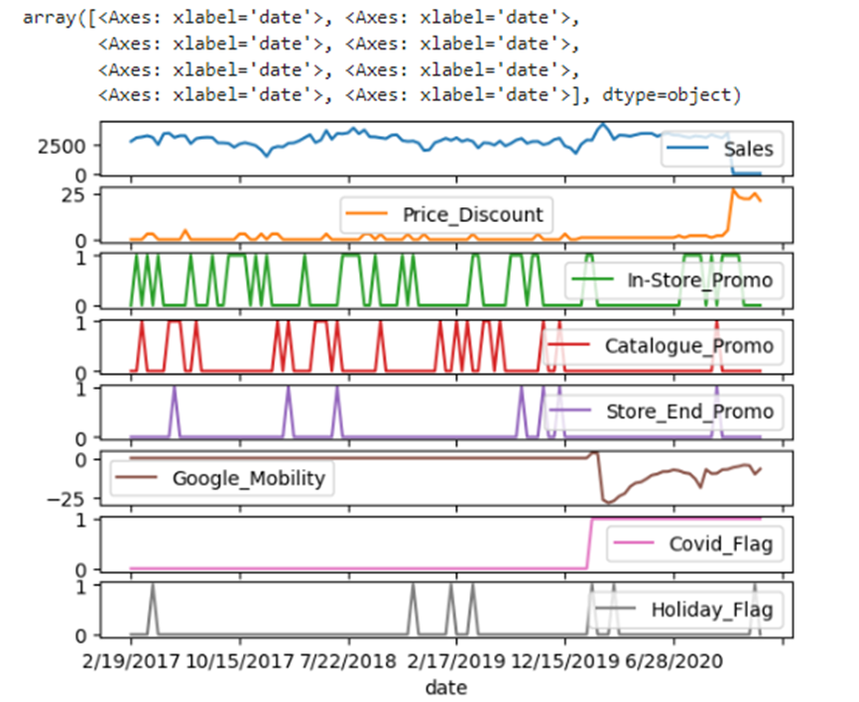
Data Analysis / EDA:
Visualization of each product

Slide 14
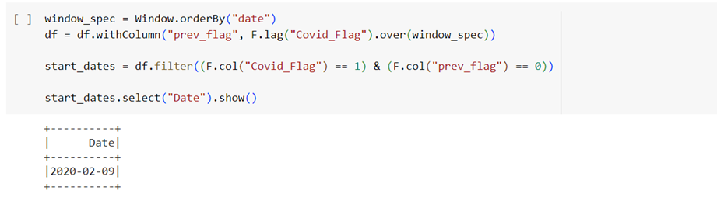
Data Analysis / EDA:
Identify when Covid_Flag started as 1.

Slide 15
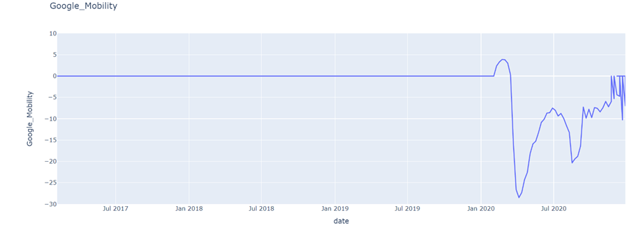
Data Analysis / EDA:
Google Mobility. How it fluctuates after Covid.

Slide 16
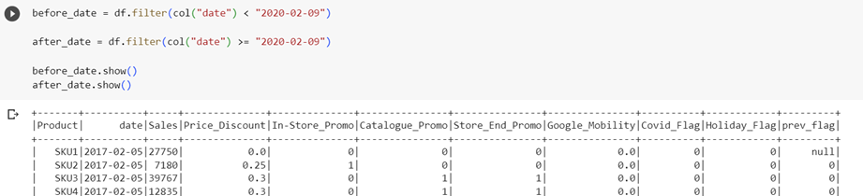
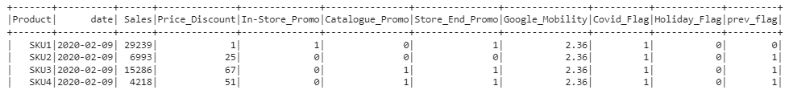
Data Analysis / EDA:
To analyze the data pre-Covid and post-Covid, we divide the data to 2

Slide 17
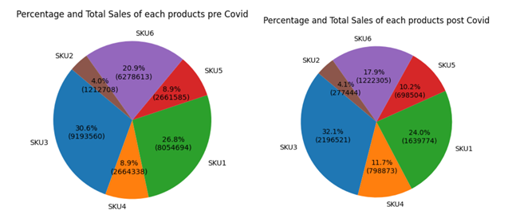
Compare the percentage/amount of sales before and after Covid

Slide 18
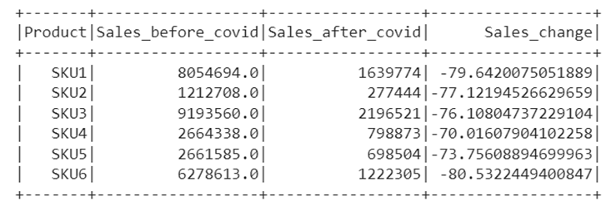
Sales of after Covid significantly reduced (70% to 80%) from before Covid

Slide 19
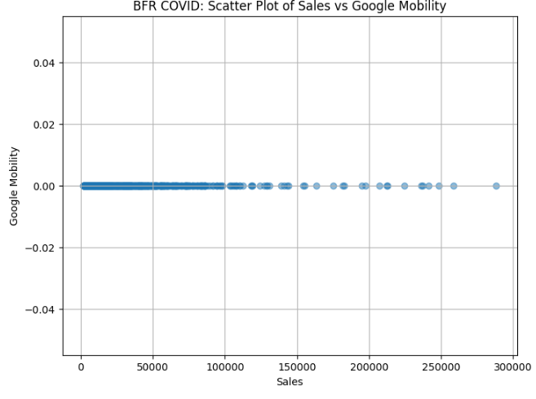
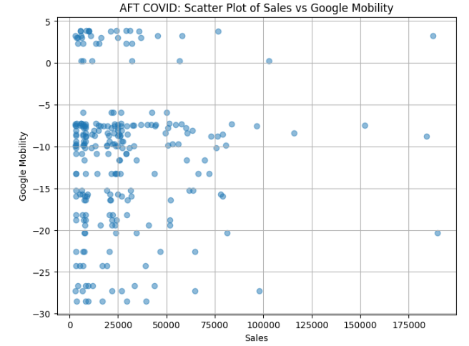
Data Analysis / EDA:
There is no correlation between sales and google mobility after covid. In Before covid, there is no activity of google mobility.

Slide 20
Models:
Tried below
The 6 is the best model in the all.
1, LSTM
2, ARIMA
3, Prophet
4, XGBoost
5, VAR
6, Ensemble model with ARIMA, Random Forest, Gradient Boosting, Prophet
7, Synthetic data with ensemble model with ARIMA, Random Forest, Gradient Boosting, Pophet

Slide 21
Ensemble method
The result:
They are not high accuracy but compared to other models I have got reliable results. 'SKU1': {'MAPE': 6.725454844298099e+19, 'Accuracy': -6.725454844298099e+19},
'SKU2': {'MAPE': 1.0609801207744612e+19, 'Accuracy': -1.0609801207744612e+19},
'SKU3': {'MAPE': 8.719252794930592e+19, 'Accuracy': -8.719252794930592e+19},
'SKU4': {'MAPE': 2.7614022422728913e+19, 'Accuracy': -2.7614022422728913e+19},
'SKU5': {'MAPE': 2.021129320263402e+19, 'Accuracy': -2.021129320263402e+19},
'SKU6': {'MAPE': 2.9092289663681716e+19, 'Accuracy': -2.9092289663681716e+19}}

Slide 22
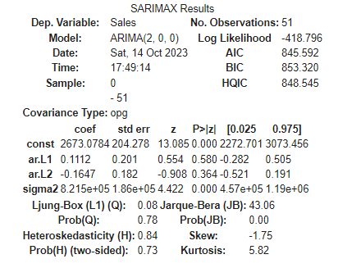
ARIMA model
The result:
MAPE:14.82%
Accuracy:85.18% for SKU2.
It seems looks good compared to the results of other models but we need to be careful because the dataset is too small that is hard to get the accurate result.

Slide 23
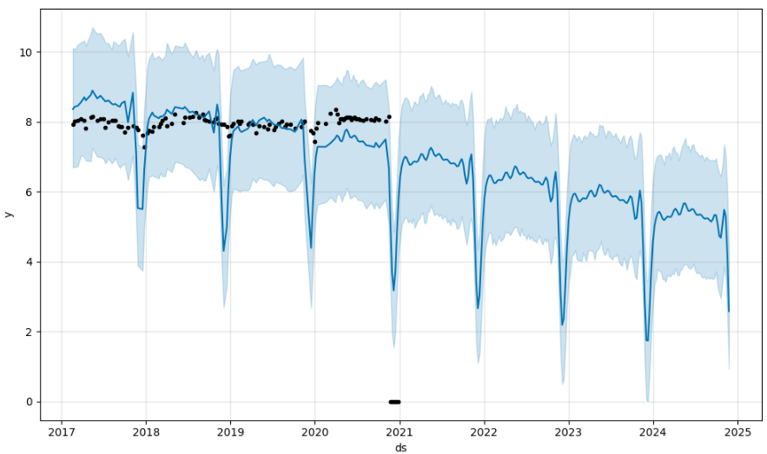
Prophet model
Result:
MAPE: inf%
Accuracy: -inf%
The result is not accurate. I need to investigate it more.
Because the Covid’s impact, the forecast is affected by it.

Slide 24
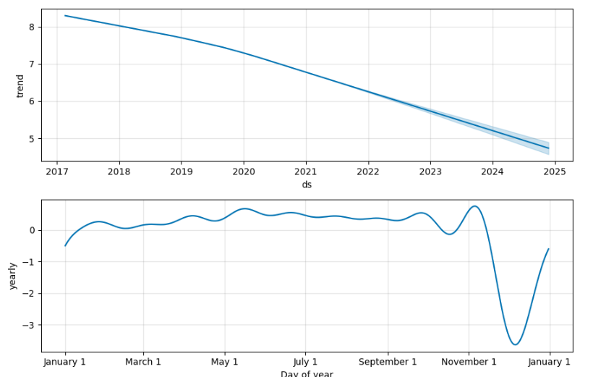
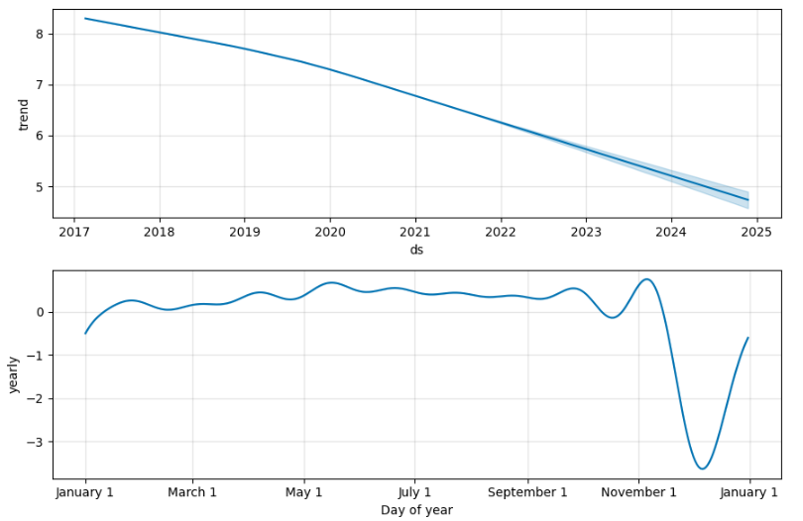
Prophet2

Slide 25
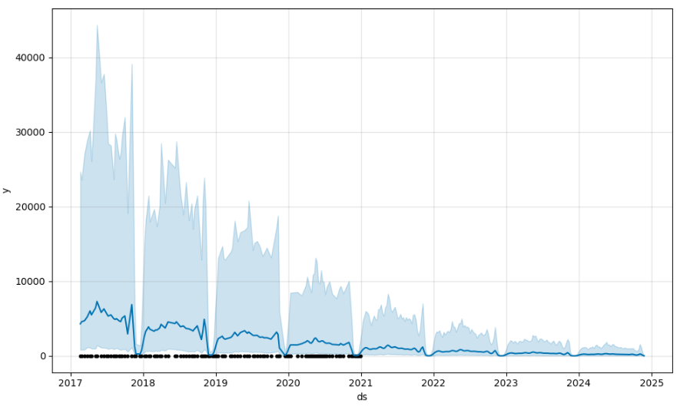
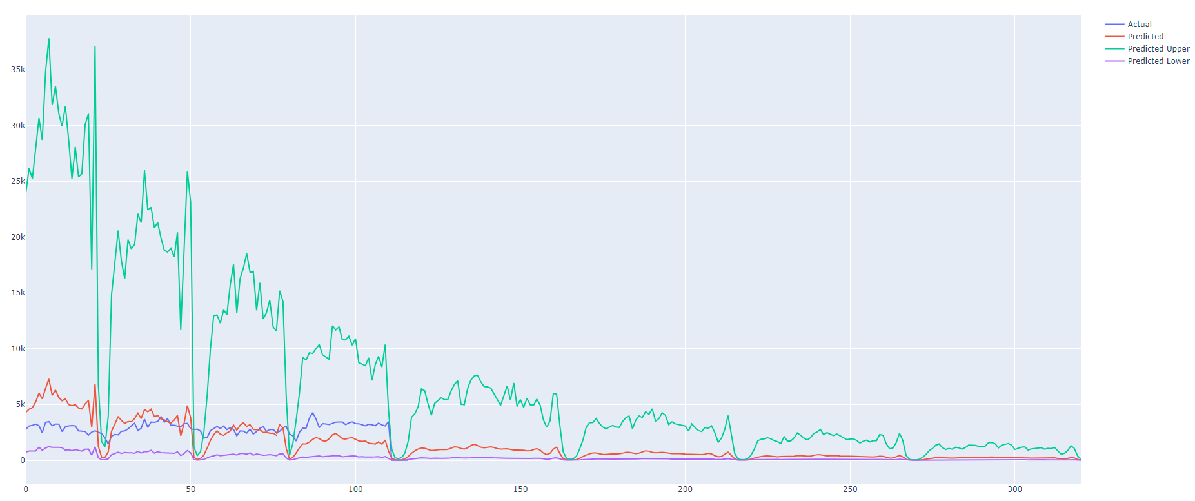
Prophet3

Slide 26
Synthetic data with Ensemble method
The result:
It was not as good as Ensemble method.
'SKU1': {'MAPE': 1647681.2717655227, 'Accuracy': -1647581.2717655227},
'SKU2': {'MAPE': 299203.142829213, 'Accuracy': -299103.142829213},
'SKU3': {'MAPE': 1610205.7865024037, 'Accuracy': -1610105.7865024037},
'SKU4': {'MAPE': 507888.4638358564, 'Accuracy': -507788.4638358564},
'SKU5': {'MAPE': 353632.54354865255, 'Accuracy': -353532.54354865255},
'SKU6': {'MAPE': 59.62359792253421, 'Accuracy': 40.37640207746579}

Slide 27
Summary: The data set itself is too small and then it needs to divide to 6 to forecast each product that is hard to forecast and causes the result of inaccuracy.

Slide 28
Thank You

