Slide 1
Carleton University Collected & Missing Demographics Data
Developer: Rahel Gunaratne
Supervisor: Dr. Fateme Rajabiyazdi
EDI Consultant: Dr. Gananatha Subrahmanyam
Notes:
We present a visualization of Carleton University Students Collected & Missing Demographics Data.

Slide 2
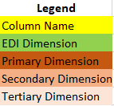
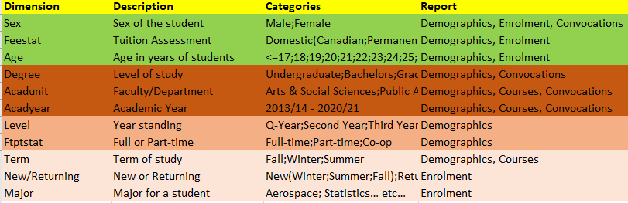
Data Dimensions
Notes:
The Carleton Data Cubes (CDC) contain information about the demographics of students. Information such as citizenship status, sex, age, faculty, degree, year and study status.

Slide 3
Goals
Visualize the data available
Visualize the data unavailable
Notes:
The goal of the project was to design an interactive visualization web-based platform. First, it must provide a visual comparison of student diversity in different academic categories. Second, it must show the missing data to bring awareness to the need for universities to collect important demographic information.

Slide 4
Phase 1
Online meetings
Missing attributes
Race
Dis/ability
Religion or Spirituality
Indigeneity
Gender
Languages spoken
Problem with ‘Gender’ Attribute
Low medium/fidelity visualizations
Notes:
Our research group conducted online meetings with an OttawaU Social Science Professor who is also a research specialist in EDI. We discussed the collected & missing attributes in the dataset and potential idea's for designs. Some of the missing attributes suggested for collection include: Race, Dis/ability, Religion or Spirituality, Indigeneity, Gender and/or langauges spoken. An inconsistency with the dataset was the labelling of the Gender attribute which was labelled as "Sex' which is not normally collected in an academic setting.

Slide 5
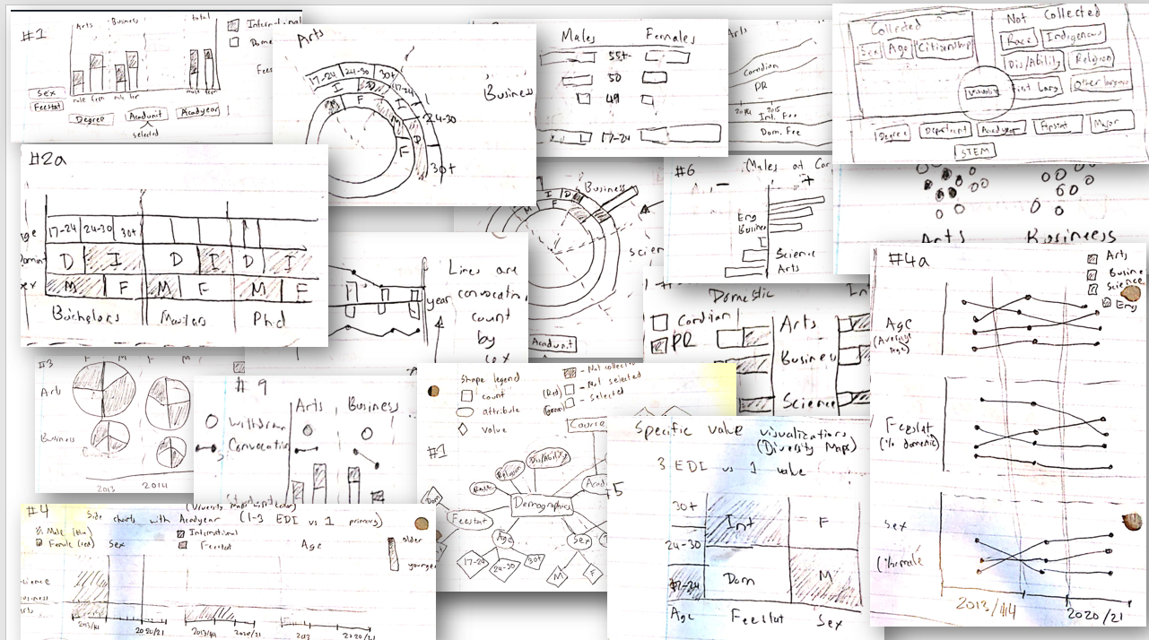
Notes:
Finally, I designed some low/medium fidelity visualizations, downloaded the data from the data cubes and cleaned it using Python.

Slide 6
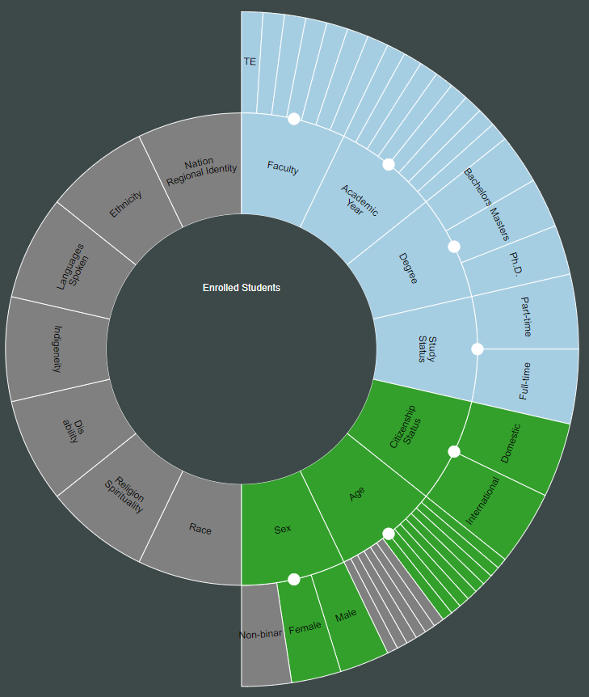

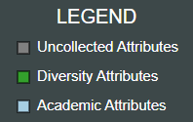
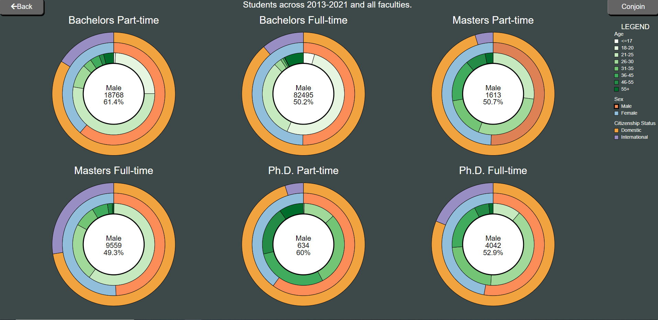

Why is it useful?
Missing data visualization
Diversity visualization
May motivate other designs
Increase awareness of diversity
Help policy makers make data driven decisions
Notes:
There are many reasons for this visualization:
- oftentimes in the real world, sometimes relevant data is missing and this visualization showcases a design that allows the user to see in proportion how much data is collected and not collected.
- the 2nd design is concise and compact and allows any combination of demographic attributes using slices and rings.
- These designs may motivate other researchers and designers to develop innovative visualizations of diversity or of missing data.
- Finally, this visualization increases awareness of student diversity in the university, and it may help policy makers make data-driven decisions in accommodation of diversity, equity and inclusion.

