Slide 1
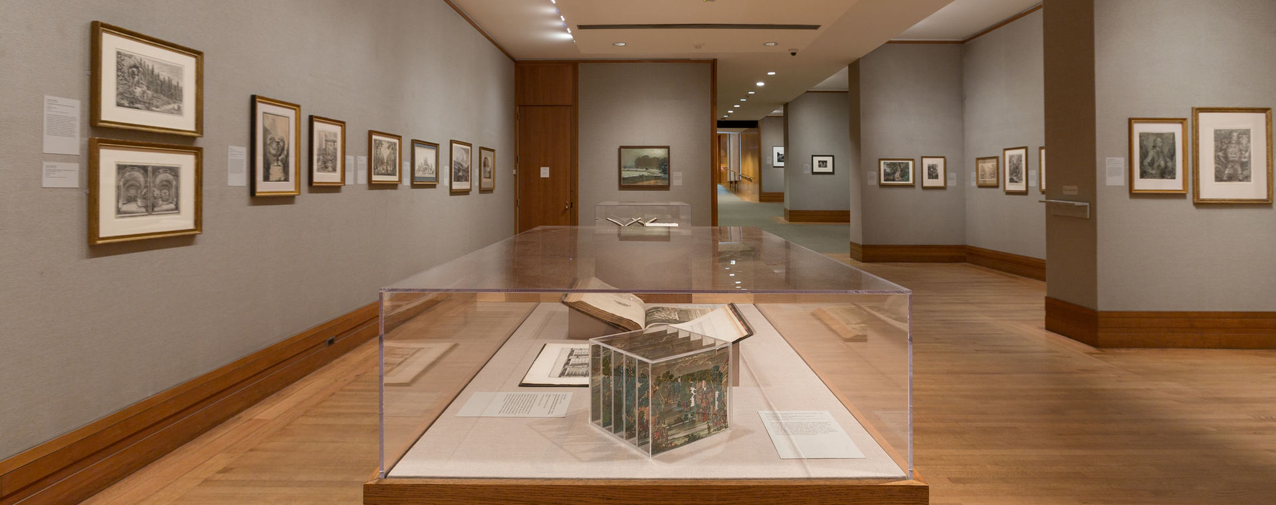
The new art museum interactive chatbot
Liu Yunzhu
SGBT Batch 3

Slide 2
Business case
Why are you building chatbot? | How is it going to interact? | How can you build a conversation flow | How are you going to get people to use? | How are you going to make money?
Let visitors see the new events and exhibition information easily | Target: all visitors to the gallery | Define set of keywords | Publish chatbot on museum website and Facebook page | Attract more visitors to the museum
Save manpower from answering calls | Tone of voice: formal but friendly | Simulate the sequence of in-person conversation | Reveal new information in advance on the chatbot | Merchandise shop incorporated onto the chatbot
Induce curiosity | Chatbot’s personality: friendly |  | A little gift for visitors registered through chatbot | Provide chatbot service to other museum and galleries

Slide 3
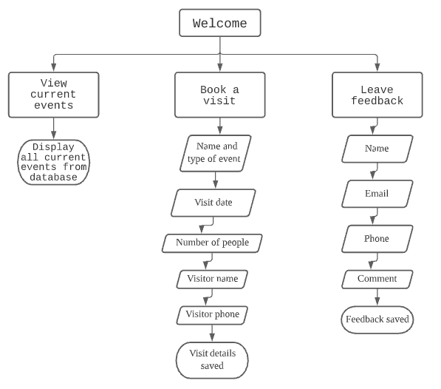
Flowchart

Slide 4
Links
https://www.facebook.com/The-New-Art-Museum-103264728327063
https://fintechtalent.net/liuyunzhu/

