Slide 1

Earthquakes with convolutional neural networks
By Kaelynn Rose

Slide 2
introduction
Goal: to train two convolutional neural network models on seismic signal images, to:
Classify whether signals are earthquakes or noise
Predict earthquake magnitude
Use Case: This study has potential applications for faster earthquake detection, as these CNN models could be used to classify and measure signals in near-real time.
Data: 630,623 seismic signals plus metadata (34 features including earthquake magnitude, depth, location, etc.)
400,000 earthquake signals
230,623 noise signals
Each signal is 60 seconds long
Notes:
The USGS takes 2.5 minutes on average to detect, process, and post to the system about an earthquake in California, 8 minutes outside of California where the seismic networks are less dense. The USGS is constantly developing new algorithms to detect earthquakes as fast as possible.

Slide 3
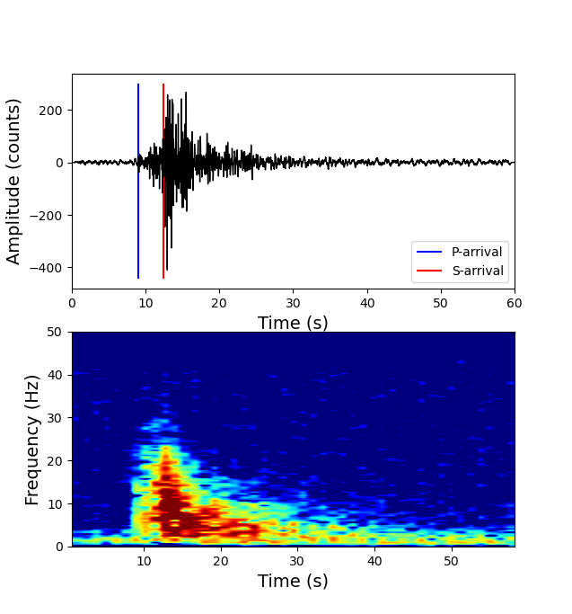
introduction
Example Earthquake Waveform & Spectrogram
Earthquakes cause ground displacement, measured by a seismometer
Earthquakes usually have a p-wave and an s-wave, and sometimes surface waves
A spectrogram is used to show the power of different frequencies in the signal over time
Notes:
The USGS takes 2.5 minutes on average to detect, process, and post to the system about an earthquake in California, 8 minutes outside of California where the seismic networks are less dense. The USGS is constantly developing new algorithms to detect earthquakes as fast as possible.

Slide 4
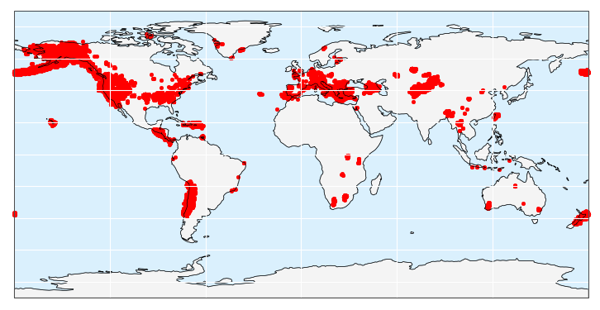
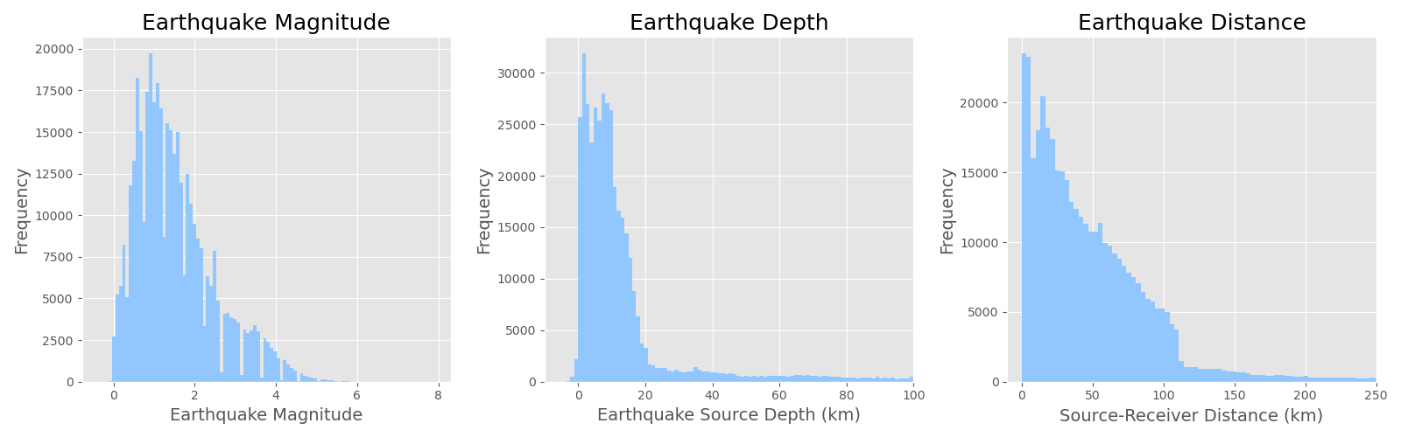
EDA
Earthquake Locations

Slide 5
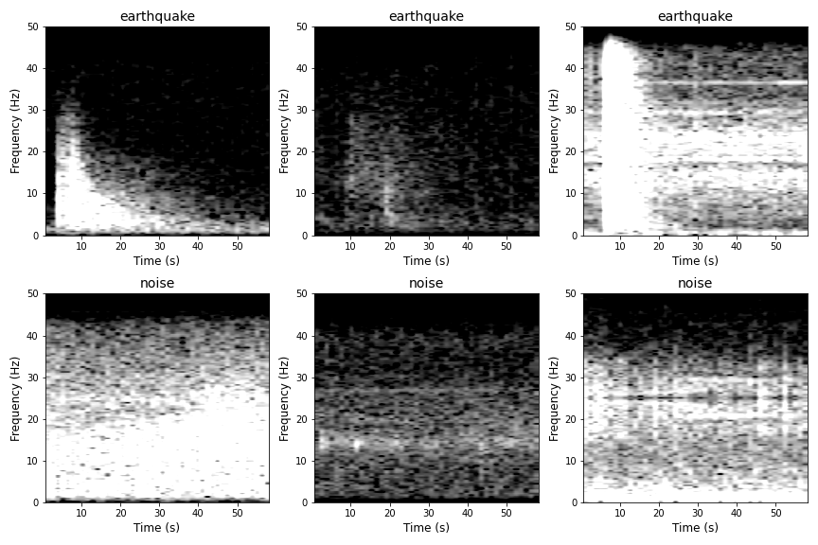
methods
Example Images Used to Train/Test CNNs
Used raw seismic signal data to plot 630,000+ spectrogram images
Normalized spectrograms so they are colored between -10 and 25 dB/Hz
Used spectrogram images to train CNNs

Slide 6
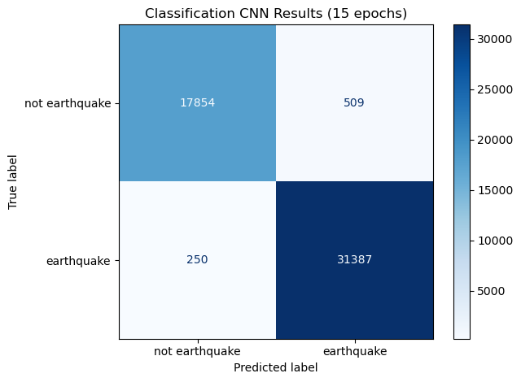
Classification cnn
Trained CNN on 200,000 images
Binary classification: ‘earthquake’ or ‘not earthquake’
Baseline model: Model predicts ‘earthquake’ for every signal.
Baseline accuracy: 0.633
Baseline precision: 0.633
Baseline recall: 1.0
Best Model:
Model accuracy: 0.9848
Model precision: 0.9840
Model recall: 0.9921

Slide 7
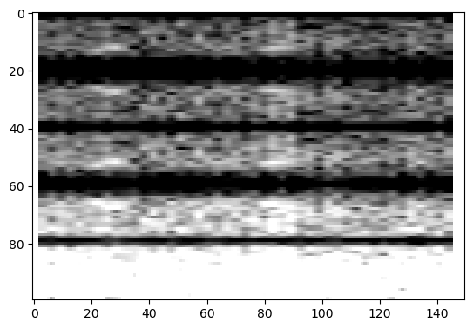
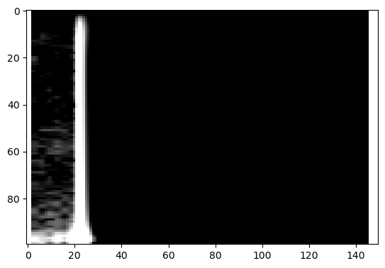
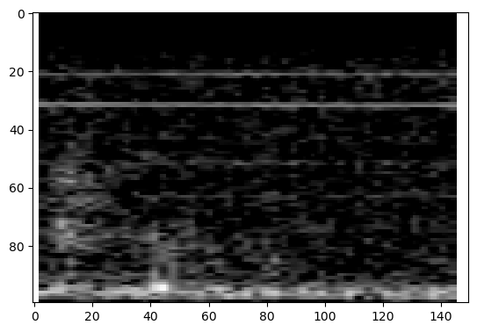
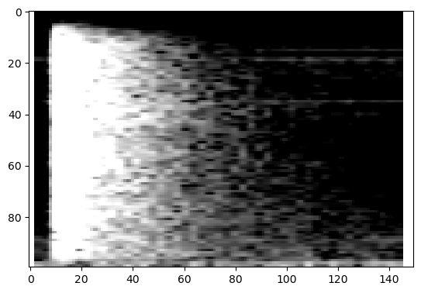
Classification cnn
Noisiest Noise
Earthquakiest Noise
Noisiest earthquake
Earthquakiest Earthquake

Slide 8
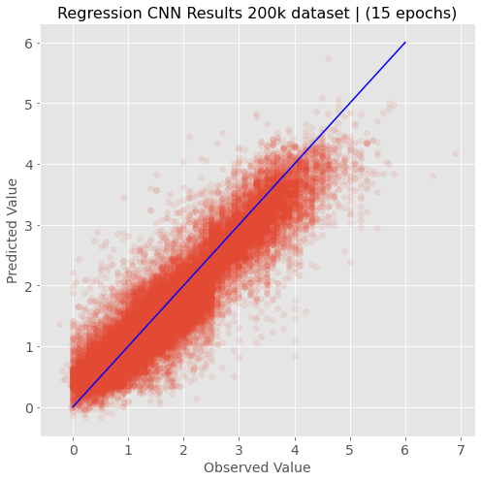
Regression cnn
Trained CNN on 200,000 images
Regression: attempt to predict the magnitude of each earthquake
Earthquake magnitudes are measured on log-scale and small earthquakes are much more common than large ones, so the predictions at higher magnitudes may have more error
Baseline model: predict mean magnitude of 1.5215
Baseline MSE: 0.9497
Best model:
MSE: 0.1344

Slide 9
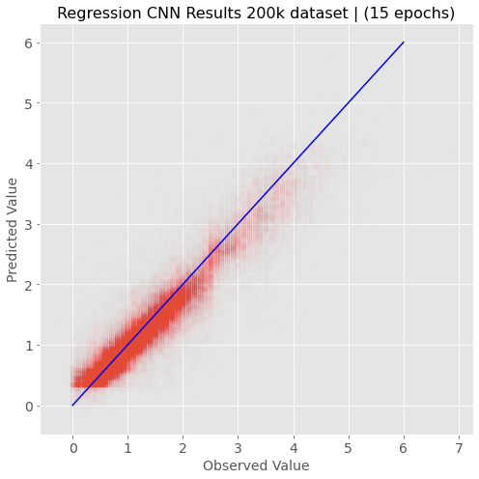
Regression cnn
Trained CNN on 200,000 images
Regression: attempt to predict the magnitude of each earthquake
Earthquake magnitudes are measured on log-scale and small earthquakes are much more common than large ones, so the predictions at higher magnitudes may have more error
MSE: 0.1344

Slide 10
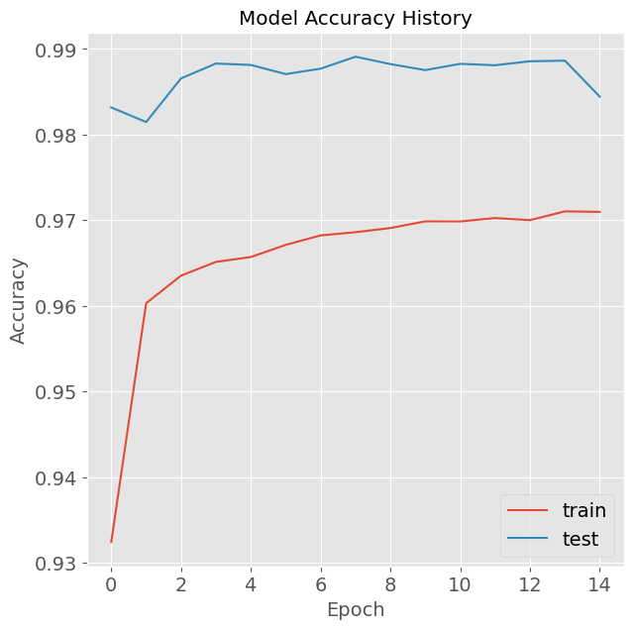
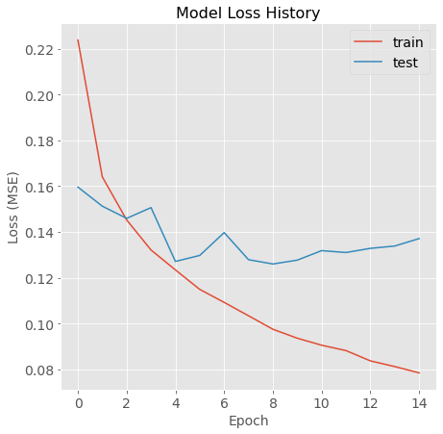
Model metrics
Classification Model Accuracy
Regression Model Loss

Slide 11
Future Work
Build a CNN to predict locations of p-wave and s-wave arrivals in earthquake signal
Connect the CNN to a seismic data network to classify earthquakes/ predict properties in near-real time
Try a simpler model like linear regression or random forest to see if good results can be achieved without CNNs

Slide 12
Questions?

Slide 13
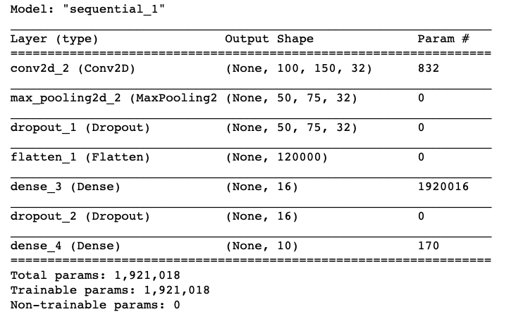
Appendices Classification CNN

Slide 14
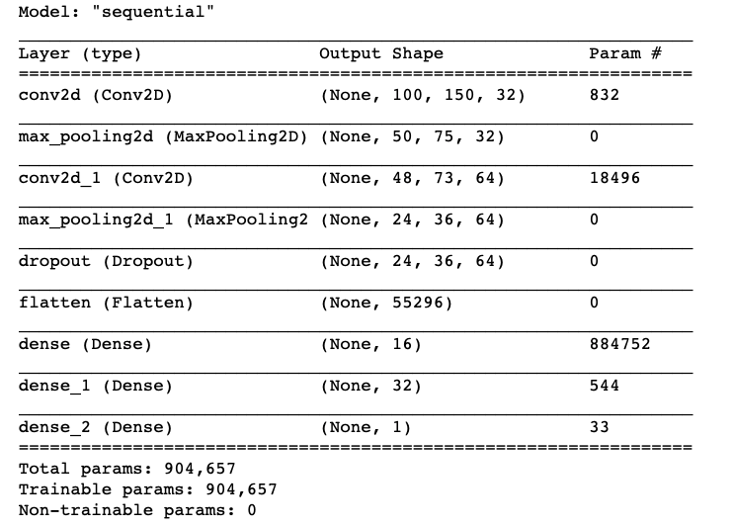
Appendices Regression CNN

