Slide 1

EARTHQUAKES WITH CONVOLUTIONAL NEURAL NETWORKS
BY KAELYNN ROSE

Slide 2
INTRODUCTION
Goal: to train two convolutional neural network models on seismic signal images, to:
Classify whether signals are earthquakes or noise
Predict earthquake magnitude
Use Case: This study has potential applications for faster earthquake detection, as these CNN models could be used to classify and measure signals in near-real time.
Data: 630,623 global seismic signals from the STanford EArthquake Dataset (STEAD; 2019) plus metadata (34 features including earthquake magnitude, depth, location, etc.)
400,000 earthquake signals
230,623 noise signals
Each signal is 60 seconds long
Notes:
The USGS takes 2.5 minutes on average to detect, process, and post to the system about an earthquake in California, 8 minutes outside of California where the seismic networks are less dense. The USGS is constantly developing new algorithms to detect earthquakes as fast as possible.

Slide 3
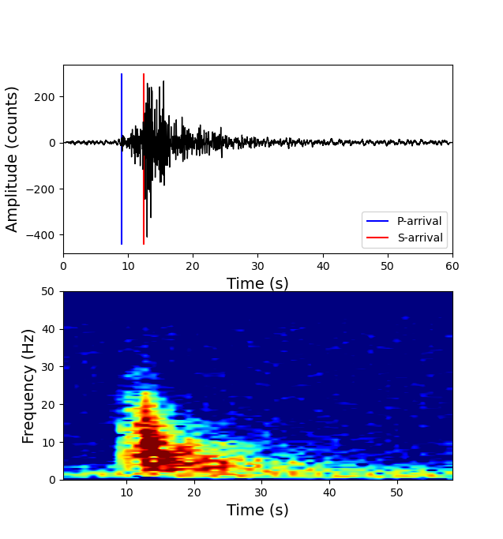
INTRODUCTION
Example Earthquake Waveform & Spectrogram
Earthquakes cause ground displacement, measured by a seismometer
Earthquakes usually have a p-wave and an s-wave, and sometimes surface waves
A spectrogram is used to show the power of different frequencies in the signal over time
Notes:
The USGS takes 2.5 minutes on average to detect, process, and post to the system about an earthquake in California, 8 minutes outside of California where the seismic networks are less dense. The USGS is constantly developing new algorithms to detect earthquakes as fast as possible.

Slide 4
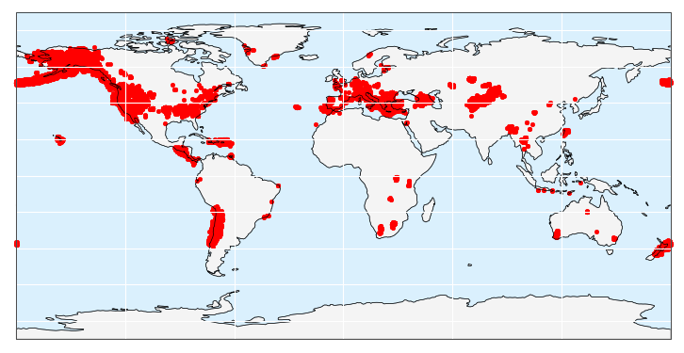
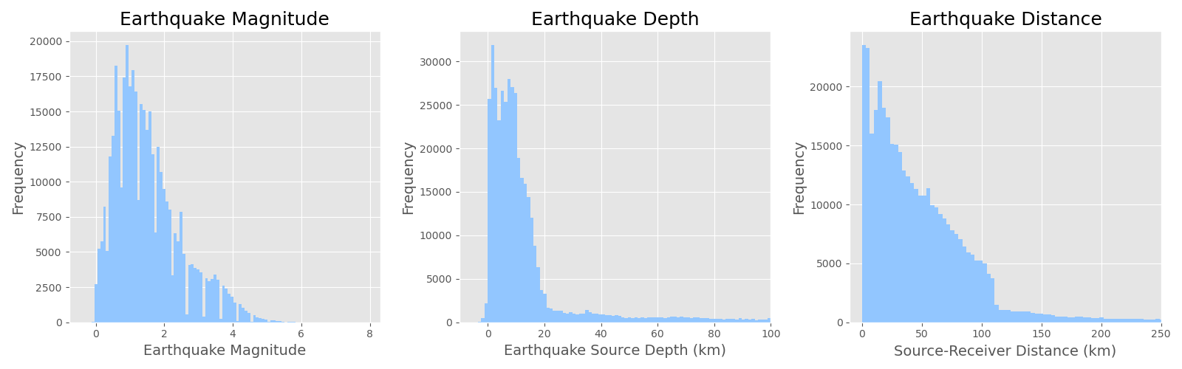
EDA
Earthquake Locations

Slide 5
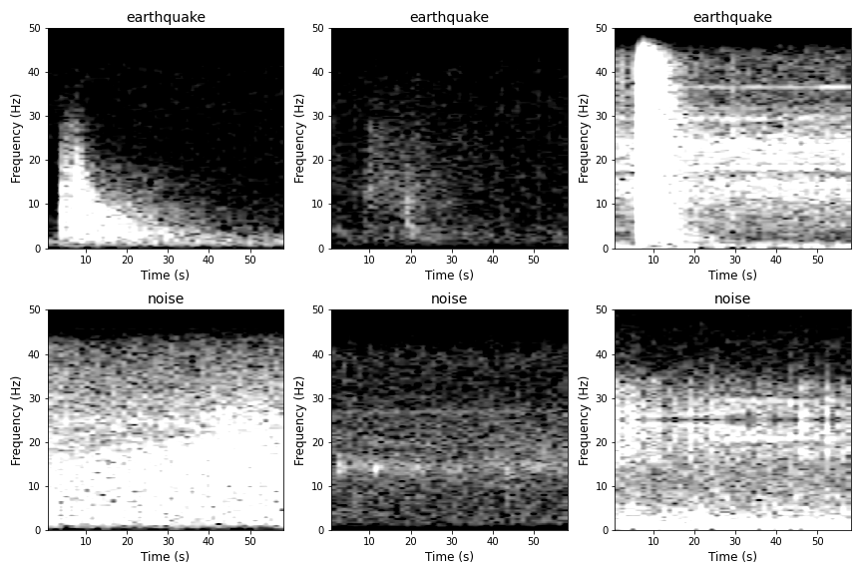
METHODS
Example Images Used to Train/Test CNNs
Used raw seismic signal data to plot 630,000+ spectrogram images
Normalized spectrograms so they are colored between -10 and 25 dB/Hz
Used spectrogram images to train CNNs

Slide 6
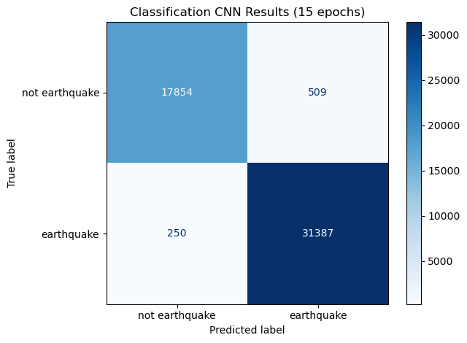
CLASSIFICATION CNN
Trained CNN on 200,000 images
Binary classification: ‘earthquake’ or ‘not earthquake’
Baseline model: Model predicts ‘earthquake’ for every signal.
Baseline accuracy: 0.633
Baseline precision: 0.633
Baseline recall: 1.0
Best Model:
Model accuracy: 0.9848
Model precision: 0.9840
Model recall: 0.9921

Slide 7
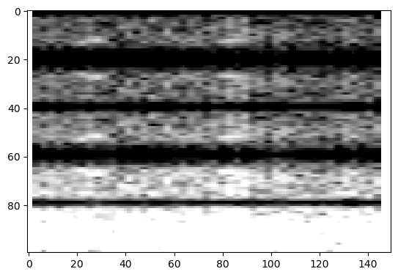
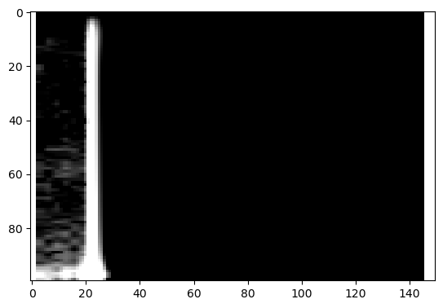
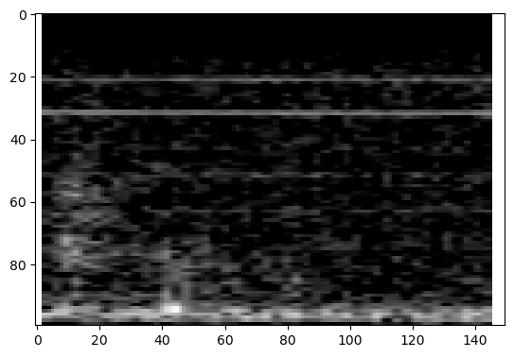
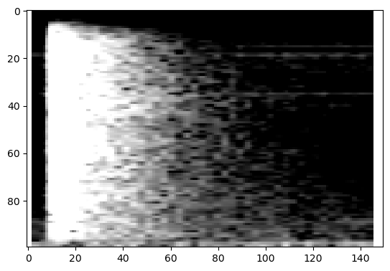
CLASSIFICATION CNN
Noisiest Noise
Earthquakiest Noise
Noisiest earthquake
Earthquakiest Earthquake

Slide 8
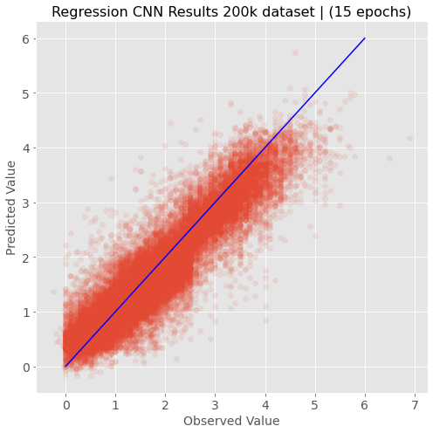
REGRESSION CNN
Trained CNN on 200,000 images
Regression: attempt to predict the magnitude of each earthquake
Earthquake magnitudes are measured on log-scale and small earthquakes are much more common than large ones, so the predictions at higher magnitudes may have more error
Baseline model: predict mean magnitude of 1.5215
Baseline MSE: 0.9497
Best model:
MSE: 0.1344

Slide 9
FUTURE WORK
More model hyperparameter tuning
Build a CNN to predict locations of p-wave and s-wave arrivals
Connect the CNN to a seismic data network

Slide 10
QUESTIONS?

Slide 11
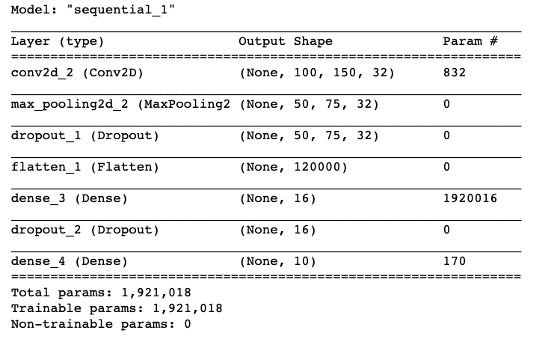
APPENDICES CLASSIFICATION CNN

Slide 12
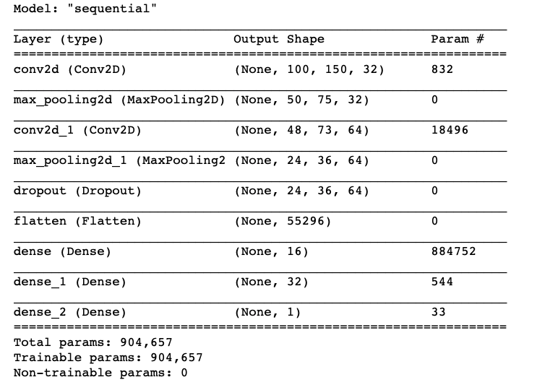
APPENDICES REGRESSION CNN

Slide 13
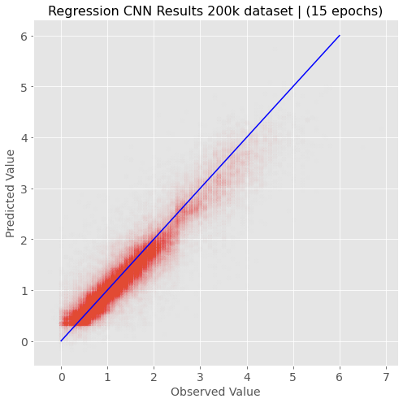
REGRESSION CNN
Trained CNN on 200,000 images
Regression: attempt to predict the magnitude of each earthquake
Earthquake magnitudes are measured on log-scale and small earthquakes are much more common than large ones, so the predictions at higher magnitudes may have more error
MSE: 0.1344

Slide 14
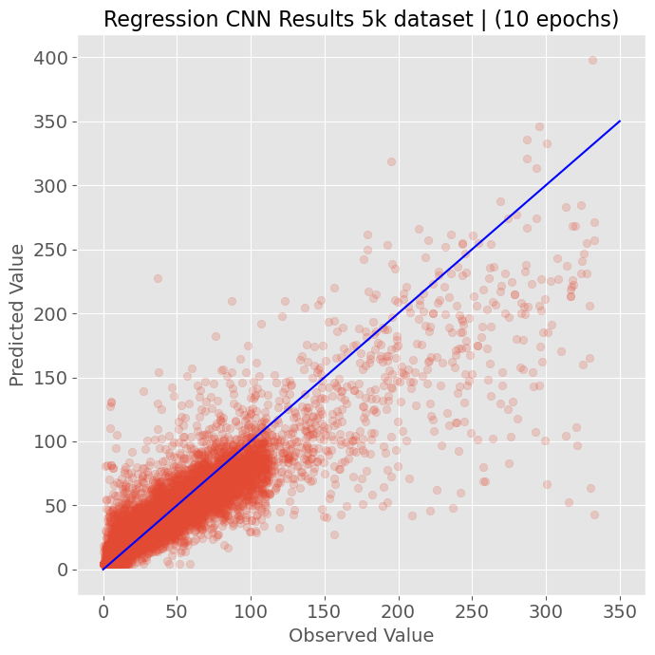
REGRESSION CNN
Regression CNN Results 30k dataset | (10 epochs)
Trained CNN on 30,000 images
Regression: attempt to predict the distance of each earthquake from the seismic station that recorded it
MSE: 601.35

Slide 15
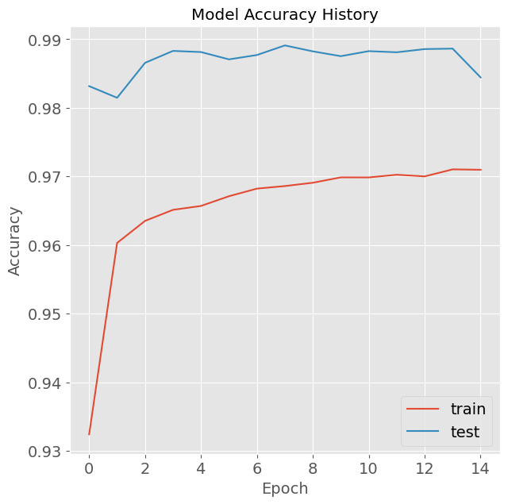
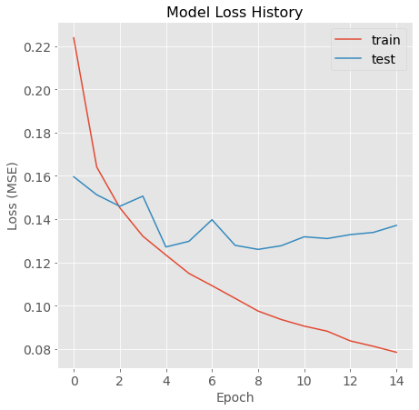
APPENDICES MODEL METRICS
Classification Model Accuracy
Regression Model Loss

Slide 16
APPENDICES CLASSIFICATION CNN
model = keras.Sequential()
model.add(keras.layers.Conv2D(32, kernel_size=(5, 5), activation = 'relu', padding = 'same'))
model.add(keras.layers.MaxPool2D(2,2))
model.add(keras.layers.Dropout(0.25))
model.add(keras.layers.Flatten(input_shape=(self.imgs.shape[1],self.imgs.shape[2])))
model.add(keras.layers.Dense(16,activation='relu'))
model.add(keras.layers.Dropout(0.5))
model.add(keras.layers.Dense(10,activation='softmax'))
model.compile(optimizer='adam',loss='sparse_categorical_crossentropy',metrics='accuracy')
self.history = model.fit(self.train_images,self.train_labels,epochs=epochs,callbacks=callbacks,validation_split=0.2)
Notes:
Relu serves as an edge detector
In Max Pooling, we overlay smaller squares onto our image, tiling the squares with no overlap. The final pixel value in the output image is simply the maximum pixel value over all pixels contained in a region defined by one of the small squares
Softmax is an activation function which assigns probabilities to each class
Convolutions are linear operations that transform an image into another image.
A dropout layer prevents overfitting by randomly dropping a percentage of the neurons
Adam optimizer is a replacement optimization algorithm for stochastic gradient descent for training deep learning models. Can handle sparse gradients on noisy problems.

Slide 17
APPENDICES REGRESSION CNN
model = keras.Sequential()
model.add(keras.layers.Conv2D(32, kernel_size=(5, 5), activation = 'relu', padding = 'same'))
model.add(keras.layers.MaxPool2D(2,2))
model.add(keras.layers.Conv2D(64, kernel_size=(3, 3), activation='relu'))
model.add(keras.layers.MaxPool2D(2,2))
model.add(keras.layers.Dropout(0.25))
model.add(keras.layers.Flatten(input_shape=(self.imgs.shape[1],self.imgs.shape[2])))
model.add(keras.layers.Dense(16,activation='relu'))
model.add(keras.layers.Dense(32,activation='relu'))
model.add(keras.layers.Dense(1))
model.compile(optimizer='adam',loss='mse')
self.history = model.fit(self.train_images,self.train_labels,epochs=epochs,callbacks=callbacks,validation_split=0.2)

