Slide 1
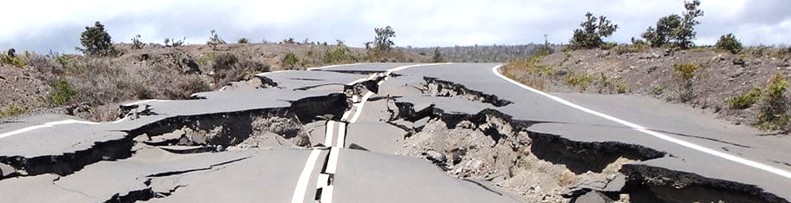
Earthquake Detection with Deep Learning
BY KAELYNN ROSE
APRIL 28, 2021

Slide 2
Goals
Build Convolutional Neural Network (CNN) and Long-Short Term Memory (LSTM) models to predict earthquake class, magnitude, p-wave and s-wave arrival times
Deploy best classification model to an AWS Lambda function to predict whether a signal is an earthquake in real-time
Use Case
Potential for faster or more reliable earthquake detection, as current methods typically depend on non-learning algorithms

Slide 3
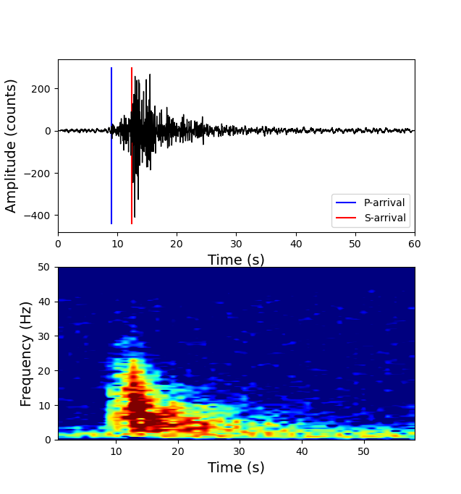
Data
Example Earthquake Waveform
& Spectrogram
100,000 global seismic signals from the STanford EArthquake Dataset (STEAD), plus metadata
34 features
~40% noise signals
~60% earthquake signals
Each signal is 60 seconds

Slide 4
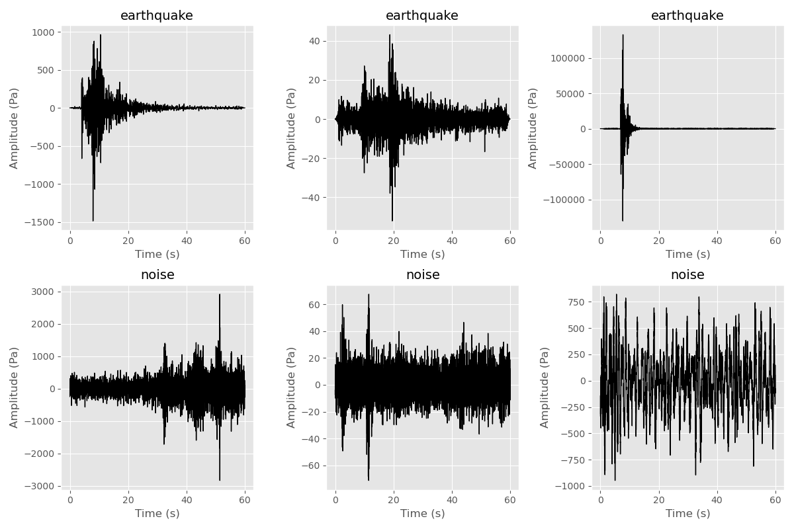
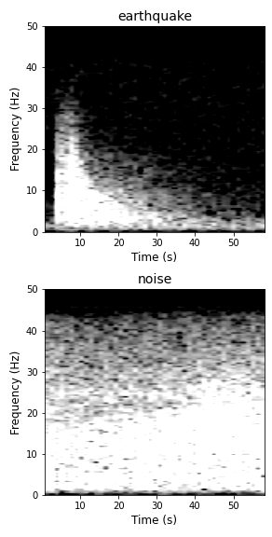
Methods: CNN
Example Waveforms & Spectrograms
Models trained/tested on spectrograms or waveform figures depending on target
Used classification CNN model for predicting earthquakes, regression CNN for other targets, each with one convolutional layer
Notes:
A convolutional neural network is a type of machine learning algorithm usually used with visual imagery because they are good at detecting patterns. A convolutional neural network structure consists of an input layer, at least one convolutional layer, and an output layer.

Slide 5
Classification CNN Architecture
Input (Images)
Convolutional Layer (32 filters)
Flattening layer
Max pooling layer
Dropout layer
Output
(Probability that the signal is an earthquake)
Dense Layer
Dense Layer
Dense layer
Notes:
A convolutional neural network is a type of machine learning algorithm usually used with visual imagery because they are good at detecting patterns. A convolutional neural network structure consists of an input layer, at least one convolutional layer, and an output layer.

Slide 6
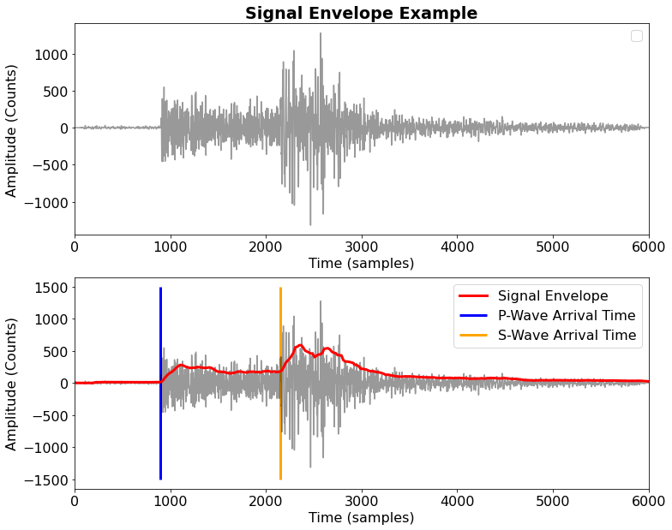
Methods: LSTM
Built an LSTM model to use the time-series signal data, to see if I could remove the need to generate images as needed for the CNN
Models trained/tested on seismic envelopes (time-series), each with 2 LSTM layers
Notes:
An LSTM is a long short-term memory network, a type of RNN. RNNs are neural networks where the output is fed back into the hidden layer, allowing information to be passed from one step of the network to the next. This is useful for time-series data, as computation will take into account historical information, and weights are shared across time. However, RNNs commonly have a problem called exploding gradients. This is where during gradient descent during back-propagation, the error gradients can become too large or small, and be multiplied through the layers, making them extremely large or vanishingly small, to the point where you can get NaN values. Long short-term memory (LSTM) is a deep learning system that avoids the exploding or vanishing gradient problem. LSTM is normally augmented by recurrent gates called “forget gates”. LSTM prevents backpropagated errors from vanishing or exploding. Instead, errors can flow backwards through unlimited numbers of virtual layers unfolded in space. That is, LSTM can learn tasks that require memories of events that happened thousands or even millions of discrete time steps earlier.

Slide 7
Classification LSTM Architecture
Input (Seismic envelopes)
Simple RNN layer
LSTM Layer
Dropout layer
LSTM Layer
Output
(Probability that the signal is an earthquake)
Dense Layer
Dense Layer
Notes:
A convolutional neural network is a type of machine learning algorithm usually used with visual imagery because they are good at detecting patterns. A convolutional neural network structure consists of an input layer, at least one convolutional layer, and an output layer.

Slide 8
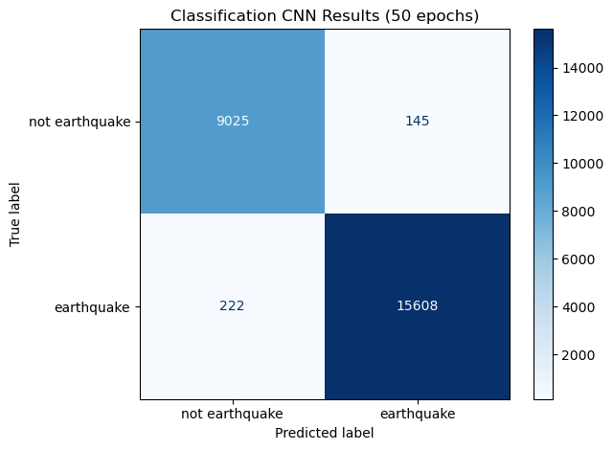
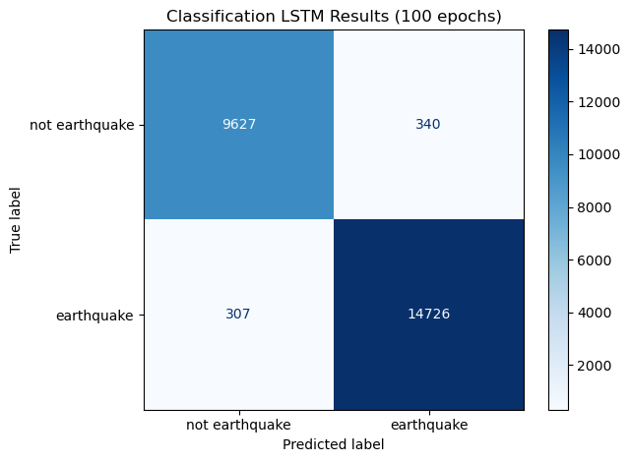
Results: Classifying Signals as ‘Earthquake’ or ‘noise’
CNN
LSTM
Accuracy: 0.98532
Precision: 0.99080
Recall: 0.98598
Accuracy: 0.97412
Precision: 0.97743
Recall: 0.97958

Slide 9
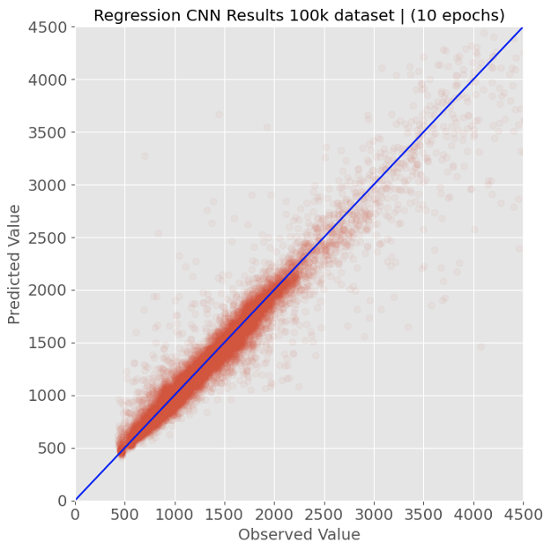
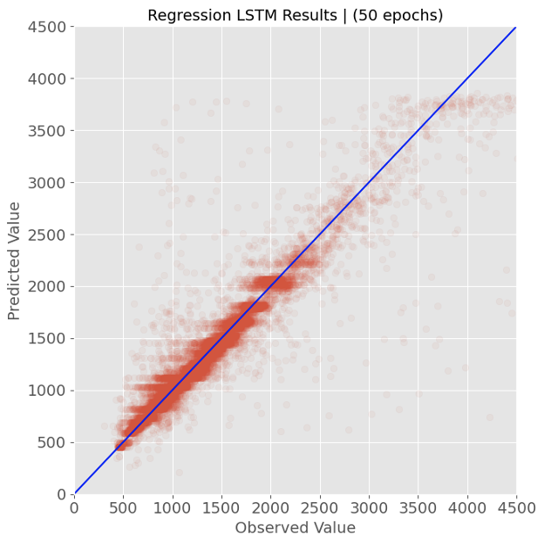
Results: S-Wave Arrival Time Prediction
CNN
LSTM
MSE: 25648.9
MSE: 42508.6

Slide 10
CNN vs. LSTM Comparison
 | Classifier (Accuracy) | Magnitude (MSE) | P-Wave (MSE) | S-Wave (MSE) | Pre-Processing Time
Baseline | 0.52164 | 0.95674 | 30772.7 | 366620.9
Best CNN model | 0.98532 | 0.15895 | 1216.2 | 25648.9 | 0.00761 s
Best LSTM model | 0.97412 | 0.38736 | 3212.2 | 42508.5 | 0.05056 s

Slide 11
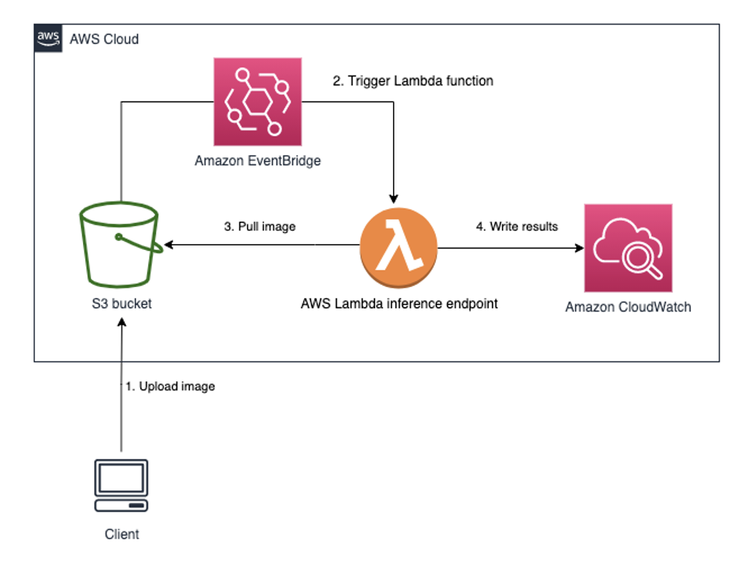
Deploying the Best Model
Model deployment method:
1.Containerized model using Docker
2.Created s3 bucket to store images
3. Deploy Docker image as AWS Lambda function
Notes:
AWS Lambda is a serverless compute service that lets you run your code without provisioning or managing servers. Lambda runs the code only when needed and scales automatically. You only pay for what you consume, and the first 1 million requests per month are free. Lambda runs code from AWS ECR, which is the Elastic Container Registry, which allows you to store, manage, and deploy your container images in AWS. Lambda will run a model and print results to Amazon CloudWatch, a monitoring service.

Slide 12
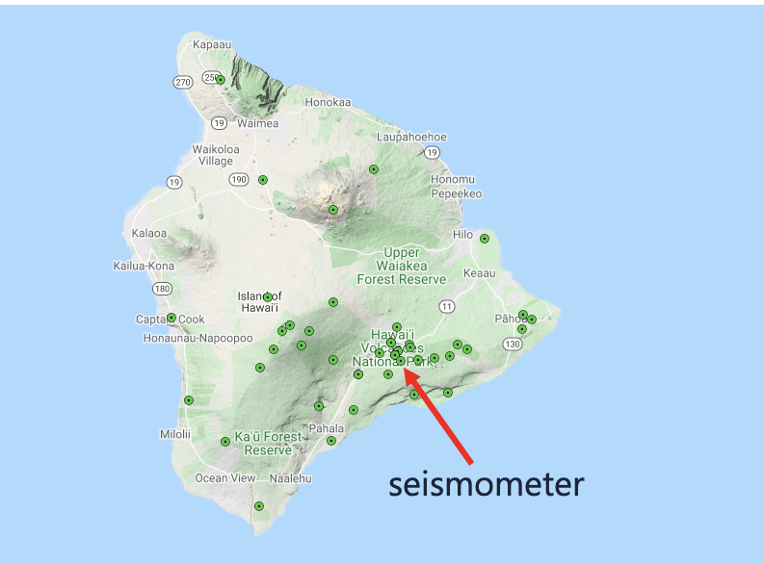
Real-Time Prediction
To make predictions in real time:
Built a pipeline to stream live data from a seismometer on Kilauea, Hawaii because the volcano produces a lot of earthquakes
Create an image every ~15 seconds, send to S3 bucket
S3 bucket triggers the Lambda function, runs the model and predicts image class
Compare model predictions to USGS public website
Notes:
Connected to the live data using ObsPy Seedlink client (Python) to connect to the IRIS Seedlink.

Slide 13
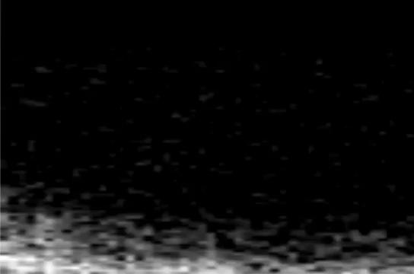
Real-Time Prediction
To make predictions in real time:
Built a pipeline to stream live data from a seismometer on Kilauea, Hawaii because the volcano produces a lot of earthquakes
Create an image every ~15 seconds, send to S3 bucket
S3 bucket triggers the Lambda function, runs the model and predicts image class
Compare model predictions to USGS public website
Network: HV | Station: AHUD | Channel: EHZ

Slide 14
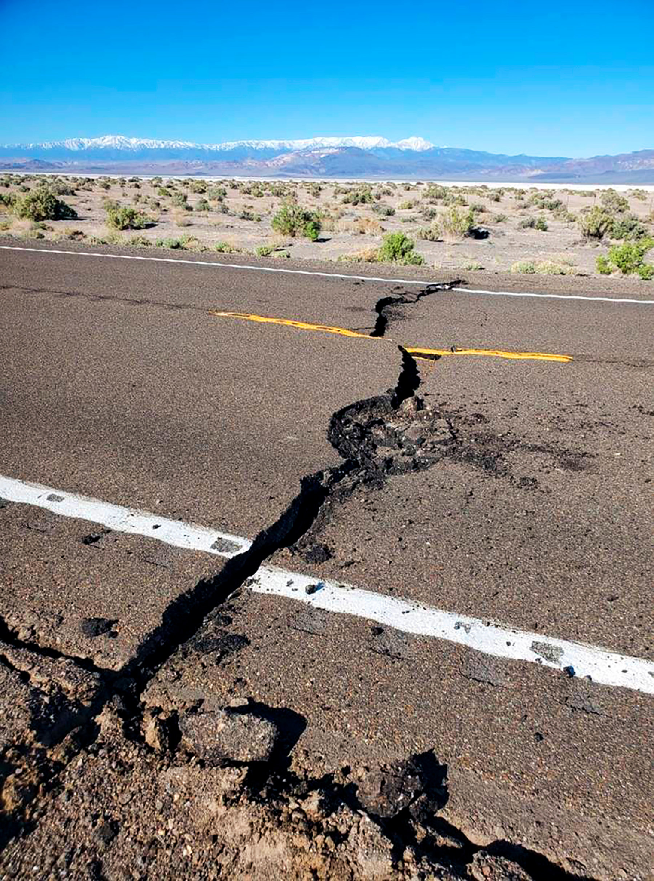
AWS
Lambda Demo

Slide 15
Thanks!
Any questions?

Slide 16
Appendices

Slide 17
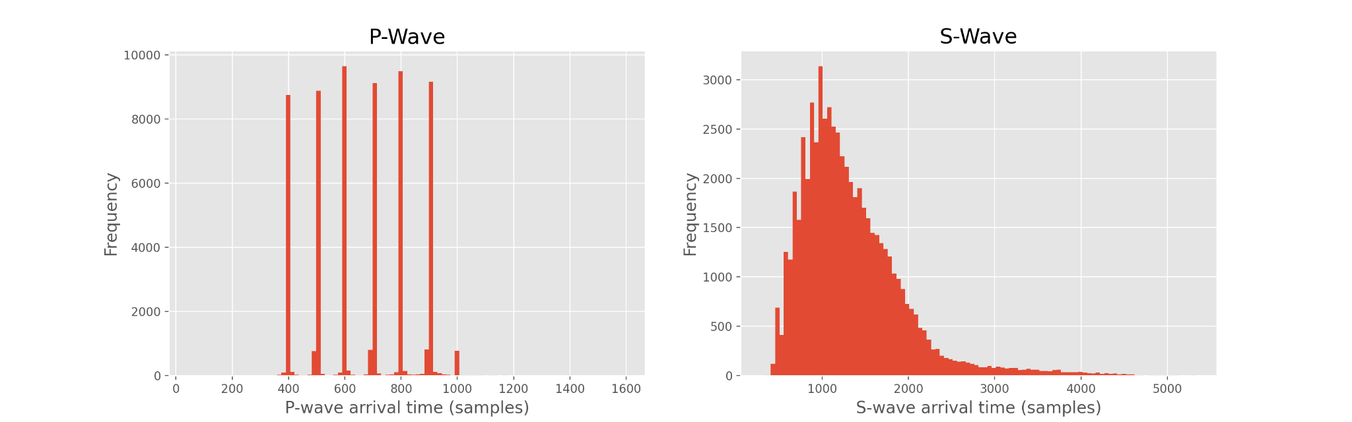
More EDA

Slide 18
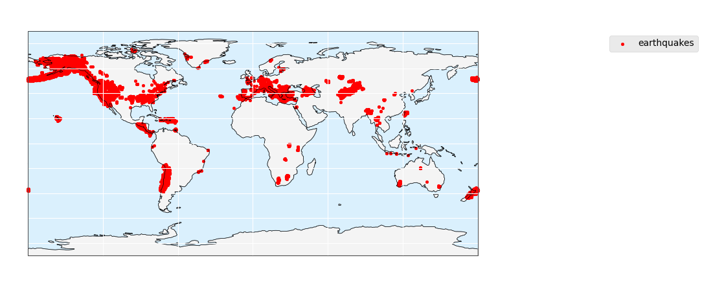
More EDA

Slide 19
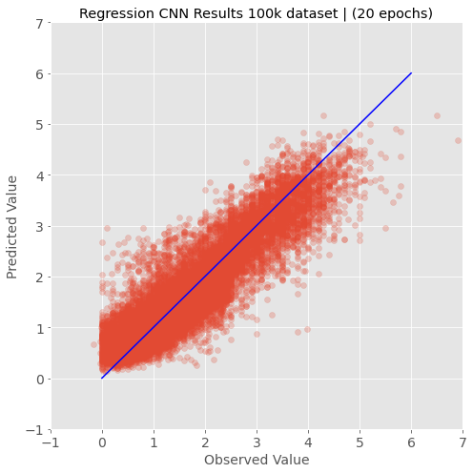
CNN Results
Class Prediction
Magnitude Prediction

Slide 20
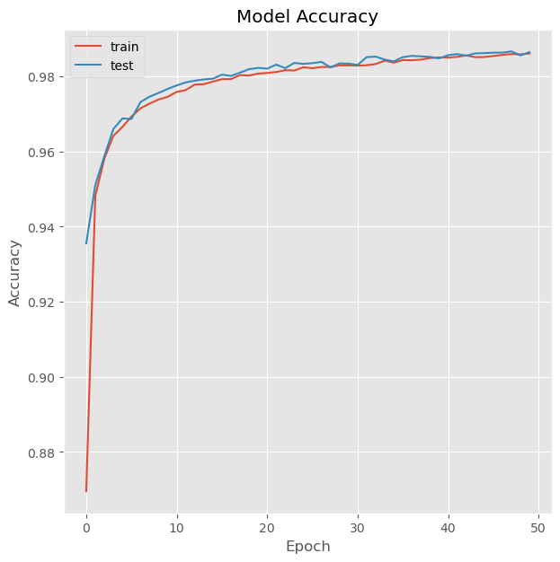
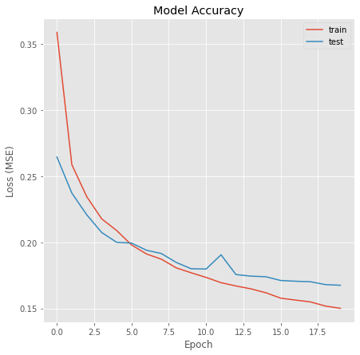
CNN Results
Class Prediction
Magnitude Prediction

Slide 21
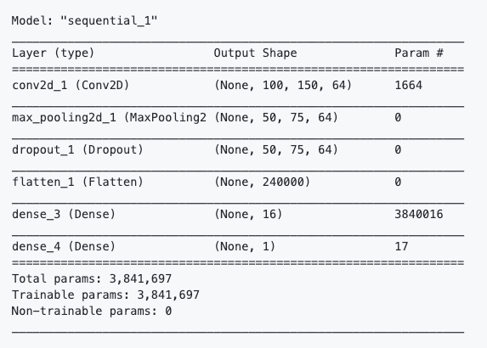
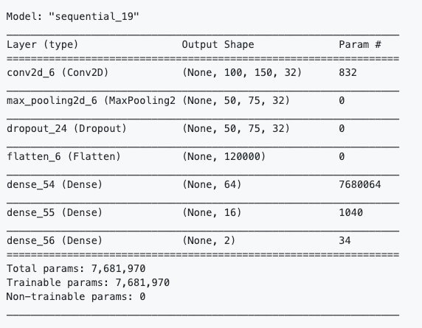
CNN Results
Class Prediction
Magnitude Prediction

Slide 22
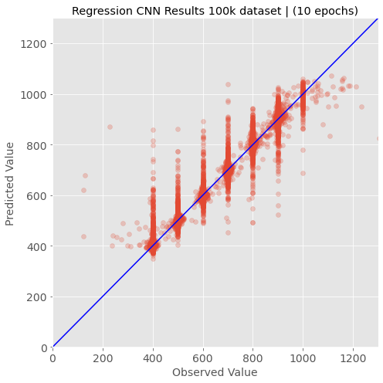
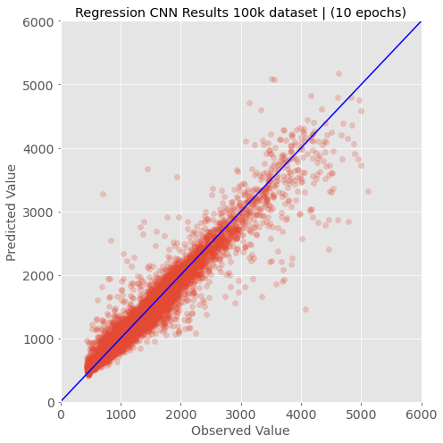
CNN Results
P-Wave Prediction
S-Wave Prediction

Slide 23
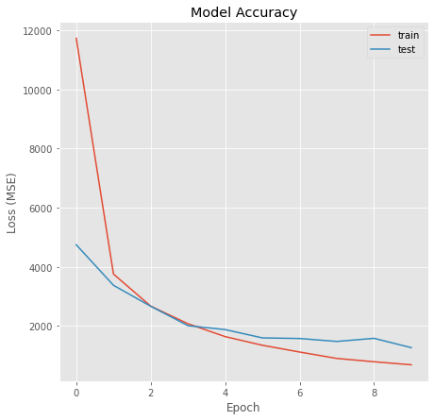
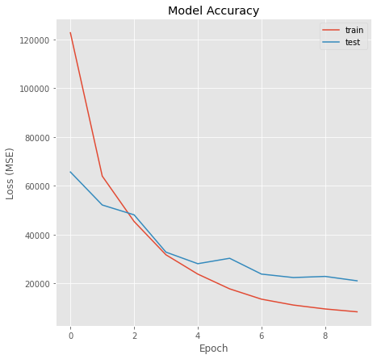
CNN Results
P-Wave Prediction
S-Wave Prediction

Slide 24
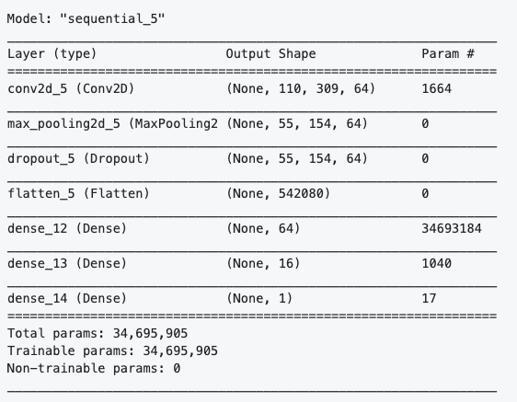
CNN Results
P-Wave Prediction
S-Wave Prediction

Slide 25
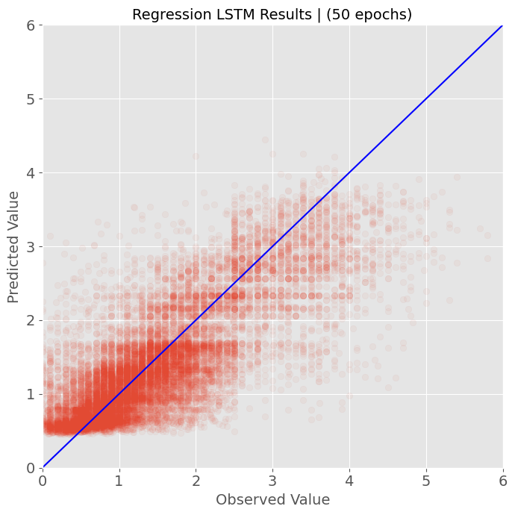
LSTM Results
Class Prediction
Magnitude Prediction

Slide 26
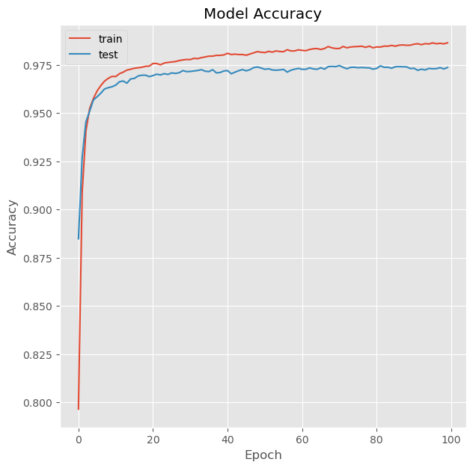
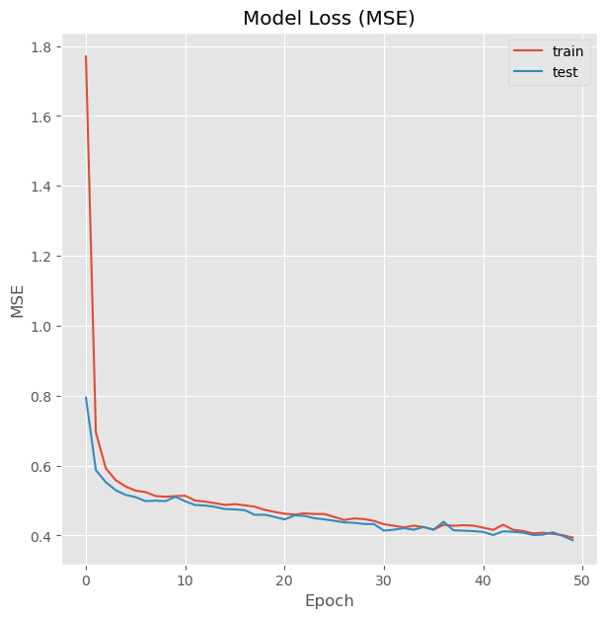
LSTM Results
Class Prediction
Magnitude Prediction

Slide 27
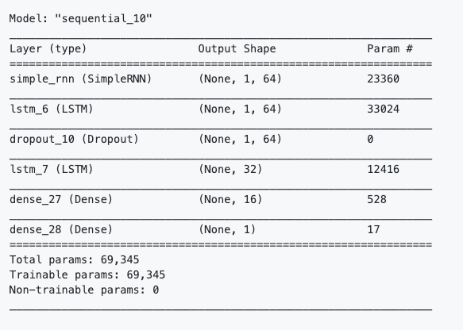
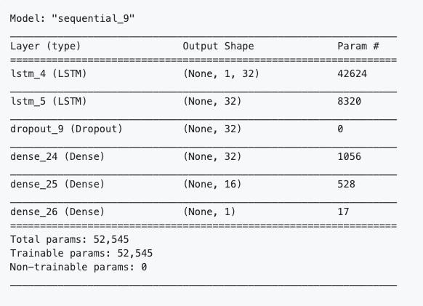
LSTM Results
Class Prediction
Magnitude Prediction

Slide 28
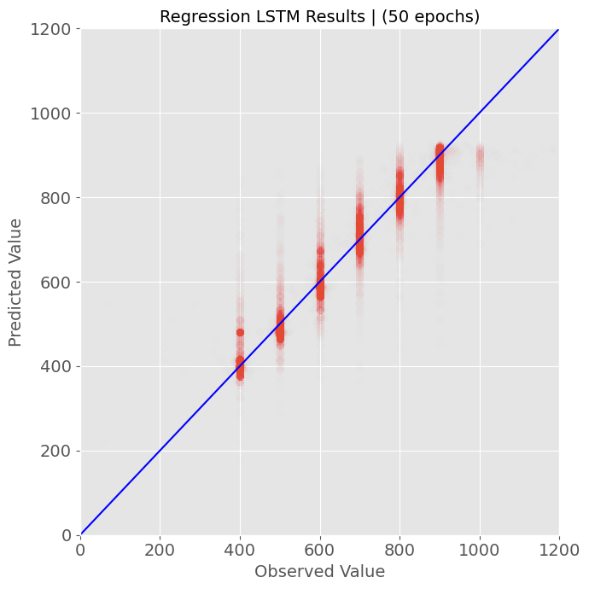

LSTM Results
P-Wave Prediction
S-Wave Prediction

Slide 29
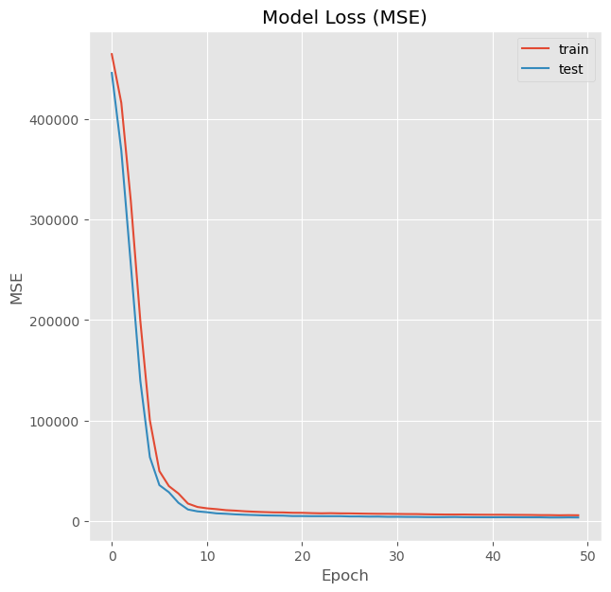
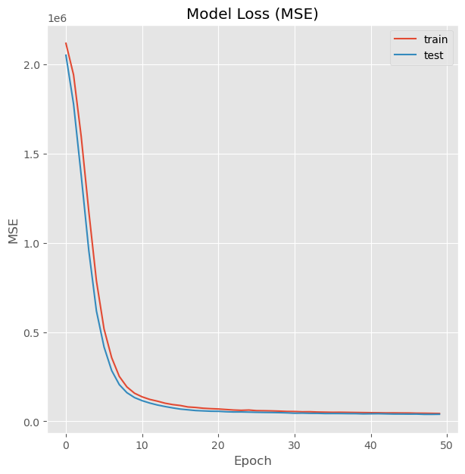
LSTM Results
P-Wave Prediction
S-Wave Prediction

Slide 30
LSTM Results
P-Wave Prediction
S-Wave Prediction

Slide 31
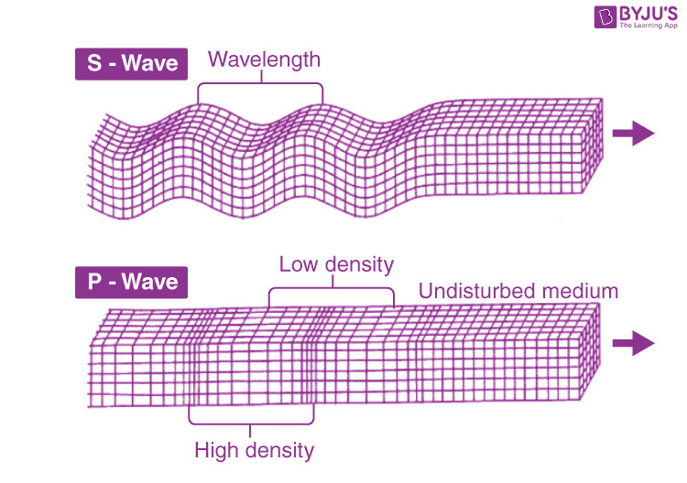

Slide 32
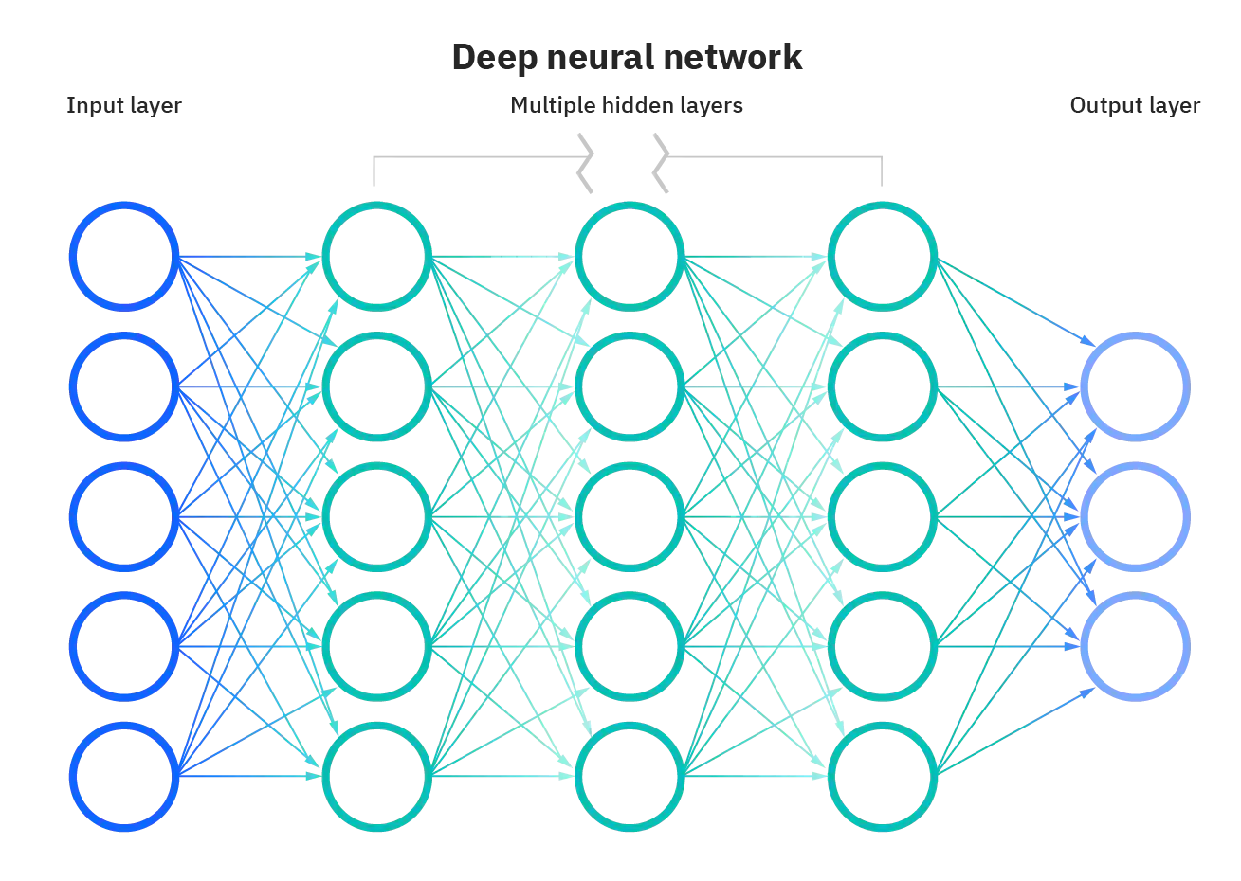
Neural Networks

Slide 33
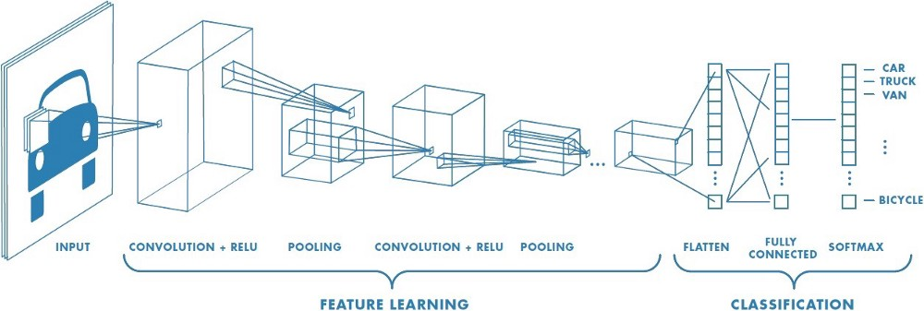
Convolutional Neural Networks

Slide 34
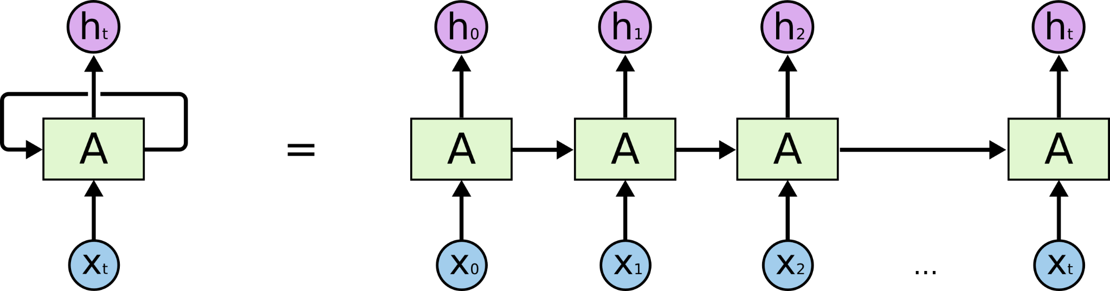
Recurrent Neural Networks

Slide 35
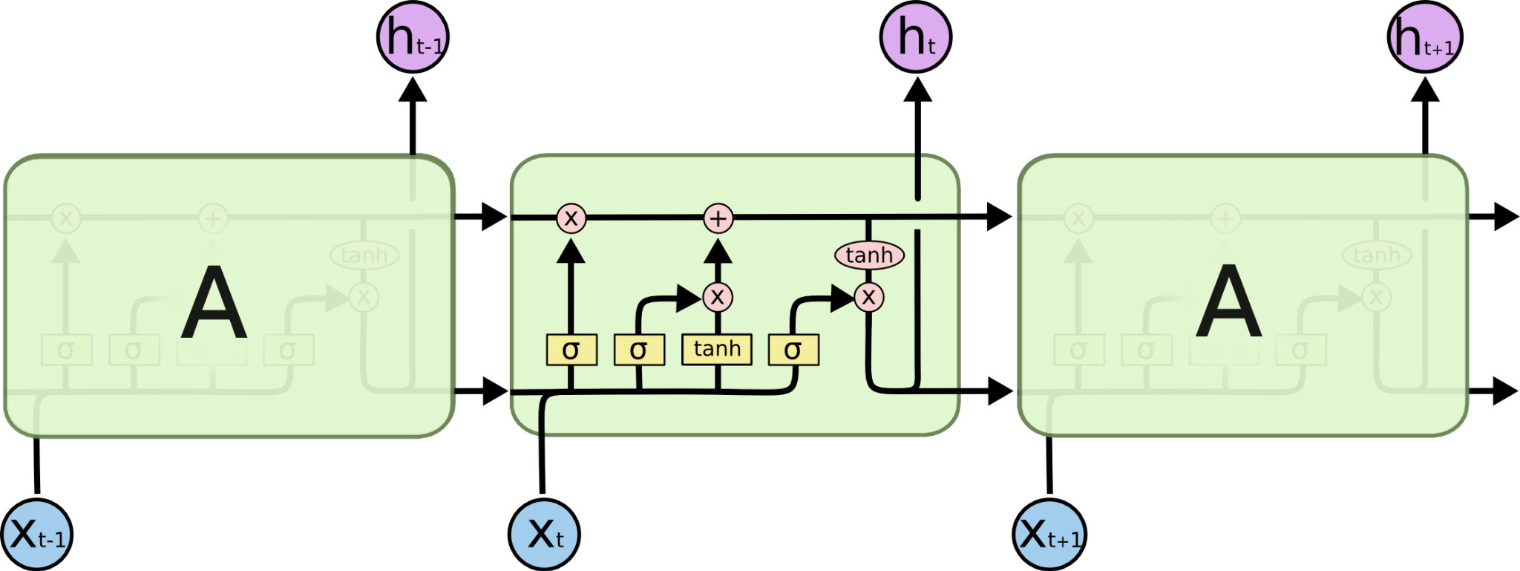
LSTMs

