Slide 1
Rideshare Churn Prediction
By:
Kaelynn Rose
Alek Sanchez
Chun Liu

Slide 2
What are we interested in?
Objective: Predict User Churn
Data: Rideshare information
~25,000 users churned
~15,000 users did not churn
Feature Importance: What factors are the best predictors for retention?

Slide 3
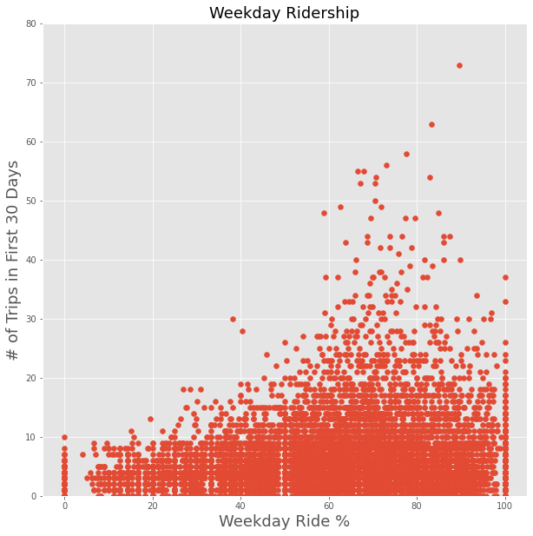
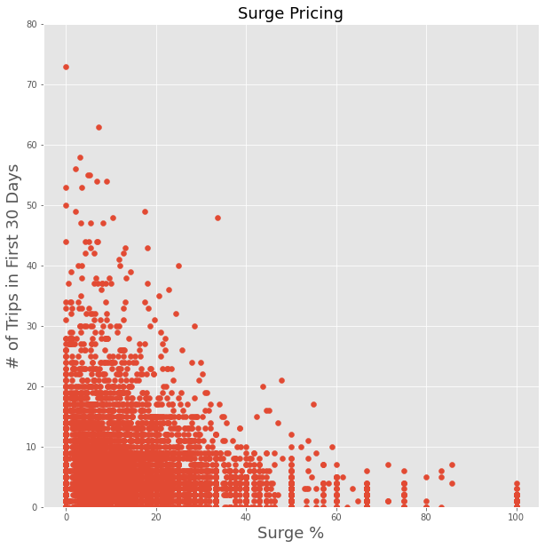
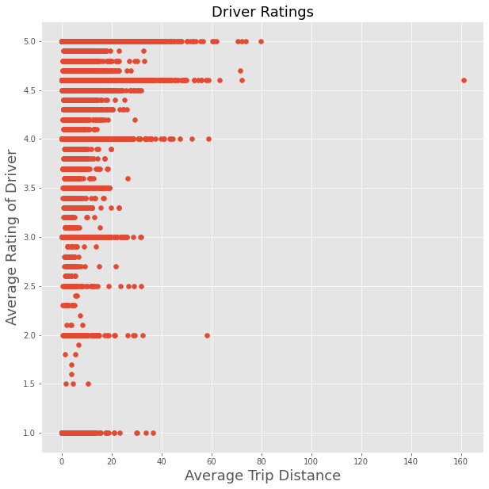
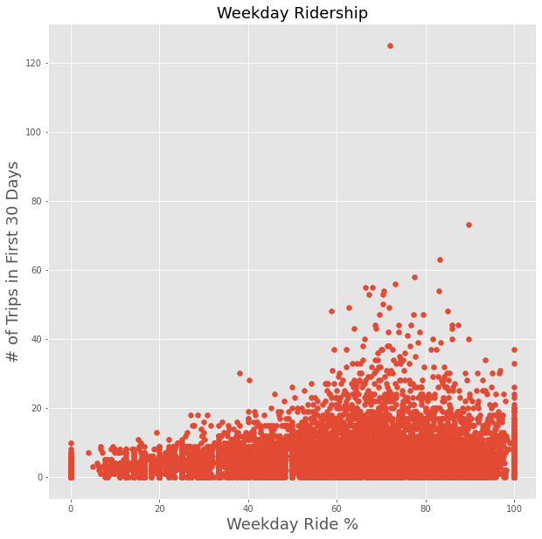
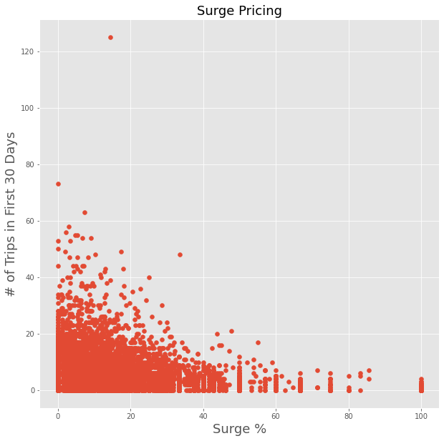
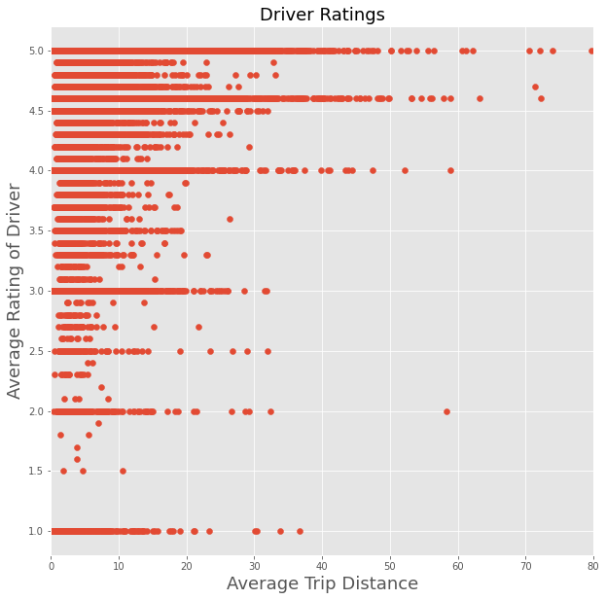
Exploratory Data Analysis
Notes:
Weekday ridership: as the % of weekday rights go UP, the number of trips in the first 30 days went UP - customers more likely to take more rides if they’re using the rideshare to get to work
Surge pricing: as the % of surge rides when UP, the # of trips in the first 30 days went DOWN - customers don’t like surge pricing
Driver ratings: as the average trip distance went UP, the average rating of the driver went UP

Slide 4
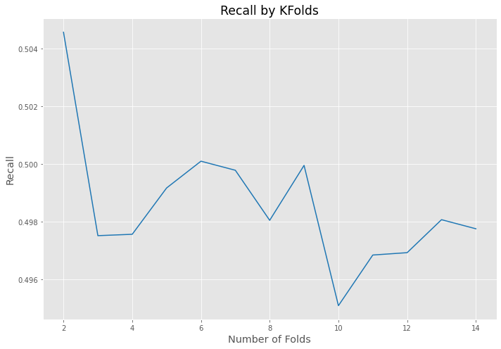
Logistic Regression
Train, Test, Split:
Accuracy: 0.7185
Precision: 0.6752
Recall: 0.5025
KFold = 2:
Accuracy: 0.7203
Precision: 0.6701
Recall: 0.5001

Slide 5
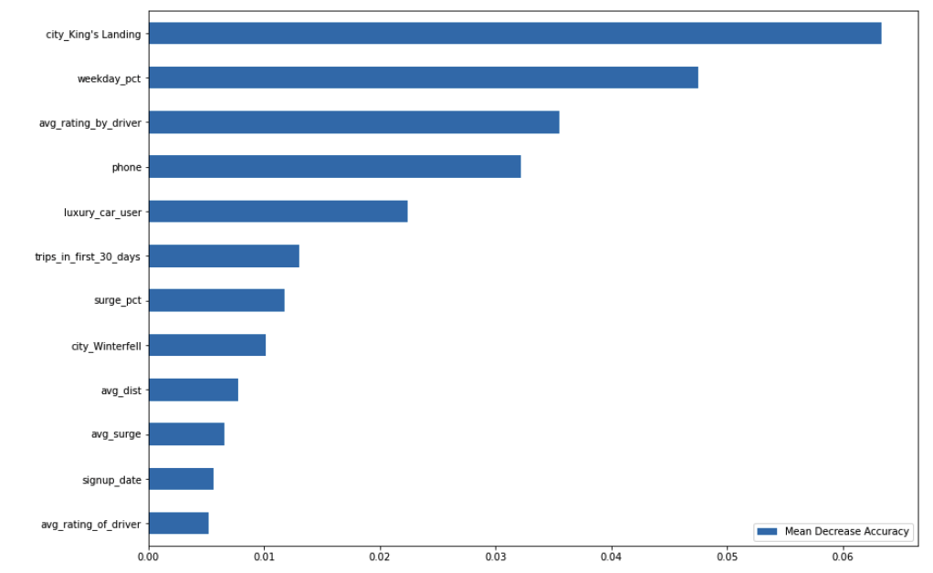
Random Forest Classifier
Feature Importance
Model used: Random Forest
Performance measures:
Accuracy: 0.7726
Precision: 0.7192
Recall: 0.6494

Slide 6
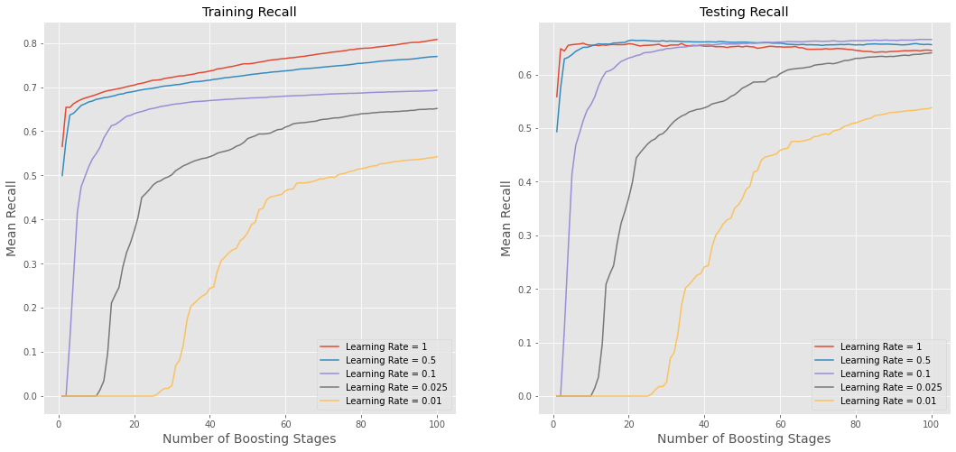
Gradient Boosting Classifier
Used a Grid Search to tune hyperparameters
The best hyperparameters gave score metrics of:
Accuracy: 0.7880
Precision: 0.7485
Recall: 0.6612

Slide 7
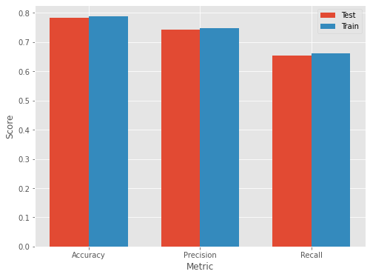
Best Model: Gradient Boosting
Trained the best Gradient Boosting model on the full test/train dataset
This resulted in:
Accuracy: 0.7837
Precision: 0.7415
Recall: 0.6634

Slide 8
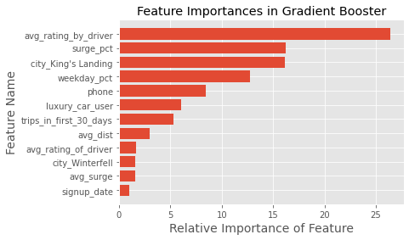
Gradient Boosting Classifier
Best Model Feature Importance
Have to be careful here, since numerical data tends to be rated more important than categorical data
But, these feature importances indicate that the top three features are average rating by driver, surge %, and being in the city of King’s Landing

Slide 9
Proposals to reduce churn
Improve rider experience
Provide incentive programs for users to take trips on weekdays
Reduce surge times, because this seems to increase ridership

Slide 10
Any Questions?

Slide 11
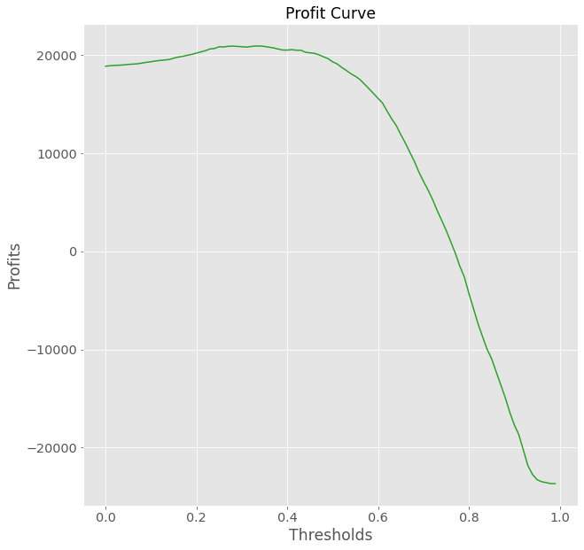
Appendix. Cost Matrix and Profit Curve
Predicted | Churn | Stay
Actual
Churn | 0 | - $10
Stay | + $5 | + $10
Optimal Threshold: 0.30
Profit: $27,710

Slide 12
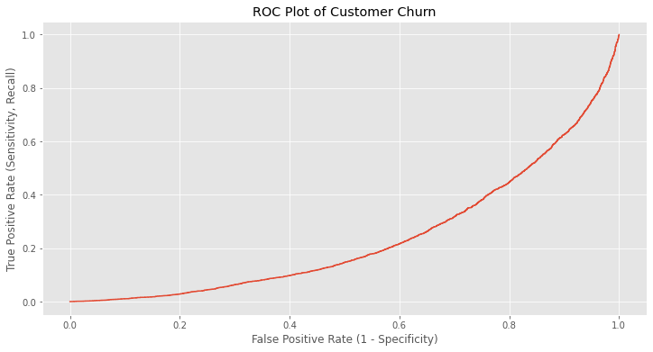
Appendix: ROC Curve

