Slide 1
Apollo CLient

Slide 2
Client Side State Management Solutions
Context API
Flux
Redux
MobX

Slide 3
Redux
Actions
Action Creators
Store
Reducers
Higher Order Components
Pure Components
Side - Effects

Slide 4
Redux – Middleware
Redux-Thunk
Redux – Saga
Redux – Observables
Redux - Promises

Slide 5
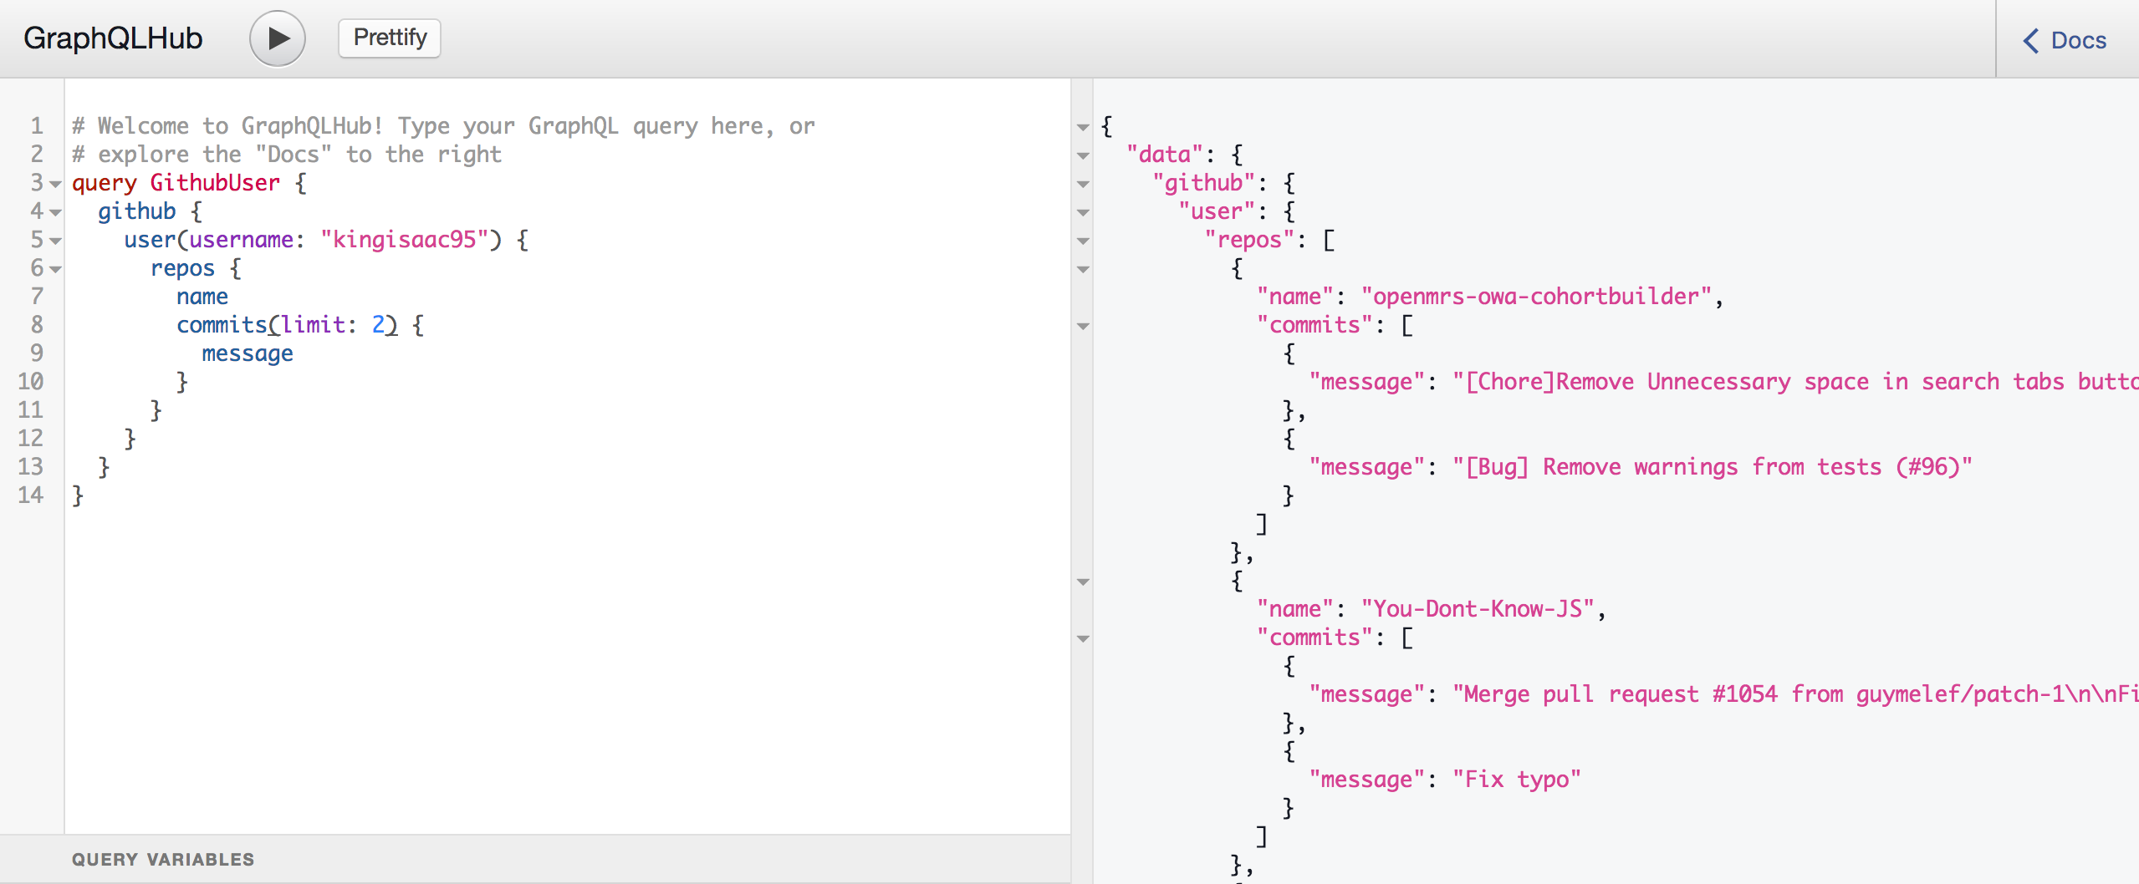
Interacting with GraphQL?

Slide 6
Apollo Client
Most Popular State Management Solution for GraphQL servers
Developed by Folks in Meteor
Open Source and Community Driven
Excellent Tooling Options
Does not contain Too much Boiler Plate Code
Provides Client Side Caching out of the box
Framework Agnostic

Slide 7
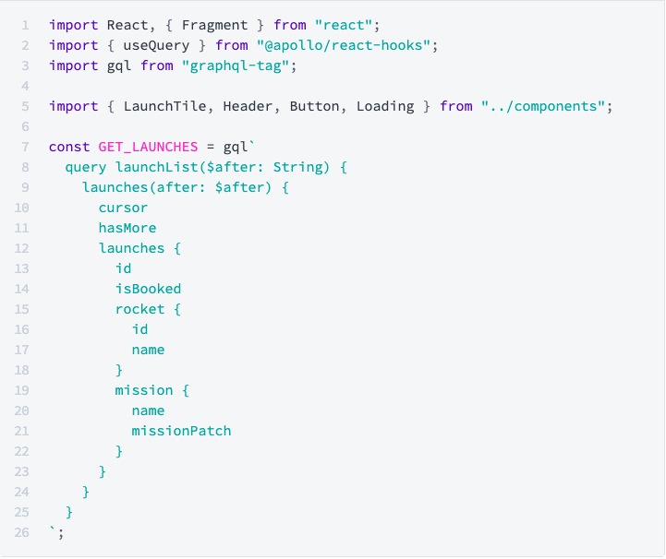
Queries

Slide 8
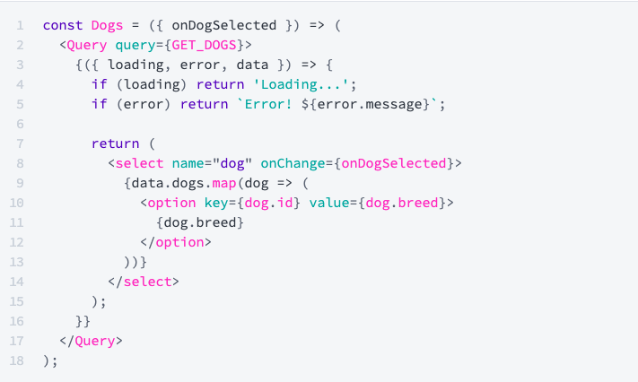
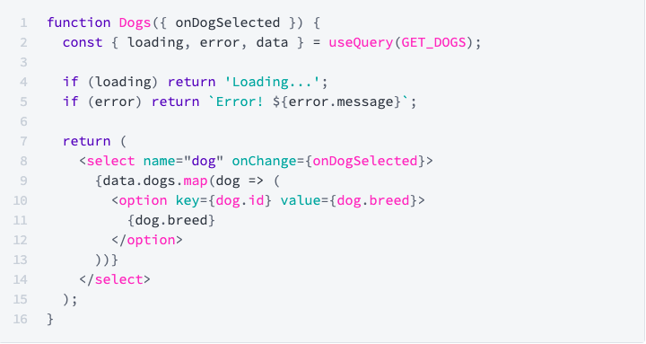
Using the Query
Using Render Props
Using useQuery Hook

Slide 9
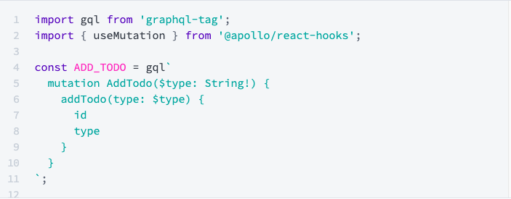
Mutations

Slide 10
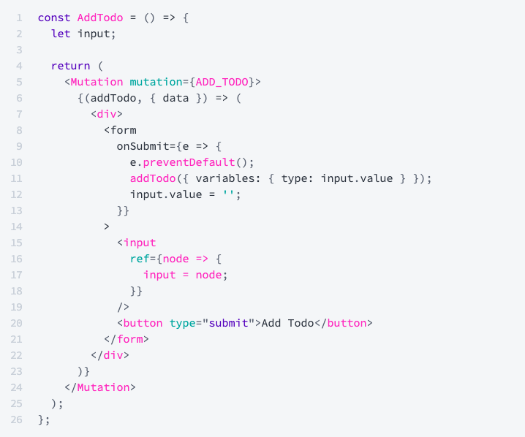
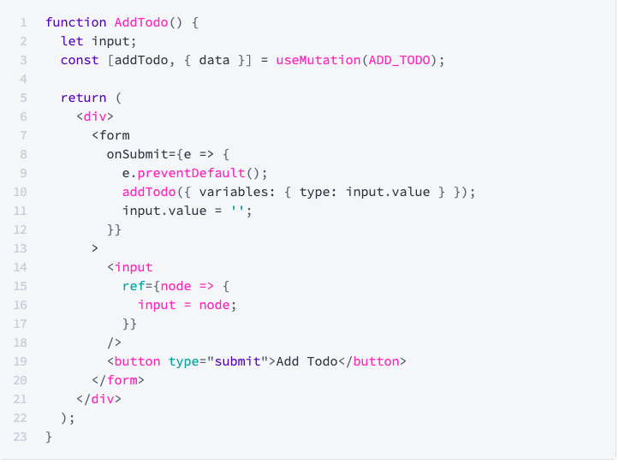
Using the Mutations
Using Render Props
Using useMutation Hook

Slide 11
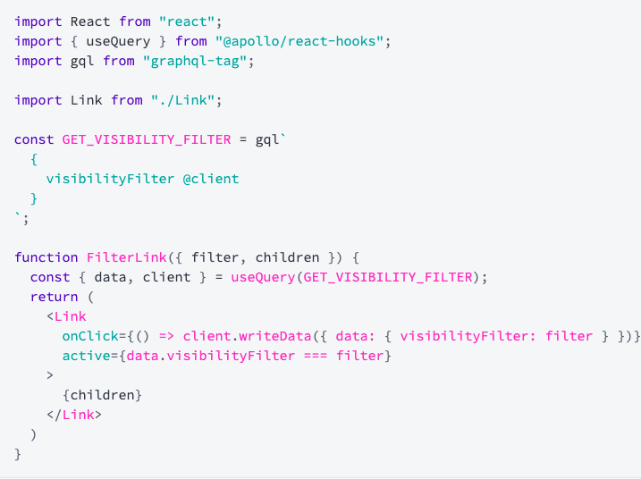
Local State Management

Slide 12
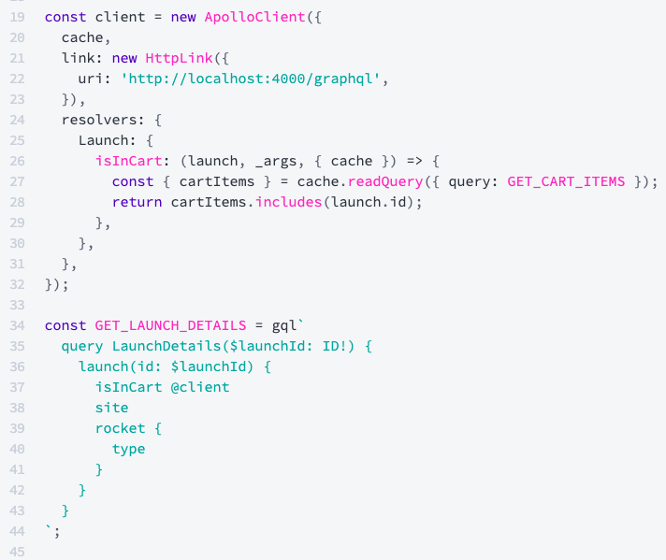
Complex State Objects

Slide 13
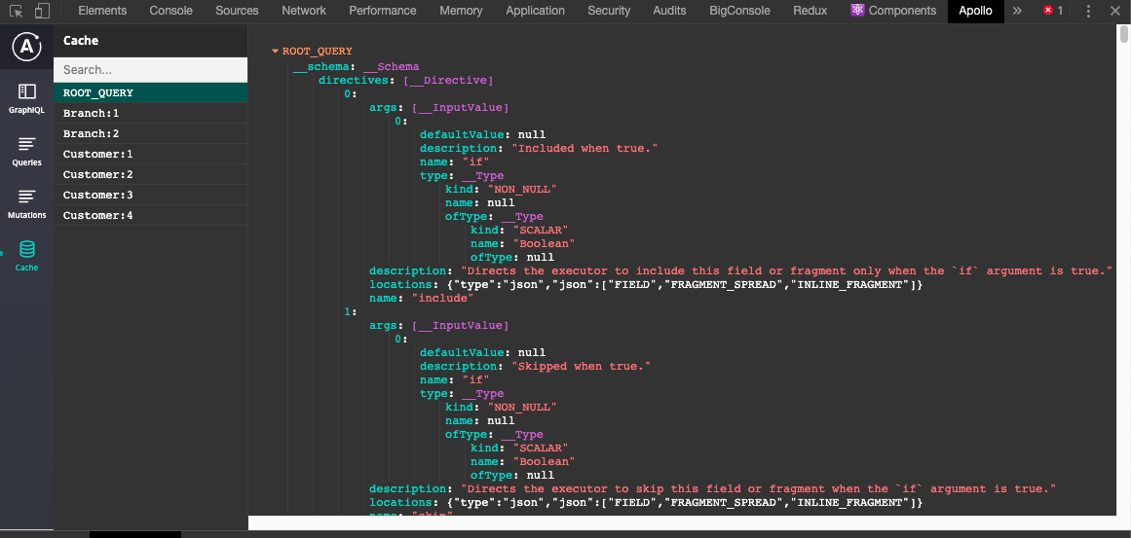
Apollo Developer Tool

Slide 14

Questions

Slide 15

Thanks

